Slide 1
Nagoya Protocol Capacity Development Needs
Business and Biodiversity Forum
Mainstreaming Biodiversity: Innovative Opportunities for Business
(Pyeongchang, Korea, 12-14 October, 2014)
Suhel al-Janabi
ABS Capacity Development Initiative
Co-Manager

Slide 2
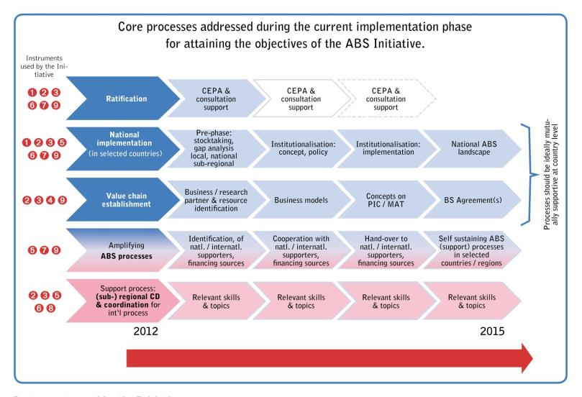

Slide 3
“Logic” of CBD regarding Access regulations
„resource-rich„ countries shall facilitate the access to genetic resources
User
Prov.
PIC / MAT
„technology-rich“ countries shall share benefits arising from GR; facilitate the access to technologies and means important for conservation and use
Notes:
These slide shows you the logic of CDB. On one hand, you have providers countries, rich in GR and TK. These countries shall facilitate the access to it.
On the other hand, you have users countries, rich sciences and technology tools. Theses countries shall share benefits arising from GR anf facilite ... Thanks to PIC/MAT contracts, ABS gives a „securité jurdique“ between both parteners.

Slide 4
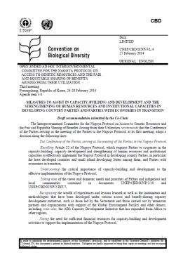
DRAFT STRATEGIC FRAMEWORK FOR CAPACITY-BUILDING AND DEVELOPMENT to support EFFECTIVE IMPLEMENTATION OF THE NAGOYA PROTOCOL ON ACCESS AND BENEFIT-SHARING
Capacity to implement and to comply with the obligations of the NP
Capacity to develop, implement and enforce domestic legislative, administrative or policy measures on access and benefit-sharing;
Capacity to negotiate mutually agreed terms;
Capacity of indigenous and local communities and relevant stakeholders, including the business sector and the research community, in relation to the implementation of the Protocol;
Capacity of countries to develop endogenous research capabilities to add value to their own genetic resources.

Slide 5
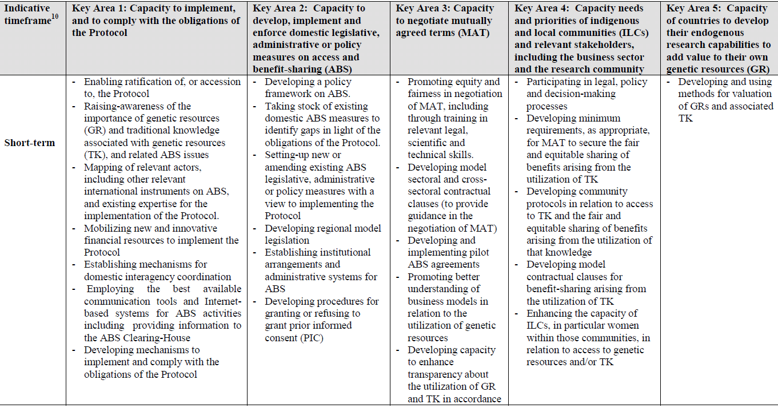
Appendix I
Overview of measures requiring capacity-building and development in order to effectively implement the Protocol based on the needs and priorities expressed by Parties and indigenous and local communities

Slide 6
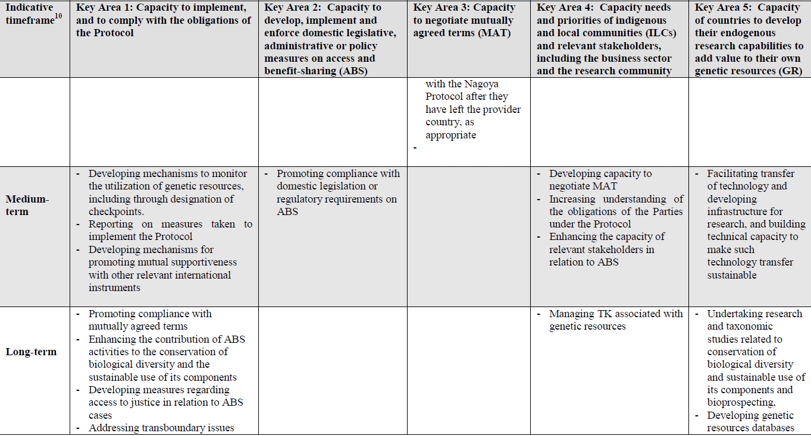

Slide 7
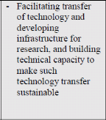
Appendix I
Overview of measures requiring capacity-building and development in order to effectively implement the Protocol based on the needs and priorities expressed by Parties and indigenous and local communities

Slide 8
Nagoya Protocol on ABS
Objective
“…. the fair and equitable sharing of the benefits arising from the utilization of genetic resources, including by appropriate access to genetic resources and by appropriate transfer of relevant technologies, taking into account all rights over those resources and to technologies, and by appropriate funding, thereby contributing to the conservation of biological diversity and the sustainable use of its components”

Slide 9
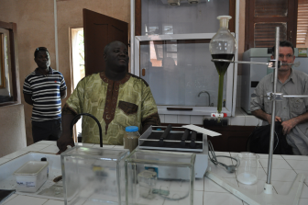
Definition of research and development under the NP
Art. 2
“Utilization of genetic resources” means to conduct research and development on the genetic and/or biochemical composition of genetic resources, including through the application of biotechnology as defined in Article 2 of the Convention.
“Biotechnology” as defined in Article 2 of the Convention means any technological application that uses biological systems, living organisms, or derivatives thereof, to make or modify products or processes for specific use.

Slide 10
use of GR: concept
Different type of genetic resources
Used for different purposes
Different types of users operating in different sectors
Animal, plant, microbial
Research & development - commercial - non commercial
based on PIC / MAT
biotech
pharmaceuticals
seed and crop protection
personal care and cosmetics
botanicals and horticulture
(farm) animal breeding
Notes:
Commercial : for exemple in pharmaceutic sector
Non commercial for exemple in biotechnology, agronomy, academic lab ...
CCL: the way of a GR is not strait, not linear, you have a large number of actors involved in it utilisation and many intermediaries. So again, the importance to well understand the hole process to optimize the BS and contracts.

Slide 11
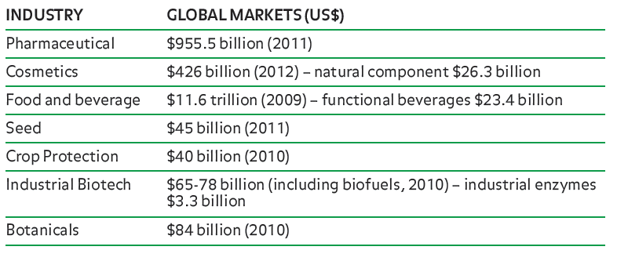
Understand business and R&D models
to guide policy makers in the establishment of effective national ABS systems
BIOSCIENCE AT A CROSSROADS: IMPLEMENTING THE NAGOYA PROTOCOL IN A TIME OF SCIENTIFIC,
TECHNOLOGICAL AND INDUSTRY CHANGE*
* 2013 by Sarah A. Laird and Rachel P. Wynberg, as part of a series of SCBD fact sheets and policy briefs
Notes:
Global market of bigest industrial sectors is huge. In fact, we observes

Slide 12
Biotechnology
Market
Global turnover around $ 75 billion
Young industry with 3 main sub sectors (green, red, white) (e.g. biochemicals, biofuels, biomaterials and some consumer products)
R&D
Objective: prove activity, enhancing effectiveness / effectivity of processes large scale
Difficulty to understand business potential of academic R&D results & future industrial needs
Specifity of (green) biotech
Focus: enzymes and metabolites from microorganisms that can endure difficult manufacturing conditions (e.g. pressure)
Some companies do bioprospecting (e.g. in extreme environments) but most use existing collection or domestic GR
Genome-mining :
search directly in soil or water without having to culture the organism
Publication of microbial genetic sequences and ability to transfer genetic material digitally
High degree of science and technology requires governmental support (e.g. biofuels) partnership to complete product development
Patent standard IP instrument
B 2 B rather rule than exemption
Sources: Literature review, interviews
Notes:
White = industrial biotech / enzimes, where Novozymes operates
Use the tools of nature (e.g. fermentation) and the genetic information to create the product
Biochemicals (e.g. pharmaceutical, food, hygienic)
Example of potential products : agricultural organic waste material as industrial feedstock
Different status of the industry in different regions
Competiont against a running process. Biorefinery products need chemical processing - not yet available!
For the integrated refinery: operate close to the production base of the biomass

Slide 13
Food and beverages
Market
Turnover of $ 11,6 trillion (2009), expected to reach $15 trillion (2015) functional beverages: $ 23,4 billion
Mature, dynamique and diversified sector (9 billion people to feed !)
R&D
Objective: health benefits (e.g. weight, energy,…)
Low level of R&D (process improvement) but innovation is increasing : functional food, natural (e.g. additive free, free from…)
Specificity
Pre R&D before corporate R&D - Use of traditional knowledge as an indication of efficacy and safety
Commodities dominate - use large volumes – reliability of supply is key
Strong competition of specific ingredients in large user countries (e.g. olive, grapefruit)
Breeding and crop protection are key, interest in wild plants for domestication
Increasing integration of food with other sectors
Increasing consumer interest in natural products (& sustainability) - > increasing trend of the use of GR (relevance of ABS)
Sources: Literature review, inteviews, EU COMTRADE, OECD, Laird & Wynberg,
Notes:
Trends:
Changing industry’s interests in GR from the South (e.g. screen material for the presence of genes, ‘genomics’, corporate collections)
Differences :
- TK ingredient - Screen smaller pool of ressources.
Compeition:
Lycopene , Soy isoflavones, Olive extracts, Green coffee extract, omega 3 and 6 oils, Oryzanol,
Common denominators:
Waste or by-products from industry, Cheap and well-established supply chains, Numerous IP opportunities (process patents, new use patents, trade names)
No ABS issues, Useful properties and safety heavily researched by public and academic and private research institutions
Huge funding from public sector
R&D agenda:
Pre R&D befoore corporate R&D
Objective of the research: benefits (e.g. weight, energy, cognition…). Often validated by traditional use.
Accessibility (e.g. science to develop, regulation, ownability)
Opportunity (e.g. food category, relevance, competition, consumer interest)
Balancing technological push and consumer preferences
Breeding and crop protection are key, interest in wild plants for domestication

Slide 14
Cosmetics & fragrance
The market
For natural cosmetics, sales of $ 26,3 billion (2011) out of a global turnover of $426 billion
Oils, fats, waxes, essential oils, plants extracts are used in ‘pure natural’ and in conventional cosmetics (very small quantities)
R&D
Objective of the research:
Fragrance : “feature characteristics” of ingredients (smell)
Cosmetic : active principle or ingredients (additif, excipient formulation). Anti aging!
Major companies focus on brand strategies and intermediaries do intensive research
R&D investments differ: from minimal processsing of raw material to advance research
Speciality: natural compound to guide synthetisation
Most ingredients are cultivated to master quality, secure supply and reduce costs
Sector specificities
Strong regulation + new Chinese regulation - narrows the focus of GR and R&D
Brand image is key - pressure to innovate – demand for a «story » but short shelve life
Mix use of patents - due to short shelf life of products it’s an expensive tool
Sustainability issues high on the agenda of B2C companies due to their customers expectations
Niche interest in GR from the South & in traditional knowledge (to guide R&D)
Sources: Literature review, interviews, Laird and Wynberg 2013
Notes:
Chinese reg : allows approximately 3000 ingredients in China.
This Limited interest in GR from the South (existing corporate collection and many ingredients already on the market)
R&D agenda
Fragrance : the mastering of the production process and quality is paramount

Slide 15
Pharmaceutical
The market
Estimated global revenues $ 955,5 (2011) expected to reach $1,2 trillion (2016)
Trend: large European and American based companies to do more R&D, with manufacturing in emerging markets, where domestic companies are also on the rise.
R&D
Objective: prove activity
Companies collaborate on R&D as budgets stall
There are many ways to develop new actives. Most large natural R&D programs have closed. -> synthetic chemistry / biotechnology.
Natural product programs are found in SME; governmental programs and universities.
Sector specificities / trends
Patent cliff – impact on corporate policies and investments
Some collection of microorganism and marine organism but overall, limited need to access “fresh” GR from the South. Very tiny quantities of material needed.
Domestic biodiversity and companies collections are first choice
High degree of science and technology (e.g. genomics) allows
faster and deeper screening (especially on microorganisms)
possibility to grow them and overcome supply issue
Decreasing interest in traditional knowledge, focus on micro-organism
Sources: Literature review, OECD, Laird & Wynberg, interviews
Notes:
A few large players and many specialised companies
Outsourced: as companies are pressured by the ‘patent cliff’ and tighter public sector budgets to improve efficiency
Limited interest in GR from providers in the South, because an interesting compound can be found elsewhere (e.g. another country, corporate collections…) niche interest in some companies:
Marine and terrestrial microorganism (e.g. compounds found in awkwards places such as volcano)
Technology now available for studying them and possibility to grow them (overcomes the supply issues).
Bioprospecting has to a large extent been replaced by R&D approaches more effective, improved understanding of disease, but there are some companies, both large and small who are still involved

Slide 16
Huge variations : - level of science & technology used, investments in R&D (0 - 10 %) - need to access GR (e.g. continuous, one-off, tiny samples) - use of TK - SOP (large producer / retailer vs. small specialist intermediaries) - level of internal R&D (from 100% in house to outsourcing of R&D) - Different requirements with respect to IP / IP Protection
BIOETHANOL

Slide 17
« Generic » Model of GR bases R&D / product development
Pre-Acces
- research proposals -funding
- market analysis,
- pre product analyis
Research & Development
Business Plan
production
sales
compliance
marketing
Production (commercialization)
Publications
Patents
Enterprise secret
Investments
MAT
X1
MAT
X
PIC
X1
0,5 – 10 years
PIC
X
upfront benefits
1 – 15 years
1 – 3 years
3 – 25 years
TT / CB / IP / publications
TT / cap dev - monetray
TT / cap dev – monetary
Time

Slide 18
Thank you
…..more on ABS and the
ABS Capacity Development Initiative
www.abs-initiative.info
Notes:
RARE : Recapitule
Action matos pour approfondir, faire ref aux publi du secretariat cbd
Remercie pour leur participation active, écoute, contribution pertinante, aide au debat
Elargit : labo prochaine etape

Slide 19
PROVIDING
COUNTRY
USING COUNTRY
PIC
Competent National Authority
GRs
+
Certificate
Utilization of GRs
Checkpoints:
Research publishing houses
Research institutions subject to public funding
Patent examination offices
Authorities providing regulatory or marketing approval of products
MAT
Terms of Use (e.g. Commercial or non-commercial; IP; 3 party)
Benefit-sharing (monetary or non-monetary)
Benefit-sharing
Provide information on PIC, MAT, source of GRs, use of GRs
Permit
Notified to ABS
Clearing-House
Logic of interplay between providing and using country
International Certificate of Compliance

