Slide 1
Business Forum: Panel Session #4 Reporting & Communications
14th October, 2014
INTEGRATED / STAKEHOLDER REPORTING: WHAT, WHY, HOW and WHEN?
Pavan Sukhdev
Study Leader, TEEB
CEO, GIST Advisory

Slide 2
“WHAT” :
IS REPORTING DIVERSITY DESIRABLE?
Statutory Reporting / Financial Reporting
Financial Statements
Disclosure Items
“Non-financial Reporting”
Sustainability Reporting
“EP&L” ….“SP&L”... “3D-P&L”… “4D-P&L”
Stakeholder Reporting
Integrated Reporting

Slide 3
“WHAT” :
IS REPORTING DIVERSITY DESIRABLE?
Statutory Reporting / Financial Reporting
Financial Statements
Disclosure Items
“Non-financial Reporting”
Sustainability Reporting
“EP&L” ….“SP&L”... “3D-P&L”… “4D-P&L
Stakeholder Reporting
Integrated Reporting

Slide 4
“WHY” : TRANSPARENCY
Transparency: “accessibility of information to stakeholders of institutions, regarding matters that affect their interests”
~ Don Tapscott & David Ticoll, 2003
“Business-as-usual” is increasingly difficult in an age of instant communication.
Whistle-blowers, inquisitive media, self-aware consumers and citizen activists routinely monitor and comment on every action of the firm far beyond its financial performance.
Transparency thus is essential for businesses with brand values & reputation to protect.
EXAMPLE: In the 1990’s, Nike faced a coordinated campaign by NGOs against its tolerance of labor practices in South East Asian production facilities that had a direct impact on the company’s brand value and reputation (Zadek 2004, Esbenshade 2004, pp. 119-120).

Slide 5
“WHY” Business today depends on, and/or drives impacts on, ALL dimensions of private & public wealth… but..
EXAMPLES | Physical Capital | Human Capital | Social Capital | Natural Capital
Private Ownership | Factories Buildings Securities Cash | Health Education Job Skills |  | Gardens Fields Forests
Community Ownership * (club goods) | Community Centres Community Schools | - Traditional knowledge | Community Norms and Customs | Community Forests Grazing Commons
Public Ownership * (public goods) | Roads Bridges | Public databases Non-patent knowledge | Law & Order Taxation Social Equity & Inclusion | High Seas fisheries National Parks/ Forests
* Creating community wealth and public wealth creates “shared value”

Slide 6
“WHY” Business today generally measures & reports only shareholder wealth impacts: on private physical capital
EXAMPLES | Physical Capital | Human Capital | Social Capital | Natural Capital
Private Ownership | Factories Buildings Securities Cash | Health Education Job Skills |  | Gardens Fields Forests
Community Ownership (club goods) | Community Centres Community Schools | - Traditional knowledge | Community Norms and Customs | Community Forests Grazing Commons
Public Ownership (public goods) | Roads Bridges | Public databases Non-patent knowledge | Law & Order Taxation Social Equity & Inclusion | High Seas fisheries National Parks/ Forests

Slide 7
“WHY” Business - for a sustainable future – will need to measure & report on ALL dimensions of its impacts …
EXAMPLES | Physical Capital | Human Capital | Social Capital | Natural Capital
Private Ownership | Factories Buildings Securities Cash | Health Education Job Skills |  | Gardens Fields Forests
Community Ownership * (club goods) | Community Centres Community Schools | - Traditional knowledge | Community Norms and Customs | Community Forests Grazing Commons
Public Ownership * (public goods) | Roads Bridges | Public databases Non-patent knowledge | Law & Order Taxation Social Equity & Inclusion | High Seas fisheries National Parks/ Forests

Slide 8
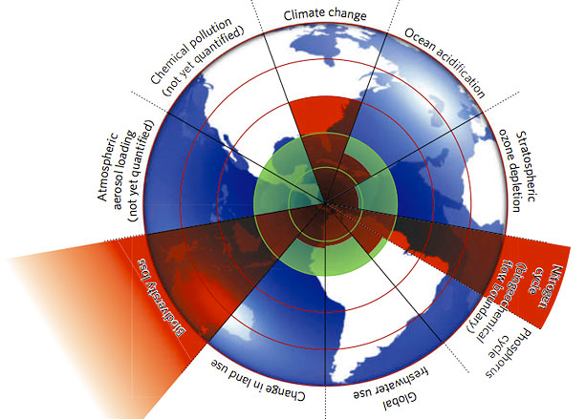
“WHY”?

Slide 9
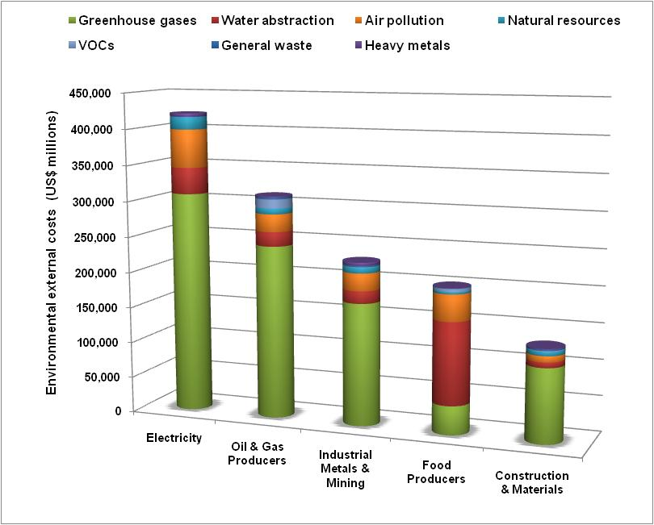
“WHY”?
Negative Corporate Externalities …..
Top 3,000 Listed Companies
Externalities total USD 2.15 Trillion per year
Source: Trucost for UNPRI, 2010.
Notes:
9

Slide 10
“WHY”?
….. Are Pushing Planetary Boundaries
Greenhouse Gases
Greenhouse Gases
Natural Resources
Natural Resources
Natural Resources
Water Abstraction

Slide 11
“WHY”:
FOUR KEY BENEFITS OF INTEGRATED REPORTING
Lower Risk Profile: Companies which integrate sustainability into their core business lower their risk profiles, enhance brands, achieve better reputation (Mays Report. 2003).
Strategic management of brand and reputation: by far the most significant driver behind non-financial reporting (NFR).
Cost-efficiencies and new opportunities via better management of business’s natural, social and human capital externalities.
Traditional corporate reporting is unable to effectively communicate to investors and other stakeholders how a business creates value and manages the risks it faces.

Slide 12
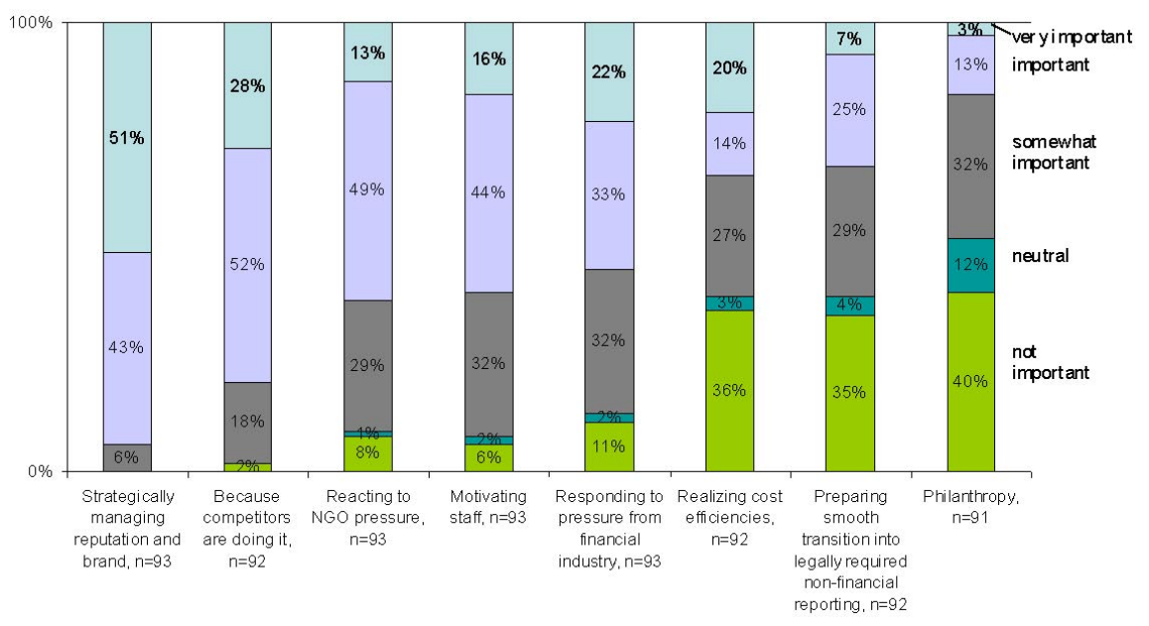
“WHY”: EIGHT DRIVERS…
Global Public Policy Institute (GPPI) report analysed EIGHT most-frequently mentioned factors cited as drivers of non-financial reporting in companies.
Source: GPPI, Trends in non-financial reporting, 2006

Slide 13
Corporate Profitability & Sustainability (Q: Is it Causality or Correlation?)
Sustainability Profitability | Sustainable: Value-Addition to all Capitals across all Stakeholders - Positive Externalities | Unsustainable: Value-added to Shareholder Financial Capital & Negative Externalities to other capitals
Profitable | Well-managed, Responsible, Long-term & Integrated-thinking, “Corporation 2020” | Conventional, Business-as-Usual, often MNC, “Corporation 1920”
Unprofitable | Responsible, maybe start-ups, maybe uncompetitive | Poorly-managed, reactive, uncompetitive

Slide 14
MANAGE WHAT YOU MEASURE…
Assess negative and positive externalities of business activities: first step towards generating cost-efficiencies and new opportunities via better management of natural, social and human capital externalities.
Example: BP’s commitment to reduce its greenhouse-gas footprint at the time of the Kyoto Protocol netted it $630 million, when it then sold gas from its oil fields that it would have otherwise flared.
Stakeholder Theory: important to engage stakeholders in long-term value creation (Andriof et al. 2002; Post et al, 2002).
Developing a long-term mutual relationship rather than simply focusing on immediate profit.
Theory argues that in order to profit and survive companies need to frequently engage with a variety of stakeholders upon whom dependence is vital.
“License-to-operate” obtained from stakeholders, not shareholders.

Slide 15
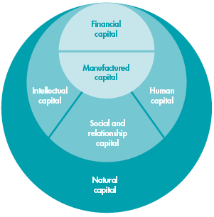
Unreported Financial Capital Value-addition (FCX)
Human Capital Externalities (HCX)
Natural Capital Externalities (NCX)
Social Capital Externalities (SCX)
“WHAT”:
Measuring & Valuing
Impacts
Sources: (1) www.theirrc.org
(2) www.gistadvisory.com, “Towards a Valuation Framework for Business Externalities”

Slide 16
Thank You !
Pavan Sukhdev,
Founder & CEO, GIST Advisory
pavan@gistadvisory.com
www.gistadvisory.com
www.corp2020.com

Slide 17
PRINCIPLE: MATERIALITY
Valuation & Reporting must focus on material externalities.
GRI Materiality Principle¹: “The information in a report should reflect the organization’s significant economic, environmental and social impacts, or information that would substantively influence the assessments and decisions of stakeholders”.
Major global initiatives for integrated reporting include
Global Reporting Initiative (GRI) Guidelines;
country-specific National Voluntary Guidelines (NVGs) and
Business Responsibility Reporting (BRR) regulations;
IIRC’s <IR> Framework;
Natural Capital Coalition’s “Protocol” (TBC/ end-2015) etc.

Slide 18
TARGETS & DRIVERS OF INTEGRATED REPORTING
Business Drivers & Regulatory Interest

Slide 19
WHY INTEGRATED REPORTING?
Global Financial Crisis
Demonstrated the interconnectedness of global markets
Need to offer their stakeholders more than just financial information and that this information needs to be presented in a concise, clear and ‘digestible’ way.
Short-Termism
Average time that US institutional investors hold stock in a particular company has fallen from seven years to seven months.
Created a distorting effect on business decision-making
Technological Advances on Information Flows, Volume and Demand
New challenges for businesses as they deal with faster and vaster flows of information, inside the company and externally with stakeholders
Age of radical transparency: managing reputation and communications is increasingly paramount

Slide 20
DRIVERS OF INTEGRATED REPORTING
Business Risks
Corporations sit at the junction of finance, society and the environment.
Four out of top ten risks identified by the World Economic Forum (WEF) relate to the natural environment (Global Risks Report, 2014):
Water crises
Failure of climate change mitigation and adaptation
Greater incidence of extreme weather events
Food crises
These risks now pose an interconnected threat to the global economy and, by extension, the way we do business.
International Consensus
“Risks and opportunities cannot be isolated, but need to be managed in a holistic way to foster the conditions for financial stability and growth, allied to developments in human talent and intellectual property, all within the limits of planetary boundaries and matched by a commitment to the long term stewardship of financial resources and physical assets”.
~ Christine Lagarde, IMF, 2014

Slide 21
REGULATORY INTEREST IN INTEGRATED REPORTING
South Africa
“King III” Corporate Governance Code
Support for International <IR> Framework and its intention to converge practice with the principles set out in the Framework
Brazil (BM&F BOVESPA)
Encouraging businesses listed on its platform to produce an integrated report (or sustainability report) on a ‘report-or-explain’ basis
Singapore
<IR> as an integral part of, “transforming Singapore into a leading global accounting hub for the Asia Pacific region by 2020”.
<IR> Steering Committee: identified five work-streams to drive forward <IR> adoption in Singapore.

Slide 22
REGULATORY INTEREST IN INTEGRATED REPORTING
USA
Section 313 of EPCRA established the Toxics Release Inventory (TRI)
Mandatory for US facilities across identified industry sectors to report annually how much of each chemical is released and/or managed through recycling, energy recovery and treatment.
TRI creates a strong incentive for companies to improve environmental performance.
India
Section 135 of the Companies Act 2013, sets a global precedence for regulatory policy, by making it mandatory for public and private companies to invest in CSR
Businesses falling under the ambit of the Act must invest 2% of its average net profits (of three preceding years) in CSR activities listed in Schedule VII of the Act
Also, businesses must report on amount spent and the impact of such spending via annual business responsibility reports (BRR)
Act seeks to bring CSR to the forefront of business decision making via “spend-disclose-or explain” mandate

Slide 23
IMPACT OF REGULATION ON INTEGRATED REPORTING & BUSINESS CREDIBILITY
STUDY: Ioannis Ioannou and George Serafeim, (2012) ‘The consequence of mandatory corporate sustainability reporting’, by, London and Harvard Business Schools
Examined the effect of mandatory corporate sustainability reporting (MCSR) on several measures of social responsibility using both country and firm-level data for 58 countries.
After the adoption of appropriate laws & regulations, the social responsibility of business leaders increases and both sustainable development and employee training become a higher priority for companies.
Corporate governance improves and on average, companies implement more ethical practices, bribery and corruption decrease, and managerial credibility increases.
These effects are larger for countries with stronger law enforcement and more widespread assurance of sustainability reports
For sample group; energy as well as waste and water consumption significantly declined & investments in employee training significantly increased
Source: http://www.hbs.edu/faculty/Publication%20Files/11-100_35684ae7-fcdc-4aae-9626-de4b2acb1748.pdf

Slide 24
KEY FIRST FOR GIST ADVISORY: GIST 360™
Stakeholder Performance – “3D P&L”
“Pants to Poverty” – Financial P&L
 | 2012 | 2011
Turnover | 2,500,000 | 2,200,000
Cost of Sales | -1,500,000 | -1,600,000
Gross Profit | 1,000,000 | 600,000
Administrative Expenses | -200,000 | -160,000
Other operating Income | 15,000 | 2,000
Operating profit/(loss) | 815,000 | 442,000
Interest Receivable | - | -
Interest Payable | - | -
Profit/(loss) on ordinary activities before taxation | 815,000 | 442,000
Tax on profit/(loss) on ordinary activities | -285,250 | -154,700
Profit/(loss) for the financial year | 529,750 | 287,300

Slide 25
KEY FIRST FOR GIST ADVISORY: GIST 360™
Stakeholder Performance – “3D P&L”
EP&L (Environmental) | 2012 | 2011
Environmental Profits
Rainwater capture, waste water reuse, mega-litres | 80,000 | 60,000
Value of Compost created | 20,000
CO2 offsets | 16,000 | 8,000
Trees Planted | 7,000 | 3,000
Biodiversity and water offsets | - | -
Environmental Losses
Water consumed | -45,000 | -48,000
Fertiliser and Pesticides consumed | - | -
CO2 emitted | -90,000 | -96,000
Trees consumed | -20,000 | -20,000
Toxins released | -7,000 | -7,000
Threatened or Endangered Animals harmed | - | -
Net Environmental Profits (Loss) | -39,000 | -100,000

Slide 26
EXAMPLES OF LEADING COMPANY PRACTICES (Cont.)
Evolution of Corporate Reporting at Novo Nordisk
Year | Report Title | GRI Adherence Level | Assurance Provider | Annual Report
1995 | Environmental Report 1995 | - | SustainAbility | Online
1996 | Environmental Report 1996 | - | SustainAbility | Online
1997 | Environment & Bioethics Report 1997 | - | SustainAbility | Online
1998 | Environment & Bioethics Report 1998 | - | Deloitte & Touche | Online
1999 | Environmental & Social Report 1999 | - | Deloitte & Touche
2000 | The Novo Group Environmental and Social Report 2000 Values in a global context | 1999 Guidelines | Deloitte & Touche
2001 | Reporting on the triple bottom line 2001 Dealing with dilemmas | 1999 Guidelines | Deloitte & Touche | PDF / Online
2002 | Sustainability Report 2002 | G2: In Accordance (GRI-checked) | Deloitte & Touche | PDF / Online
2003 | Sustainability Report 2003 What does being there means to you? | G2: In Accordance (GRI-checked) | Deloitte | PDF / Online
2004 | Annual Report 2004 Can diabetes really be defeated? | G2: In Accordance (GRI-checked) | PricewaterhouseCoopers | PDF / Online
2005 | Annual Report 2005 How Novo Nordisk is changing diabetes | G2: In Accordance (GRI-checked) | PricewaterhouseCoopers | PDF / Online
2006 | Annual Report 2006 Action defines leadership | G2: In Accordance (GRI-checked) | PricewaterhouseCoopers | PDF / Online
2007 | Annual Report 2007 United to change diabetes | G3: A+ Self-declared | PricewaterhouseCoopers | PDF / Online
2008 | Annual Report 2008 Our focus is our strength | G3: A+ Self-declared | PricewaterhouseCoopers | PDF / Online
Source: http://annualreport2008.novonordisk.com/images/how-we-are-accountable/PDF/history.pdf

Slide 27
EXAMPLES OF LEADING COMPANY PRACTICES (Cont.)
SAP Integrated Report 2013
Concise statements describing the connections between SAP’s financial and non-financial indicators (integrated performance analysis).
Highlight linkages (positive and negative) between margin and revenue, and non-financial indicators such as GHG footprint and total energy consumed.
GHG Footprint >> Revenue: positive impact on SAP’s revenue because customers increasingly ask their suppliers to act sustainably – demonstrated through environmental awards, and financial performance (measured by stock market performance) (Klassen & McLaughlin, 1996).
Renewable Energy >> Margin: purchase of renewable energy over conventional energy sources correlated with higher costs. Thus expect a small negative impact on margin when SAP augments purchase of renewable energy.
Total Energy Consumed >> Margin: reduced energy consumption is strongly correlated with a reduction in costs.
Source: http://www.sapintegratedreport.com/2013/en/strategy-and-business-model/integrated-performance-analysis.html

Slide 28
Thank You !
Pavan Sukhdev,
Founder & CEO, GIST Advisory
pavan@gistadvisory.com
www.gistadvisory.com
www.corp2020.com

