Slide 1
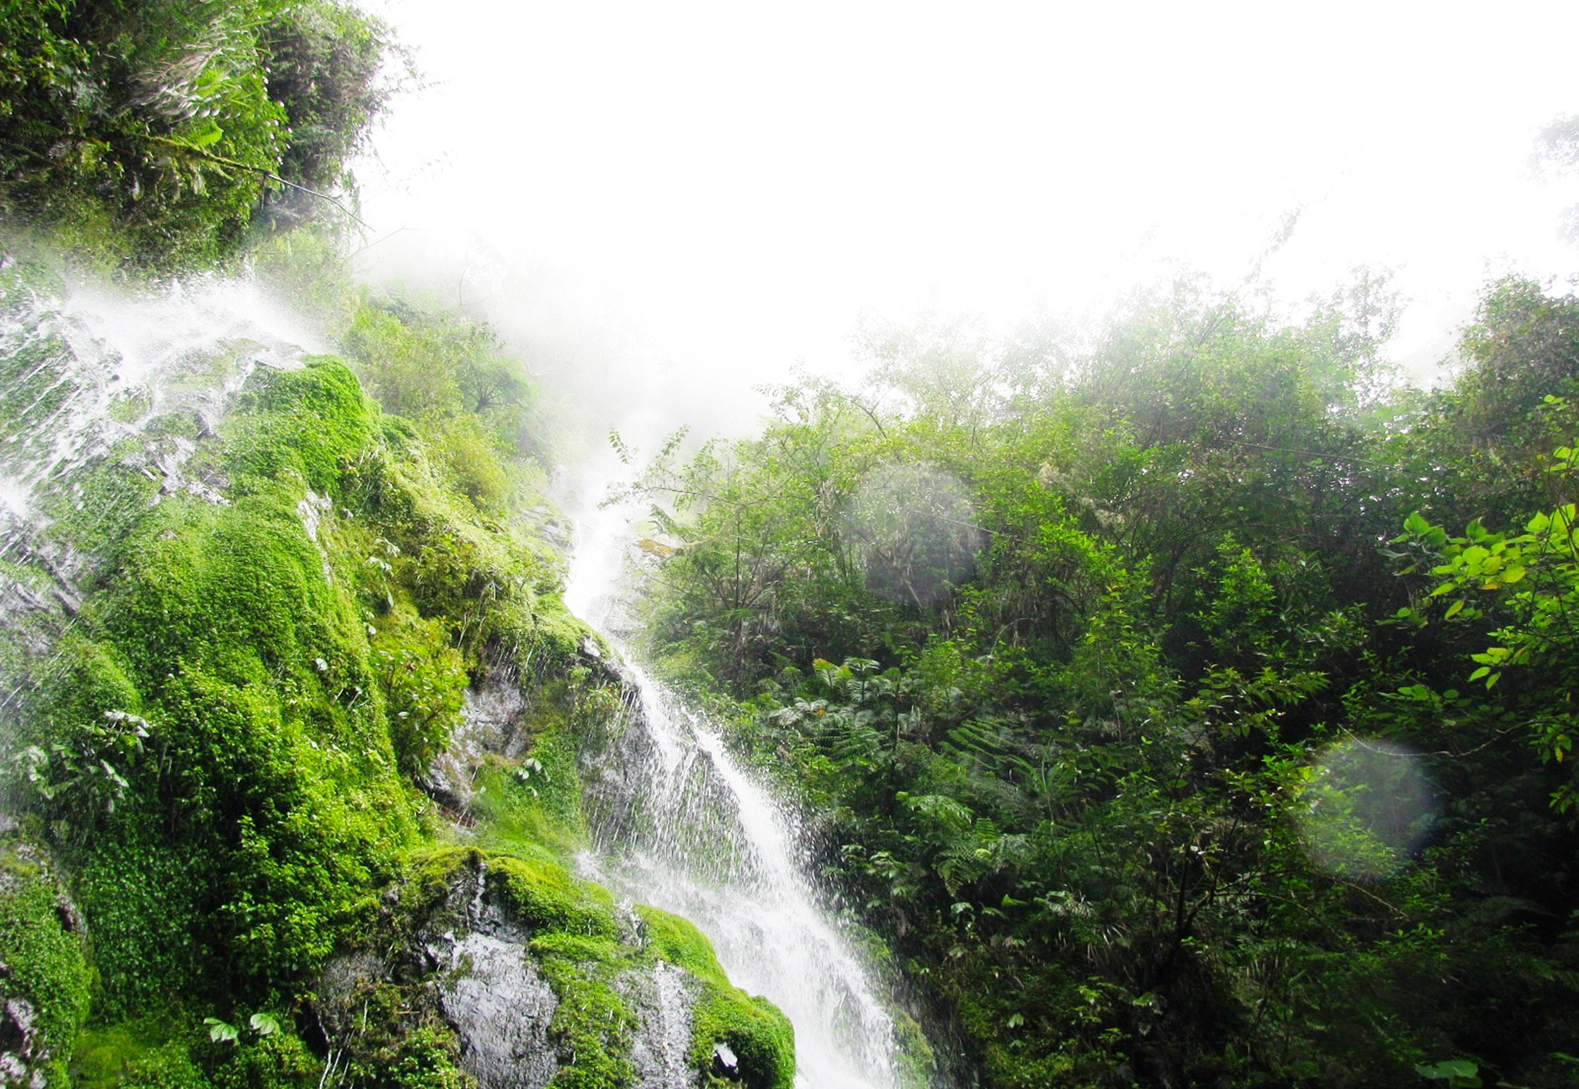


Ecosystem Accounting/
Natural Capital Accounting Experiences in the Philippines
Theresa Mundita Lim
Director
Biodiversity Management Bureau
Department of Environment and
Natural Resources
Mt. Kalatungan Range Natural Park
Photo credits: NewCAPP Project, BMB-DENR
Notes:
As director of the Biodiversity Management Bureau, the difficulty of arguing in support of biodiversity is not lost on me, especially when the alternatives contribute to incomes, employment, and exports whilst biodiversity is usually measured as number of trees or birds or fish. Ecosystem accounting and valuation are important tools that help contextualize and blunt the development agenda especially when large scale destruction of biodiversity resources is concerned. By appropriate valuation, we are able to value the destruction, both seen and unseen, both measured immediately and for future generations.

Slide 2
Presentation Outline
Precursor accounting projects
Current ecosystem accounting / valuation projects
BIOFIN as consolidator of results
Notes:
The coverage of this presentation will be as follows :
Precursor accounting projects
Current ecosystem accounting / valuation projects
BIOFIN as consolidator of results

Slide 3
Precursor Ecosystem Accounting /
Resource Valuation
Projects
Environmental and Natural Resources Accounting Project (ENRAP), 1991-2000, USAID
Integrated Environmental Management for Sustainable Development (IEMSD) Programme, 1995, UNDP
Philippine Framework on the Development of Environment Statistics (PFDES), 2000, ADB
Notes:
Even prior to the current wave of ecosystem accounting / valuation projects, the Philippines already implemented
Click 1 - the Environmental and Natural Resource Accounting Project or ENRAP. From 1991 -2000, the Philippines implemented ENRAP to address deficiencies in the System of National Accounts to reflect economic-environmental interactions by explicitly recognizing that the natural environment is a productive economic sector. Environmental quality services, waste disposal services, environmental damage, and natural resource depreciation were some of the variables measured by ENRAP. Some policy applications of ENRAP include: (i) inputs to the logging ban issue; (ii) fee reforms for grasslands and plantation agreements; and (iii) the phase out of leaded gasoline due to emission coupled with health effects.
In 1995, the UNDP supported
Click 2 - the Integrated Environmental Management for Sustainable Development (IEMSD) Programme which has two sub projects: ENRA 1, which adopted the UN System of integrated Environmental and Economic Accounting (SEEA) framework and compiled Assets & Activity Accounts from 1988 – 1994, and ENRA II, which started in 1998, and began the Institutionalization of the Philippine Economic-Environmental and Natural Resources Accounting (PEENRA) System and piloting at subnational levels.
In 2000, the Asian Development Bank supported the development of
Click 3 - the Philippine Framework on the Development of Environment Statistics (PFDES) and by 2000, the Philippines published the Compendium of Environmental Statistics

Slide 4
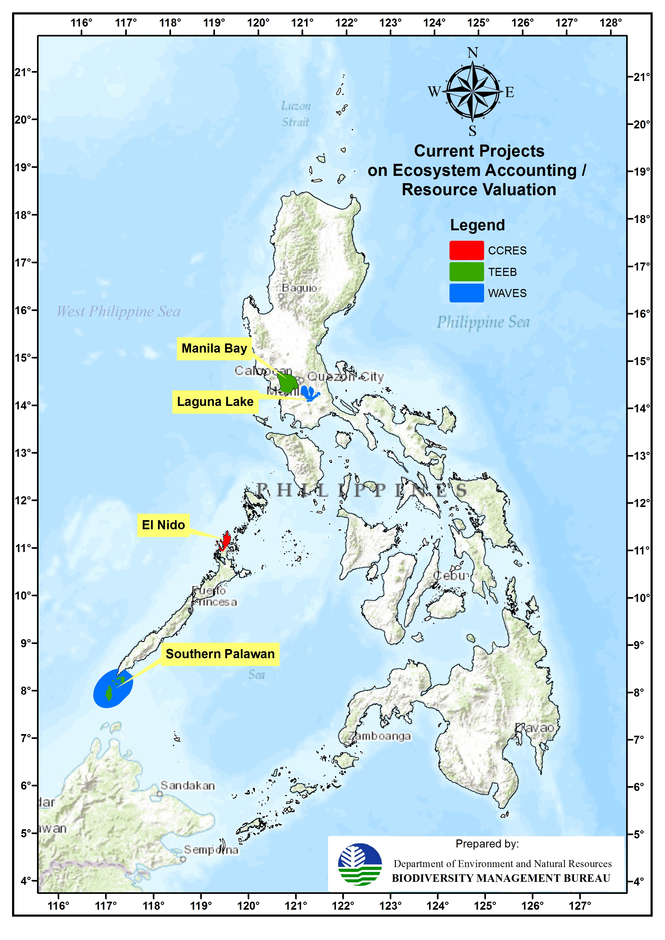
Current Projects
Wealth Accounting And The Valuation of Ecosystem Services (WAVES)
Capturing Coral Reef Ecosystem Services (CCRES)
System of Environmental and Economic Accounting (SEEA)
The Economics of Ecosystems and Biodiversity (TEEB)
Notes:
Click 1 - At present there are at least five major projects providing technical assistance in resource valuation and ecosystem accounting. These are
Click 2 - WAVES or wealth accounting and the valuation of ecosystem services is working in Laguna Lake and Southern Palawan
Click 3 – CCRES or Capturing Coral Reef Ecosystem Services is piloting in El Nido, Palawan
Click 4 – SEEA or System of Environmental and Economic Accounting is working at the national level
Click 5 – TEEB or The Economics of Ecosystems and Biodiversity piloting in Manila Bay and Southern Palawan

Slide 5
Biodiversity Finance Initiative
BIOFIN
WAVES
CCRES
SEEA
TEEB
Notes:
BIOFIN can be viewed as an
Click 1 - umbrella project which will utilize the outputs of these 4 projects.

Slide 6

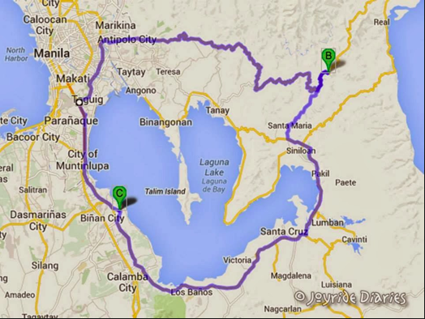
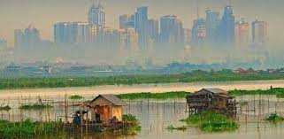
Laguna Lake
www.cecam-project.net
  Appropriate pricing drinking water
  Appropriate pricing for aquaculture operators
Notes:
Click 1 - WAVES (Wealth Accounting and Valuation of Ecosystem Services) is working in two locations: Laguna Lake and Southern Palawan.
Click 2 - Laguna Lake Basin is a vital ecosystem and center of economic activity for Manila and its neighboring provinces. The area surrounding the lake is home to an estimated 15 million people who rely on the lake for water, food, energy, recreation and livelihoods.
Click 3 - The Lake’s ecosystem is at risk with fish catches dwindling, predatory aquatic species proliferating, and increasing rainfall causing perennial flooding.
Click 4 - WAVES shall properly price the waters for water concessionaires and for aquaculture operators.

Slide 7
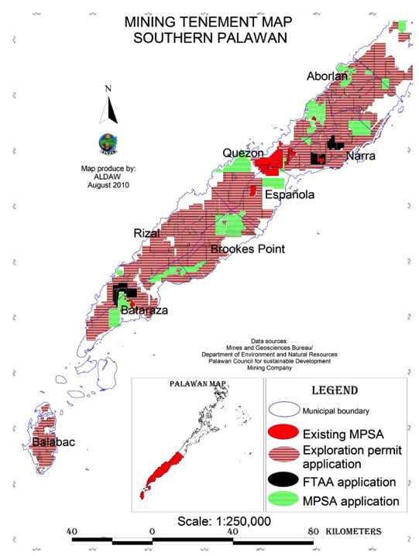
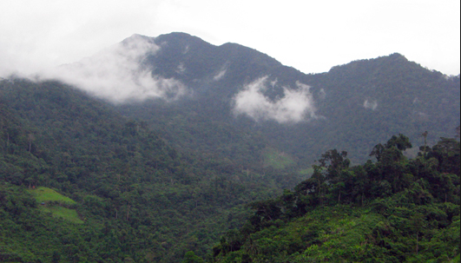
Competing demands: mining, agriculture, tourism, ancestral lands
Mt. Matalingahan
www.plant-talk.org
Notes:
Click 1 - There are numerous competing demands on resources in biodiversity-rich Southern Palawan. It is home to indigenous tribes and there is great potential for ecotourism and agriculture but the three large protected areas in the area are threatened by uncontrolled bird hunting, conversion of forest lands, mining claims and destruction of watershed areas.
Click 2 - One of the largest protected areas is Mt. Mantalingahan for which the total economic value of ecosystem services was estimated by Conservation International to reach USD 5.5 billion. WAVES will provide decision makers with data and evidence-based analysis to make the best decisions for the region.
In addition, WAVES shall contribute to macroeconomic indicators of sustainable development through the establishment of mineral accounts involving the Philippines Statistics Authority and the Mines and Geosciences Bureau of the DENR.

Slide 8
System of Integrated Environmental and Economic Accounting
(SEEA)
Focus on mineral and mangrove accounts
On-going integration of the Phil-WAVES with Philippine Statistics Authority Macro Economics Statistics Office
First set of estimates for mineral accounts targeted for December 2014
Notes:
SEEA - System of integrated Environmental and Economic Accounting (SEEA)
What was discussed was the WAVES component which is executed through a Bank -(world Bank) executed trust fund.
Click 1 - There is yet another component which is funded by the Philippine government and is executed by the Philippine statistics Authority focusing on
Click 2 - SEEA accounts for minerals, mangroves and macro indicators. Scoping of data for the national account (i.e., gold, copper, nickel and chromium) and satellite account (i.e., nickel).

Slide 9
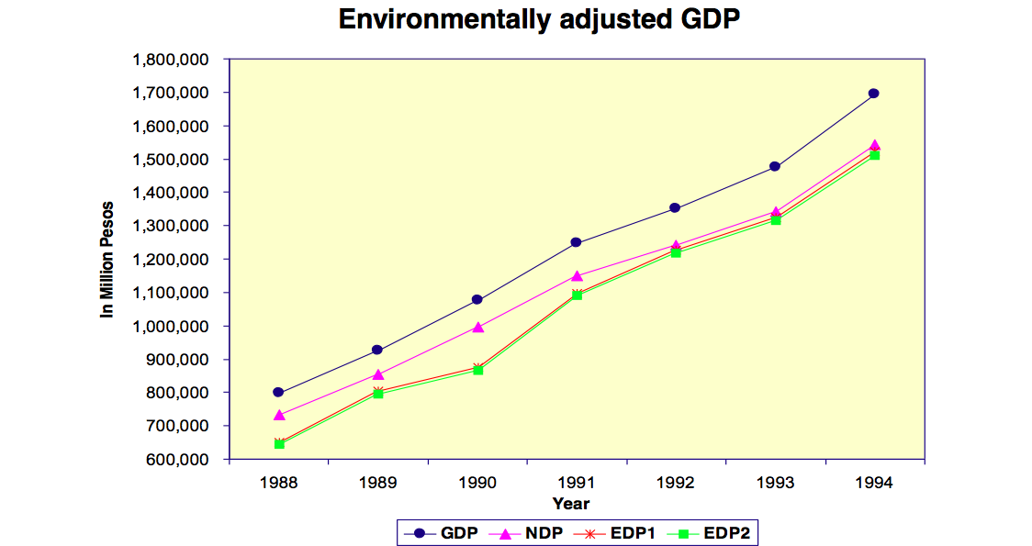
Notes:
The previous ENRA resulted in an unpublished interim environmentally adjusted GDP based on Monetary Asset and Emission Accounts estimates from 1988 to 1994. EDP1, or the environmentally adjusted NDP (Net Domestic Product), the red line, is computed by deducting the estimated resource depletion from the conventional NDP while EDP2, or the environmentally adjusted NDP, the green line, is derived by deducting from the EDP1 the estimated environmental cost of degradation. Note that the divergence between official GDP estimates and EDP1 and EDP2 is about 2 billion pesos.

Slide 10
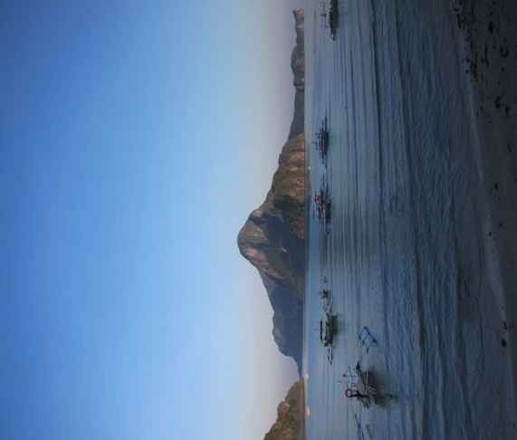
What is CCRES?
El Nido, Palawan
Technical assistance project – East Asia-Pacific Region
Collaborative partnership: Partners from donor agencies, research institutions, government, regional projects, private businesses, NGOs and communities
Five year duration (October 2013 – December 2018)
$10.4 million in funding: US$4.5m (GEF); AUD$2.0m (UQ); $3.9m (Partners)
Credit: Mags Quibilan
Notes:
CCRES - Capturing Coral Reef and Related Ecosystem Services
Click 1 - CCRES will undertake research to calculate a value for the contribution which natural assets in the coastal environment - seagrass beds, mangroves, coral reefs – make to livelihoods, food security and climate resilience in coastal communities across the East Asia Pacific region.
Click 2 - The project will develop eco-friendly businesses, toolkits and spatial planning models which will harness the value of the coastal natural capital and assist communities to develop new, sustainable revenue streams.

Slide 11
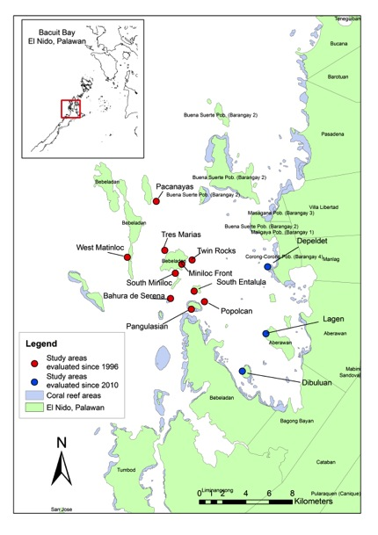
Philippines: El Nido, Palawan
El Nido
Last Ecological Frontier
Notes:
Click 1 - El Nido is the CCRES pilot site in the Philippines.
Click 2 - A first-class municipality located in northwest Palawan, El Nido has one of the highest marine biodiversity in the country. It is also a declared National Protected Area and a Marine Biodiversity Area. El Nido has been dubbed
Click 3 - the "Last Ecological Frontier" but with the tremendous increase in tourism from 10,000 tourists in 1994 to over 50,000 in 2013, El Nido is now under threat.
CCRES is now in the design phase with work programs designed, stakeholder consultations organized, and data collection started.

Slide 12
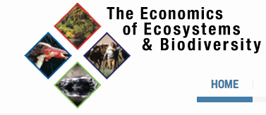
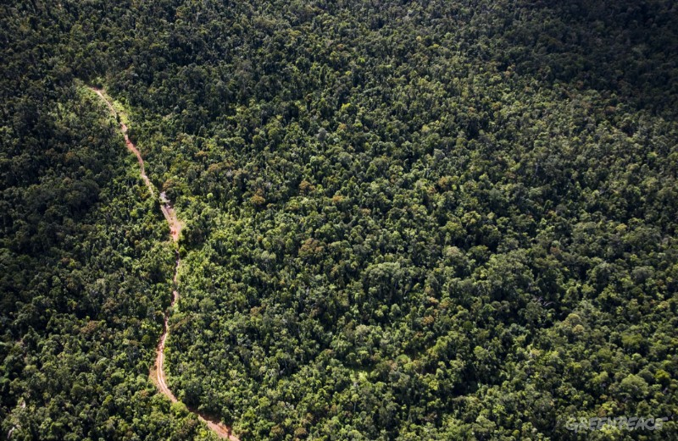
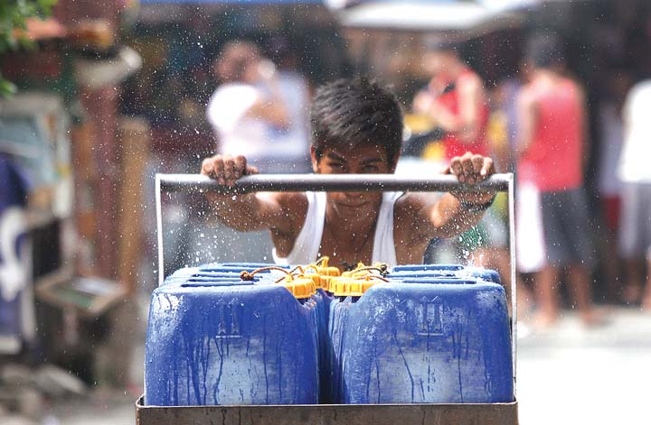
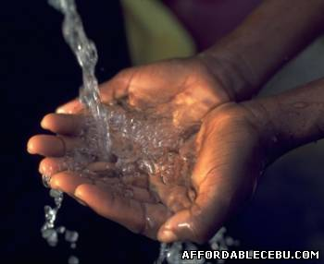
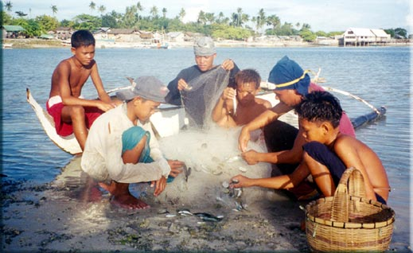
TEEB
Bhutan
Ecuador
Liberia
Philippines
Tanzania
Ecosystem Services
Increasing Carbon stocks
Livelihood
http://www.greenpeace.org/seasia/ph/press/releases/Logging-Ban-must-include-forest-communities-in-decision-making-for-effective-implementation--Greenpeace/
Michael Varcas/Manila Bulletin
Water Supply
Food
http://oneocean.org/fish/the_philippine_fisheries_situation.html
Notes:
Click 1 - Five countries (Bhutan, Ecuador, Liberia, Philippines and Tanzania) expressed interest to participate in this three year project, and they will each undertake a TEEB country study, specific to their specific context, over the three years of the project.
A TEEB country study identifies
Click 2 - the ecosystem services that are vital to meeting the country’s policy priorities and makes recommendations on how these services can be integrated into policies. These recommendations depending on the country context, can include policies for poverty alleviation, subsidy reform, land use management, protected area management, securing livelihoods, investment in natural infrastructure restoration and national accounting to include natural capital.

Slide 13
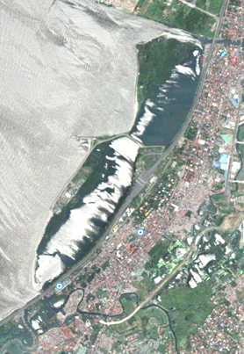
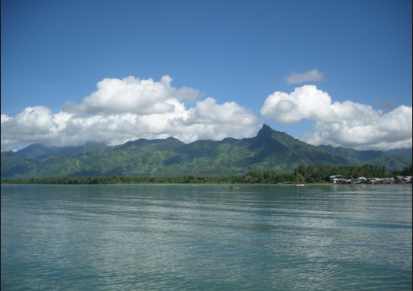
TEEB
www.ncr.denr.gov.ph
Brooke’s Point, Southern Palawan
Aerial Photo of Las Pinas-Paranaque
Critical Habitat & Ecotourism Area
Issue: Land reclamation
Notes:
TEEB studies can help countries answer these questions:
What is the natural capital in my country and what is driving change?
Do we measure and understand our natural capital?
To what extent are the values of nature integrated into decision-making?
What are the issues that need policy attention?
What are the policy tools and decision options that offer solutions?

Slide 14
DENR vs PBSAP Budget (2015)
$ 40 Billion – National budget
1.042 Billion - BMB
PhP 18.402 Billion – PBSAP
Notes:
TEEB studies can help countries answer these questions:
Click 1 - What is the natural capital in my country and what is driving change?
Do we measure and understand our natural capital?
To what extent are the values of nature integrated into decision-making?
What are the issues that need policy attention?
What are the policy tools and decision options that offer solutions?

Slide 15
TEEB
What is the natural capital in my country and what is driving change?
Do we measure and understand our natural capital?
To what extent are the values of nature integrated into decision-making?
What are the issues that need policy attention?
What are the policy tools and decision options that offer solutions?
Notes:
TEEB studies can help countries answer these questions:
Click 1 - What is the natural capital in my country and what is driving change?
Do we measure and understand our natural capital?
To what extent are the values of nature integrated into decision-making?
What are the issues that need policy attention?
What are the policy tools and decision options that offer solutions?

Slide 16
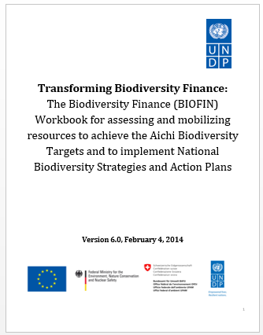
Biodiversity Finance Initiative
(BIOFIN)
The BIOFIN Methodology is a roadmap for creating a national biodiversity business plan
Notes:
BIOFIN
Click 1 - The Philippines is one of the 19 pilot countries for BIOFIN, a project conceived to
Click 2 - close the global financing gap for the conservation and sustainable use of biological diversity by assisting developing countries in identifying, accessing, combining and sequencing sources of biodiversity funding to meet their specific needs.

Slide 17
Biodiversity Finance Initiative
(BIOFIN)
Notes:
BIOFIN estimated the costs of implementing the PBSAP from 2015-2028 with the pie chart illustrating the breakdown of costs according to Aichi Targets. The total estimated cost is USD 6,297,357,596 (low).
Protection accounts for 50% of the total estimated cost at $3.1 billion dollars. 42% is attributed to Restoration with a total estimated cost of $2.6 billion. While this budget includes direct action towards attempting to restore ecosystem services and functions, it does not include the value of lost ecosystem services, which will even inflate the cost even more. This also denotes the goal of the country for both Protection and Restoration go hand-in-hand in its futile attempt in reverting to the pre-exploitation levels and at the same time protect the biodiversity from various factors affecting its decline.
We are hoping that future iterations of the PBSAP costing will surely benefit given inputs from WAVES, TEEB, CCRES, and SEEA.

Slide 18
Source : BIOFIN, Filling the Financial Gap for PAs in Belize
Notes:
BIOFIN will pilot at least one resource mobilization scheme from a menu that includes traditional sources such as grants and government allocations to non=traditional resource generation schemes such as carbon credits, water fees, use fees, conservation fees, etc --- which will require, in one form or another, some inputs from valuation of ecosystem services or ecosystem accounting. We are therefore pleased that WAVES, TEEB, CCRES and BIOFIN are being implemented simultaneously and we will ensure the convergence of outputs.

Slide 19
Importance of Valuation
Valuation is an essential component of investment planning – Benefit/Cost Analysis; Trade off Analysis; ROI should be embedded with ecosystem services costs/benefits
Valuation contributes to appropriate pricing of ecosystem goods and services
Valuation techniques can inform investment decisions (benefit / cost) but institutional strengthening processes should not be ignored
Notes:
Valuation is an essential component of investment planning. When we do benefit / cost analysis or trade off analysis or compute for Return on Investments, our benefits must reflect ecosystem services which are left unvalued such as biodiversity in the case of a forest and coastal protection in the case of coral reefs, for example. Our return on Investment (ROI) then will be embedded with ecosystem services costs / benefits. It would be ideal to do ecosystem accounting on a regular basis so in the meantime, we are thankful for the technical assistance that WAVES, CCRES, TEEB and BIOFIN will provide.
Second is the contribution of valuation to the appropriate pricing of ecosystem goods and services. This is very useful as we evaluate our user fee systems and ensure that the willingness to pay of users are adequately reflected.
Lastly, valuation techniques can inform investment decisions (benefit / cost) but institutional strengthening processes should not be ignored.

Slide 20
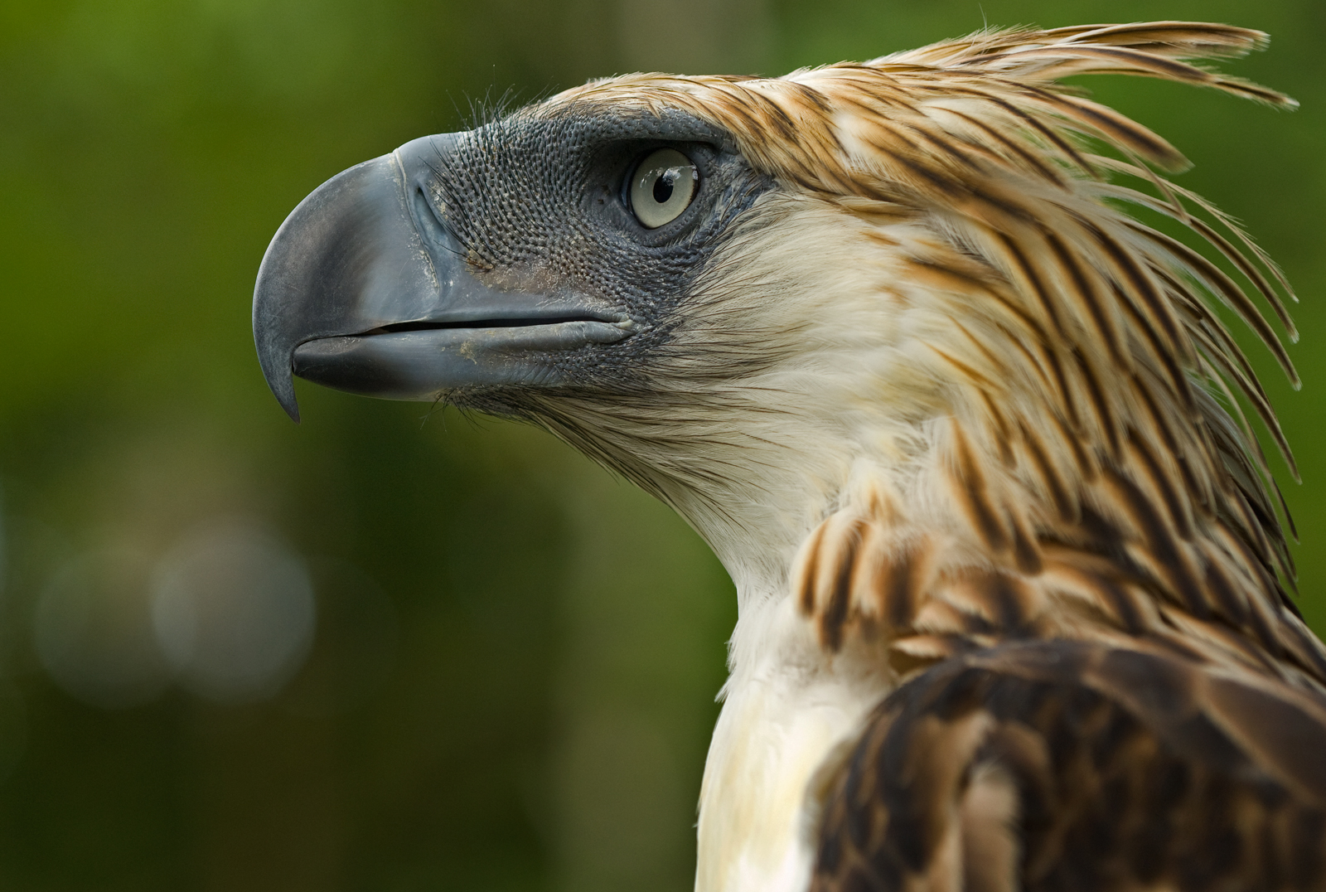
Kamsahamnida!
Salamat!
Thank You!
Biodiversity Management Bureau
Department of Environment and Natural Resources
www.bmb.gov.ph
bmb@bmb.gov.ph
Philippine Eagle
Photo credits: Klausse Nigge

