Slide 1
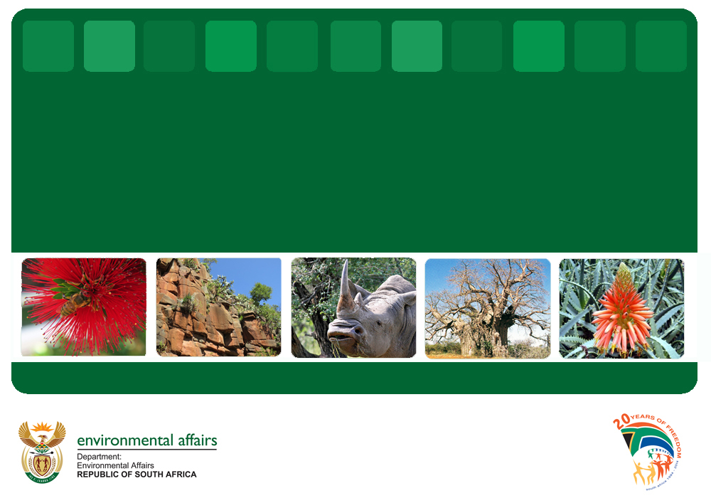


Enhancing incentives and resource mobilisation for landscape protection in support of sustainable development in South Africa
Wilma Lutsch
Department of Environmental Affairs, SA
Biodiversity and Conservation

Slide 2
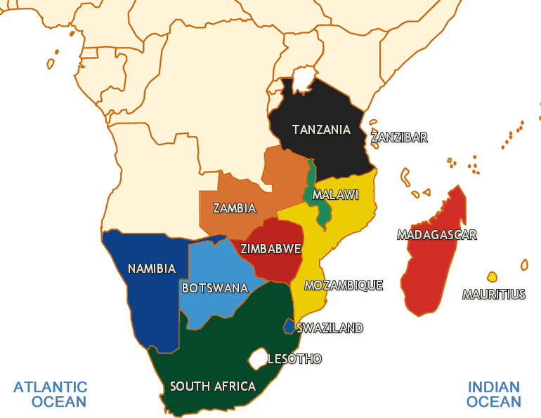
Status: National biodiversity
Southern tip of Africa
~ 1% of global land surface
> 95000 species
5-8% of plant, bird, reptile, & mammal species
High levels of endemism (particularly in Cape Floral Kingdom)
Notes:
South Africa is one of the most bio-diverse countries globally, situated at the southern tip of Africa with more than 95000 species recorded the country contains between 5 and 8 percent of global biodiversity while representing just less than one percent of the global land mass. There are high levels of endemism in the country and particularly so in the Cape Floral Kingdom – a fully contained kingdom within the country.

Slide 3
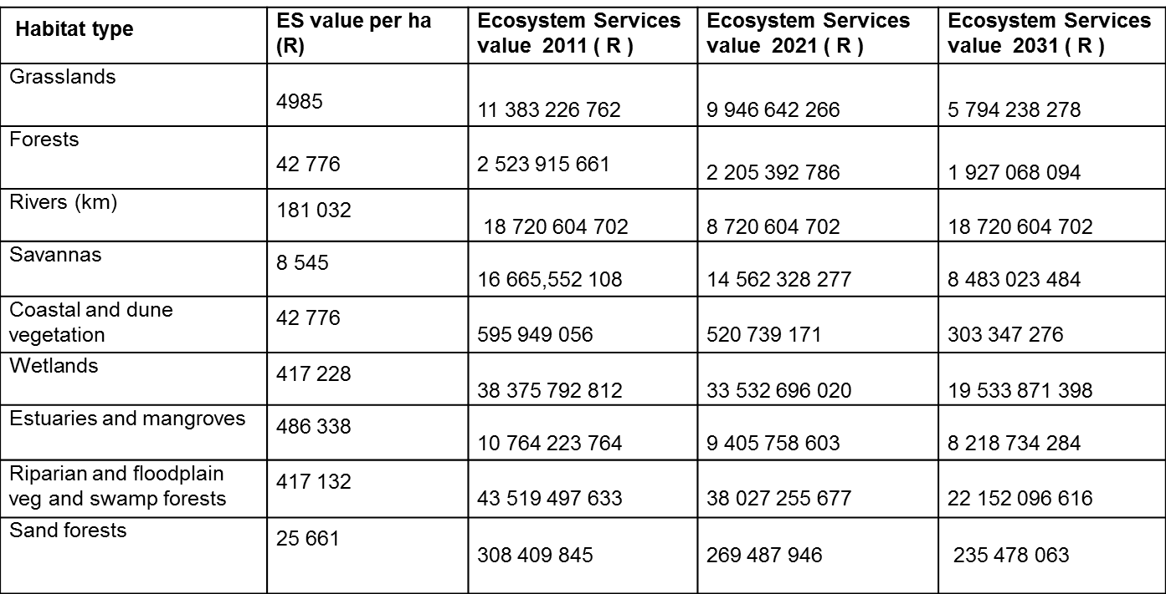
Projected Loss of Service Value Due to Transformation of Natural Assets in KZN
TOTAL SERVICES PROVIDED BY BIODIVERSITY | 2011 R 149 billion | 2021 R 132 billion | 2031 R 89 billion
If current rate of loss continues Treasury will need to find an additional R17 billion to compensate for the loss of essential services biodiversity is providing for free
Notes:
This is a table which reflects the projected loss of service value due to transformation of natural assets in one of our provinces. In these columns the habitat types and their ecosystem services values are quantified for intervals of 10 years 2011, 2021 and 2031. It is estimated that if the current loss continues, our national treasury will need to find an additional R17 billion to compensate for the loss of essential services biodiversity is providing for free.

Slide 4

What does that mean in real terms?
Biodiversity offers R150 billion worth of services
Ezemvelo is given a budget of
R512 million to conserve biodiversity
The return on this is R292.36 for every R1 invested by the province in Ezemvelo
This value could also be taken as the amount that Treasury would have to fund should there be no ecosystems services provided

Slide 5
Protected Area Expansion in South Africa
South Africa’s protected area estate does not effectively represent the full range of globally important species and habitats in South Africa’s hotspots
Traditional protected area expansion through land purchase is no longer cost effective
Low cost mechanisms for protected area expansion and management need to be supported
The creation of Private Protected Areas is recognised as a critical means of protected area expansion to meet national and international targets
Notes:
South Africa’s protected area estate does not effectively represent the full range of globally important species and habitats in South Africa’s hotspots.
Traditional protected area expansion through land purchase is no longer cost effective, and it is recognised that low cost mechanisms for protected area expansion and management need to be supported.
The creation of Private Protected Areas is seen as a critical means of protected area expansion to meet national and international targets

Slide 6
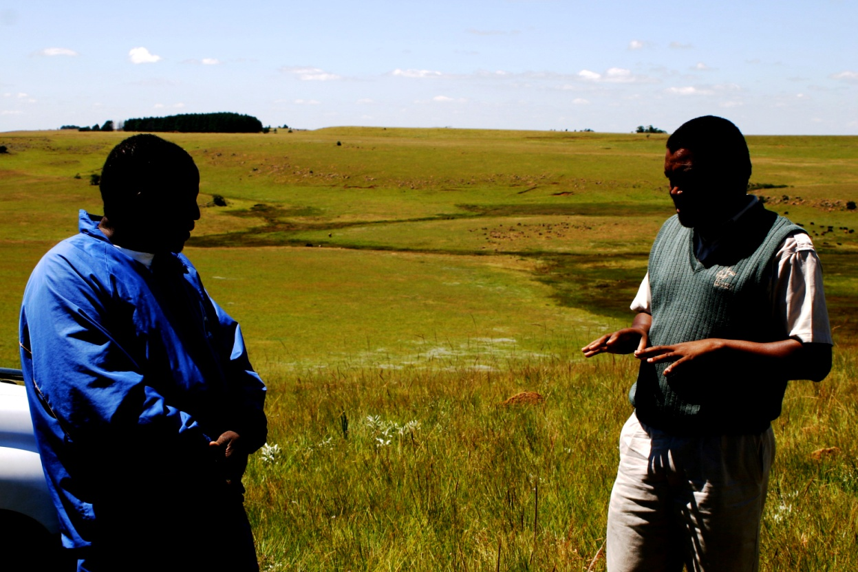
Biodiversity Stewardship Programme in South Africa
A programmatic approach to entering into agreements with private and communal landowners to protect and manage biodiversity priority areas in South Africa
Primary goal: to conserve and effectively manage biodiversity priority areas through voluntary agreements with landowners
Implemented by conservation authorities, often with the support of NGOs
Notes:
Biodiversity stewardship is a programmatic approach to entering into agreements with private and communal landowners to protect and manage biodiversity priority areas in South Africa. The programmes are led by conservation authorities, often with the support of NGOs. The primary goal of biodiversity stewardship is to conserve and effectively manage biodiversity priority areas through voluntary agreements with landowners.

Slide 7
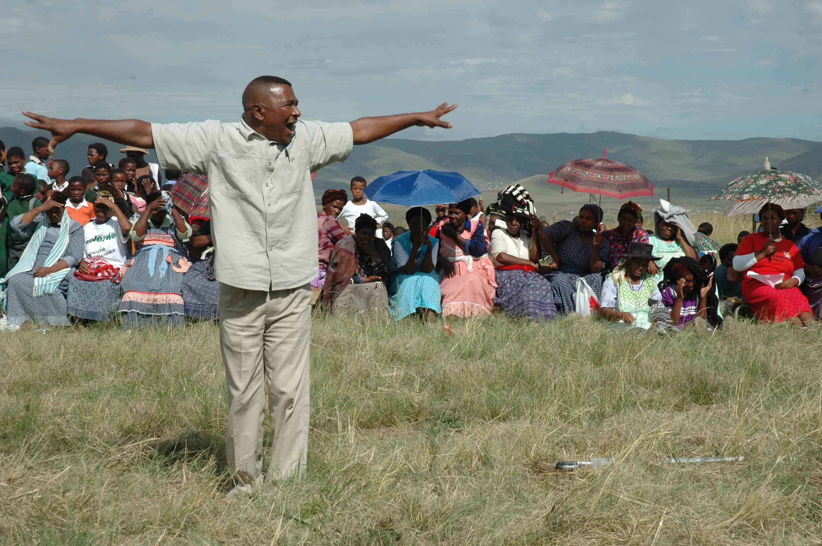
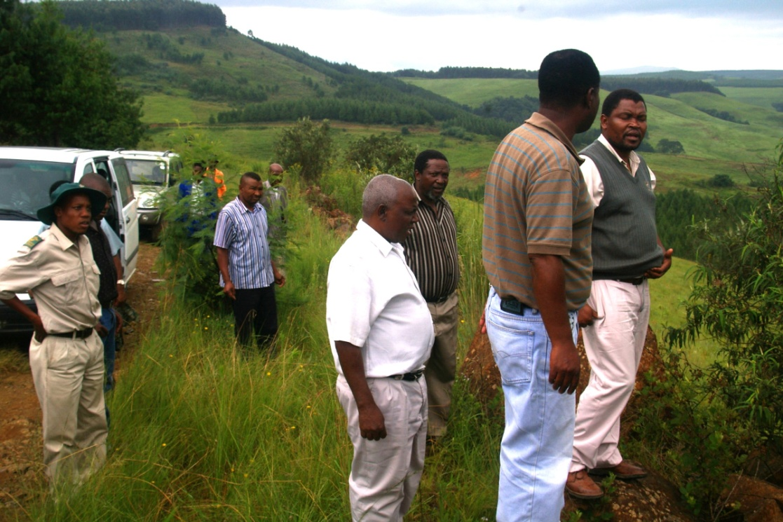
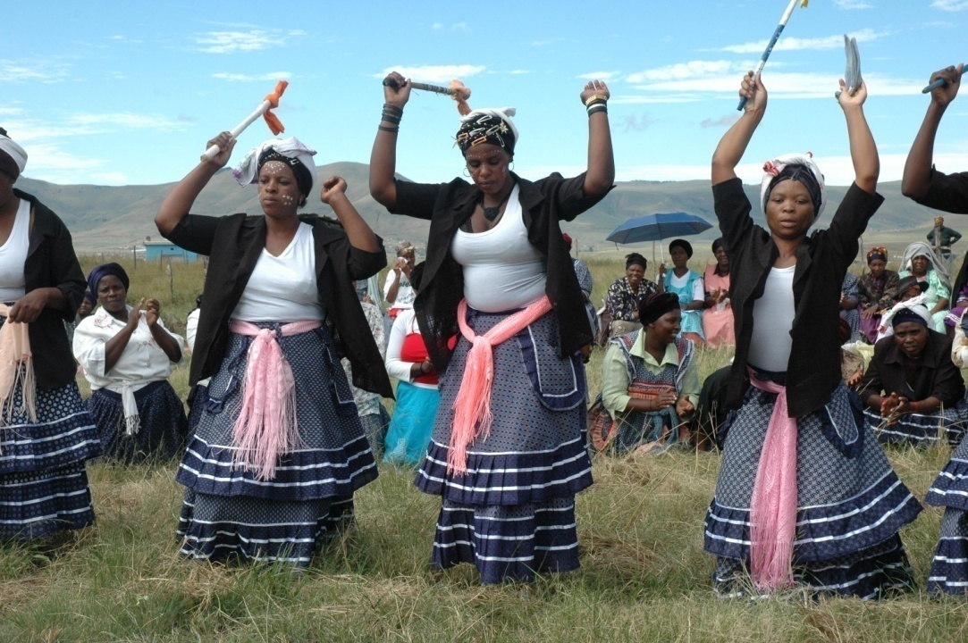
UMGANO EXAMPLE
Phase 1: Commercial Forest managed by community
Phase 2: Biodiversity Management Agreement signed for cattle project on 21 November 2008, at the launch of the KZN Biodiversity Stewardship Programme
Phase 3: Declaration of mountain area as Nature Reserve, in negotiation process
Nkosi L. Baleni: “I would like to establish something of lasting value for my people”

Slide 8
Biodiversity Stewardship agreements for protected areas only created in biodiversity priority areas, systematically identified at provincial and national scale
Land ownership and management responsibility remains with the landowners, with support from state and NGOs
Annual auditing by the conservation authority
Nature Reserve
Protected Areas Act
Protected areas
Protected Environment
Protected Areas Act
Biodiversity Management Agreement
Biodiversity Act
Increasing landowner commitment to conservation
Conservation areas
Increasing support from conservation authority
Increasing biodiversity importance
Biodiversity Agreement
contract law
Biodiversity Partnership Area
Non-binding
Notes:
Within the Biodiversity Stewardship programme, a suite of agreement types exist, ranging from non-binding to long-term formally declared protected areas.
This allows for flexibility in the landscape, where less restrictive agreements can be put in place in certain areas, such as buffers and multiple use landscapes, while formal protected areas can be created in areas of high biodiversity importance.
The higher ‘types’ of agreements are formal protected areas, recognised and regulated by the Protected Areas Act, and contributing to the South Africa’s protected area estate.
Biodiversity Stewardship agreements for protected areas are only created in biodiversity priority areas, systematically identified at provincial and national level, in line with the protected area expansion strategies (provincial and national).
In the Biodiversity Stewardship model, land ownership and management responsibility remains with the landowners, with support from state and NGOs.
Annual auditing of the management of the land under contract is done by the conservation authority.

Slide 9
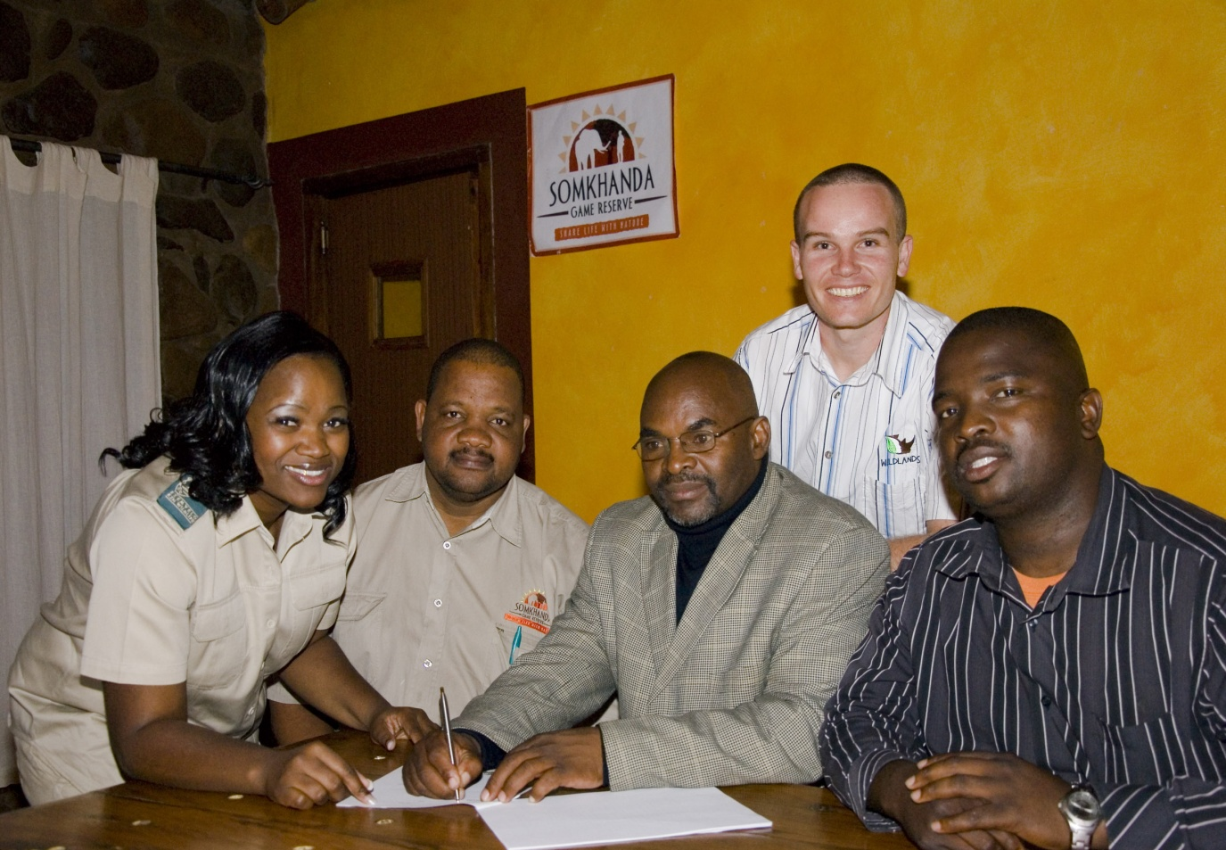
Somkhanda
UMGANO EXAMPLE
On 1 July 2009 Nkosi Zeblon Gumbi signed the declaration agreement and Protected Area Management Agreement for the declaration of 11 600 ha as nature reserve
The Nature Reserve was declared on 17 February 2011
Rhino’s have been established on the nature reserve with the assistance of WWF

Slide 10
Province | Protected Areas Proclaimed |  | Protected Areas in Negotiation
 | Number | Hectares | Number | Hectares
Eastern Cape | 7 | 90 448 | 6 | 143 626
Free Sate | 0 | 0 | 1 | 17 456
Gauteng | 0 | 0 | 11 | 6 933
KwaZulu-Natal | 18 | 58 490 | 49 | 187 157
Limpopo | 0 | 0 | 3 | 56 010
Mpumalanga | 7 | 103 937 | 5 | 25 388
North West | 0 | 0 | 2 | 2 736
Northern Cape | 4 | 154 854 | 15 | 58 894
Western Cape | 35 | 43 665 | 54 | 43 782
Total | 71 | 451 395 | 146 | 541 981
Notes:
Ten years since the Biodiversity Stewardship programme was first piloted, it is now operational in all 9 provinces, and has secured some 71 protected areas totalling around 450,000 ha. Another 540,000 are in negotiation through these programmes.
[Speaker: This is the most up-to-date data from DEA, compiled by Willeen Olivier, for the provincial Biodiversity Stewardship programmes. Finalised 1 Oct2014]

Slide 11
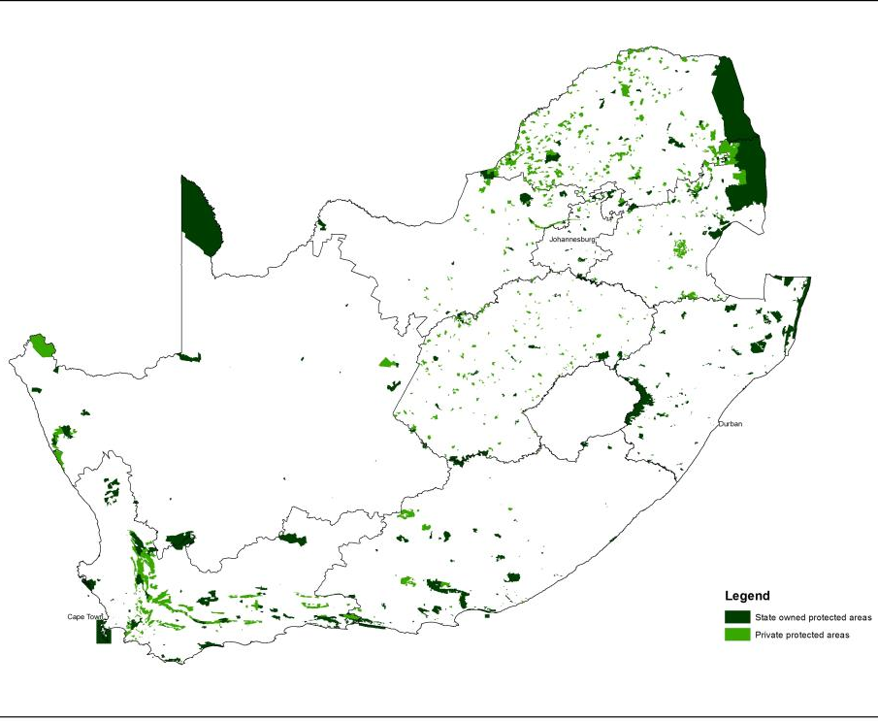
Of South Africa’s 8.7 mil ha of terrestrial protected areas, some 35 % are private protected areas
Notes:
Speaker:
Dark green: state owned protected areas
Light green: privately owned protected areas. [This included communal land, which is technically state owned, but managed by communities and therefore viewed as PPA by DEA]
[Speaker: very important that you are clear these are the terrestrial PAs. Marine PAs, including Prince Edward Island, push the total PA ha much higher, which brings the % privately owned right down. I have verified these numbers with DEA (Kallie Naude)]

Slide 12
Biodiversity stewardship resource mobilisation for protected area expansion
Cost to the state across two models for protected area expansion
Biodiversity stewardship model is at least 90 times less costly to conservation authority than land purchase, in some areas as much as 500 times
Biodiversity Stewardship | Land Acquisition
Negotiation (for stewardship) and legal declaration | Negotiation (for sale), purchase (cost of land) and legal declaration costs
Preliminary results
Tracey Cumming
SANBI
Notes:
While there is a cost to the conservation authority to implement these programmes, which requires dedicated staff to negotiate and maintain sound relationships with landowners, this cost is far less than the alternative model of land purchase.
Through relinquishing development rights on the land, formally protecting the land, and managing the land effectively for biodiversity conservation, the private sector essentially contributes significant resources towards national biodiversity conservation targets.
Preliminary results from a study has indicated that the cost to the conservation authority to get land formally protected though the biodiversity stewardship model is at least 90 times less costly than outright land purchase, and in some cases as much as 500 times less costly.
[Speaker:
Additional info on the results in case there are questions:
Study based on two provinces with the most experience in biodiversity stewardship (KZN and Western Cape)
Securing a protected area, compared the cost of
Biodiversity stewardship – cost to the state to negotiate the agreement and the legal declaration of a PA
Acquisition – cost to the state for negotiating the sale, market value of the land, and legal declaration costs.
This is not published yet, so must be seen as preliminary results.]

Slide 13
Biodiversity stewardship resource mobilisation for protected area expansion
Managing protected areas (annual cost)
Biodiversity stewardship model is 4 – 17 times less costly to the conservation authority than managing their own protected areas (depending on biome–related biodiversity management costs)
Costs supplemented by NGO involvement – often a three way partnership between landowner, state and NGO
One province in study which had METT scores for both biodiversity stewardship PAs and state run PAs – METT average same for both
Preliminary results
Tracey Cumming
SANBI
Notes:
Managing the land, once protected, is between 4 and 17 times less costly to the conservation authority than if it was managed purely by the conservation agency.
[Speaker:
Additional info on the results in case there are questions:
Managing a protected area
Biodiversity stewardship cost to the state to maintain relationship with landowner, provide technical support, and conduct annual audits
Cost to the state to manage biodiversity on their own protected areas, cost per ha, excluded tourism and any off-site costs.
This is not published yet, so must be seen as preliminary results]

Slide 14
Fiscal incentives to support private sector resource mobilisation for protected areas
Fiscal incentives developed in property rates and income tax legislation supporting biodiversity stewardship
Income tax:
  deductions based on the cost of managing the protected area
  a deduction based on a portion of the value of the land, acknowledging the landowner's relinquishment of development rights
The property rates exemptions are applicable largely to portions of protected areas (state and privately owned) not generating income
Notes:
South Africa now has tax incentives which aim to assist landowners with private protect areas. These incentives relate to both property rates, and income tax.
- The income tax incentives allow deductions based on the cost of managing the PPA, as well as a deduction based on a portion of the value of the land, acknowledging the landowner's relinquishment of development rights.
- The property rates exemptions are applicable largely to portions of protected areas not generating income
While the fiscal incentives are a cost to the fiscus, it is a smaller cost than land purchase and management

Slide 15
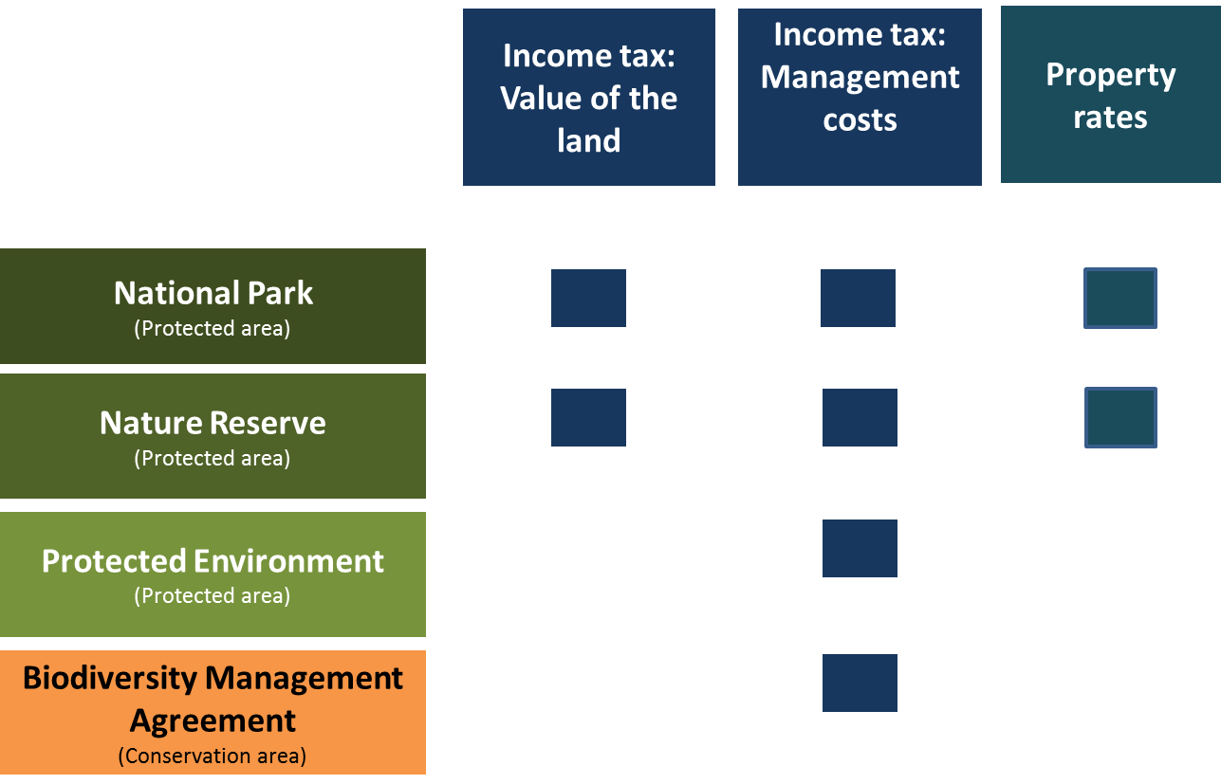
Fiscal incentives to support private sector resource mobilisation for protected areas
Notes:
[Speaker: this shows which fiscal incentives are applicable to which protected areas. The point you might want to make is that the more restrictive protected areas have more substantial fiscal incentives.]

Slide 16

GEF investment in Biodiversity Stewardship
South Africa and UNDP Partnership has been a catalyst for many of our successes:
Feasibility of Biodiversity Stewardship model
Model development and pilot
Growth of Biodiversity Stewardship across Cape Floristic Region (CAPE) – almost $800 000, incl. implementation and enabling mechanisms, such as fiscal incentives
Grasslands programme – co-funded stewardship posts at provincial and national (enabling) level, and NGOs
Notes:
Biodiversity Stewardship in South Africa has had GEF support from the very beginning. GEF funds were used to fund the first feasibility study on the stewardship mechanism, to develop the mechanism, and to pilot the first projects.
The GEF funded CAPE project, focussed on the Cape Floristic Region, supported the development and growth of stewardship for 2004 to 2010, to the tune of almost R9 million – a little under $800 000 at today’s rate. This supported not only on-the-ground implementation, but also the development of an enabling environment for Biodiversity Stewardship, including the development of fiscal incentives.
The GEF funded Grasslands programme supported the growth of stewardship as it expanded across the country, co-funding numerous posts provincial, NGO and national posts.

Slide 17
South Africa’s GEF 5 projects supporting Biodiversity Stewardship and financial sustainability
South Africa’s GEF 5 Protected Area and Mainstreaming projects both include substantial investments in Biodiversity Stewardship, as well as specific investments to ensure financial sustainability of the protected area estate

Slide 18
Key Challenges
Ensuring sufficient funding for the provincial Biodiversity Stewardship programmes
  - To secure more land through Biodiversity Stewardship
  To continue to provide technical support to participating landowners into the future
Increased support to landowners
Notes:
Despite the Biodiversity Stewardship model being substantially more cost effective than purchase, there remains a challenge to ensure sufficient funding for the provincial Biodiversity Stewardship programmes
Tangible support, particularly, but not limited to, Biodiversity Stewardship sites on communal land, needs to be increased. A recent study on the participation of Biodiversity Stewardship participants has shown that technical support from, and a maintained sound relationship with, the conservation authority is a major driver of continued landowner commitment.

Slide 19


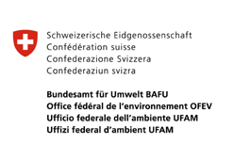

South Africa BIOFIN
Planned process:
  Reviewing biodiversity policies, institutions and expenditures
  Defining the costs of implementing NBSAP
  Developing a resource mobilisation strategy for biodiversity finance
  Initiate implementation of the resource mobilisation strategy
Begin late 2014/early 2015
Notes:
South Africa is one of 19 countries to implement the BIOFIN project.
The South African BIOFIN project is expected to follow the process of:
Reviewing biodiversity policies, institutions and expenditures
Defining the costs of implementing NBSAP
Developing a resource mobilisation strategy for biodiversity finance
Initiate implementation of the resource mobilisation strategy
The work is due to start in late 2014 or early 2015
[Speaker: the global BIOFIN project would have already been explained in an earlier talk in this session]

Slide 20
Experimental Ecosystem Accounts
UN Statistics Division in partnership with UNEP (TEEB) & CBD Secretariat
  Project on experimental ecosystem accounting – Phase 1 underway (funded by Govt of Norway)
  7 pilot countries, including SA
  Partnership with StatsSA, SANBI, DWS, DEA, CSIR
Ecosystem accounting is one aspect of environmental accounting – still relatively new
Notes:
UN Statistics Division working with 7 countries on developing experimental ecosystem accounts, of which South Africa is one.
This work fits into the broader System of Environmental-Economic Accounting (SEEA). Phase 1 of the pilot project is funded by the Norwegian government through the UN and implemented in close partnership with national agencies and departments in South Africa.
Ecosystem accounting is a subset or component of environmental accounting. It focuses on systematically measuring and tracking the condition of ecosystem assets and the provision of ecosystem services.
[Speaker: Environmental accounting focuses on so-called “individual environmental assets”, such as minerals, water, fish stocks, timber. The SEEA Central Framework deals with these, and was approved as an international statistical standard in 2012. Ecosystem accounting focuses on ecosystem assets and ecosystem services. The approach and methods are still more experimental, and there is not yet an agreed international standard – hence the need for further research and experimentation.]

Slide 21
Further Investment in Expanding the Protected Area Estate
DEA has commissioned a National Sustainable financing Strategy for State Managed Protected Areas
Complementary Programmes
Environmental Programmes ( Working FOR )
Bioregional Programmes (CAPE, STEP, SKEP, Grasslands)
GREEN FUND - Potential not fully exploited
JOBS FUND

Slide 22
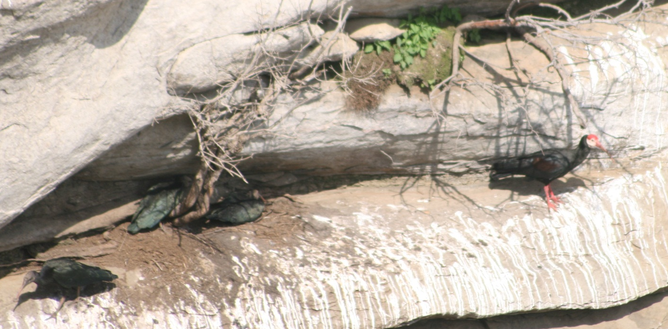
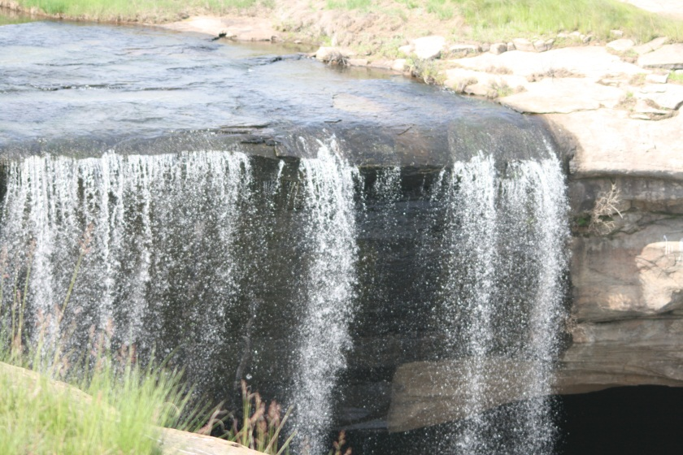
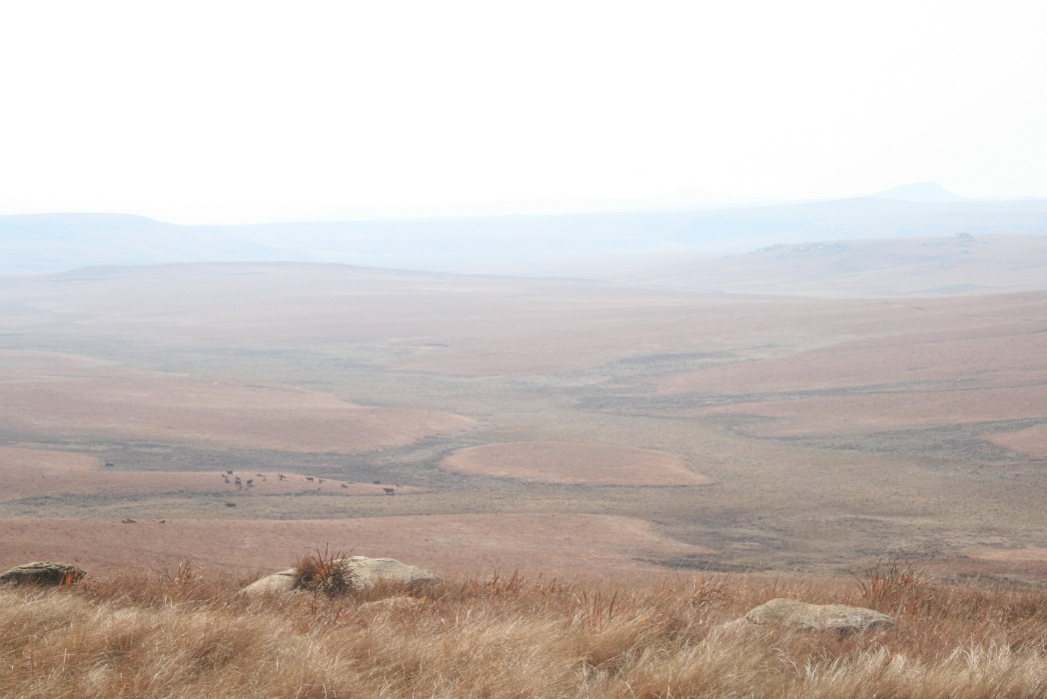
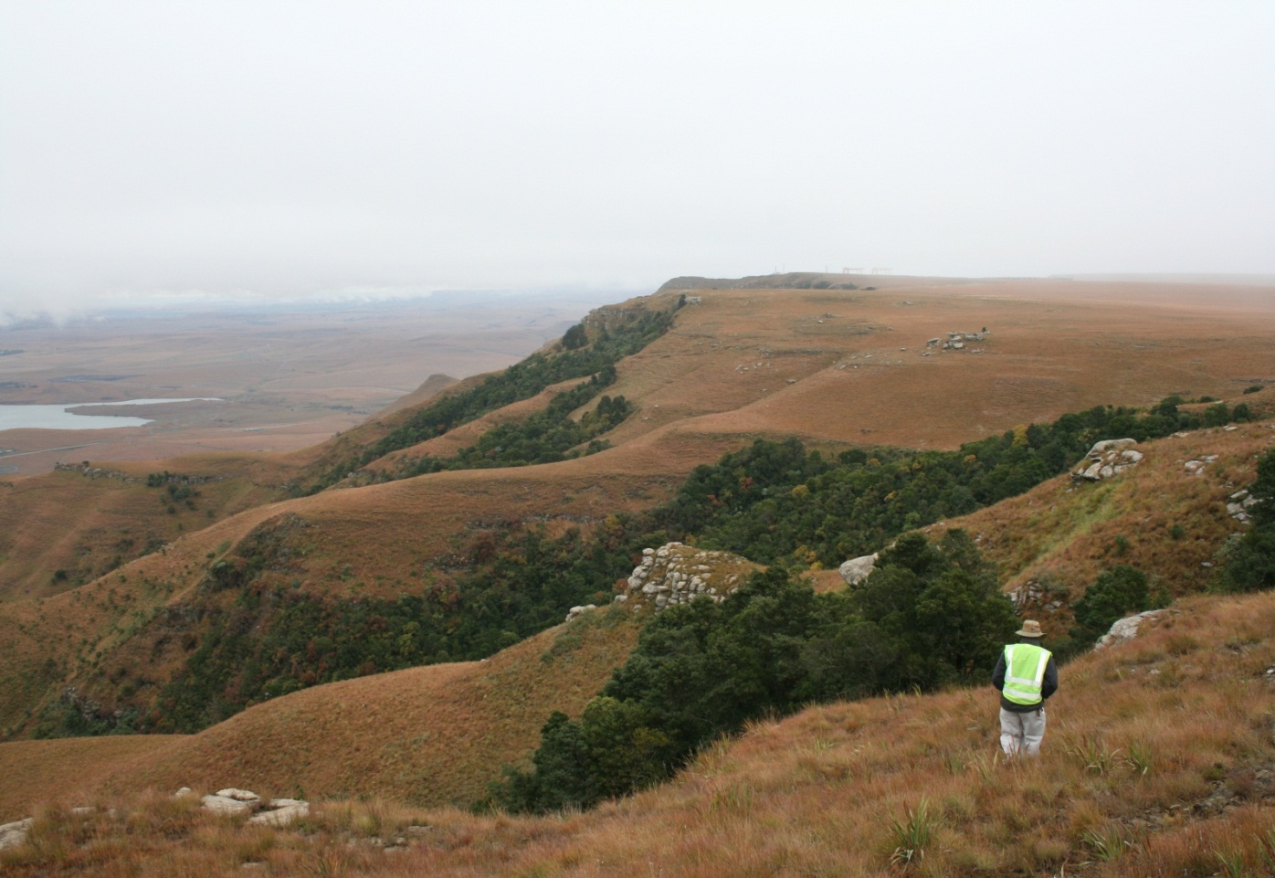
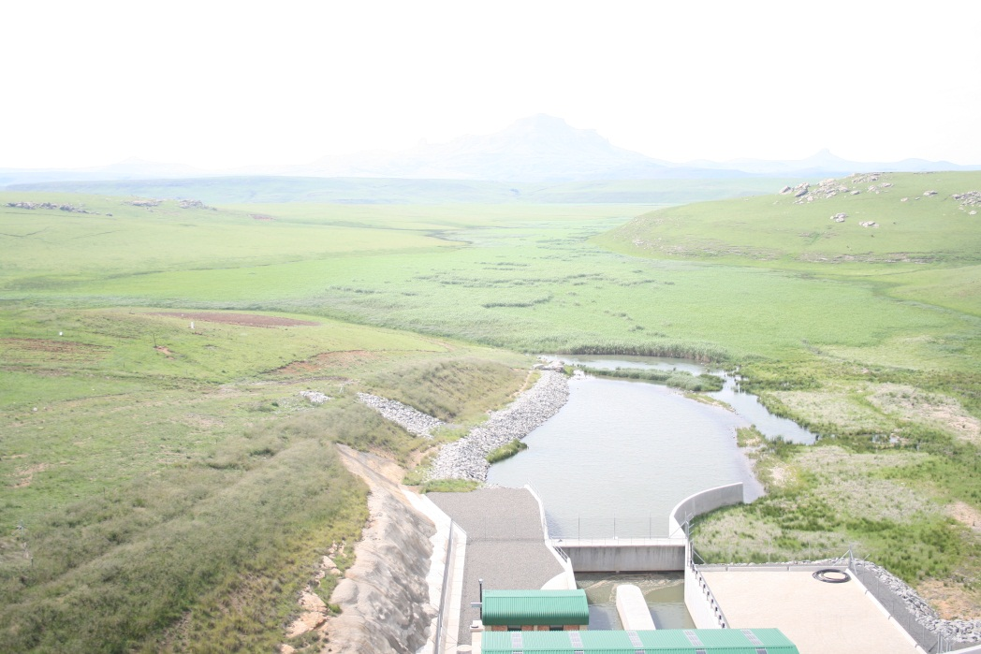
8 000 + ha of high altitude Grassland under conservation

Slide 23

Wilma Lutsch
Director: Biodiversity Conservation

