Slide 1
Mainstreaming Sustainable Production and Consumption
Jason Clay
SVP Markets, WWF-US

Slide 2
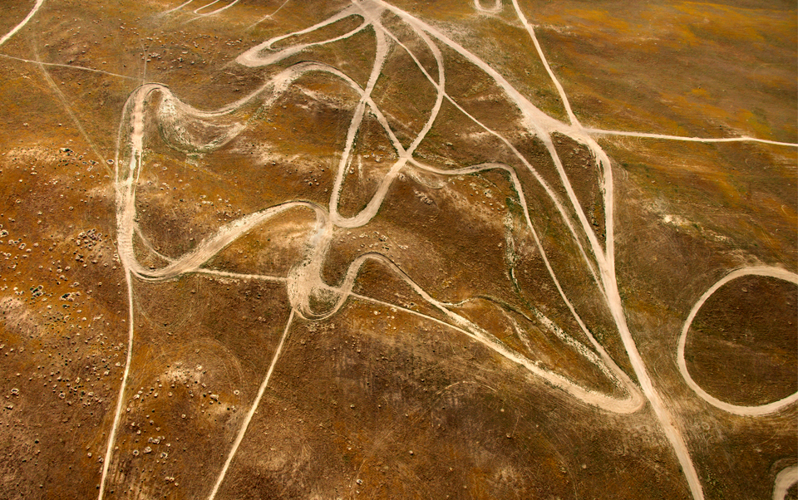
“If you don’t know where you’re going,
any road will get you there.”

Slide 3
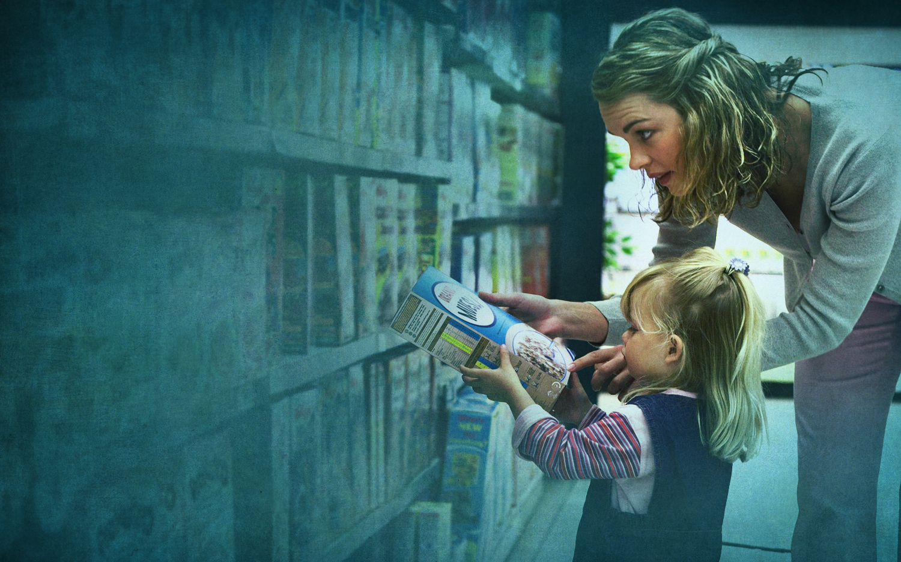
On a finite planet, should consumers have a choice about sustainable products?
or should all choices be sustainable?

Slide 4
sustainable commodities—
from niche to norm

Slide 6
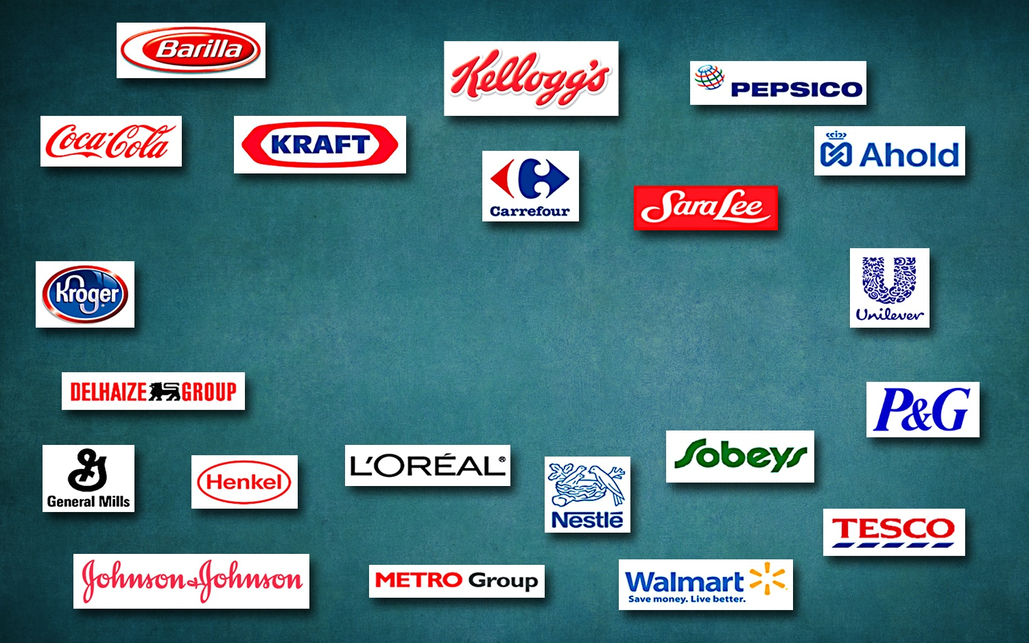

Slide 7
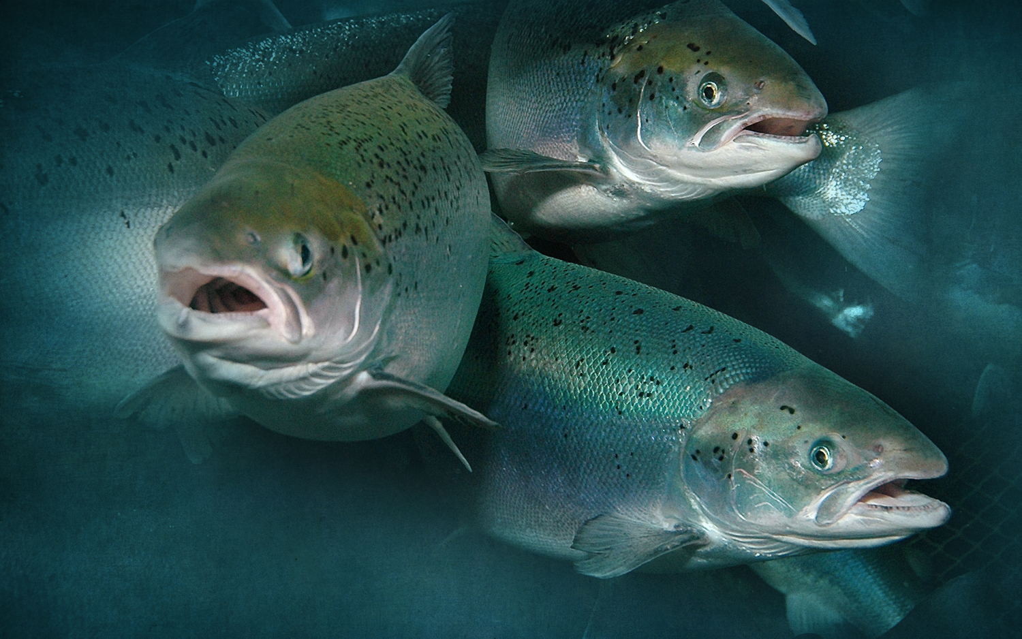
salmon
aquaculture

Slide 8
Growing the success of Irish food & horticulture

Slide 9
the issue is
risk both availability and reputation

Slide 10
Components of S&P 500 Market Value
83%
68%
32%
20%
19%
80%
81%
68%
percent
32%
17%
Tangible assets
Intangible assets
Source: Ocean Tomo

Slide 11
Traded commodities – then and now
physical values
other values
weights and measures
water use
quality
GHG emissions
color
smallholder
foreign matter
deforestation
health and safety
Illegally produced

Slide 12
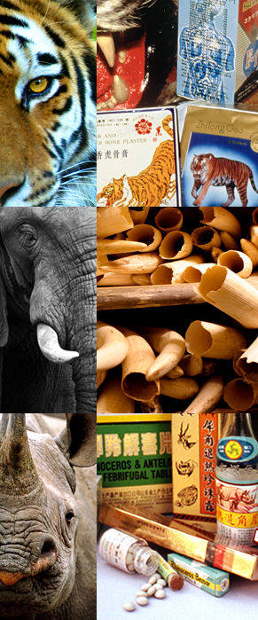
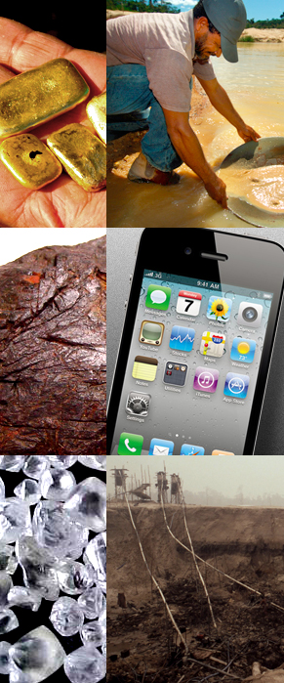
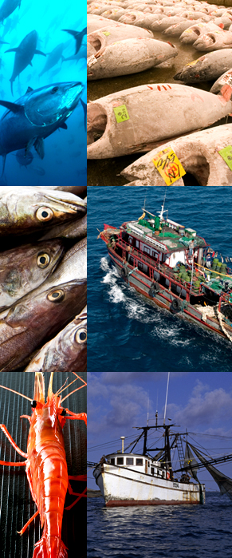
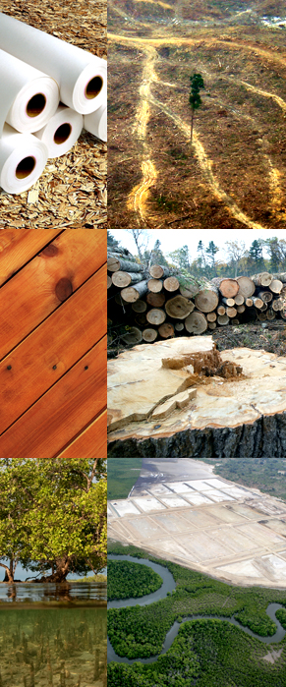
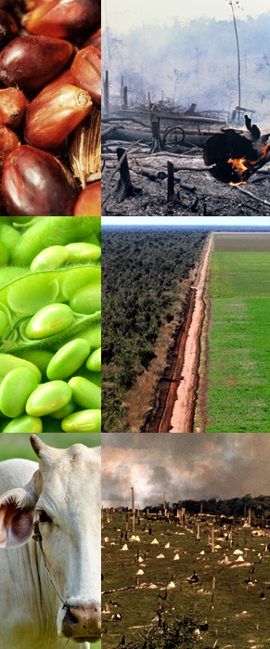
Illegally produced
SPECIES
MINERALS
FISH
FOREST
PLANTATION
tigers
gold
bluefin tuna
pulp
palm oil
elephants
coltan
demersal fishes
timber
soy
rhinos
diamonds
shrimp and prawns
mangroves
beef
Notes:
No builds

Slide 13
Reward the best, or move the rest?
government regulation
voluntary standards
number of producers
performance shift
worse
average
better

Slide 14
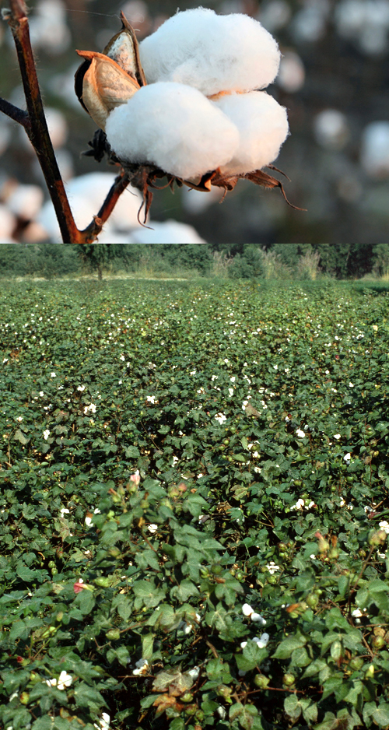
BCI—Cotton
BCI Roundtable began in 2004
5 years to develop standards
6 years of implementation
680,000 producers meet BCI standards
3.7% of global production
Metric based, continuous improvement

Slide 15
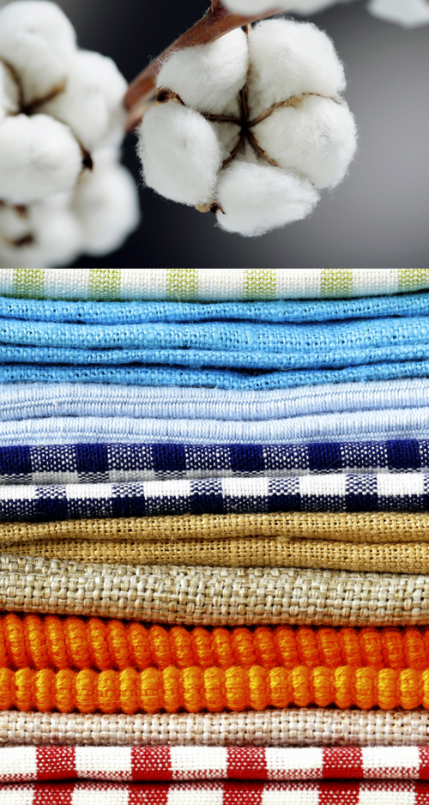
IKEA on-farm results
80,000 growers, India and Pakistan
60% fewer pesticides
40% less water
30% less fertilizer
15-20% more income

Slide 16
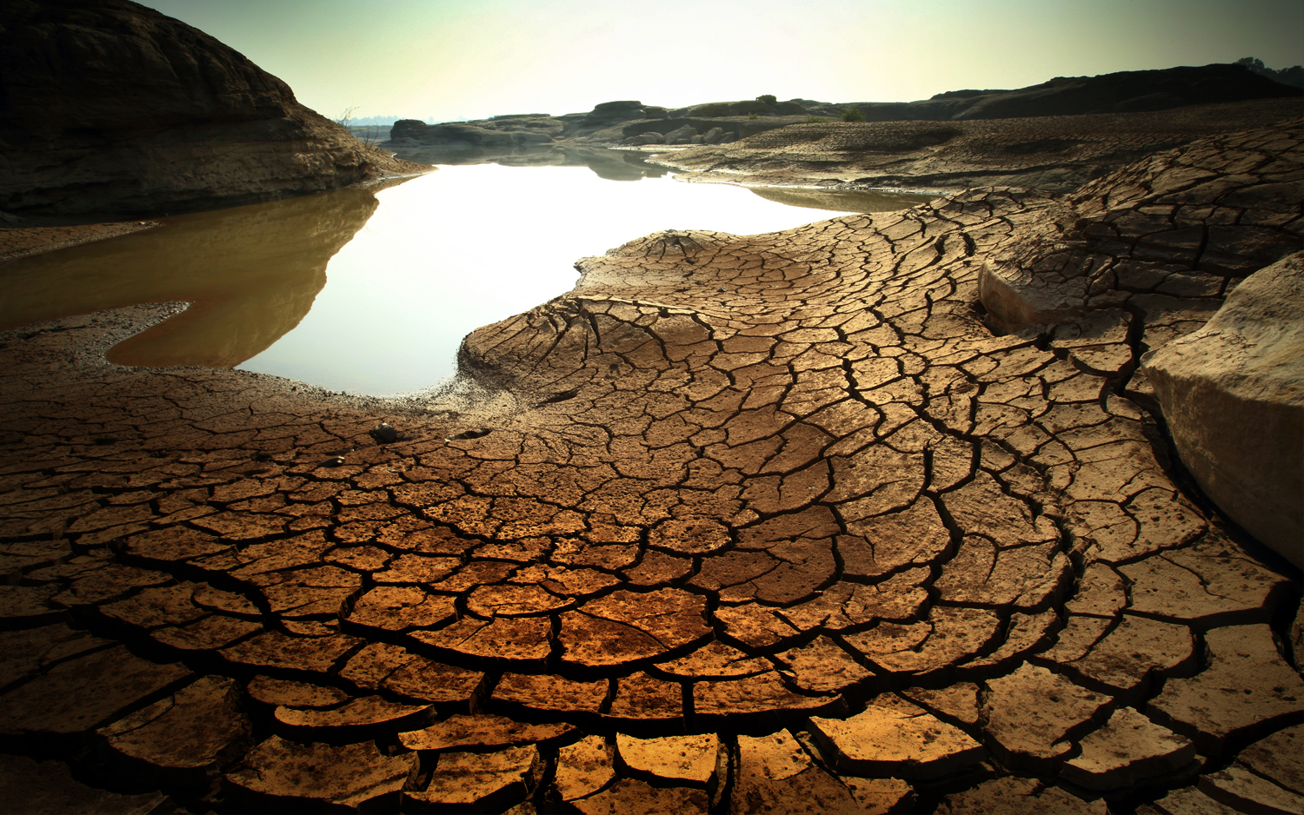
urban agriculture
waste
carbon
genetics
over & under consumption
technology
climate change &
property rights
better practices
agriculture
degraded land

Slide 17
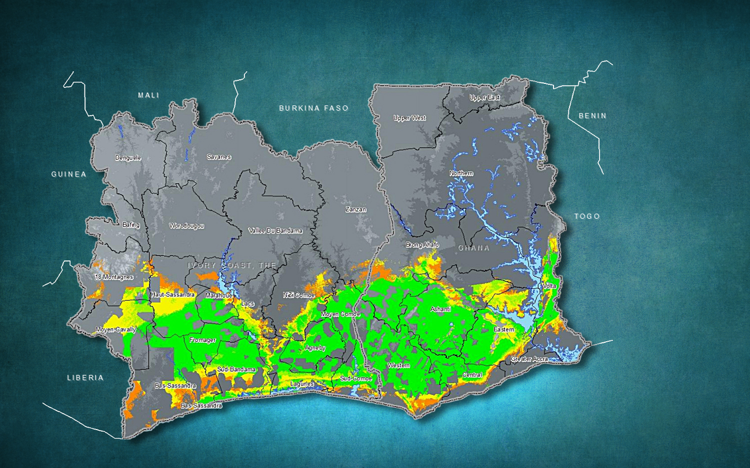
Suitability of cocoa production
Current
Suitability
Barely
Marginal
Good
Very good
Excellent
Source: Armando Isaac Martinez, a.i.martinez@cgiar.org; Narioski Castro

Slide 18
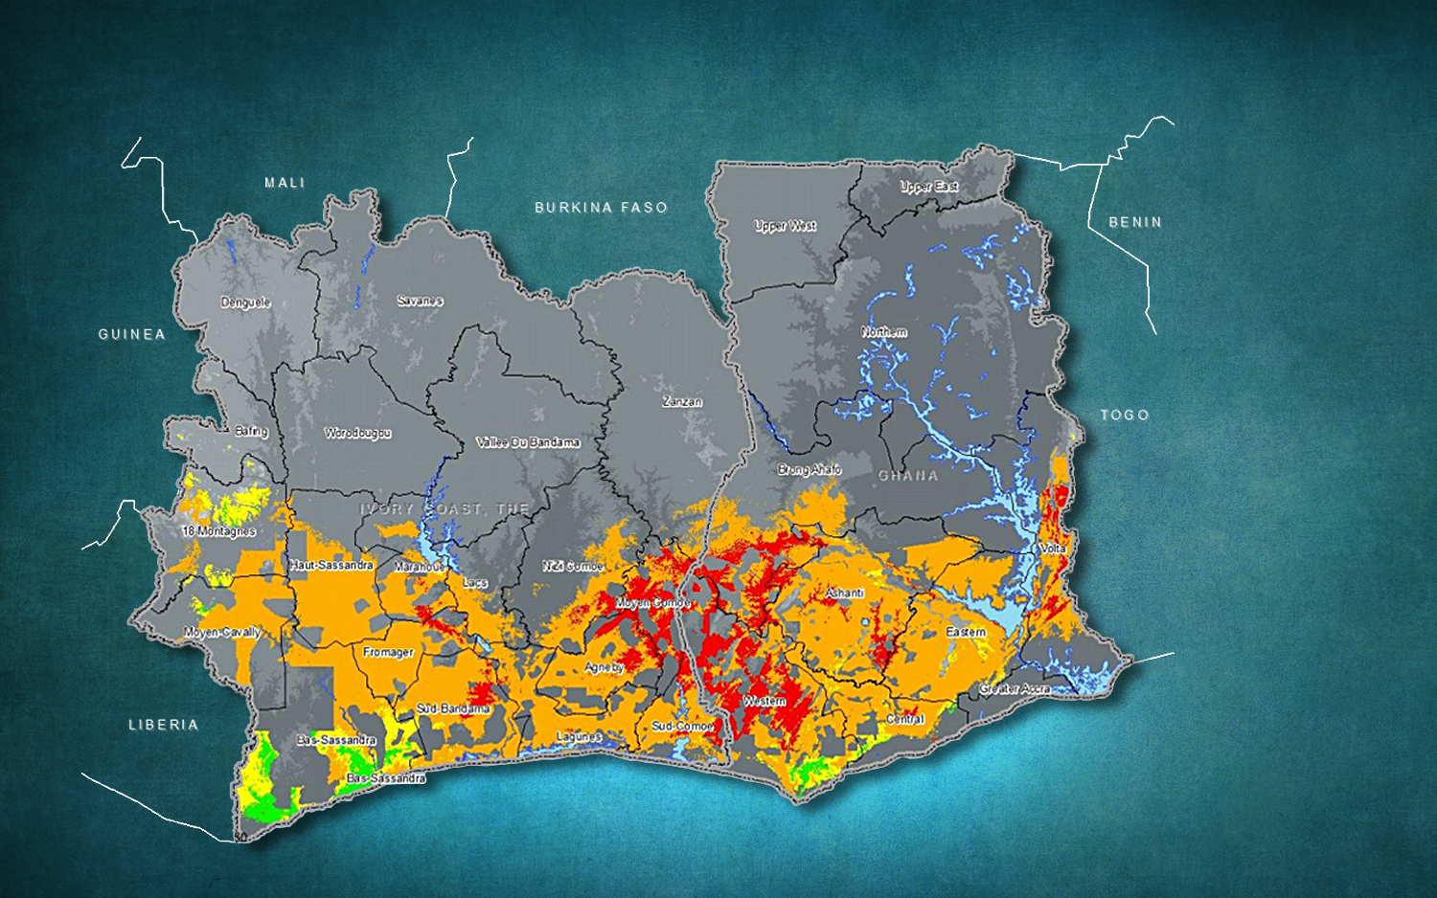
Suitability of cocoa production
2030
Suitability Change
Much less
Less Suitable
No Change
More Suitable
Source: Armando Isaac Martinez, a.i.martinez@cgiar.org; Narioski Castro

Slide 19
in the short term
climate smart agriculture =
efficient production

Slide 20
in the medium term, producers change crops

Slide 21
Use the system to change it (long-term contracts, pooled commitments)
purchases

Slide 22
think about it

