Slide 1
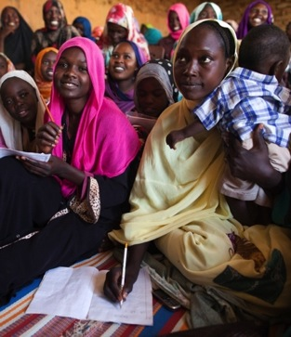
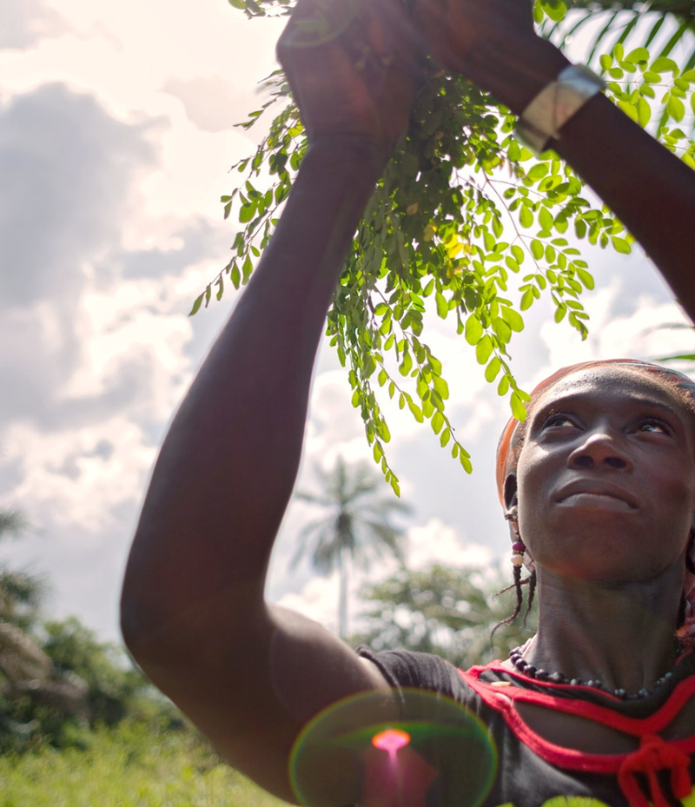
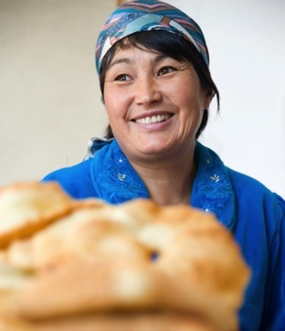
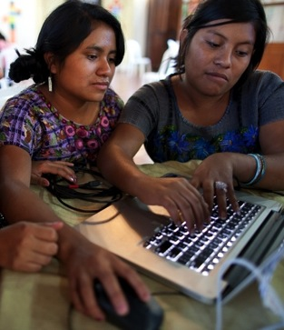
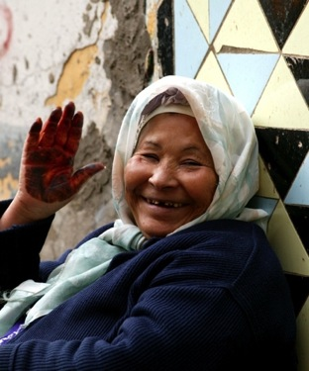
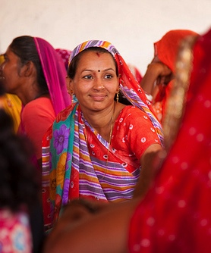

Advancing Gender in the
Post-2020 Period
Draft Outline of a new Gender Plan of Action

Slide 2
Overview
Rationale and basis for a new gender plan of action
Review of implementation of the 2015-2020 Gender Plan of Action
Consultations on gender in the post-2020 framework
Guiding ‘principles’ for the draft outline
Structure, key components of the draft outline
Guiding questions for initial feedback
Proposed consultation process
Q & A

Slide 3
Review of Implementation of the 2015-2020 Gender Plan of Action
Findings
Value of the Gender Plan of Action as a policy/advocacy tool;
Proposal for a new plan to be developed in a participatory and consultative manner
Need to advance national implementation
Need for clear, actionable and measurable gender-biodiversity objectives to support implementation, long-term investment and concerted action
Gender-responsive implementation in the post-2020 period will require gender to be fully mainstreamed in national biodiversity strategies and action plans (NBSAPs), integrated in the post-2020 review process, and addressed in national reporting
Full review document (CBD/SBI/3/2/ADD3) is available at:
https://www.cbd.int/meetings/SBI-03
Notes:
Need to build on project results to strengthen action at larger scales;
Need for further capacity development, the collection and analysis of sex-disaggregated data, adequate financing and reporting

Slide 4
Consultations on Gender in the Post-2020 Global Biodiversity Framework
Key recommendations
Increase women’s leadership, participation and access to decision-making fora, including through quotas to ensure women’s equitable representation;
Strengthen women's collective action;
Promote and protect women’s rights and access, control and ownership of resources, including land; and
Enabling actions to enhance and ensure equitable benefits and human well-being
Full workshop report is available at: https://www.cbd.int/conferences/post2020/gender

Slide 5
Draft Outline for a new gender plan of action
Guiding ‘principles’
Alignment with zero draft of the post-2020 global biodiversity framework
Target 20 - Equitable participation in decision-making, and ensure rights over relevant resources of indigenous peoples and local communities, women and girls, and youth
Gender-responsive implementation – national, sub-national and local
Focus on actions by Parties and engagement of all relevant stakeholders
Clear, actionable and measurable objectives
Alignment with SDGs and other relevant international commitments

Slide 6
Structure – Draft Outline
Section I: Draft Action Areas
Draft Action Areas, Objectives
Section II: Implementation Support Mechanisms
Draft Objectives
Section III: Responsibility and Transparency, Outreach, Awareness and Uptake
Draft Objectives
Coherence with relevant international commitments
Additional components: National and Sub-National Actions, and Main Actors
Draft Outline is available at:
https://www.cbd.int/sbi/review.shtml
Notes:
Additional components to be added as the plan is further developed include the identification of National and Sub-National Actions corresponding to the objectives, and main actors responsible for implementation of actions

Slide 7
Draft Outline
Draft Action Areas
Ensure equitable participation in decision-making related to biodiversity for women and girls
Ensure rights over relevant resources for women and girls
Ensure equitable benefits for women and girls
Implementation Support Mechanisms
Resources
Capacity-building
Generation and sharing of scientific knowledge
Partnerships and Collaboration
Responsibility and Transparency, Outreach, Awareness and Uptake
Review process
Monitoring and reporting
Outreach, awareness and uptake
Notes:
Objectives (aligned with Draft Action Areas):
Equal representation and leadership of women in biodiversity-related governance bodies at all levels
Enhanced engagement of women’s groups and women delegates in CBD processes
Gender-responsive development, revision, implementation and monitoring of national biodiversity strategies and action plans (NBSAPs), including gender-responsive project planning and reporting
--
Legal and societal barriers to women’s access, ownership and control over land and other biological resources are removed
Reduced risks to women environmental defenders, and of gender-based violence in the context of biodiversity conservation and sustainable use
--
Women and men have equal access to benefits associated with biodiversity conservation and sustainable use, and from the utilization of genetic resources
Increased paid employment opportunities for women in biodiversity-related sectors

Slide 8
Questions to consider in providing input
Guiding Questions – Draft Outline and Review Template
https://www.cbd.int/sbi/review.shtml
Section I: Draft Action Areas
Are priority gender-biodiversity issues well reflected?
Are there other priorities you would propose as action areas or objectives?
Section II: Implementation Support Mechanisms
Are there other related objectives you would propose?
Section III: Responsibility and Transparency, Outreach, Awareness and Uptake
Are there other topics or related objectives you think are important to include?
Deadline for initial feedback – August 31
Consultation process continues at SBI- 3, and through to COP 15
Notes:
Section I: Draft Action Areas
Do the draft action areas reflect priority gender-biodiversity issues in your country or region?
Are there other action areas you would propose as priorities for addressing gender and biodiversity issues in your country or region?
Do the draft objectives reflect priority gender-biodiversity issues in your country or region?
Are there other objectives you would propose that are important for gender and biodiversity in your country or region?
Section II: Implementation Support Mechanisms
Are there other objectives related to Implementation Support that you think are important for the work of your government or organization on gender and biodiversity?
Section III: Responsibility and Transparency, Outreach, Awareness and Uptake
Are there other topics that are important to the gender-biodiversity work of your government or organization that you think should be added to this list?
Are there other objectives related to these topics that you think are important for the work of your government or organization on gender and biodiversity?

Slide 9
Consultation Process
Initial Consultation – to August 31, 2020
Inputs on Priority Action Areas and Objectives
Preparation of revised Outline for review (SBI-3 – November 2020)
Inputs on revised Outline
Request for input on national and sub-national actions, main actors
Review of draft plan, including national and sub-national actions
Presentation of proposed plan to COP15 for adoption
Ongoing – inputs into development of post-2020 global biodiversity framework, including goals, targets and indicators
Best Practices Review – identification of relevant actions for the post-2020 period

Slide 10
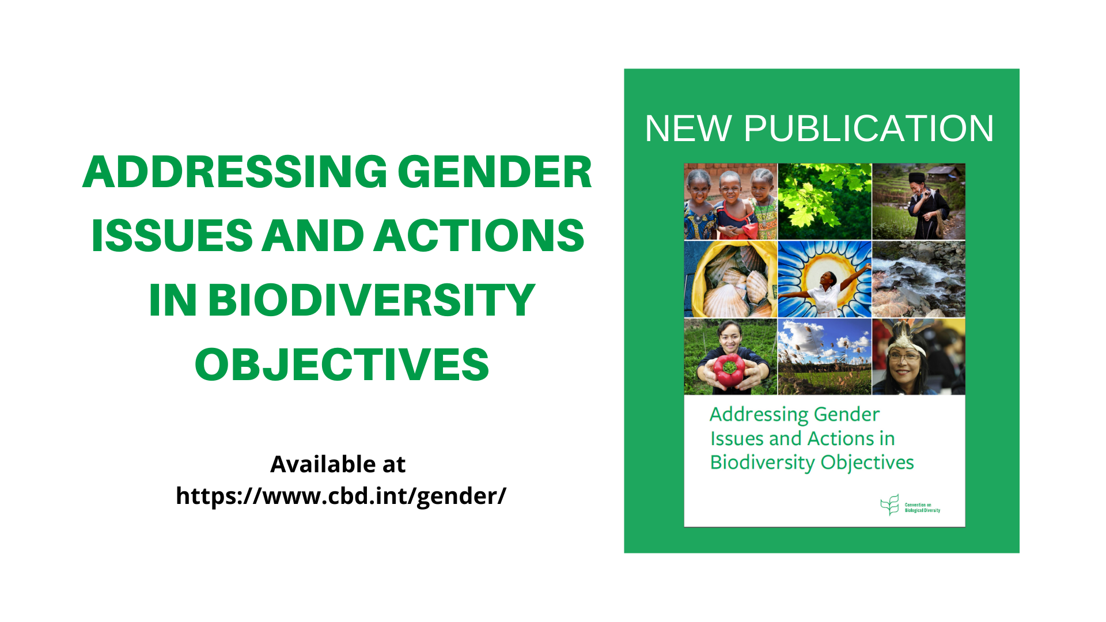

Slide 11
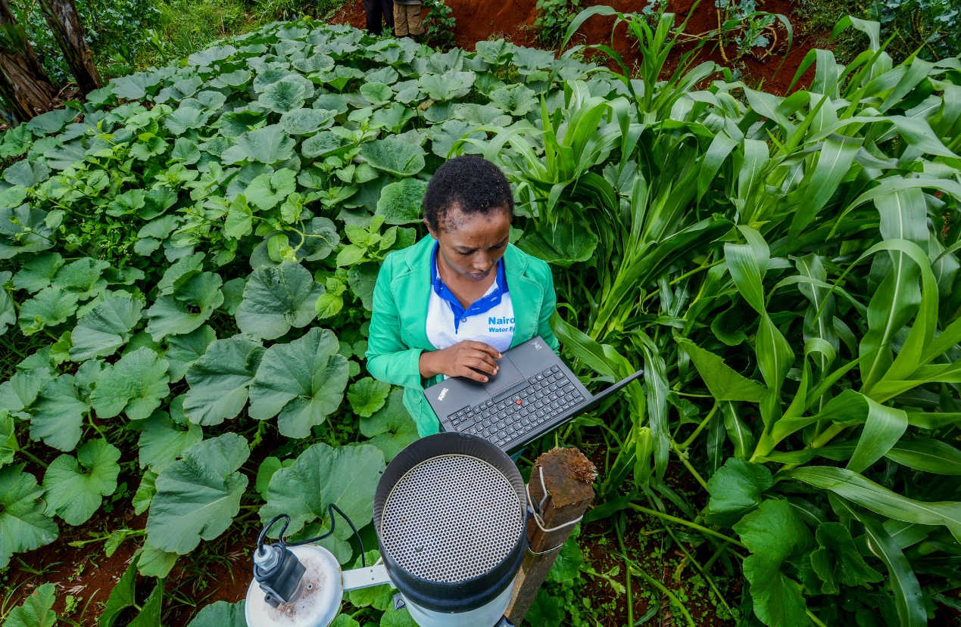
Questions and Answers
Structure of the Draft Outline
Types of Input Requested
Consultation Process
Notes:
Is the Structure of the Draft Outline, and the three sections clear?
Is it clear what type of input is requested in this initial consultation?
Is the proposed consultation process understood?

