Slide 1
CHM Knowledge Fair — Poster Guidelines
Please Read THIS FIRST: Instructions and Guidelines on how to complete and export your poster | Do not submit it as part of the final poster.
Please Use Slide 4 only as your actual poster template.
Replace every placeholder with your own content, then export Slide 2 only as a print-ready PDF.
Slides 1, 2 and 3 are guidance slides and should not be submitted. Slide 5 is a sample/example poster created for visual guidance and should not be submitted
1. Focus on Telling a clear CHM story
2. Fill the compulsory results section
Choose strong examples rather than trying to report everything. Focus on a practical change, tool, service, workflow, partnership or lesson that others can understand and adapt.
The lower part of the poster is mandatory. Explain: what changed because of the CHM, what was learned, what other Parties can adapt, and what support or partnerships are needed next.
3. Select optional theme(s)
4. Use evidence and visuals
You may highlight one or more optional themes: governance, portal/website management, content and knowledge assets, interoperability, stakeholder engagement, and innovation/future readiness.
This is important: Include screenshots, maps, workflows, charts, usage statistics, before/after examples, or concrete outputs. Keep text short. The poster should be readable from 1–2 metres. This can make the poster visually appealing
5. Keep the reserved areas clear
6. Export correctly
Do not place essential content in the top-right or bottom-right reserved areas. The Secretariat may use these areas for a poster number, QR code or display label.
A1 portrait. Submit as PDF. Use high-resolution images where possible. Embed fonts. Confirm that maps, photos, data and logos can be publicly displayed.
Suggested writing formula
Challenge → Approach → Evidence of use → Results → Lessons → Replication potential → Support/partnership needs
Visual guidelines
Common mistakes to avoid
Title: size 40
Text on the poster: 24-30 font size
Color: use strong contrast to ensure text is readable.
Screenshots: use at least 2–4 meaningful visuals, screenshots
References/links: keep to the most important resources. Generate QR codes using tools like www.qr.io so that users looking at poster can visit the resources.
Use colors in a aesthetically appealing way so that poster doesn’t look too much busy or difficult to read
Do not paste a full report into the poster.
Do not use small fonts or dense tables.
Do not submit an expression of interest or draft through the submission form.
Do not include content for which public display rights are unclear.
Do not cover the QR/poster-number reserved areas.
After completing Slide 4: File → Save As → Create PDF/XPS → Options → publish only Slide 2, or delete the instruction slides before export.
Template prepared for CHM Knowledge Fair | COP 17

Slide 2
CHM Knowledge Fair — Theme Guide
Use this slide as guidance only. Do not submit it as part of the final poster.
COMPULSORY: Mandatory theme: results, lessons and replication potential
Every poster must try to answer these four questions:
1. What changed because of the CHM?
2. What was learned?
3. What could other Parties adapt?
4. What support or partnerships are needed next?
This is the core value of the poster. It helps the Knowledge Fair remain practical and useful for peer learning.
Suggested Themes
CHM governance and management
Strategy or roadmap; institutional roles; dedicated staffing or funding; coordination committee; national collaboration; facilitation of technical and scientific cooperation; systems to mobilize/gather information from multiple sources.
CHM portal and website management
Portal functionality; contributor model; use of biodiversity taxonomies, terminology and metadata; analytics and usage statistics; interoperability with national or global databases; content approval workflows.
Content and knowledge assets
Information on national biodiversity; progress towards national and global targets; implementation activities; legislation; cooperation and networking; scientific and technical references; case studies, reports, news, events and links.
Interoperability and data exchange
APIs, metadata standards, controlled vocabularies, data harvesting, links between national CHM and the central CHM, ABSCH, BCH or other relevant systems.
Whole-of-government and whole-of-society engagement
Use of the CHM to connect ministries, scientific institutions, indigenous peoples and local communities, civil society, academia, youth, business and other stakeholders, as appropriate.
Innovation and future readiness
Use of dashboards, maps, visualization, artificial intelligence, machine learning, natural language processing, multilingual services or other digital methods to improve discoverability and use.
Note: Submitters are not expected to cover every optional theme. A focused poster with clear results and lessons is preferable to a dense poster that tries to include everything.

Slide 3
Final Export and Submission Checklist
Complete these checks before exporting the poster as PDF.| Do not submit it as part of the final poster.
Content checklist
Design checklist
☐ Poster tells clear CHM story
☐ Compulsory results section is complete
☐ one optional theme. If being used, is highlighted
☐ Evidence of use or impact is included
☐ Lessons and replication potential are clear
☐ Support/partnership needs are stated
☐ Title is short and specific
☐ Text is readable from 1–2 metres
☐ Main visual is clear and high-resolution
☐ Dense paragraphs and small tables are avoided
☐ Top-right poster ID area is clear
☐ Bottom-right QR area is clear
Technical checklist
Rights and permissions
☐ Slide size is A1 portrait
☐ Final file is exported as PDF
☐ Images are high resolution where possible
☐ Important content is kept away from edges
☐ Maps are appropriate for public display
☐ Photographs can be used publicly
☐ Logos are authorized
☐ Data and screenshots can be shared
☐ Sensitive or confidential information is excluded
☐ Contact details are correct
How to export only the poster slides
Option A: Delete Slides 1, 3 and 4, then export the remaining poster slide as PDF.
Option B: Use File → Print → Print as PDF/XPS → Options → publish only Slide 4.
Check the PDF before submitting it through the CHM submission form.
Recommended poster size: A1 portrait — 594 mm × 841 mm.
This template uses placeholders only. Please replace them with your own approved content before submission.

Slide 4
CHM Knowledge Fair | COP 17
Flag/authorized logo
Poster language:
Contact with email ID
CHM / website link:
SAMPLE
POSTER
Name of the Party/Organization
POSTER TITLE: (use font size 40)
One-sentence summary:
Optional theme(s) highlighted — select one or more:
☐ Governance
☐ Portal / website
☐ Content assets
☐ Interoperability
☐ Engagement
☐ Innovation
1. Challenge or opportunity
3. Main visual: show the CHM example
What CHM / knowledge-management challenge or opportunity was addressed?
Replace this placeholder with a screenshot, map, workflow, dashboard, data flow, photo, timeline or diagram.
Use this space to make the poster understandable at a glance.
2. Approach / solution
What was developed or strengthened?
Tip: give short explanations with each screenshot to explain its purpose
4. Implementation partners
5. Evidence of use / impact
6. Useful resources / links
Who was involved?
List key ministries, agencies, scientific institutions, communities, partners, networks or other stakeholders. Explain roles briefly.
Add 2–4 concrete indicators or examples.
Examples:
• number of users / contributors
• datasets or pages published
• institutions connected
• training participants
• data exchanged
• decisions or workflows supported
Add 2–4 links or QR-friendly resources.
Examples:
• national CHM URL
• dashboard or database
• guidance or training material
• case study or report
Key message for other Participants
In one or two sentences, explain the main lesson other Parties should remember from this example.
COMPULSORY SECTION — Results, lessons and replication potential
What changed because of the CHM?
What was learned?
What could other Parties adapt?
What support or partnerships are needed next?
Describe the practical difference made by the CHM or information service.
Example: better access, improved coordination, faster reporting, increased use, more contributors, stronger cooperation.
Share 2–3 lessons from implementation.
What worked? What was difficult? What would you do differently?
Explain what is reusable by others.
Example: template, workflow, data model, governance approach, training method, partnership model, interoperability method.
Identify next steps and possible cooperation needs.
Example: technical support, capacity-building, funding, data partnerships, regional exchange, interoperability assistance.
Footer: Add acknowledgements, partner logos, or a short disclaimer if needed. Keep this area clean and readable. Do not place essential content in the QR area.
QR CODE AREA
Secretariat use
Submission reminder: export this poster slide as a print-ready PDF. Confirm that all images, maps, logos and data can be displayed publicly.

Slide 5

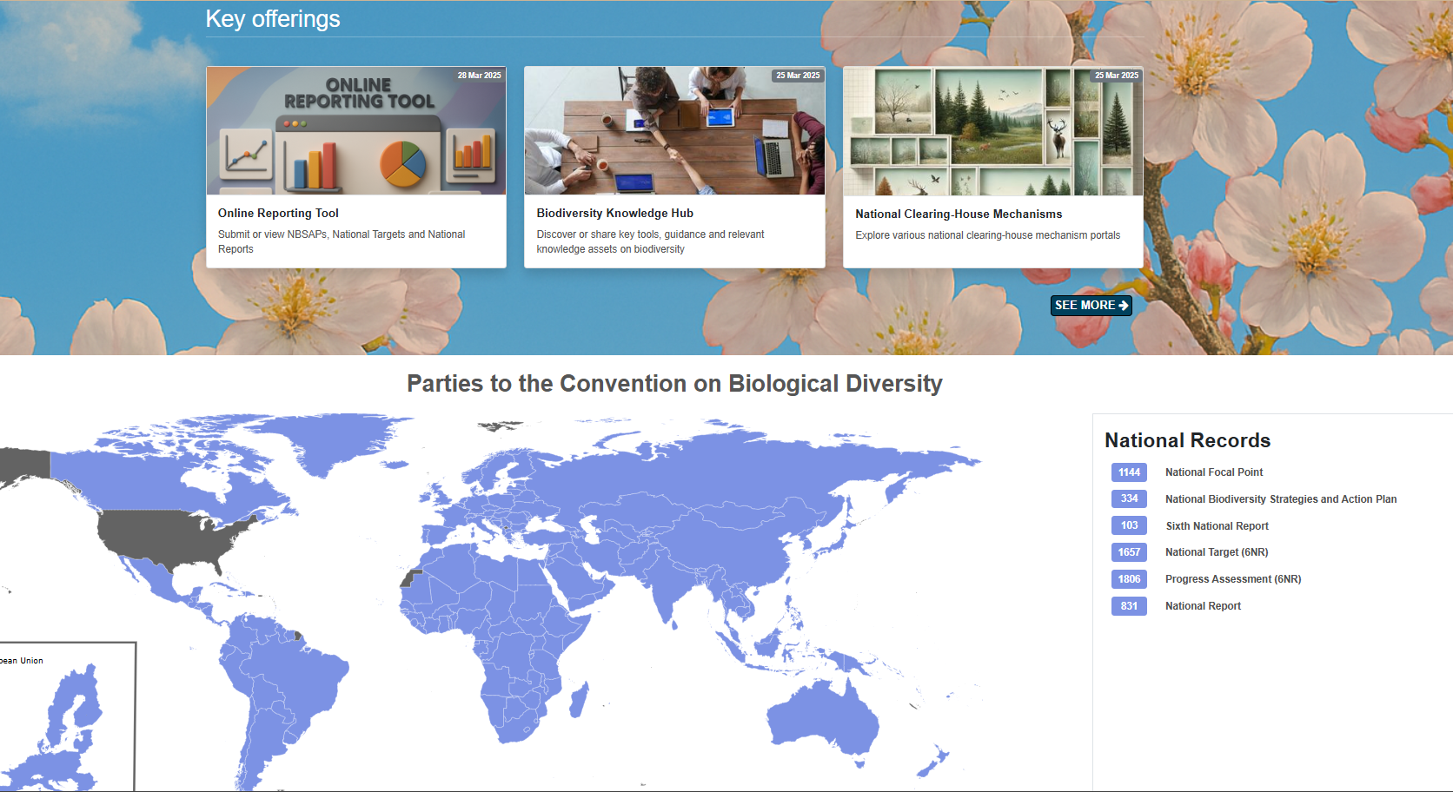
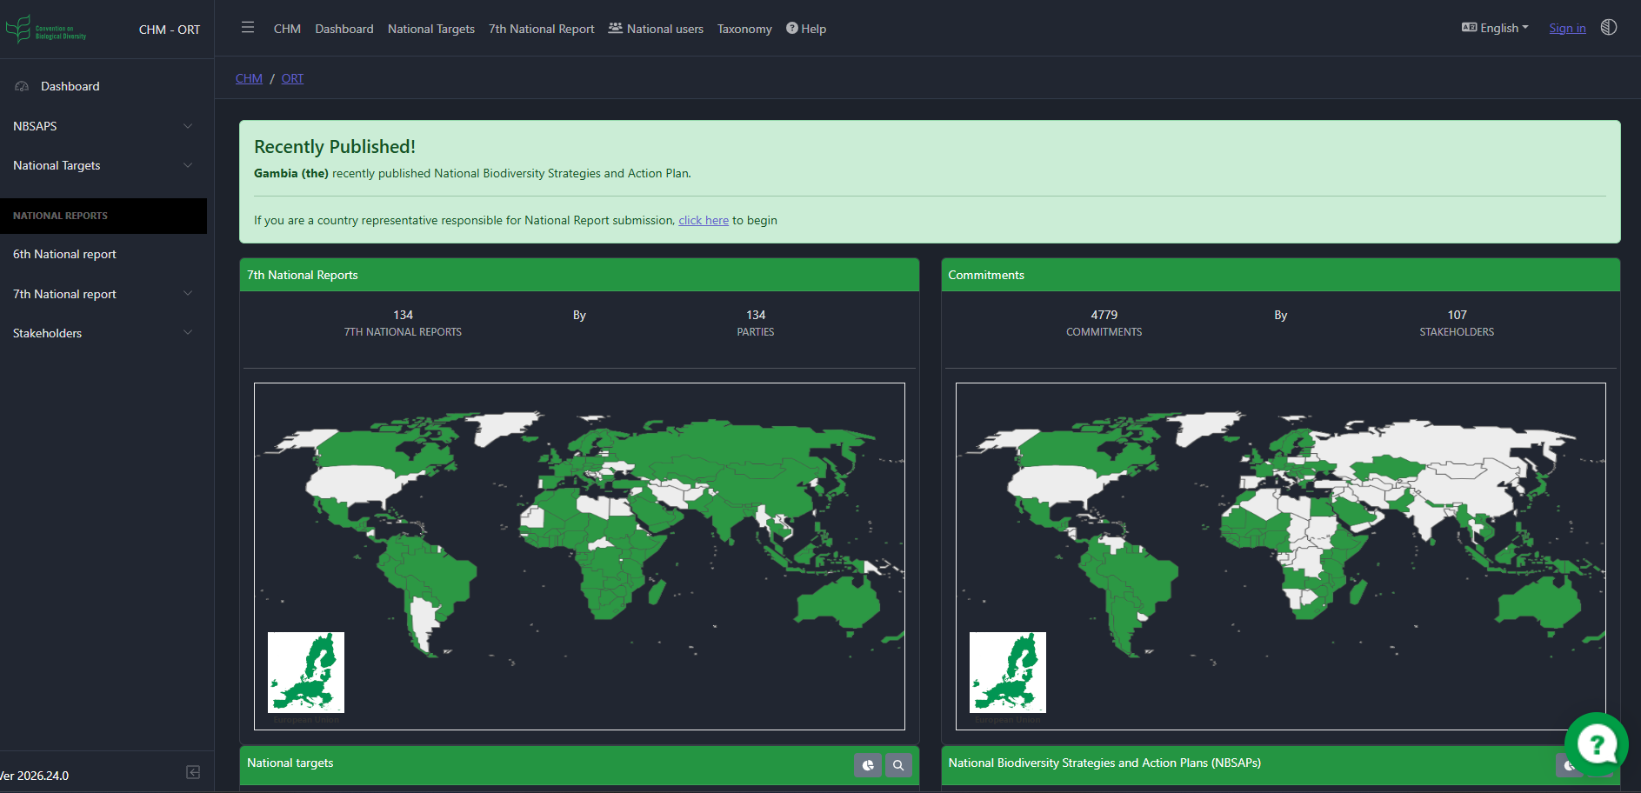
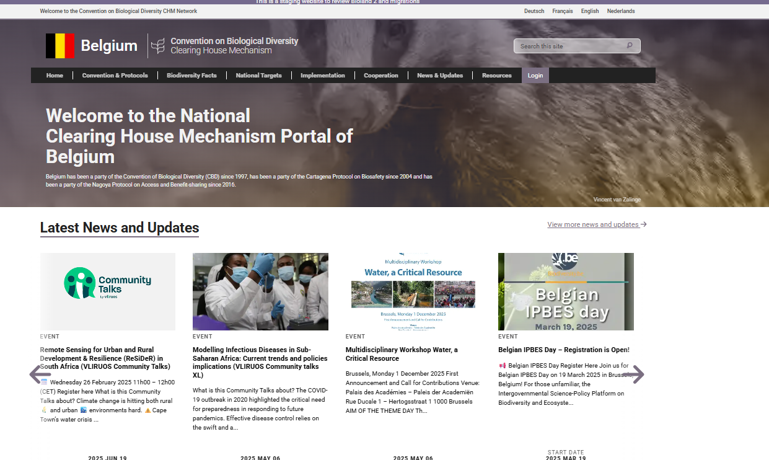
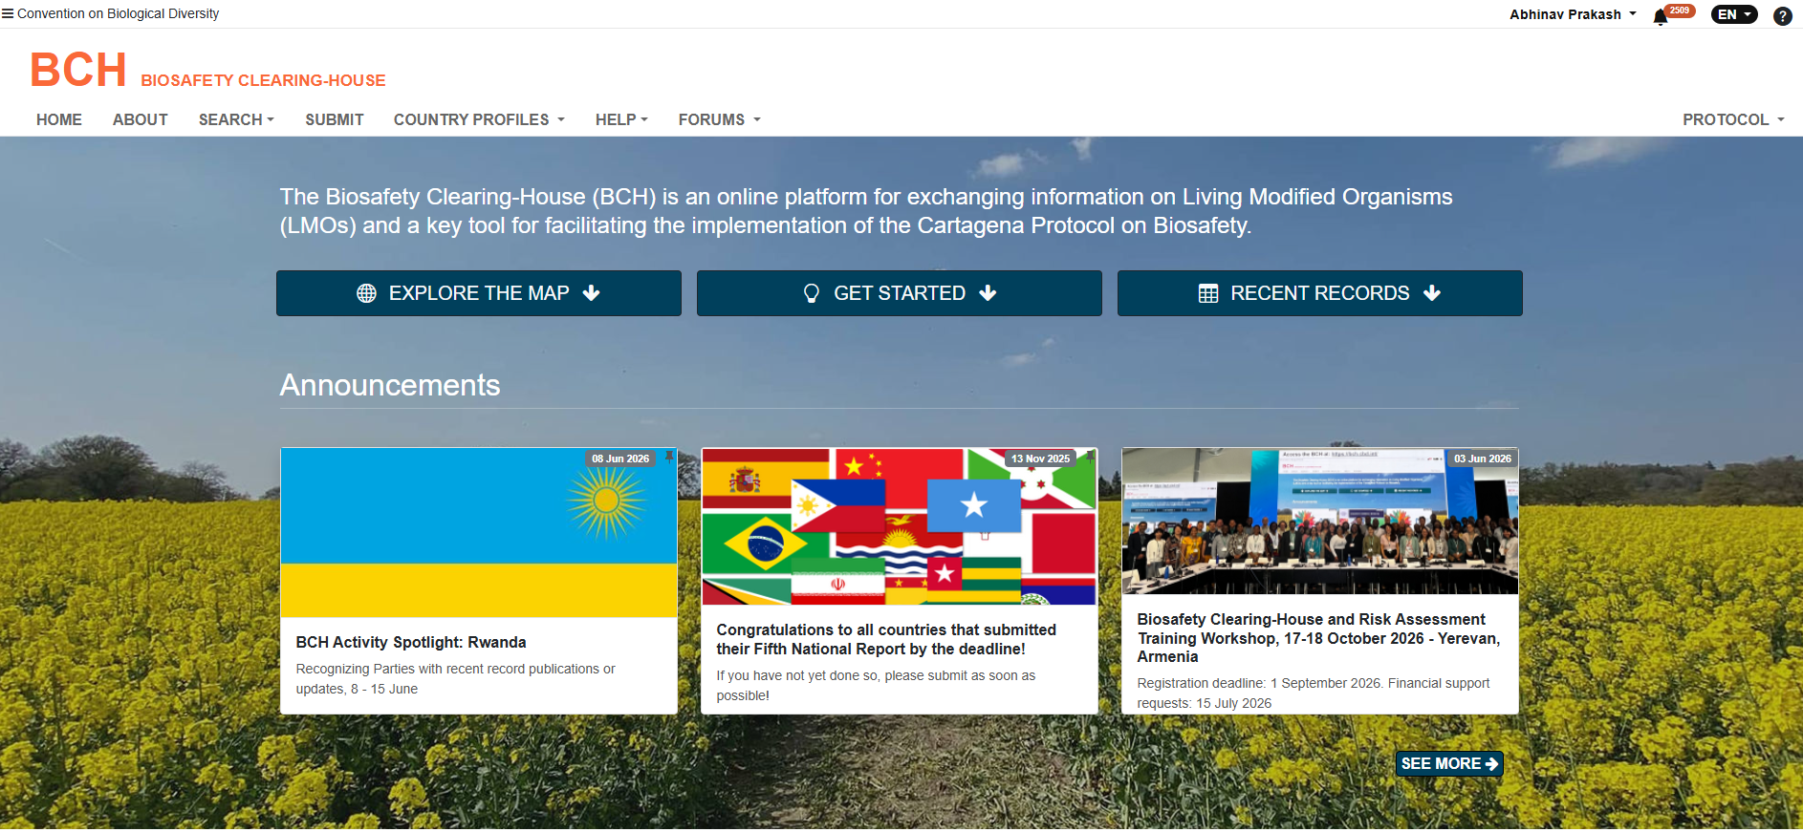
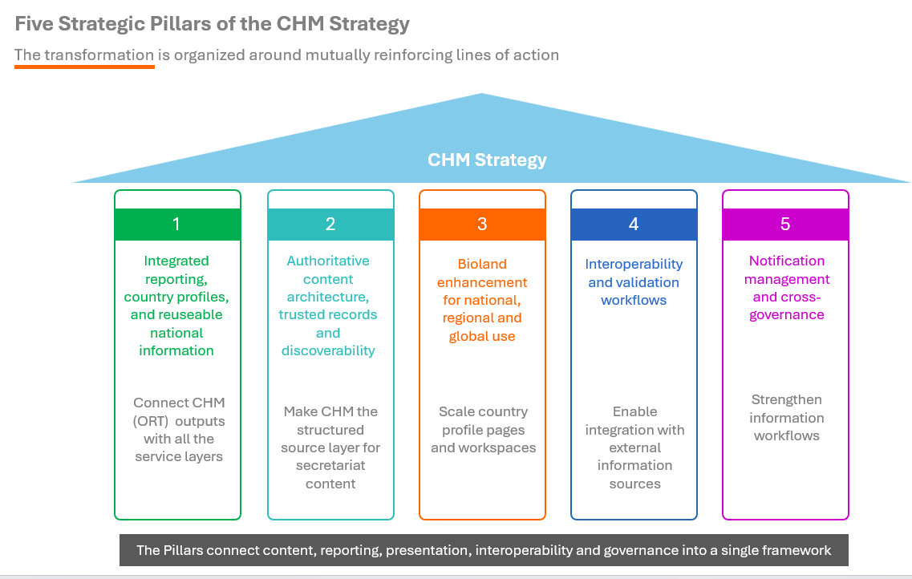
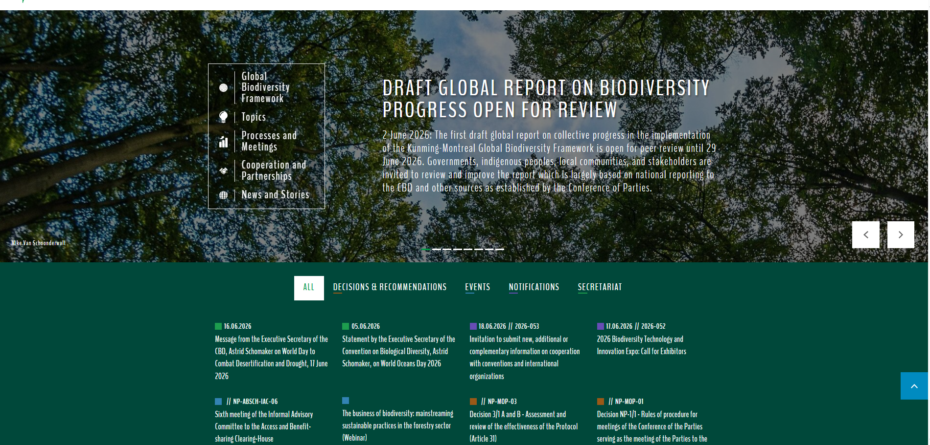
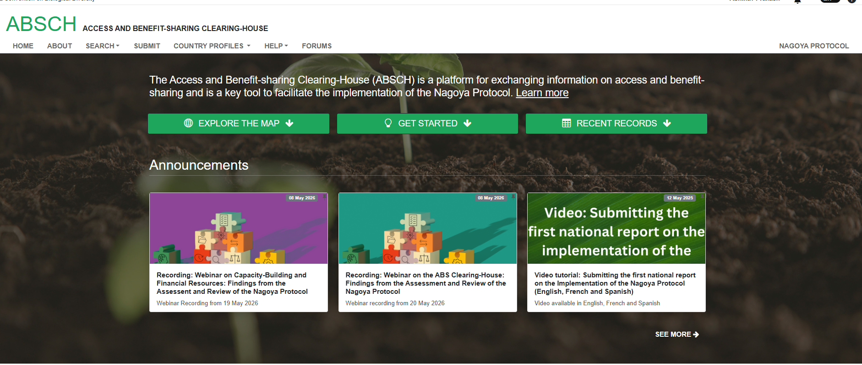
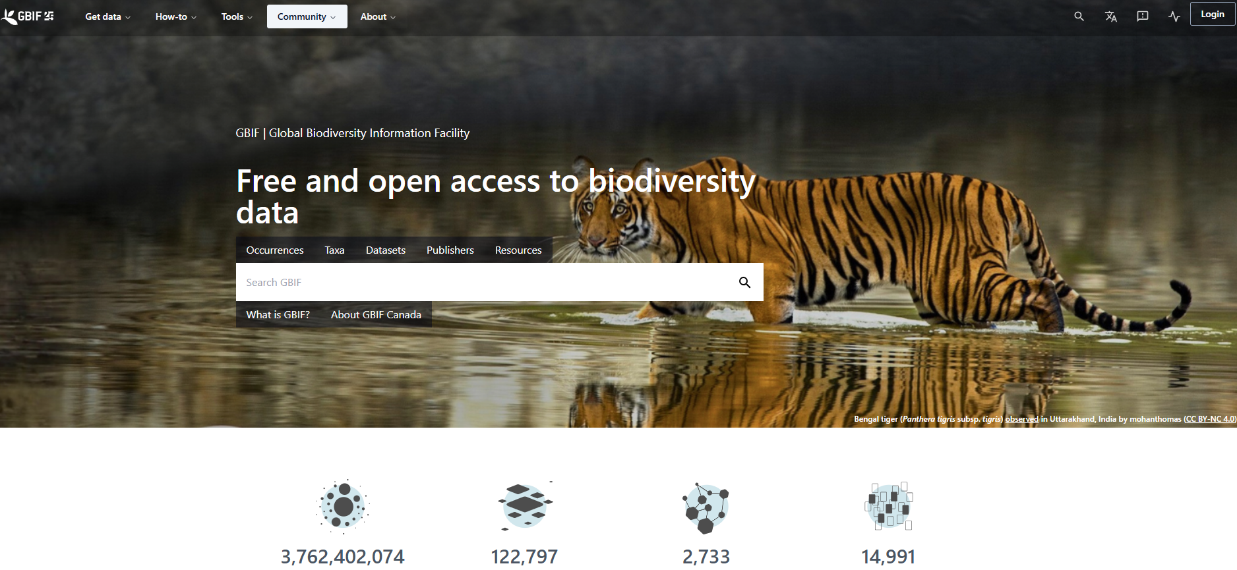
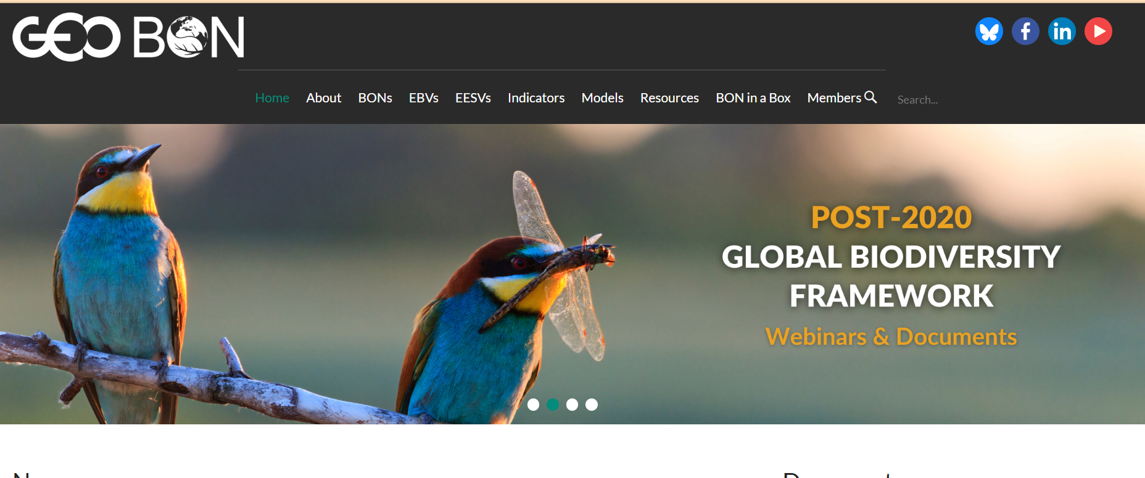



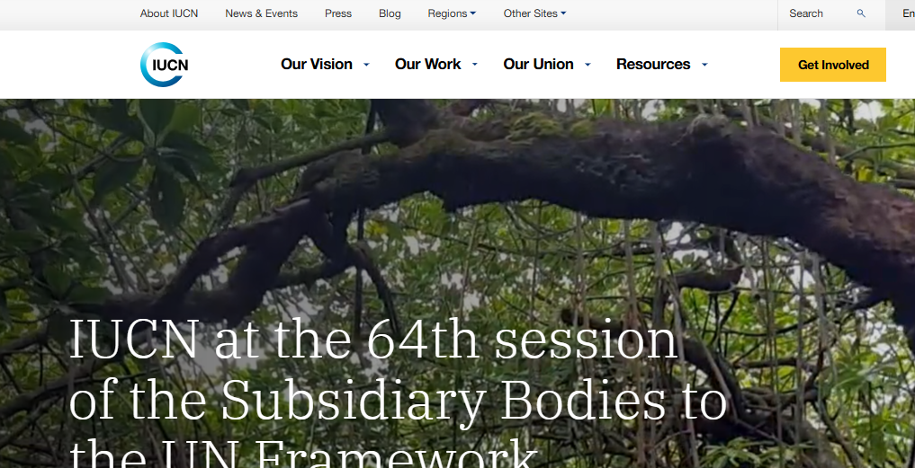
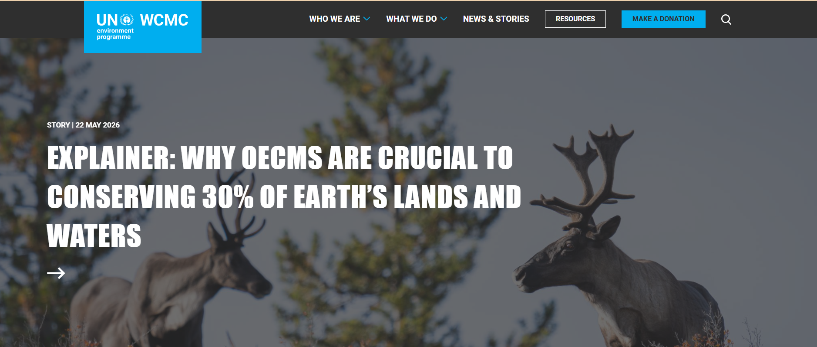
CHM Knowledge Fair | COP 17
Poster language: English
Contact: Abhinav Prakash, Information management Officer, abhinav.Prakash@un.org
CHM / website link: https://chm.cbd.int/en/
SAMPLE
POSTER
CBD Secretariat
Improving Knowledge management and Information sharing through CHM portal
One-sentence summary: This poster will highlights the progress made towards knowledge management and information sharing through the CHM portal
Optional theme(s) highlighted — select one or more:
☐ Governance
☐ Portal / website
☐ Content assets
☐ Interoperability
☐ Engagement
☐ Innovation
1. Challenge or opportunity
3. Main visual: show the CHM example
What CHM / knowledge-management challenge or opportunity was addressed?
Disaggregated knowledge and information sources, uncategorized information,
Replace this placeholder with a screenshot, map, workflow, dashboard, data flow, photo, timeline or diagram.
2. Approach / solution
What was developed or strengthened?
Enhancement of CHM Portal
Strengthening of Online Reporting Tool
Development of Bioland Tool
Strengthening of Taxonomy
Strengthening of Interoperable
This is an Example
4. Implementation partners
5. Evidence of use / impact
6. Useful resources / links
GBIF
GEOBON
3400 national targets published on ORT
126 national reports published on ORT
700 submissions by parties and partners on CHM portal
200 new organizations registered on CHM portal
3 KM4B workshops organized involving 150 participants
34 Bioland 2.0 portals released
CHM Portal
ORT
CBD Website
IUCN
UNEP WCMC
Key message for other Participants
Strategic alignment with KMGBF goals and targets
Focused partnerships to build on shared expertise and experience
User centric design for improved user experience and accessibility
Consistent application of meta-tags and taxonomy for information findability and discoverability
COMPULSORY SECTION — Results, lessons and replication potential
What changed because of the CHM?
What was learned?
What could other Parties adapt?
What support or partnerships are needed next?
Improved accessibility to information submitted by Parties and organizations
Data clean-up and organization is critical for the information to be useful
Training help and capacity building is important to ensure all stakeholders can use the information effectively
The taxonomy framework created by Secretariat can be used by all the Parties and organizations to organized biodiversity related information and knowledge
Further adoption and use of Bioland 2.0 by Parties
Development of APIs by relevant organizations for data sharing with the Secretariat
Footer: Add acknowledgements, partner logos, or a short disclaimer if needed. Keep this area clean and readable. Do not place essential content in the QR area.
QR CODE AREA
Secretariat use
Submission reminder: export this poster slide as a print-ready PDF. Confirm that all images, maps, logos and data can be displayed publicly.

