Slide 1
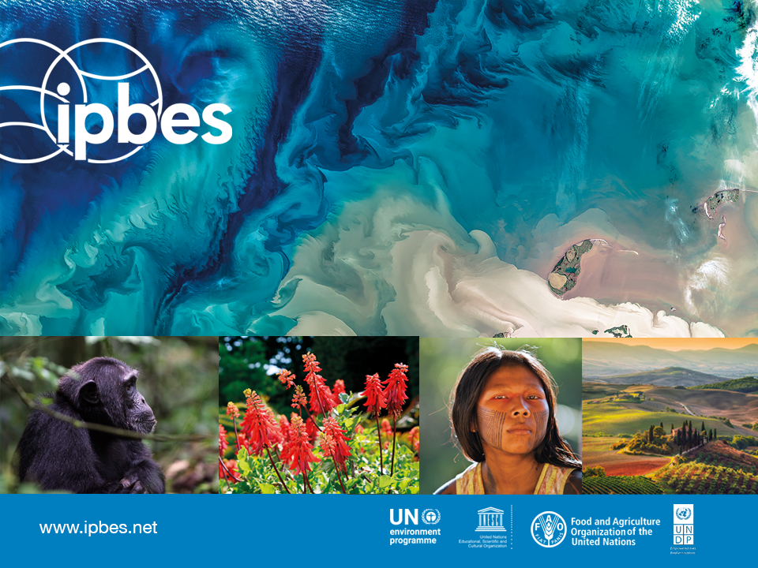
IPBES #PandemicsReport:
Escaping the ‘Era of Pandemics’ https://ipbes.net/pandemics

Slide 2
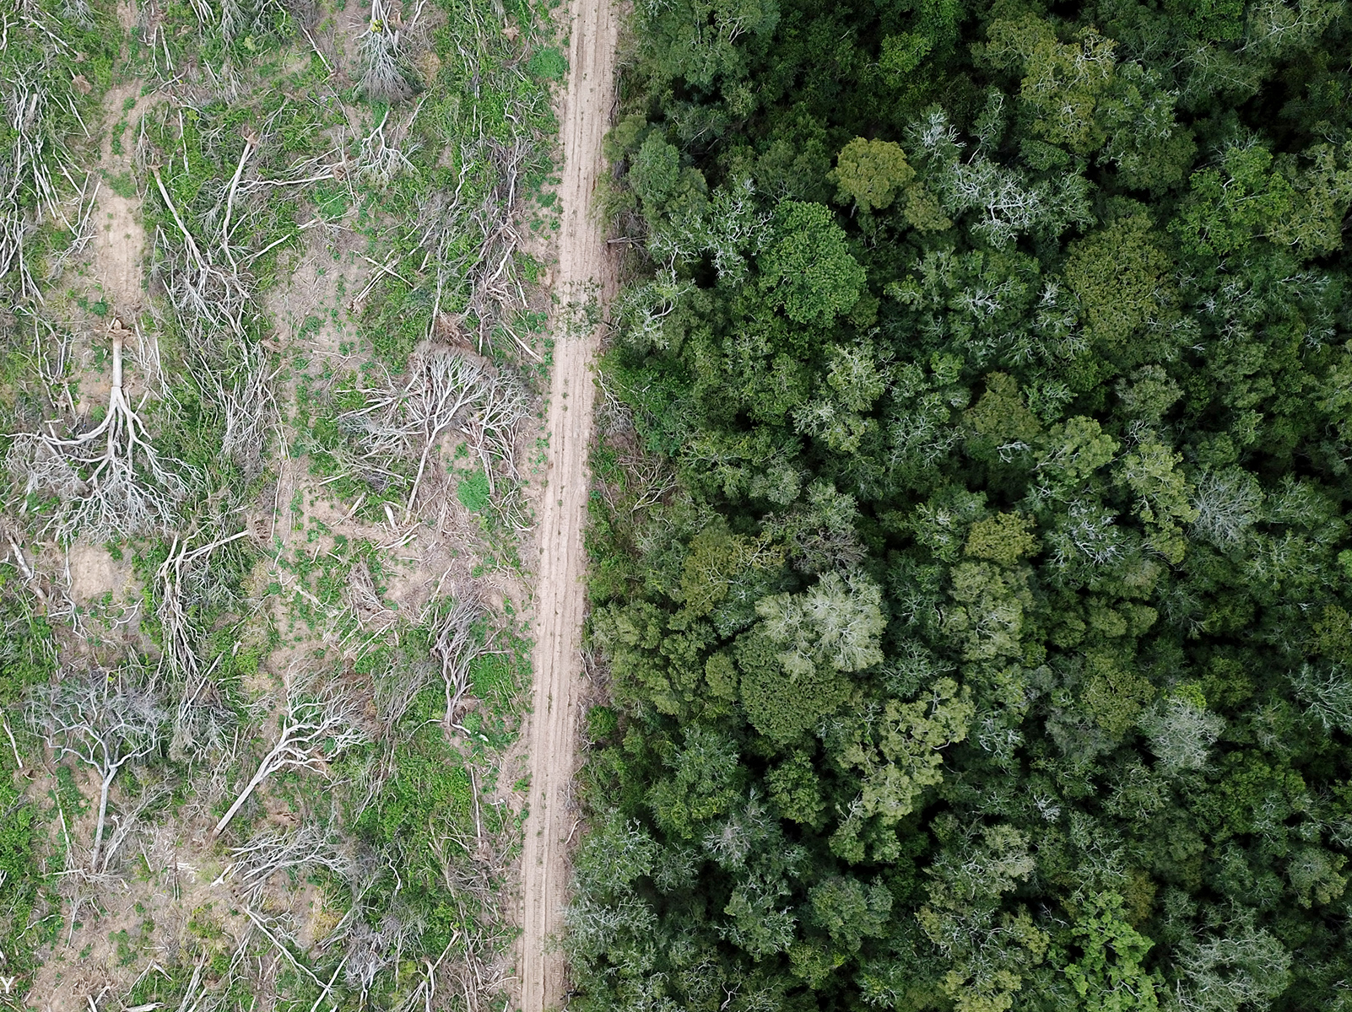
We can escape the Pandemic Era, but it will require a
seismic shift
from reaction
to prevention.

Slide 3

Almost All Pandemics of the Modern Era Are Caused by Zoonoses
COVID-19
HIV/AIDS
Ebola
Zika
SARS
Influenza A (H1N1/H2N2)
Notes:
Around 75% of new and emerging diseases are zoonoses
While the viruses behind these major health threats come from animals … the cause of their spread is entirely human [next slide]

Slide 4
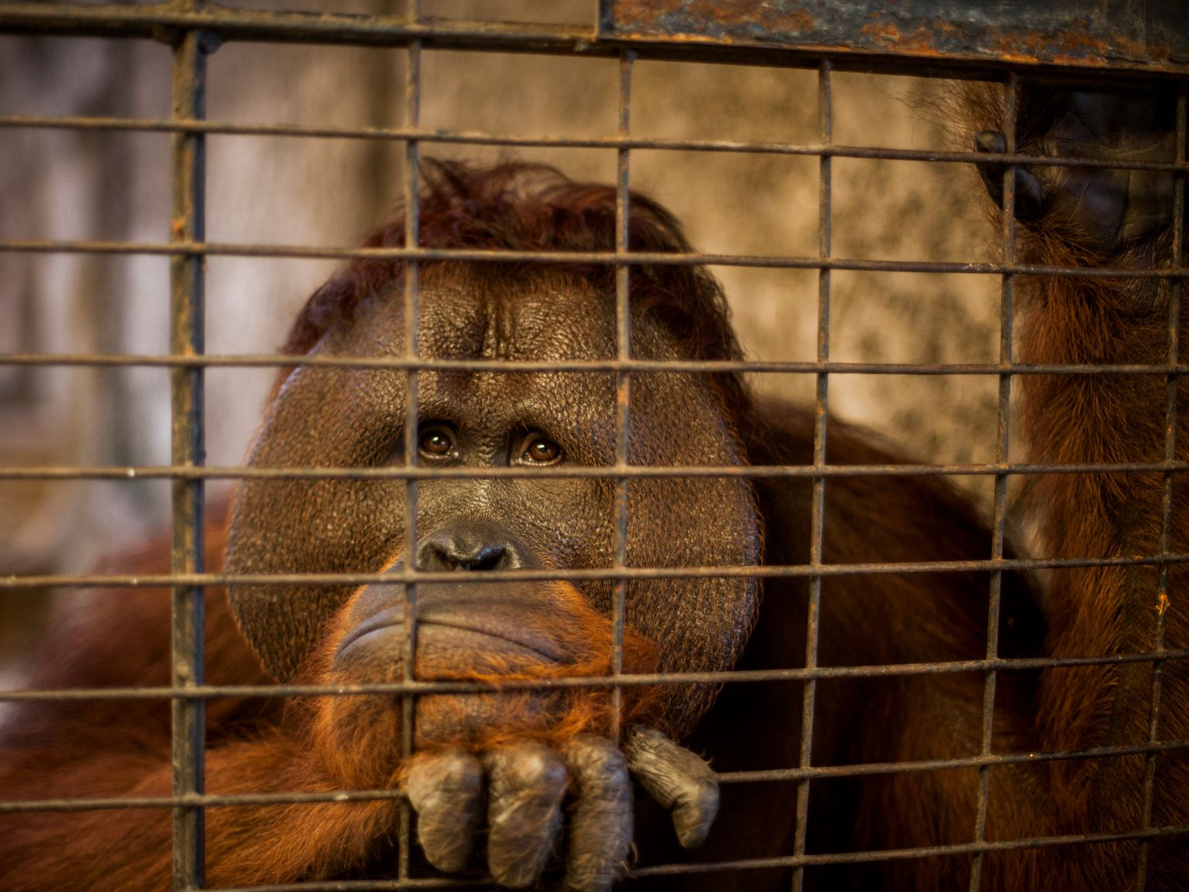
Drivers of Disease
Land-use change
  Deforestation
  Urbanization
Agricultural expansion and intensification
Wildlife trade and consumption
Notes:
Peter not sure if you want to swap out the middle bullet for climate change?

Slide 5
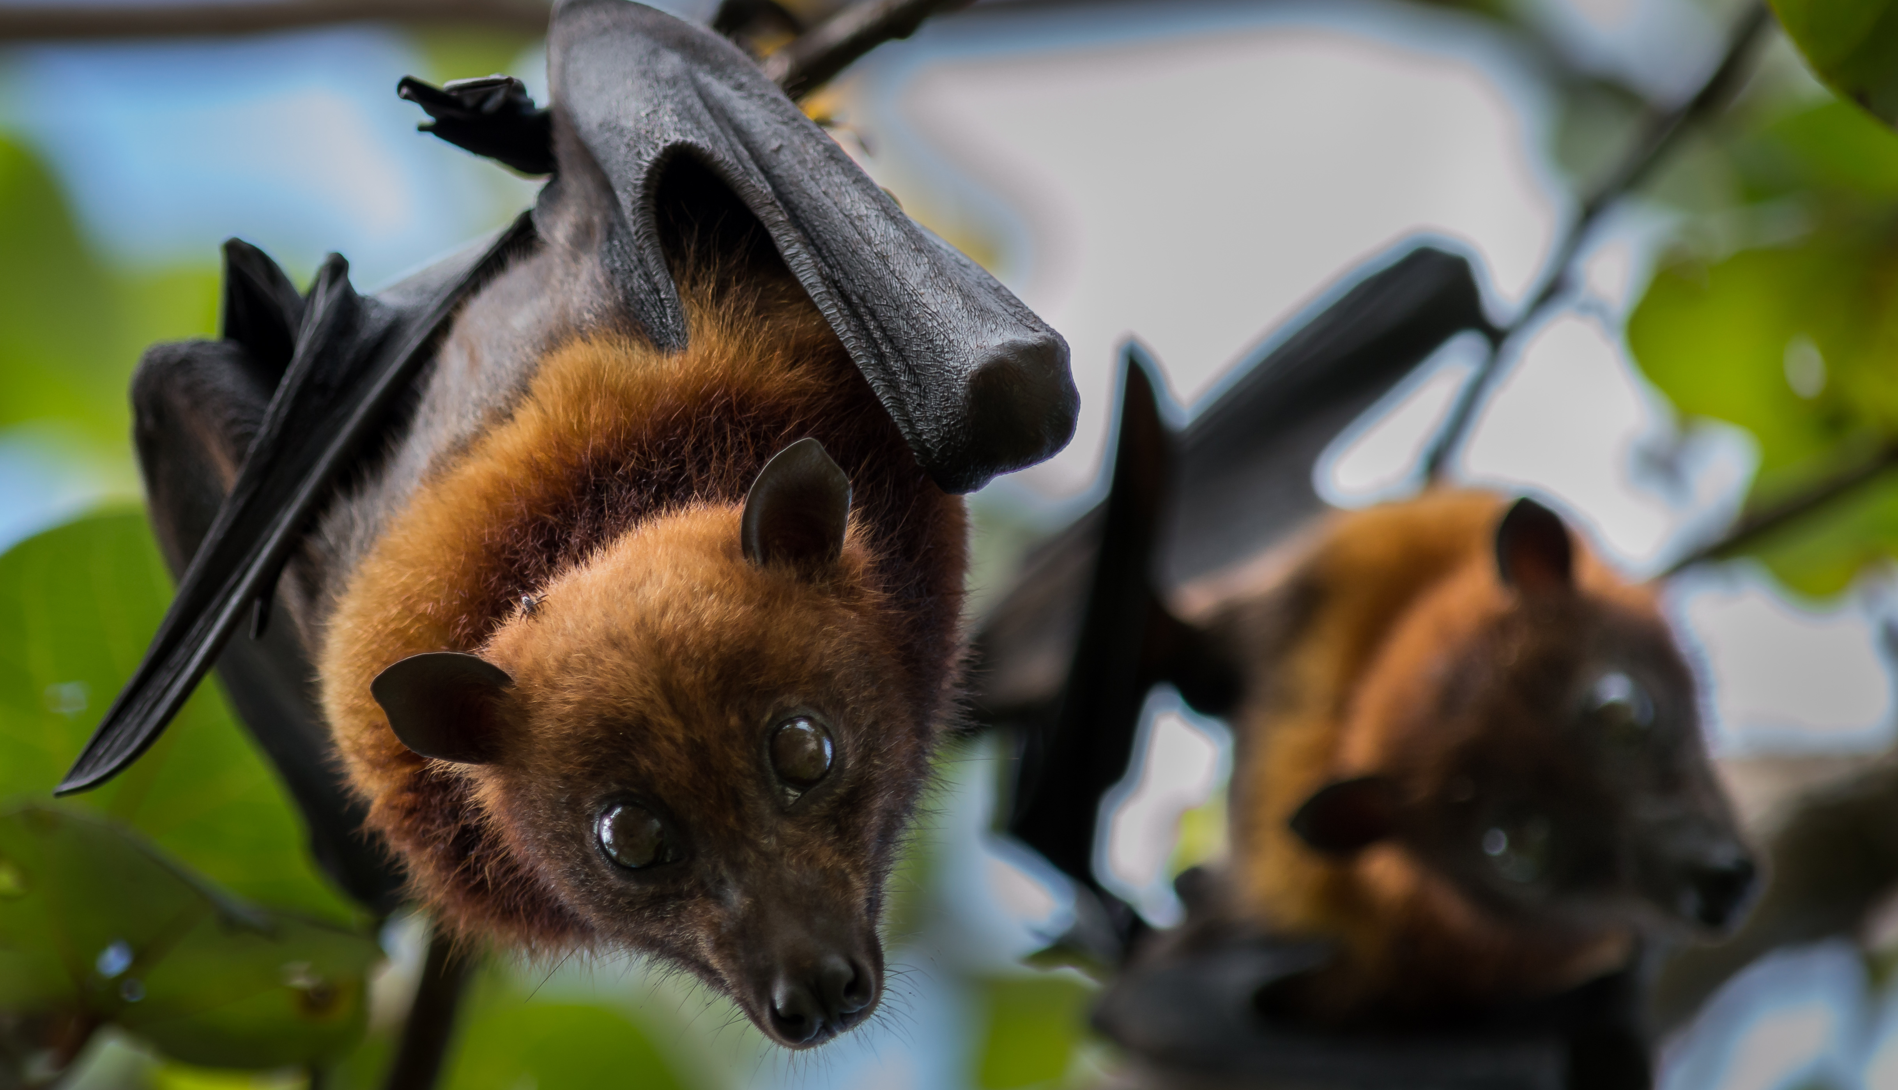
There are as many as 1.7 million undiscovered viruses circulating in the wild right now. Between 631,000 - 827,000 could likely infect us.
Notes:
Five new diseases emerge each year

Slide 6
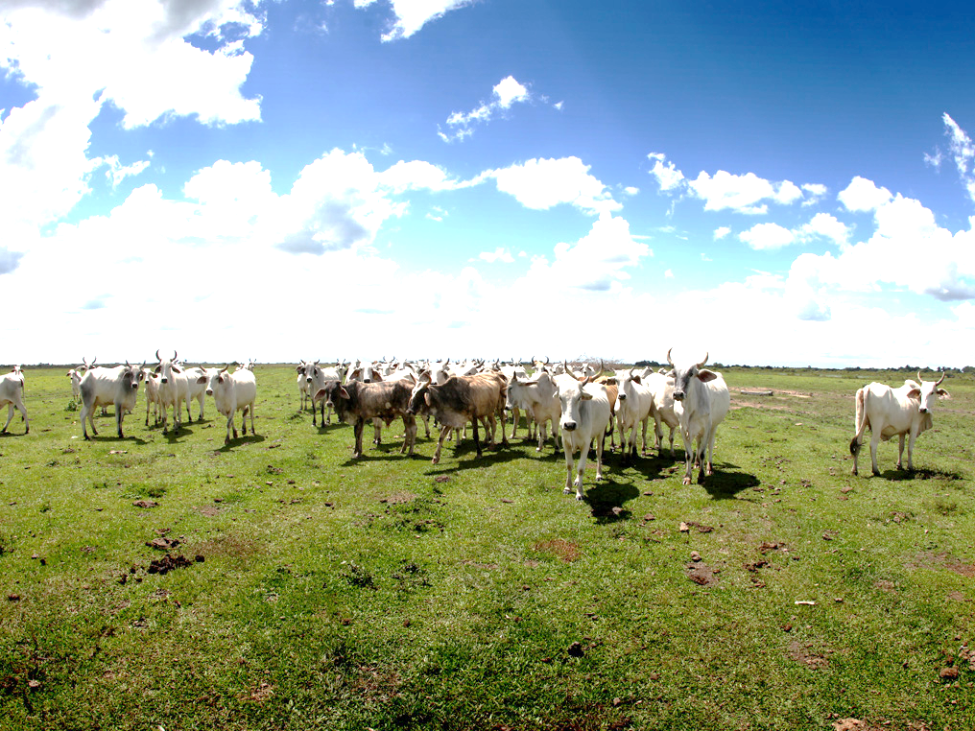
We Can Identify and Address Pathogen Threats Before They Spread
Intergovernmental council on pandemic prevention
  Policy-relevant scientific information on disease emergence
  Coordinate a monitoring framework
One Health approach
  Build pandemic preparedness programs
  Enhance ability to investigate and control outbreaks
Incorporate pandemic risk into planning
  Factor pandemic cost into consumption, production, and government policies and budgets
  Enacting taxes or levies on high pandemic-risk activities
Notes:
Policy Options (from exec. summary):
• Launching a high-level intergovernmental council on pandemic prevention to provide decision-makers with the best science and evidence on emerging diseases; predict high-risk areas; evaluate the economic impact of potential pandemics and to highlight research gaps. Such a council could also coordinate the design of a global monitoring framework.
• Countries setting mutually-agreed goals or targets within the framework of an international accord or agreement – with clear benefits for people, animals and the environment.
• Institutionalizing the ‘One Health’ approach in national governments to build pandemic preparedness, enhance pandemic prevention programs, and to investigate and control outbreaks across sectors.
• Developing and incorporating pandemic and emerging disease risk health impact assessments in major development and land-use projects, while reforming financial aid for land-use so that benefits and risks to biodiversity and health are recognized and explicitly targeted.
• Ensuring that the economic cost of pandemics is factored into consumption, production, and government policies and budgets.
• Enabling changes to reduce the types of consumption, globalized agricultural expansion and trade that have led to pandemics – this could include taxes or levies on meat consumption, livestock production and other forms of high pandemic-risk activities.
• Reducing zoonotic disease risks in the international wildlife trade through a new intergovernmental ‘health and trade’ partnership; reducing or removing high disease-risk species in the wildlife trade; enhancing law enforcement in all aspects of the illegal wildlife trade and improving community education in disease hotspots about the health risks of wildlife trade.
• Valuing Indigenous Peoples and local communities’ engagement and knowledge in pandemic prevention programs, achieving greater food security, and reducing consumption of wildlife.
• Closing critical knowledge gaps such as those about key risk behaviors, the relative importance of illegal, unregulated, and the legal and regulated wildlife trade in disease risk, and improving understanding of the relationship between ecosystem degradation and restoration, landscape structure and the risk of disease emergence.

Slide 7

Our business-as-usual approach does not work.

Slide 8
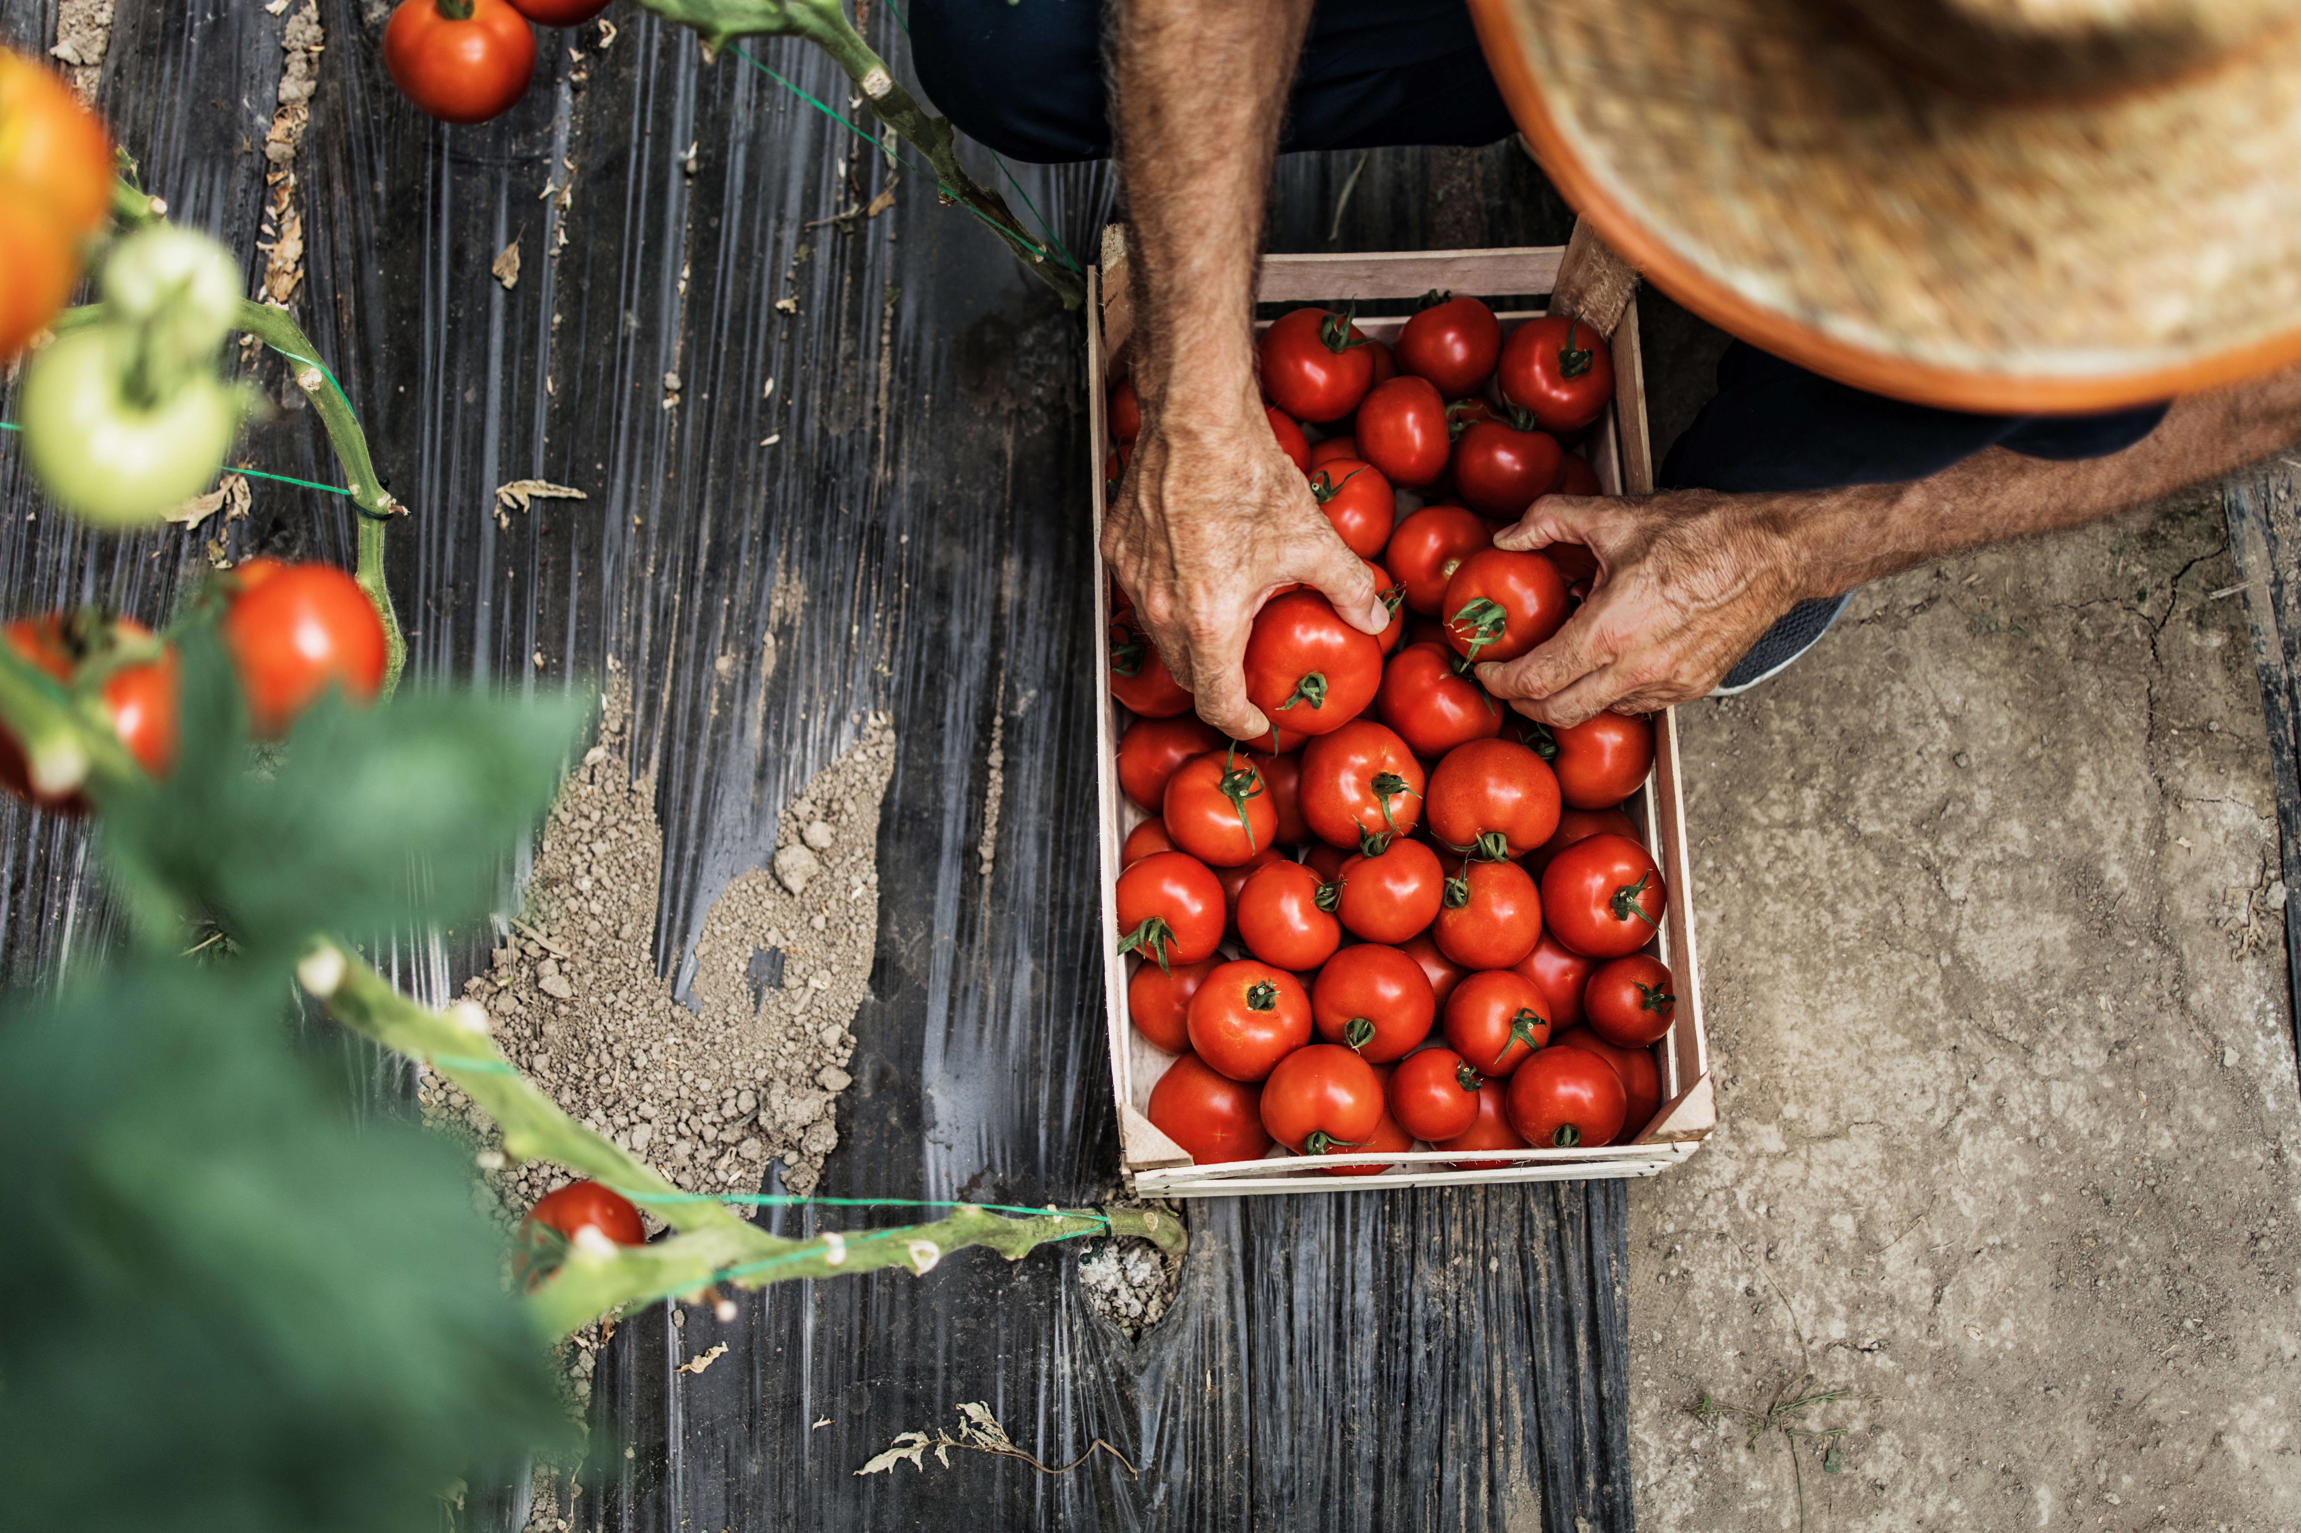
As We Wait for a Vaccine…
79 million cases of COVID-19 worldwide
  1.62 million deaths
Exacerbating existing inequalities
  Gaps in care
  Economic impact more severe for women, people in poverty, and Indigenous Peoples
  Pandemic control policies can and should be inclusive
Trillions of dollars lost
  The cost of preventing pandemics pales in comparison to the impact of just one
Notes:
Business as usual is to wait for an outbreak to start and then try to control it … but while we’re working to control COVID-19 all of this bad stuff has happened

Slide 9
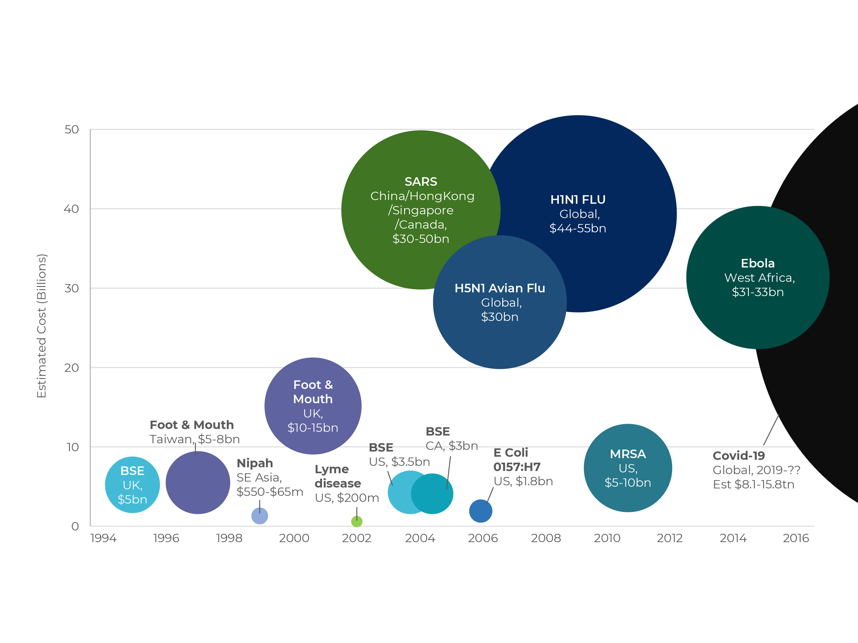
Notes:
Cost of previous outbreaks and estimated cost of COVID-19

Slide 10

Strong economic incentives for transformative change to reduce the risk of pandemics
As We Wait for a Vaccine…
Pandemics and other emerging zoonoses cause widespread human suffering
> $1 trillion in economic damages annually
Global strategies to prevent pandemics ~$22 - $31 billion annually – two orders of magnitude less than the damages pandemics produce.
Photo: Tim Dennell
Notes:
Pandemics and other emerging zoonoses cause widespread human suffering, and likely more than a trillion dollars in economic damages annually. This is in addition to the zoonotic diseases that have emerged historically and create a continued burden on human health. Global strategies to prevent pandemics based on reducing the wildlife trade and land use change and increasing One Health surveillance are estimated to cost between $40 and 58 billion annually – two orders of magnitude less than the damages pandemics produce. This provides a strong economic incentive for transformative change to reduce the risk of pandemics.

Slide 11
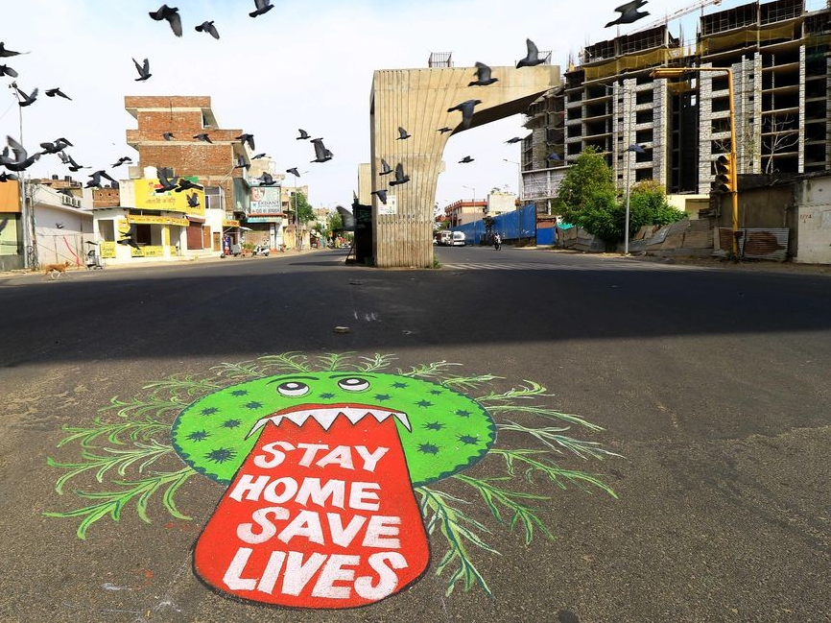
As We Wait for a Vaccine…
Strong economic incentives for transformative change to reduce the risk of pandemics
Pandemics and other emerging zoonoses = > $1 trillion in economic damages annually
Global strategies to prevent pandemics ~ $22-31 billion annually – two orders of magnitude less than the damages pandemics produce
Photo: Tim Dennell
Notes:
Pandemics and other emerging zoonoses cause widespread human suffering, and likely more than a trillion dollars in economic damages annually. This is in addition to the zoonotic diseases that have emerged historically and create a continued burden on human health. Global strategies to prevent pandemics based on reducing the wildlife trade and land use change and increasing One Health surveillance are estimated to cost between $40 and 58 billion annually – two orders of magnitude less than the damages pandemics produce. This provides a strong economic incentive for transformative change to reduce the risk of pandemics.

Slide 12
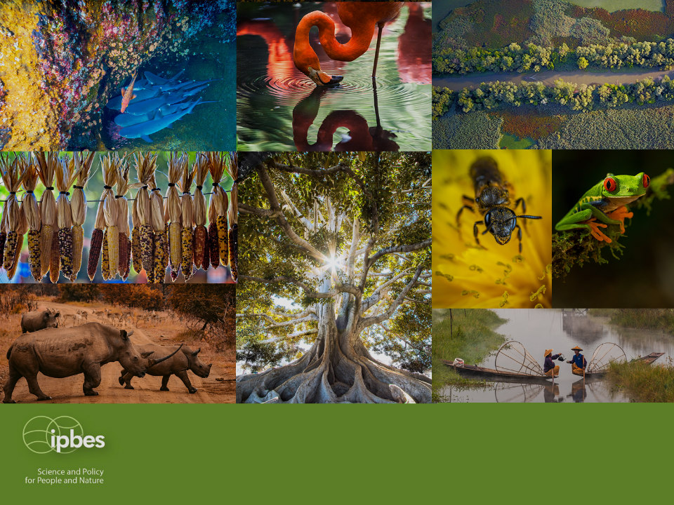
Thank you!
IPBES Secretariat, UN Campus
Platz der Vereinten Nationen 1, D-­53113 Bonn, Germany
secretariat@ipbes.net
@IPBES
www.ipbes.net

