Slide 1
DEVELOPMENT OF POST-2020 GLOBAL BIODIVERSITY FRAMEWORK
UPDATE ON PROCESS AND UPDATED ZERO DRAFT
OEWG Co-Chairs
Francis Ogwal
Basile van Havre
18 SEPTEMBER 2020
Special Briefing Session

Slide 2
Presentation Plan
Process
  Planning assumptions
  Roles of subsidiary bodies and working group
  Key recommendations from OEWG2 meeting
  Preparation of Draft 1.0
Updated Zero Draft

Slide 3
1. Process
Roles of Subsidiary Bodies & OEWG
Committees: SBSTTA , SBI and OEWG:
  Each has Unique & Valuable roles
    E.g. SBSTTA is the only forum/opportunity to discuss science among experts
  Complementary roles
    E.g. for indicators: SBSTTA will discuss scientific validity then SBI will discuss how they will be implemented
  Exclusive roles
    OEWG: Negotiation of Goals and Targets

Slide 4
1. Process
Key Recommendations from WG2020-2
Co-Chairs to Prepare updated draft of the GBF based on Rome discussion: Posted September 1 - presented today
SBSTTA to provide scientific and technical advice as per the mandates from COP, WG2020-1 and WG2020-2 (including, scientific advice – numerical values, indicators, baselines)
SBI to provide advice on implementation – resource mobilization, capacity development, enabling conditions, knowledge management, outreach and awareness, responsibility and transparency
Co-Chairs to prepare draft 1.0 in advance of WG2020-3

Slide 5
1. Process
Draft 1.0
Will reflect
  WG2020-1 and WG2020-2
  WG8j, SBSTTA-23, SBSTTA-24 and SBI-3
  Written Submissions up to Feb 24, 2020
  Thematic consultations and other Post-2020 meetings
Will be the basis for negotiations at WG2020-3

Slide 6
1. Process
How Will Your Work be Included
DSI
Advice on
Numerical values
Indicators (headline)
Availability of baseline information
Goals & Targets
SBSTTA
Thematics: Sustainable Use
Co-Lead report
Co-Lead report
Draft 1
Thematics: Synergies, ABS
OEWG
CoP
Implementation Support
  Resource Mobilization
  Capacity development
  Knowledge
  …
Enabling Conditions
Responsibility & Transparency
Outreach and Awareness
Advice on GBF language (principles)
SBI
CoP decision with details

Slide 7
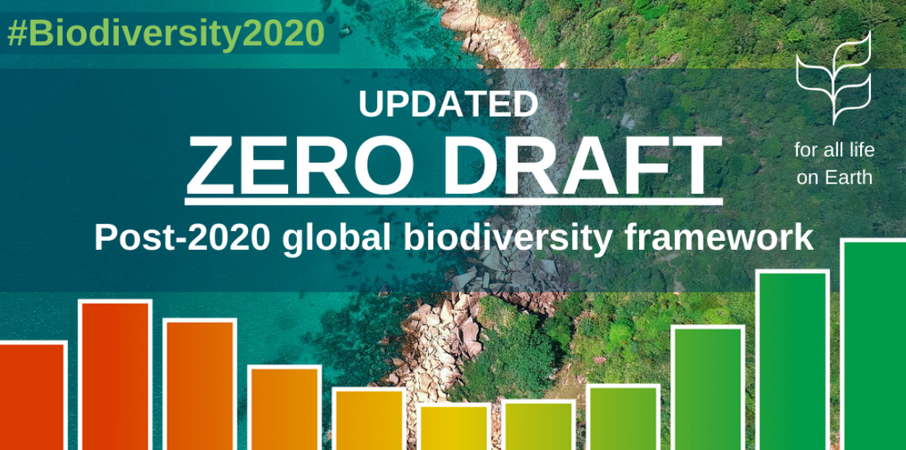
2. Progress on Development of the Post-2020 Global Biodiversity Framework

Slide 8
2 Updated Zero Draft
Key Updates
Goals
  Combined Goals A B and C (now: all in Goal A)
  Shortened Goal D
  Added a Goal on Means of Implementation
  Added Milestones for each Goal
Targets
  Added a species focused (now: Target 3)
  Tools and Solutions: Merger & Reordered for better flow
Sections E to H (now: Sections F to I):
  Update to the whole section

Slide 9
2 Updated Zero Draft
II/B&D: Goals & Targets (Milestones)
Milestones: Included in updated Zero Draft with the objectives of:
  Ensuring we are able to measure and show progress toward in 2030 milestones and 2050 Goals
  Ensuring we can evaluate if the Action Targets are the right tools to meet the 2050 Vision

Slide 10
2 Updated Zero Draft
II/B&D: Goals A & B
Zero Draft
Updated Zero Draft
A No net loss in the area and integrity of freshwater, marine and terrestrial ecosystems
B The percentage of species threatened with extinction, is reduced by [X%] and the abundance of species has increased on average by [X%]
C Genetic diversity is maintained or enhanced on average
A: The area, connectivity and integrity of natural ecosystems increased by at least [20%] supporting healthy and resilient populations of all species while reducing the number of species that are threatened by [X%] and maintaining genetic diversity. 2030 Milestones The area, connectivity and integrity of natural ecosystems increased by at least [5%], which facilitates increased conservation and recovery of species, as well as the maintenance and/or increase in genetic diversity. The number of species that are threatened is reduced by [X%] and the abundance of species has increased on average by [X%]
D Nature provides benefits to people improvements in nutrition for at least [X million] people improvements in sustainable access to safe and drinkable water for at least [X million] people improvements in the resilience from natural disasters for at least [X million] people at least [30%] of efforts to achieve the targets of the Paris Agreement
B: Nature’s contributions to people have been valued, maintained or enhanced through conservation and sustainable use supporting global development agenda for the benefit of all people 2030 Milestones (a) Nature contribute to the sustainable nutrition, access to safe drinking water and resilience to natural disasters for at least (X million) people (b) Nature is valued through ecosystem service valuation and public and private sector disclosure

Slide 11
2 Updated Zero Draft
II/B&D: Goals C & D
Zero Draft
Updated Zero Draft
E The benefits, shared fairly and equitably, from the use of genetic resources and associated traditional knowledge, have increased by [X]
C: The benefits, from utilization of genetic resources are shared fairly and equitably 2030 Milestone (a) Equitable systems for sharing benefits are established in all countries in order for the benefits to be shared fairly and equitably from the use of genetic resources and associated traditional knowledge.
D: Means of implementation is available to achieve all goals and targets the Framework 2030 Milestones (a) By 2022, resources and capacity have been identified/committed to implement the Framework for the period of 2020 to 2030, including the incorporation of traditional knowledge, science and technology, and monitoring. (b) By 2030, resources, and potential future resources, have been identified/committed by 2030 for the periods to 2040 and to 2050.
New request from WG2020-2

Slide 12
2 Updated Zero Draft
II/E: Reducing Threats: Targets 1-3
Zero Draft
Updated Zero Draft
1 Retain and restore freshwater, marine and terrestrial ecosystems, by increasing at least [50%] of land and sea area under comprehensive spatial planning addressing land/sea use change, achieving a net increase in area, connectivity and integrity and retaining existing intact areas and wilderness
2 Protect sites of particular importance for biodiversity through protected areas and other effective area-based conservation measures, covering at least [60%] of such sites and at least [30%] of land and sea areas with at least [10%] under strict protection
T1: By 2030, [50%] of land and sea areas globally are under spatial planning addressing land/sea use change, retaining most of the existing intact and wilderness areas, and allow to restore [X%] of degraded freshwater, marine and terrestrial natural ecosystems and connectivity among them
T2: By 2030, protect and conserve through well connected and effective system of protected areas and other effective area-based conservation measures at least 30% of the planet with the focus on areas particularly important for biodiversity
T3: By 2030, ensure active management actions to enable wild species of fauna and flora recovery and conservation, and reduce human-wildlife conflict by [X%]
New request from WG2020-2

Slide 13
2 Updated Zero Draft
II/E: Reducing Threats: Targets 4-7
Zero Draft
Updated Zero Draft
5 Ensure that the harvesting, trade and use of wild species, is legal and at sustainable levels
3 Control all pathways for the introduction of invasive alien species achieving a [50%] reduction in the rate of new introductions, and eradicate or control invasive alien species to eliminate or reduce their impacts by 2030 in at least [50%] of priority sites
T4: By 2030, ensure that the harvesting, trade and use of wild species of fauna and flora, is legal, at sustainable levels and safe.
T5: By 2030, manage, and where possible control, pathways for the introduction of IAS, achieving [50%] reduction in the rate of new introductions, and eradicate, control and manage IAS to eliminate or reduce their impacts, including in at least [50%] of priority sites
4 Reduce by at least [50%], pollution from excess nutrients, biocides, plastic waste and other sources
6 Contribute to climate change mitigation and adaptation and disaster risk reduction through nature-based solutions, providing [about 30%] [at least XXX MT CO2=] of the mitigation effort needed to achieve the goals of the Paris Agreement, complementing stringent emission reductions and avoiding negative impacts on biodiversity and food security
T6: By 2030, reduce pollution from all sources, including reducing excess nutrients [by x%], biocides [by x%], plastic waste [by x%] to levels that are not harmful to biodiversity and ecosystem functions and human health
T7: By 2030, increase contributions to climate change mitigation adaption and disaster risk reduction from nature-based solutions and ecosystems based approached, ensuring resilience and minimizing any negative impacts on biodiversity

Slide 14
2 Updated Zero Draft
II/E: Meeting Peoples Needs: Targets 8-9
Zero Draft
Updated Zero Draft
7 Enhance the sustainable use of wild species providing, benefits, including enhanced nutrition, food security and livelihoods for at least [X million] people, especially for the most vulnerable, and reduce human-wildlife conflict by [X%]
8 Conserve and enhance the sustainable use of biodiversity in agricultural and other managed ecosystems to support the productivity, sustainability and resilience of such systems, reducing related productivity gaps by at least [50%]
T8: By 2030, ensure benefits, including nutrition, food security, livelihoods, health and wellbeing, for people, especially for the most vulnerable through sustainable management of wild species of fauna and flora
T9: By 2030, support the productivity, sustainability and resilience of biodiversity in agricultural and other managed ecosystems through conservation and sustainable use of such ecosystems, reducing productivity gaps by at least [50%]

Slide 15
2 Updated Zero Draft
II/E: Meeting Peoples Needs: Targets 10-12
Zero Draft
Updated Zero Draft
9 Enhance nature-based solutions contributing, to clean water provision for at least [XXX million] people
10 Enhance the benefits of green spaces for health and well-being, especially for urban dwellers, increasing the proportion of people with access to such spaces by at least [100%]
11 Ensure that benefits from the utilization of genetic resources, and related traditional knowledge, are shared fairly and equitably, resulting in an [X] increase of benefits
T10: By 2030, ensure that, nature based solutions and ecosystem approach contribute to regulation of air quality, hazards and extreme events and quality and quantity of water for at least [XXX million] people
T11: By 2030, increase benefits from biodiversity and green/blue spaces for human health and well-being, including the proportion of people with access to such spaces by at least [100%], especially for urban dwellers
T12: By 2030, increase by [X] benefits shared for the conservation and sustainable use of biodiversity through ensuring access to and the fair and equitable sharing of benefits arising from utilization of genetic resources and associated traditional knowledge

Slide 16
2 Updated Zero Draft
II/E: Tools & Solutions Targets 15-16
Zero Draft
Updated Zero Draft
17 People everywhere take measurable steps towards sustainable consumption and lifestyles, taking into account individual and national cultural and socioeconomic conditions, achieving just and sustainable consumption levels
18 Promote education and the generation, sharing and use of knowledge relating to biodiversity, in the case of the traditional knowledge, innovations and practices of indigenous and local communities with their free, prior and informed consent, ensuring that all decision makers have access to reliable and up-to-date information for the effective management of biodiversity
16 Establish and implement measures in all countries to prevent potential adverse impacts of biotechnology on biodiversity
T15: By 2030, eliminate unsustainable consumption patterns, ensuring people everywhere understand and appreciate the value of biodiversity, make responsible choices commensurate with 2050 biodiversity vision, taking into account individual and national cultural and socioeconomic conditions
T16: By 2030, establish and implement measures to prevent, manage or control potential adverse impacts of biotechnology on biodiversity and human health reducing these impacts by [X]

Slide 17
2 Updated Zero Draft
II/F: Implementation Support Mechanisms
Mobilizing Sufficient Resources
An enhanced financial mechanism that delivers resources for developing countries;
Reducing or redirecting resources causing harm to biodiversity;
Generating additional financial and non-financial resources from all sources, including from international and domestic sources and the public and private sectors;
Enhancing the effectiveness and efficiency of resource use;
National finance plans to support implementation.
Capacity Development
Enabling evidence-based implementation through nationally determined and/or country-driven actions, in accordance with national priorities;
Support to government and non-government actors at all levels, particularly in developing countries and countries with economies in transition, to develop, utilize and retain requisite capacities and to learn, adapt and manage change;
Building capacities at the individual, organizational and enabling environment levels to facilitate effective policy formulation, the mainstreaming of biodiversity into all sectors, implementation of the framework and the establishment of national systems and measures for transparency and reporting.

Slide 18
2 Updated Zero Draft
II/F: Implementation Support Mechanisms
Knowledge generation, management and sharing
Greater protection of traditional knowledge and recognition of its contributions to the conservation and sustainable use of biodiversity;
Promotion of biodiversity science and education and organizational learning.
Technical and scientific cooperation, technology transfer and innovation
  Support mechanisms for technical and scientific cooperation, technology transfer and innovation on mutually agreed terms;
  Support for cooperation amongst developing countries and with developed countries

Slide 19
2 Updated Zero Draft
II/G Enabling Conditions
The participation of IPLCs and a recognition of their rights in the implementation of the framework
The participation of all relevant stakeholders, NGOs, youth, civil society, local and subnational authorities, the private sector, academia and scientific institutions
Gender equality, gender-responsive approaches and empowerment of women and girls
Recognition of intergenerational equity
Synergies among relevant MEAs and other relevant international processes, including the 2030 Agenda for Sustainable Development
Partnerships to leverage sustainable activities and programmes at the local, national, regional and global levels

Slide 20
2 Updated Zero Draft
II/G Enabling Conditions
Inclusive and integrative governance
Mainstreaming biodiversity in all sectors
The engagement of private sector, academic institutions and civil societies
Safety and security in use of biodiversity to prevent spillover of zoonotic diseases, spread of invasive alien species and illegal trade in wildlife
Political will and recognition at the highest levels of government of the urgent need to halt biodiversity loss
The active involvement of subnational governments, cities and other local authorities and a recognition of their competence and specific roles for the implementation of the framework
Consider and recognize, where appropriate, the rights of nature

Slide 21
2 Updated Zero Draft
II/H: Responsibility & Transparency
The successful implementation of the framework is dependent on the use of a comprehensive system for planning, reporting and review.
This system minimizes the burden on Parties, the Secretariat and other entities. It is aligned with, and where appropriate integrated with other processes including Agenda 2030 and the Sustainable Development Goals.
The system will be complemented by the systems of non-State actors, and the development of new systems or the adaptation of existing ones is encouraged.

Slide 22
2 Updated Zero Draft
II/H: Responsibility & Transparency
The system for planning, reporting and review for national government entities includes the following elements:
(a) Planning
  National strategies and action plans:
    Are the main instrument to identify national commitments
    Include all targets and actions
    Address all performance indicators relevant to the identified targets drawing on the monitoring framework attached to this framework
    Should include a financing plan
    Should be updated quickly according to an agreed schedule.
  Indicators will be an important part of planning and reporting process including Headline indicators
  Planning documents will be updated on a continuous basis

Slide 23
2 Updated Zero Draft
II/H: Responsibility & Transparency
(b) Reporting
  National reports
      Report on all actions using agreed indicators
      Will be issued regularly and in time
    Global reports / Global stocktake
      Global collation of statistical information
      Takes place frequently
    Reporting schedule
      used regularly
    Global assessment processes
      Including GBO and IPBES processes will be reviewed for efficiency and complementarity and timeliness

Slide 24
2 Updated Zero Draft
II/H: Responsibility & Transparency
(c) Review: Three Tools
  Global analysis of progress on objective/numerical elements of targets and progress towards milestones and goals;
  Open ended Forums for the review of national implementation and to share lessons learned and best practices;
  Voluntary in-depth peer review of national implementation by experts including from other parties.

Slide 25



Thank You
UN BIODIVERSITY CONFERENCE
COP 15 – CP/MOP10-NP/MOP4
Ecological Civilization-Building a Shared Future for All Life on Earth
KUNMING • CHINA
#Post2020
#Nature

Slide 26
Annex:
Updated Zero Draft

Slide 27
3. Next Steps
Moving Forward
June
Jul
Aug
Sept
Oct
TBC
DSI
Them. Sust Use
Docs
Docs
Sp. Sessions
Them. Synergies
DSI Webinar
SBSTTA
Them. ABS
Draft 1.0
OEWG-3
Final Draft
COP 15
GBO-5
Review Mechanisms
Resource Mobilization
Post-2020
Rev. SBSTTA docs
Annotations
SDG linkages
Advice on numerical targets
SBI docs
Complete Updated draft (incl: Goals, Milestones, Targets, & Sections E to H)
SBI-3

Slide 28
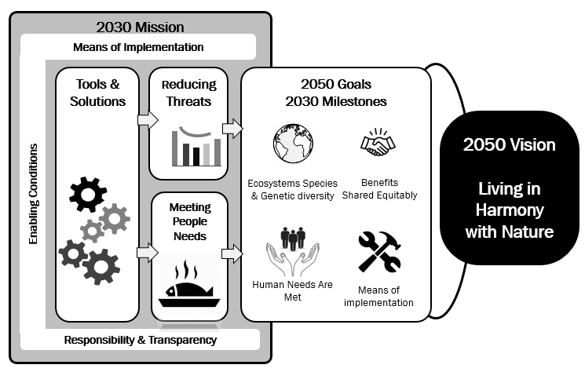
2 Updated Zero Draft
Part I, Part II Sections A & C
Part I
Sections A & B: Not discussed in Rome: No changes
Section C: Theory of Change: Goals updated
Part II
Section A Vision: No changes
Section C Mission: Not discussed in Rome: No changes

Slide 29

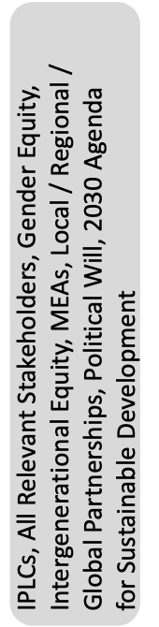


2 Updated Zero Draft
Goals and Targets
Means of
Implementation
Resource Mobilization, Capacity Building, Technology Transfer, Traditional Knowledge
Reducing Threats
2050 Goals
2030 Milestones
2050 Vision
Tools & Solutions
Reducing Threats
New/reorder in red
1. Land/Sea Plan, Retain, Restore
Ecosystems, Species and Genetic Diversity
2. Land/Sea Protect, Conserve
i) Area, connectivity & integrity of natural ecosystems increased by at least [5%]
ii) Number of threatened species reduced by [X%] & abundance of species increased by [X%]
3. Species Recovery, Conservation
4. Sustainable Harvest, Trade, Use
13 (was 14). Mainstream in Policies, Planning, Regulation
5. Invasive Alien Species
6. Pollution
(b) Nature’s Contributions to People
14 (15). Mainstream in Production and Supply Chains
7. Climate Change
15 (18). Sustainable Consumption - Responsible Choices
i) Contribute to nutrition & food security, access to safe drinking water & resilience to natural disasters for at least [X] million people
ii) Nature is valued through green investments, ecosystem service valuation, financial disclosure
Meeting Peoples Needs
8. Use of Species (Fishery…)
Living in Harmony with Nature
16 (17). Biosafety
17 (13). Incentives & Subsidies
9. Use of Spaces (Agriculture…)
18 (16). Resource Mobilization and Capacity Building
10. Other Regulating Services
Enabling Conditions
(c) Benefits Shared Fairly and Equitably
19. Information Available, including Traditional Knowledge
11. Health Culture
12. Benefits Sharing
i) ABS mechanisms are established in all countries
ii) Benefits shared increased by [x%]
20. IPLCs, Women & Girls, Youth
Responsibility & Transparency
Planning, Reporting, Review, Additional Mechanisms
(d) Means of Implementation
i) By 2022, means to implement to 2030
ii) By 2030, means to implement to 2040

Slide 30
2 Updated Zero Draft
II/E: Tools & Solutions: Targets 13-14
Zero Draft
Updated Zero Draft
13 Integrate biodiversity values into national and local planning, development processes, poverty reduction strategies and accounts, ensuring that biodiversity values are mainstreamed across all sectors and that biodiversity-inclusive strategic impact assessments and environmental impact assessments are comprehensively applied
14 Reform economic sectors towards sustainable practices, including along their national and transnational supply chains, achieving a reduction of at least [50%] in negative impacts on biodiversity
T13: By 2030, integrate biodiversity values into policies, regulations, planning, development processes, poverty reduction strategies and accounts at all levels, ensuring that biodiversity values are mainstreamed across all sectors and integrated into assessments of environmental impacts
T14: By 2030, achieve reduction of at least [50%] in negative impacts on biodiversity by ensuring production practices and supply chains are sustainable

Slide 31
2 Updated Zero Draft
II/E: Tools & Solutions: Targets 17-20
Zero Draft
Updated Zero Draft
12 Reform incentives, eliminating the subsidies most harmful for biodiversity, ensuring, that incentives, including public and private economic and regulatory incentives, are either positive or neutral for biodiversity
15 Resources, including capacity-building, for implementing the framework have increased from all sources so that resources have increased by [X%] and are commensurate with the ambition of the targets of the framework
T17: By 2030, redirect, repurpose, reform or eliminate incentives harmful for biodiversity, including [X] reduction in the most harmful subsidies, ensuring that incentives, including public and private economic and regulatory incentives, are either positive or neutral for biodiversity
T18: By 2030, increase by [X%] financial resources from all international and domestic sources, through new, additional and effective financial resources commensurate with the ambition of the goals and targets of the Framework and implement the strategy for capacity-building and technology transfer and scientific cooperation to meet the needs for implementing the post2020 global biodiversity framework

Slide 32
2 Updated Zero Draft
II/E: Tools & Solutions: Targets 17-20
Zero Draft
Updated Zero Draft
19 Promote the full and effective participation of indigenous peoples and local communities, and of women and girls as well as youth, in decision-making related to the conservation and sustainable use of biodiversity, ensuring equitable participation and rights over relevant resources
20 Foster diverse visions of good quality of life and unleash values of responsibility, to effect new social norms for sustainability
T19: By 2030, ensure that quality information, including traditional knowledge, is available to decision makers and public for the effective management of biodiversity through promoting awareness, education and research
T20: By 2030, ensure equitable participation in decision-making related to biodiversity and ensure rights over relevant resources of indigenous peoples and local communities, women and girls as well as youth, in accordance with national circumstances

Slide 33
2 Updated Zero Draft
II/I: Outreach, Awareness and Uptake
  Increasing understanding, awareness and appreciation of the values of biodiversity including the associated knowledge, values and approaches used by IPLCs
  Raising awareness of all actors of the existence of the goals and targets of the post-2020 global biodiversity framework and progress made towards their achievement;
  Promoting or developing platforms and partnerships, including with media and civil society to share information on successes, lessons learned and experiences in acting for biodiversity

Slide 34
GBF: Updated Zero Draft
Means of
Implementation
Resource Mobilization, Capacity Building, Technology Transfer, Traditional Knowledge
2050 Goals
2030 Milestones
2050 Vision
Tools & Solutions
Reducing Threats
1. Land/Sea Plan, Retain, Restore
2. Land/Sea Protect, Conserve
13 . Mainstream in Policies, Planning, Regulation
3. Species Recovery, Conservation
4. Sustainable Harvest, Trade, Use
Ecosystems, Species and Genetic Diversity
14. Mainstream in Production and Supply Chains
Enabling Conditions
5. Invasive Alien Species
15. Sustainable Consumption - Responsible Choices
6. Pollution
16. Biotechnology & Biosafety
7. Climate Change
Living in Harmony with Nature
17. Incentives & Subsidies
Meeting Peoples Needs
18. Resource Mobilization and Capacity Building
8. Use of Species (Fishery…)
19. Information Available, including Traditional Knowledge
9. Use of Spaces (Agriculture…)
(b) Nature’s Contributions to People
10. Other Regulating Services
20. IPLCs, Women & Girls, Youth
11. Health Culture
12. Benefits Sharing
(c) Benefits Shared Fairly and Equitably
(d) Means of Implementation
Responsibility & Transparency
Planning, Reporting, Review, Additional Mechanisms

