Slide 1



SBSTTA 24 Briefing Webinar
SBSTTA agenda item 6: marine and coastal biodiversity
Joe Appiott
28 January 2021

Slide 2
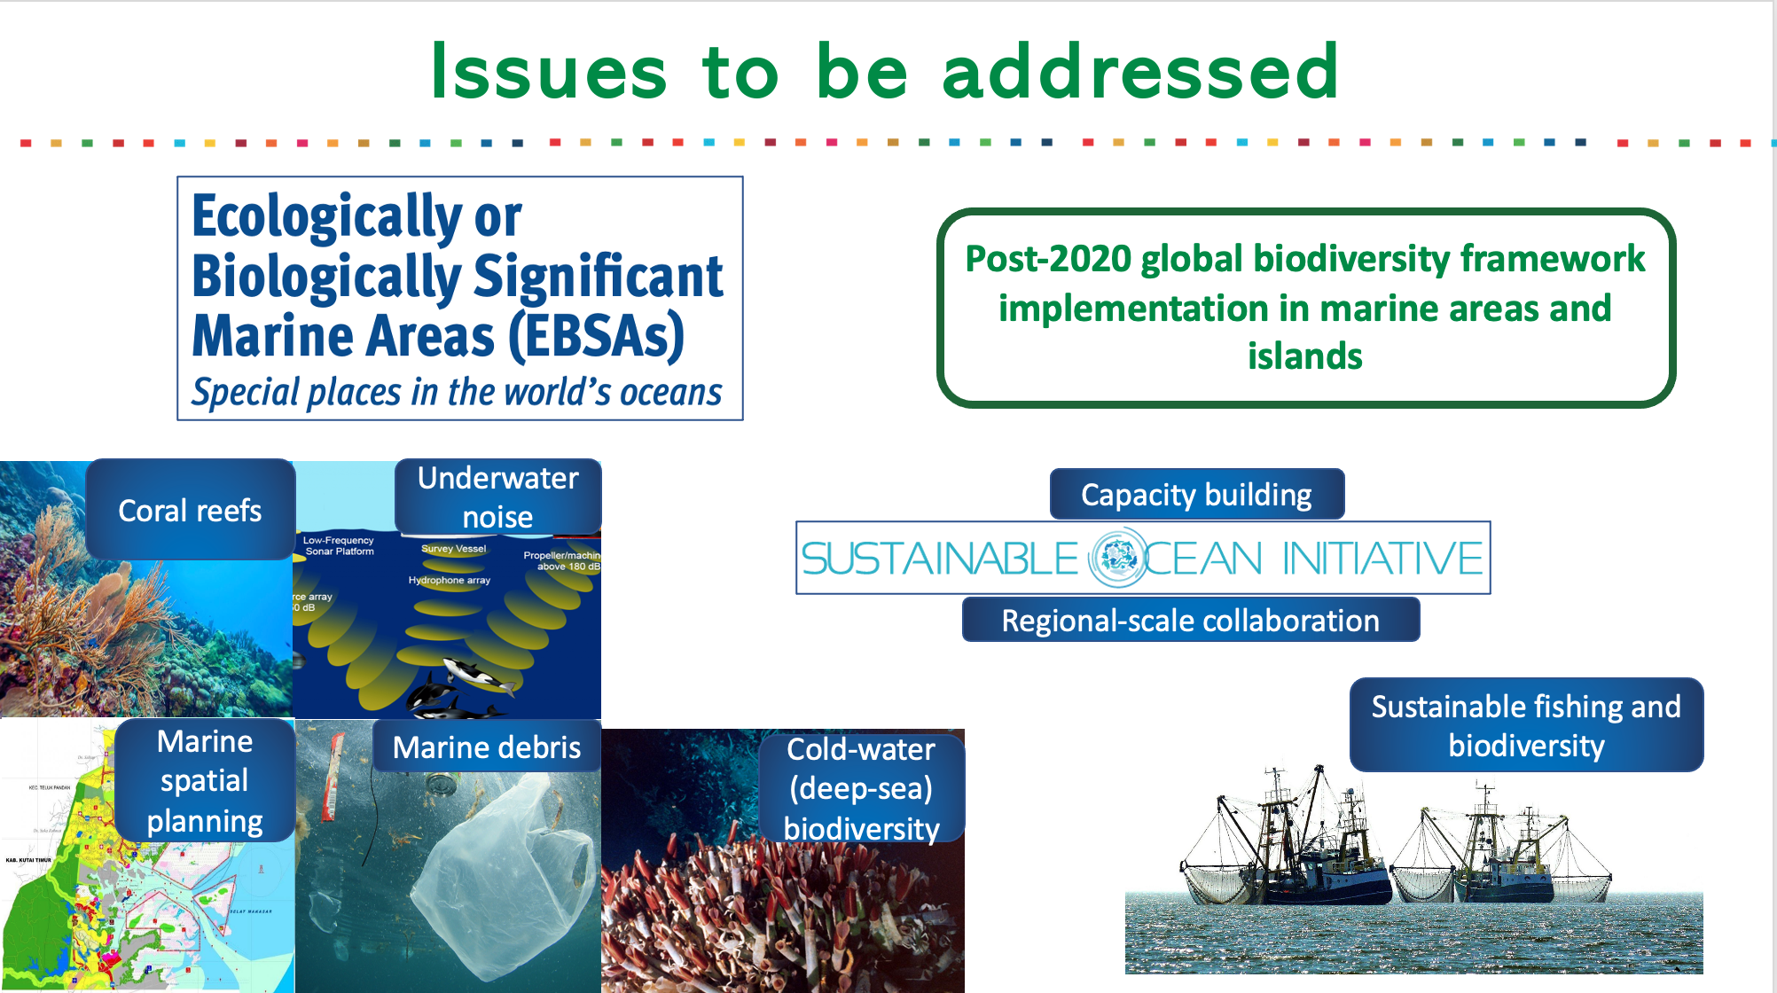
Issues to be addressed
Marine Insight
© A. Damar
Richard Carey

Slide 3
Requests from COP decisions on marine and coastal biodiversity
Requested the Secretariat to identify options for modifying the description of EBSAs, for describing new EBSAs, and for strengthening the scientific credibility and transparency of this process (14/9)
Requested the Secretariat to continue to work on the compilation and synthesis of information related to:
  Anthropogenic underwater noise (14/10)
  Marine spatial planning (14/10)
  Voluntary practical guidance on marine debris (13/10)
  Voluntary specific workplan on biodiversity in cold-water areas within the jurisdictional scope of the Convention (13/10)
  Priority actions to achieve Aichi Biodiversity Target 10 (12/23)
Requested the Secretariat to continue the capacity building activities under the Sustainable Ocean Initiative (SOI) (14/10)
Requested the Secretariat to continue cooperation with FAO and IUCN-FEG on Aichi Target 6 and fisheries and biodiversity issues (14/10)

Slide 4
SBSTTA 24 documents on marine and coastal biodiversity
Official document
CBD/SBSTTA/24/6
Progress report and suggested recommendations
Information documents
CBD/EBSA/WS/2020/1/2 | Report of EBSA workshop
CBD/POST2020/WS/2019/10/2 | Report of post-2020 marine consultation
CBD/SBSTTA/24/INF/1 | Compilation of MSP experiences
CBD/SBSTTA/24/INF/2 | Synthesis of experiences on T10 Priority Actions
CBD/SBSTTA/24/INF/3 | Synthesis of experiences on coldwater workplan
CBD/SBSTTA/24/INF/4 | Technical paper updating CBD Technical Series No. 83 on marine debris
CBD/SBSTTA/24/INF/5 | Draft CBD Technical Series report on underwater noise
CBD/SBSTTA/24/INF/10 | Report of expert meeting on OECMs in marine fishery sector
Outcomes of EBSA workshop for North-East Atlantic already addressed at SBSTTA 23 and will be considered at COP 15
Documents do not cover all areas of work ongoing under marine programme (e.g., substantive input to other processes)

Slide 5
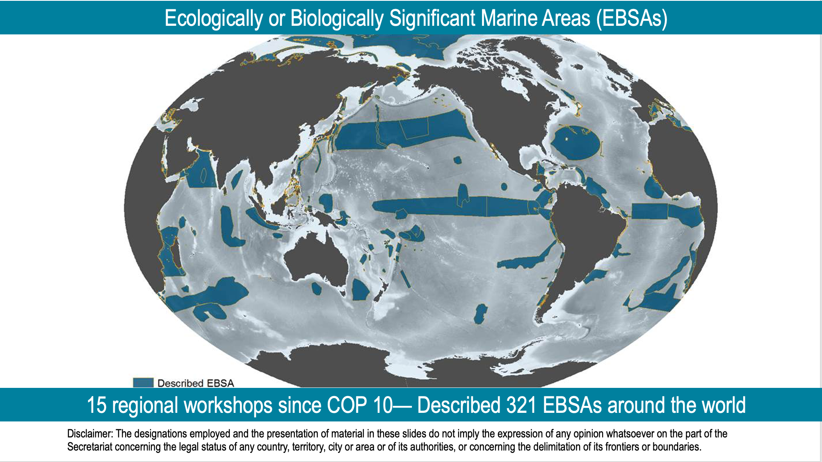

Slide 6
Practical Challenges with Current EBSA Process
No mechanism to revise EBSA descriptions considered by SBSTTA/COP
  New research and data becomes available about features described as an EBSA that may affect the shape or the ranking against EBSA criteria
  Information previously used has changed
  Features described as an EBSA have changed or shifted location
  Incorrect/inaccurate information was used to describe an EBSA
  Simple mistake in EBSA description—Technical, linguistic or editorial errors
Lack of clarity on how to (i) describe new EBSAs through mechanism other than / in addition to regional workshop and (ii) incorporate outputs from national processes
Gaps in areas/features covered by regional workshops
Different countries conducting their own EBSA or EBSA-like processes that have not been included in regional workshops

Slide 7
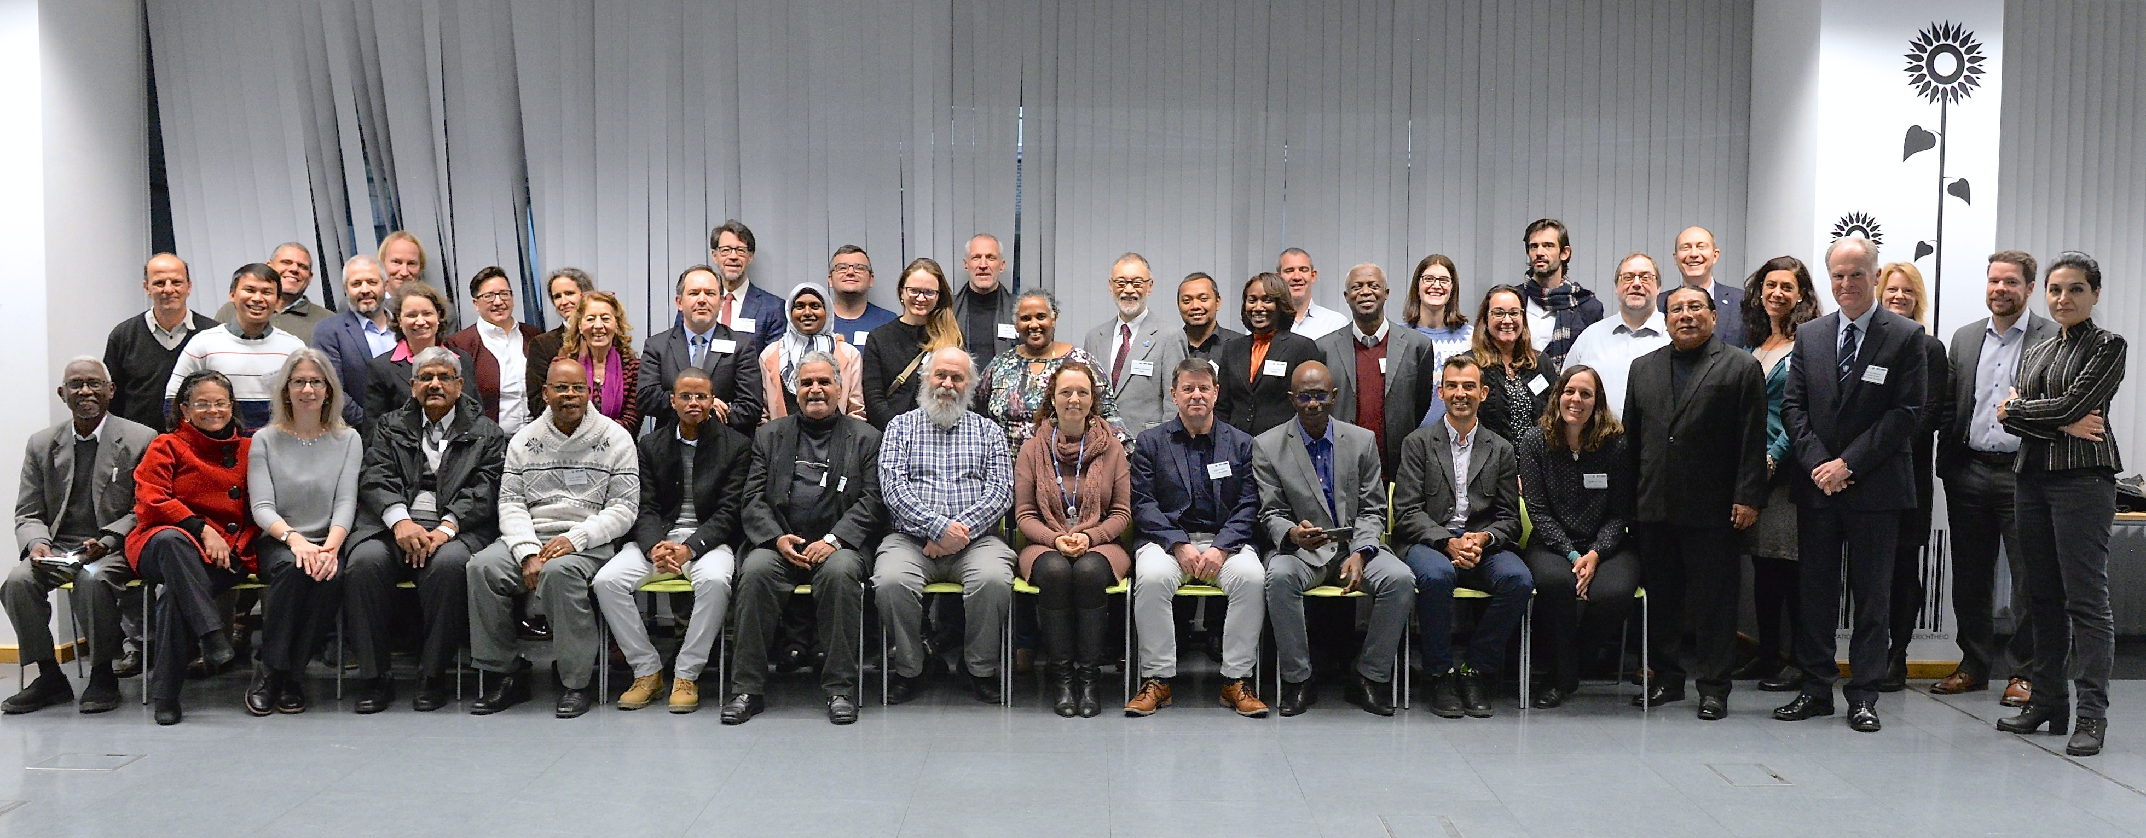


Slide 8
Annexes on EBSA issues
Provides proposed modalities to address the practical challenges faced by the current EBSA process
Aim to address concerns and differing perspectives that have been subject of ongoing debates since COP 13
Informed by EBSA expert workshop discussions
Issues separated into individual annexes to facilitate more organized discussions
Modalities delineated with respect to areas within and areas beyond national jurisdiction, reflecting different rights of governments in these different jurisdictions

Slide 9
Annexes on EBSA issues
General considerations in the modification of descriptions of EBSAs and the description of new EBSAs (annex I)
Repository and information-sharing mechanism for EBSAs (annex II)
Modification of EBSA descriptions (annexes III-IX)
  Reasons for modification
  Proponents for modification
  Modification of EBSAs:
    For editorial reasons
    Within national jurisdiction
    In areas beyond national jurisdiction
    Straddling multiple national jurisdictions
    Straddling areas both within and beyond national jurisdiction
Description of new EBSAs (annexes X-XIV)
  Proponents for description of EBSAs
  Description of new EBSAs
    Within national jurisdiction
    In areas beyond national jurisdiction
    Straddling multiple national jurisdictions
    Straddling areas within and beyond national jurisdiction

Slide 10
Other marine issues
to be addressed at SBSTTA 24
Future work to implement the Post-2020 global biodiversity
Post-2020 framework being discussed under other items and in Post-2020 Working Group
Thematic Workshop on Marine and Coastal Biodiversity for the Post-2020 Global Biodiversity Framework (November 2019)
Work on marine-related indicators
Once adopted, work will be needed to support implementation in marine areas and islands
Information document:
CBD/POST2020/WS/2019/10/2--Report of post-2020 marine consultation

Slide 11
Other marine issues
to be addressed at SBSTTA 24
Syntheses of knowledge/experiences on:
Marine spatial planning (CBD/SBSTTA/24/INF/1)
Priority Actions to Achieve Aichi Biodiversity Target 10 for Coral Reefs and Closely Associated Ecosystems (CBD/SBSTTA/24/INF/2)
Voluntary Specific Workplan on Biodiversity in Cold-water Areas within the Jurisdictional Scope of the Convention (CBD/SBSTTA/24/INF/3)
Marine debris (CBD/SBSTTA/24/INF/4)
Anthropogenic underwater noise (CBD/SBSTTA/24/INF/5)

Slide 12
Other marine issues
to be addressed at SBSTTA 24
Fisheries and biodiversity mainstreaming
Secretariat working closely with FAO, UNEP, IUCN-FEG and others on various issues, including on other effective area-based conservation measures (OECMs), reporting/assessment on Aichi Target 6, regional-scale collaboration, others
SCBD, UNEP and FAO coordinate Sustainable Ocean Initiative Global Dialogue with Regional Seas Organizations and Regional Fishery Bodies
Information document:
CBD/SBSTTA/24/INF/10--Report of expert meeting on OECMs in marine fishery sector

Slide 13
Other marine issues
to be addressed at SBSTTA 24
Sustainable Ocean Initiative capacity building
Sustainable Ocean Initiative (SOI) is a global capacity building partnership coordinated by the Secretariat
Convenes various capacity building activities, including national and regional workshops, and training of trainers
Work underway to develop the SOI Post-2020 Action Plan to guide SOI activities in supporting implementation of post-2020 framework

Slide 14





Questions ?
facebook.com/UNBiodiversity
twitter.com/UNBiodiversity
instagram.com/UNBiodiversity
linkedin.com/company/UNBiodiversity
Secretariat of the Convention
on Biological Diversity
413 St. Jacques Street, Suite 800
Montreal, Quebec, Canada H2Y 1N9
Tel. +1 514 288 2220
secretariat@cbd.int
www.cbd.int

