Slide 1
Briefing Webinar – 26 January 2021
SBSTTA-24 agenda item 3
Post-2020 global biodiversity framework
(Monitoring Framework)

Slide 2
General comments from the peer review
Simplify the framework for use.
Explain the logic of the framework and criteria for the Monitoring Framework.
Engage national statistical systems in monitoring at the national level.
Develop Headline indicators which can be for national and global analysis.

Slide 3
Approach
Indicators for Goals and Targets
Goals: State indicators
For example: Ecosystem extent, Gross Ecosystem Product (value of ecosystem services)
Targets: Action indicators
For example: Protected areas (policy indicator), material footprint (consumption indicator)

Slide 4
Approach (continued)
Balance aspiration and feasibility
Preference to existing indicators, but not at the expense of measuring what is important
Selection is based on information available and the peer review. If no indicator exist, but it could be developed it is included. If there was no proposal for an indicator then the gap still exist.
Preference for existing national methodologies which have been agreed by an intergovernmental body
Framework for the Development of Statistics (FDES) and the System of Environmental Economic Accounting (SEEA) of the UN Statistical Commission (the highest intergovernmental body on statistics and includes representation from 193 Member States)

Slide 5
Indicator groups
Group 1 - Headline indicators:
A minimum set of high-level indicators which captures the majority of the overall scope of the goals and targets. For tracking national and global progress.
Group 2 - Component indicators
For monitoring each component of each goal and target. For tracking national and global progress.
Group 3 - Complementary indicators
For thematic or in-depth analysis, may be less relevant some countries, but may be highly relevant for global analytical products.

Slide 6
Indicator groups main differences
The Headline and Component Indicators mostly differ in terms of the broadness of scope.
The Complementary indicators provide even more detail which can be used for analysis.
Example 1: Target 2 Headline: Protected area coverage of important biodiversity areas versus Component indicators: PA coverage for Marine, Terrestrial, Freshwater, Mountain. Example of complementary indicator: Status of key biodiversity areas
Example 2: Pollution indicators Target 6 (there is no one index on pollution, aligned with the SDG process)

Slide 7
Headline indicators
Suggesting that these indicators are used by all Parties in National Reports with three proposed reporting options: use globally available data, replace globally available data with national data or report ‘no data’
A subset of the Headline indicators could be selected for national or global communication products

Slide 8
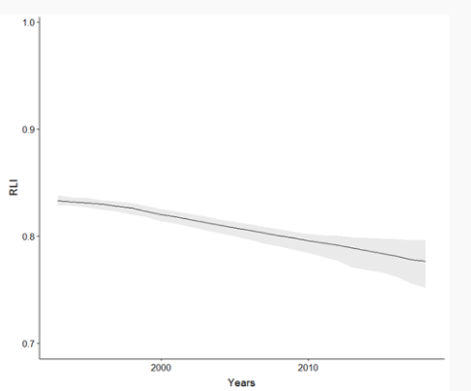
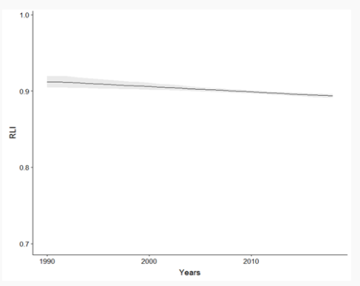
Example
Red List Index
Use global dataset OR use national dataset
Or report ‘no data’ (no national data and no agreement with the global data)
South Africa: Global IUCN Red List (from 6th National Report)
South Africa: National Red List (from 6th National Report)

Slide 9
Common indicator criteria
Related to the topic of the Goal or Target (attempted to place in most relevant place with the aim to reduce duplication)
Indicators currently exist or could be available soon.
Example: Goal C: Number of research and development results or publications shared as a result of an ABS agreement (non-monetary benefits of ABS are difficult to measure and formulate an indicator)
Example: Target 18: Official development assistance, public expenditure and private expenditure on conservation and sustainable use of biodiversity and ecosystems (can mostly be measured and there is work underway on expenditure)

Slide 10
Common indicator criteria (continued)
Indicators have been or are likely to be agreed through a scientific or intergovernmental process
Example: Goal B: Gross Ecosystem Product (being developed under the UN System of Environmental Economic Accounting, SEEA)
Example: Target 1: Percentage of land covered by landscape scale land-use plans for terrestrial, freshwater and marine ecosystems* (existence of plans in SDGs)
Example: Goal 1: The proportion of populations maintained within species (being developed by GEOBON)

Slide 11
Headline and Component level additional criteria
The indicators are nationally and globally relevant, including the ability of the indicator to be disaggregated and aggregated from global to national and national to global scales without creating bias.
Example: Red list index (global database and national databases)
Example: Extent to which legislative, administrative or policy frameworks to ensure fair and equitable sharing of benefits have been adopted (SDG 15.6.1 is the number of countries, this framework has proposed extent as opposed to ‘number’)
(Note that this criteria is not necessary for the Complementary indicators)

Slide 12
Headline and Component level additional criteria (continued)
Preference was given based on data availability and an existing global programme or entity working on the indicator (including providing national capacity building activities)
Indicators that are already being used by some national governments, ideally where there is an opportunity to work with the UN Statistical Commission
Indicators where subnational or geospatial disaggregation is possible.

Slide 13
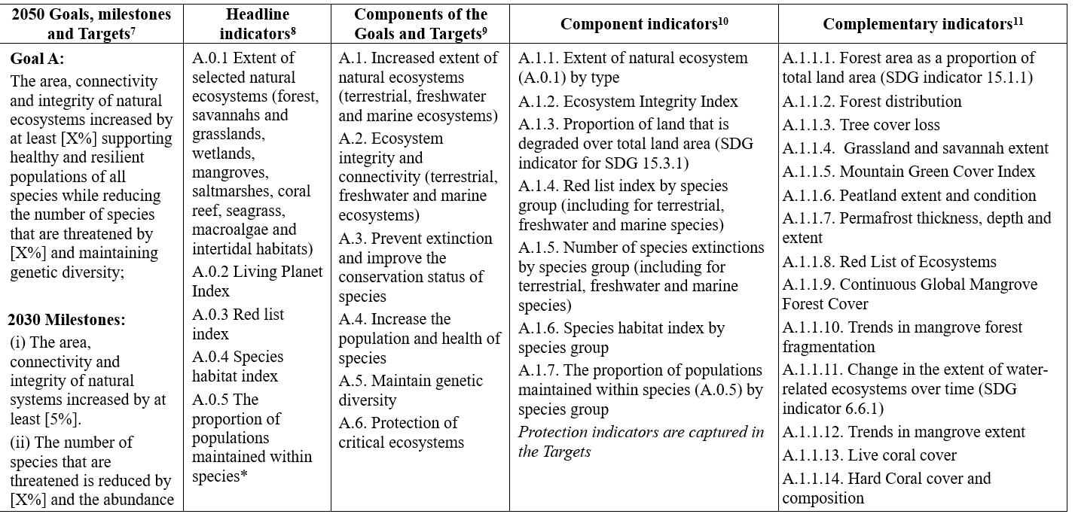

Slide 14
Expert Group
Provide technical advice on the implementation of the indicators and monitoring framework, including definitions, metadata and sharing of best practices
Gap filling advice for temporal and spatial data gaps, including through the use of big data (citizen science, remote sensing, etc.)
Advice on capacity-building needs and modalities
Small group
Composition: mix of Parties (Parties encouraged to nominate technical experts and statisticians from other sectors), NGOs and other stakeholders – based on nominations
Build upon existing biodiversity monitoring initiatives and provide a way to make sure the national relevance and uptake of indicators

Slide 15
Questions ?
facebook.com/UNBiodiversity
twitter.com/UNBiodiversity
instagram.com/UNBiodiversity
linkedin.com/company/UNBiodiversity
Secretariat of the Convention
on Biological Diversity
413 St. Jacques Street, Suite 800
Montreal, Quebec, Canada H2Y 1N9
Tel. +1 514 288 2220
secretariat@cbd.int
www.cbd.int

