Slide 1


Webinar
Modalities for the early submission of statements for SBSTTA-28 and SBI-7
2 July 2026

Slide 2
Webinar
2 July 2026
Introduction
CBD Notification 2026-049 on Information webinars in preparation for SBSTTA-28 and SBI-7
Today’s webinar: Modalities for the early submission of statements for SBSTTA-28 and SBI-6

Slide 3
Webinar schedule
Webinar | Topic | Date(s) | Time (EST, UTC-5)
Webinar session 1 | Modalities for the early submission of statements for SBSTTA-28 and SBI-7 | 2 July 2026 | 9:00-10:30 a.m.
Webinar session 2 |  | 2 July 2026 | 4:00–5:30 p.m.
Content

Slide 4
Webinar structure
Aim: provide information on the modalities for the early submission of statements for SBSTTA-28 and SBI-7.
Presentations will be made as follows:
  Background and overview of the modalities
  How to submit early statements on the portal
  Q & A

Slide 5
Webinar structure
The webinar is NOT a negotiation session
There will be a Q&A after all the presentations have been made
  Please use the Q&A function on Teams to raise your questions
  Technical questions or points of clarification will be addressed

Slide 6
Webinar
28 January 2026
Background and overview of the pilot modalities
Decisions 16/25, CP-11/5, NP-5/10: The Executive Secretary, together with the Bureaux, was requested to explore and make use of, as appropriate, relevant ways and means to facilitate early preparations for meetings, such as options for streamlining agendas, peer-reviewing documents in advance and the early submission of statements.

Slide 7
Background and objectives of the Modalities
Agreement by joint Bureau meeting to implement modalities for early submission of statements for all substantive agenda items of SBI-7 and SBSTTA-28, based on experience from SBI-6 and SBSTTA-27.
Nature of Modalities: Informal and voluntary.
Objectives of the Modalities:
• Facilitate effective preparations for Parties and observers.
• Minimize time spent on first readings of agenda items.
Implementation of modalities should preserve rights of Parties.

Slide 8
Application of the Modalities
Application of the modalities:
All substantive agenda items of SBSTTA-28 (items 3 to 8) as follows:
3. Planning, monitoring, reporting and review:
(a) Global review of collective progress in the implementation of the Kunming-Montreal Global Biodiversity Framework;
(b) Monitoring framework for the Kunming-Montreal Global Biodiversity Framework.
4. Matters related to the work programme of the Intergovernmental Science-Policy Platform on Biodiversity and Ecosystem Services.
5. Synthetic biology.
6. Sustainable wildlife management.
7. Scientific and technical needs to support the implementation of the Kunming-Montreal Global Biodiversity Framework: strategic review of and update to the programme of work on protected areas.
8. Marine and coastal biodiversity.

Slide 9
Application of the Modalities
Application of the modalities cont.:
All substantive agenda items of SBI-7 (items 3 to 14) as follows:
3. Planning, monitoring, reporting and review: global review of collective progress in the implementation of the Kunming-Montreal Global Biodiversity Framework.
4. Resource mobilization and financial mechanism:
(a) Resource mobilization;
(b) Financial mechanism.
5. Digital sequence information on genetic resources.
6. Fifth assessment and review of the effectiveness of the Cartagena Protocol on Biosafety and midterm evaluation of the implementation plan and the capacity-building action plan for the Protocol.
7. Second assessment and review of the effectiveness of the Nagoya Protocol on Access to Genetic Resources and the Fair and Equitable Sharing of Benefits Arising from Their Utilization.
8. Synthetic biology: thematic action plan to support capacity-building and development, access to and transfer of technology and knowledge-sharing.
9. Engagement with subnational governments, cities and other local authorities to enhance the implementation of the Kunming-Montreal Global Biodiversity Framework.
10. Capacity-building and development and technical and scientific cooperation.
11. Clearing-house mechanism and knowledge management.
12. Mainstreaming of biodiversity within and across sectors.
13 . Communication, education and public awareness.
14. Administrative and budgetary matters.

Slide 10
Process overview - Modalities
Process overview:
Issuance of notification: At least one month prior to the meetings (Notification 2026-055 issued on 26 June 2026).
Guidelines for Submission: Upload statements online in any of the six UN languages. Email to Secretariat if facing technical difficulties with uploading.
Template of a statement provided in notification, for voluntary use.
Deadline for submissions: 20:00 hrs. Nairobi time on 26 July 2026, for SBSTTA-28, and on 3 August 2026 for SBI-7.

Slide 11
Process overview - Modalities
Process overview cont.:
Publication: Statements published as-is, no editing by the Secretariat.
AI assisted translations of statements: will be generated, but original statement remains authoritative.
Different publication dates:
Party statements - simultaneously after the submission deadline; unless a Party requests publication of its statement upon upload.
Observer statements: upon upload.

Slide 12
Outcome of the process - Modalities
Information document:
• The Secretariat will prepare an information document to include:
  A list of Parties and observers that submitted statements.
  A link to the statements portal.
Information document to be published on morning of first day of the concerned meeting.

Slide 13
Entry of statements on record - Modalities
Entry of statements on record:
• When an agenda item is taken up for first reading, the Chair will:
State that, unless there are any objections from Parties and observers listed in the information document, their statements will be formally entered on the record.
Invite Parties to express support for specific observer statements by pressing the microphone button for the Chair to read out their names from the speakers’ list.

Slide 14
Revisions or additions - Modalities
Revisions or additional statements:
• Revisions of early statements or additional statements may be submitted according to normal meeting procedures.
• As the early submission process aims to save time, participating Parties and observers encouraged not to deliver an oral statement during the first reading, except to make clarifications.
Rights of Parties to make concise oral interventions not limited.
• Those that did not submit early statements may do so during the formal meeting, following the usual procedure.
No Party to be disadvantaged for not participating in early submission process.

Slide 15
Preparation of CRPs and non-Papers
Preparation of conference room papers:
• As part of the normal meeting procedure, the Chair will prepare:
o A conference room paper; or
o A non-paper, if needed (if a contact group is established).
• These will be based on:
o Oral statements and interventions made during the first reading.
o Early statements entered on record.
• CRPs and non-Papers contain proposed compromise text to facilitate consensus building.
• Chair or contact group co-chairs to provide explanations, as appropriate, on how submissions were reflected in CRPs or non-papers.

Slide 16
Outcome of overall process
The experiences of Parties and observers related to the modalities will continue to be compiled and submitted to the Bureaux for review, with a view to further improving the modalities for future meetings.

Slide 17
Thank you.
Next presentation.

Slide 18
Webinar
2 July 2026
How to submit early statements on the portal

Slide 19
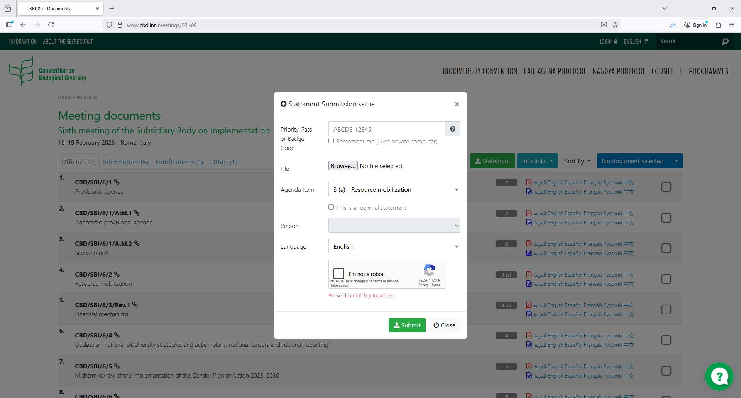

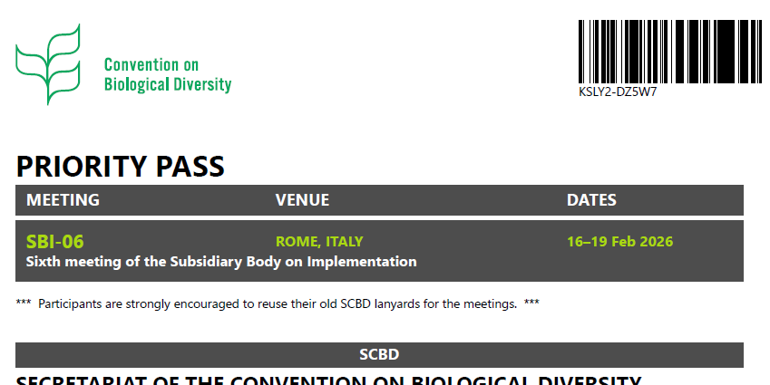
1. Go to meeting page on CBD.int website
https://www.cbd.int/meetings/sbstta-28 or https://www.cbd.int/meetings/sbi-07
3. Enter the Priority-Pass
(Badge Code)
2. Select
“Upload Statement”
XXXXXXXXX
ABCDE-12345
XXXXXXXXX
XXXXXXXXX
XXXXXXXXX
XXXXXXXXXXXXXXXXXXXXXXXXXXXXXXXXXXXXXXXXX
4. Select
the agenda item from the drop down
5. Select the
“I’m not a robot” security checkbox
6. Select “Submit”

Slide 20
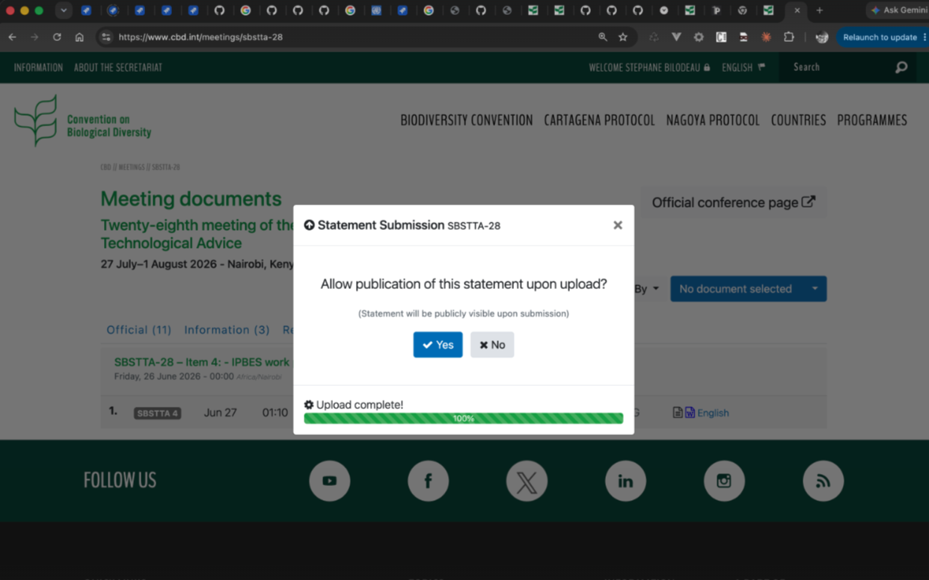
For Parties, an additional prompt will appear:
Allow publication of this statement upon upload (yes / no)

Slide 21
Q & A

