Slide 1
Briefing Webinar – 21 January 2021
SBI-3 agenda item 9
Enhancing Review of the Post-2020 GBF
Options to enhance planning, reporting, and review mechanisms with a view to strengthening the implementation of the Convention
(contained in doc CBD/SBI/3/11)

Slide 2
Preparatory process for the post-2020 GBF
At COP 14, Parties requested the development of options to enhance review mechanisms, with a view to strengthening the implementation of the Convention.
Cop14 also requested the testing of a Party-led review process through an open-ended forum and to consult with Parties and stakeholders on modalities for enhancing the review of implementation.
Paragraph 18 of decision 14/34, requested the SBI to contribute to the development of the post-2020 global biodiversity framework by complementing it with elements related to means to support and review implementation.

Slide 3
Documents prepared for agenda item 9
CBD/SBI/3/11 - Options to enhance planning, reporting, and review mechanisms with a view to strengthening the implementation of the Convention
CBD/SBI/3/11/ADD1 - National reporting under the Convention and its Protocols
CBD/SBI/3/11/ADD2 - Proposed actions to enhance synergies in reporting to biodiversity-related conventions and the Rio Conventions
CBD/SBI/3/INF.3 – Analysis of 6th National Reporting process
Additional documents in preparation:
Updated Analysis of Experiences under the Convention and Other Processes, and Considerations for the Enhancement of a Multidimensional Review Mechanism
Further Information on Non-State Actor commitments and the Post-2020 Global Biodiversity Framework
Further information and Draft Template for National Commitments to the post-2020 Global Biodiversity Framework

Slide 4
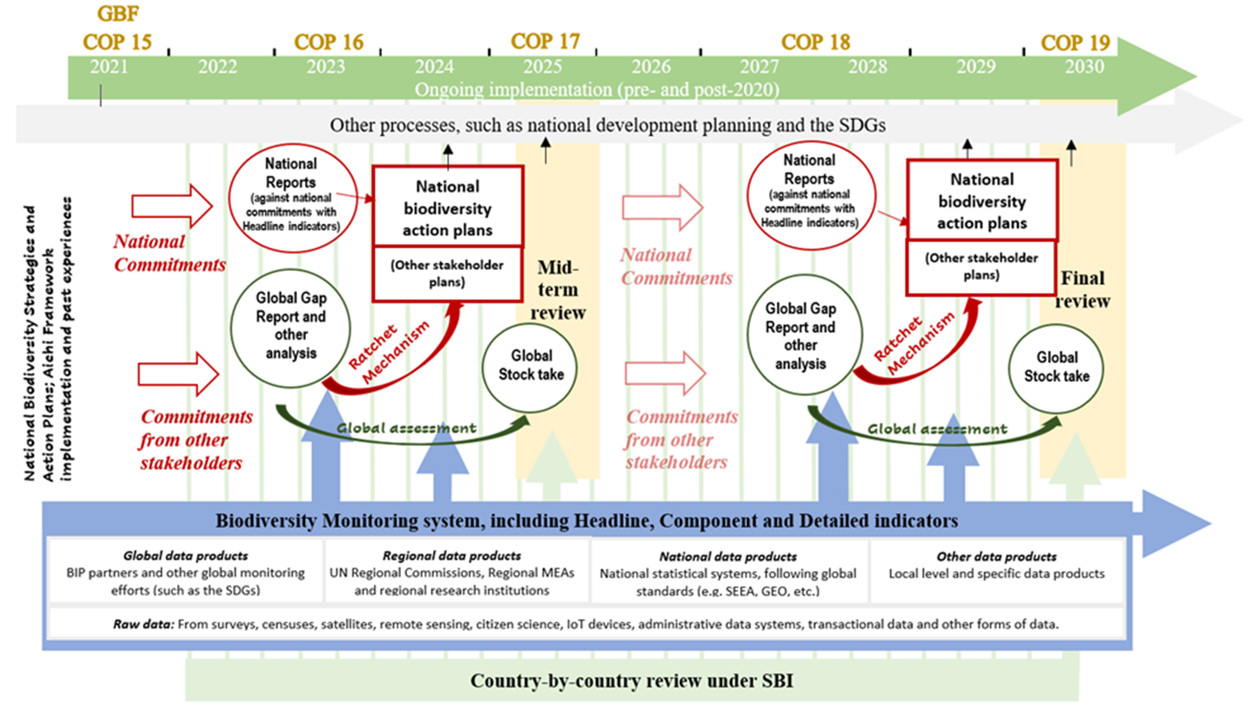

Slide 5
Elements of the system
Mobilizing national commitments and commitments of non-State actors immediately after COP 15*
NBSAP updating or revision in light of the post-2020 GBF as needed
National reporting*
Country-by-country review process under the Subsidiary Body on Implementation
Global analytical review
Promoting the use of indicators for all the above (SBSTTA24/3)
* Covered in more detail in presentations later in this session.
Note: There will likely be a need for additional documentation to explain each element of the system (once a system is determined).

Slide 6
Commitments/Contributions submission
National commitments/contributions towards the global goals and targets would be within the first year of after COP15.
National commitments would be submitted to the clearing-house using a standardized format to facilitate analysis and global review.
Commitments of non-State actors, indigenous peoples and local communities, and stakeholders would continue to be submitted on a voluntary basis using a standardized procedure.
All commitments will be aggregated and a global commitment gap report will be prepared.
Gap analysis will be used to enhance ambition to achieve global goals and targets for the post-2020 period.

Slide 7
National planning - NBSAPs
There should be a feedback loop between planning and reporting and review.
NBSAPs are the main vehicle for national biodiversity planning and implementation.
NBSAPs should provide a whole-of-government (vertical and horizontal) approach and help to increase commitment and political support for implementation of the post-2020 GBF, including by linking with the SDGs and national development planning.
The NBSAP should be an elaboration of the national targets/commitments and how these will be achieved
The National Commitment/Contribution submission form would be a bridge between the National Targets and GBF which would provide a format for standardization of the submission of national targets
Revisions to the NBSAP should be done as necessary on the basis of the above.

Slide 8
National reporting
National reports will continue to be the main monitoring, reporting and review mechanism under the Convention and the Protocols.
Reporting templates for the seventh national report and subsequent reports will have standardized sections relating to the monitoring framework with headline indicators proposed as a mandatory component.
All Parties will report progress against the global goals and targets, drawing upon actions taken at national and local levels and their outcomes.
Non-State actors, indigenous peoples and local communities, civil society and the private sector would also be encouraged to contribute to the national report.

Slide 9
Country-by-country review
Designed to enhance ambition and implementation of the post-2020 GBF through mutual learning among Parties
Conceptually, all countries would have an opportunity to participate in the review once during the decade.
Trial Phase of an Open-Ended Forum on Review of Implementation held online on 16 and 17 Sept 20 (decision 14/29). Findings of survey after the trial included:
Forum could assist in assessing major needs and gaps; bring government units together; enhance capacity-building, peer-to-peer learning and other areas
Clarification is still needed on the specific purpose of the forum; role of Observers and civil society representatives in the forum; common methodology and guidance for preparing the review report and the linkages with reporting on the contribution of national targets

Slide 10
Global analytical review
A biodiversity monitoring information system which would support near-real-time, dynamic monitoring.
Gap analysis of national commitments in relation to the aspirations set out in the post-2020 framework.
This would compare the level of ambition in the GBF to the predicted impact of National and Non-State Actor Commitments in order to identify gaps and a need for ratcheting up.
A global stocktake of implementation (learning from GBO), using information from national reports and gap report.
These would inform the reviews of the Conference of the Parties and its subsidiary bodies.

Slide 11
Monitoring
Covered in SBSTTA agenda item 3 and will be presented in the webinar on 26 January.
Three levels of monitoring
Headline indicators which can be used for both national and global analysis and which will be mandatory/highly-recommended in National Reports
More detailed Component and Complementary indicators
Balance aspiration and feasibility
Preference to existing indicators, but not at the expense of measuring what is important.

Slide 12
Key timing
Within one year of COP15, submission of national commitments – then ongoing
NBSAP revisions as needed in order to align with the GBF and to align with national processes.
At COP16 [in 2023], would review the cumulative impact of national contributions towards each of the goals and targets of the post-2020 global biodiversity framework
By 2024, national report submission
At COP17 [in 2025], undertake a global stocktake of progress towards each of the goals and targets of the post-2020 global biodiversity framework
At COP18 [in 2027/8], updated global review and national reporting
At COP19 [in 2030], final review

Slide 13





Questions ?
facebook.com/UNBiodiversity
twitter.com/UNBiodiversity
instagram.com/UNBiodiversity
linkedin.com/company/UNBiodiversity
Secretariat of the Convention
on Biological Diversity
413 St. Jacques Street, Suite 800
Montreal, Quebec, Canada H2Y 1N9
Tel. +1 514 288 2220
secretariat@cbd.int
www.cbd.int

