Slide 1
Health and Biodiversity
Item 9 of SBSTTA-24
SSSF, PBU, Laetitia Sieffert
2 February 2021

Slide 2
COP decision 14/4
Requests formulated to the Executive Secretary:
Integrated science-based indicators, metrics and progress measurements tools
Targeted messaging approaches on mainstreaming biodiversity for the health sector
Draft global action plan to mainstream biodiversity and health linkages into national policies, strategies, programmes and accounts
Promotion and facilitation of dialogues, regional and subregional capacity-building workshops on biodiversity-health approaches
Compilation of information and exploration of a mechanism to facilitate access to scientific literature and other reports on health and biodiversity

Slide 3
Health and biodiversity for SBSTTA-24
Approach to health and biodiversity :
Multiple interlinkages between health and biodiversity
Biodiversity-inclusive one health approach, among other holistic approaches
Contextualization with COVID-19 and reducing risks of future pandemics
Recognition of common drivers to biodiversity loss and negative health outcomes
‘Build back better’ agenda and post-2020 global biodiversity framework
Partnerships:
Inter-agency Liaison Group (ILG) on Biodiversity and Health, WHO-CBD joint programme of work
Pre-session documents to be made available for SBSTTA-24 formal meeting:
Agenda item 9 – Biodiversity and Health and Annex
Information document

Slide 4
Pre-session documents for SBSTTA-24
Agenda item 9 - Biodiversity and Health
Section I - Recalling requests to the Executive Secretary formulated in decision 14/4
Section II - Contextualization of interlinkages between biodiversity and health in light of the COVID-19 pandemic, and reference to the ‘build back better’ agenda
Section III - Summary of activities and updates
science-based indicators (reference to post-2020 global biodiversity framework)
targeted messaging approaches
dialogues and capacity-building workshops
information sharing
Section IV - suggested recommendation
Annex: Global Action Plan for Biodiversity and Health
Information document - Synthesis of key messages on mainstreaming health and biodiversity interlinkages

Slide 5
Timeline for Global Action Plan
Draft document shared with WHO and ILG
Draft document issued for peer review
(4 weeks)
Completion of draft document
Availability of documents for SBSTTA-24
(6 weeks)
2 February
SBSTTA-24 BRIEFING
17-19 & 24-26 February
INFORMAL MEETING OF SBSTTA-24
FORMAL MEETING OF
SBSTTA-24

Slide 6
References and key materials (1)
CBD leading reference documents:
Special virtual session for SBSTTA-24 and SBI-03 on biodiversity, One Health and COVID-19:
Discussion document on biodiversity, one health and the response to COVID-19 (CBD/SBSSTA-SBI-SS/2/2)
Technical information on biodiversity and pandemics (CBD/SBSTTA-SBI-SS/2/Inf/1)

Slide 7
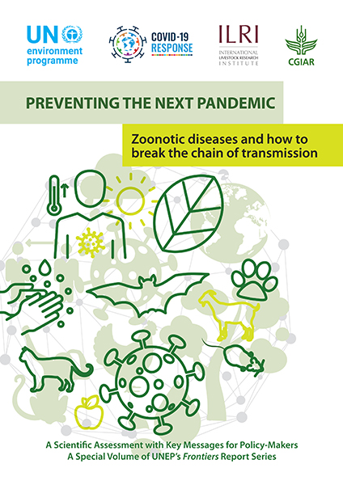
References and key materials (2)
Reports and activities by partners (non exhaustive) :

Slide 8
Questions ?
facebook.com/UNBiodiversity
twitter.com/UNBiodiversity
instagram.com/UNBiodiversity
linkedin.com/company/UNBiodiversity
Secretariat of the Convention
on Biological Diversity
413 St. Jacques Street, Suite 800
Montreal, Quebec, Canada H2Y 1N9
Tel. +1 514 288 2220
secretariat@cbd.int
www.cbd.int

