Slide 1
Invasive alien species
Item 10 of SBSTTA-24
SSSF, Junko Shimura and Katie Millette
2 February 2021

Slide 2
COP decision 14/11
Online discussion forum on development of IAS management tools and guidance
Ad Hoc Technical Expert Group on IAS to provide advice or develop elements of technical guidance on management measures on invasive alien species to be implemented by broad sectors
To explore with the Secretariat of the United Nations ECOSOC, the WCO and the Inter-agency Liaison Group on IAS the possibility of developing a system of classification and labelling

Slide 3
Findings of GBO5 on Target 9
Number of successful eradications

Slide 4
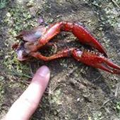
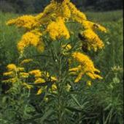
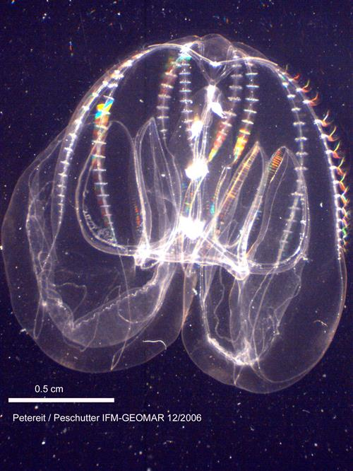
Status of Biological Invasions
Ca. 22,000 alien species have been spread, globally
Ca. 4,000 (18%) species are invasive alien species
CBD country profile page on CHM (http://www.cbd.int/countries) shows the link to IAS information for Parties contained in GRIIS

Slide 5
Status of Regulations
National regulations on IAS in 70 countries by 2015
National regulations are mostly relevant to controls established on IAS
Preventive regulations based on formal risk analyses are advised
Pathway measures in marine & aquatic environments advanced
Unintentional introductions (contaminants, stow-away) guidance is approved (annex to decision 14/11)
(Turbelin et al. (2017), J. Ecol. Biogeogr.)

Slide 6
Outcome of the Online Forum CBD/IAS/AHTEG/2019/1/INF/1
Elements of technical guidance
(outcome of Online Forum on IAS, May – Sept 2019)
Participation by 98 experts from Parties and organizations, 258 contributions filled in the forum discussion
Conclusion was considered by AHTEG: CBD/IAS/AHTEG/2019/1/INF/1
(https://www.cbd.int/doc/c/d56b/254f/f263e27be6e1bb97f564e21d/ias-ahteg-2019-01-inf-01-en.pdf)
Notes:
Analyses on biological invasion risk, cost and benefit/efficiency, management feasibility, and the potential impact on biodiversity and cultural values;
Environmentally hazardous articles to raise awareness among the officials in agriculture and transport sector and the Customs;
Explanatory guide for scientific community to share the data and data tools on invasive alien species;
Training guide to fulfill the capacity required;
Publication of best practices of invasive alien species management;
Explanatory guide on how to apply the SPS measures for invasive alien species
management.

Slide 7
SBSTTA to consider elements of CBD guidance
CBD/SBSTTA/24/10
Annex I. Analyses on invasion risk and costs
Annex V. Existing standards relevant to IAS
Annex II. Issue of E-Commerce and regulations
Annex I. Multi-criteria decision making
Annex V. Technical capacity gap to fill
Annex III. Climate change etc.
Annex IV. IAS occurrence and impact data

Slide 8
Progress on classification and labelling for consignments of living organisms
“Guidance on Devising and Implementing Measures to Address the Risks Associated with the Introduction of Alien Species as Pets, Aquarium and Terrarium Species, and as Live Bait and Live Food” annexed to decision XII/16
“Supplementary Voluntary Guidance for Avoiding Unintentional Introductions of Invasive Alien Species Associated with Trade in Live Organisms” (decision 14/11, annex I) called for the labelling of the “potential risk to biodiversity”
An informal document entitled, “Environmentally hazardous articles(living organisms)” to the Sub-Committee of Experts on the Transport of Dangerous Goods at its fifty-fifth session (1 to 5 July 2019 in Geneva). The Sub-Committee noted the request to explore the inclusion of environmentally hazardous living organisms into chapter 2.9, class 9 of the “United Nations Recommendations on the Transport of Dangerous Goods - Model Regulations”, to prevent the introduction of invasive alien species
The WCO specified prohibited and restricted goods, under the WCO Framework of Standards on cross-border e-commerce, including living organisms, invasive alien species, sanitary and phytosanitary concerned goods (regulated pests, pathogens)

Slide 9
LIST OF DOCUMENTS
CBD/SBSTTA/24/10
CBD/SBSTTA/24/INF/15
Invasive alien species: technical specifications under the World Customs Organization Framework of Standards on Cross-border E-commerce
CBD/AHTEG/IAS/2019/1/2 (Outcome of Online Forum)
CBD/IAS/AHTEG/2019/1/3 (Outcome of AHTEG)

Slide 10
Thank you for your attention Questions ?
Secretariat of the Convention
on Biological Diversity
413 St. Jacques Street, Suite 800
Montreal, Quebec, Canada H2Y 1N9
Tel. +1 514 288 2220
secretariat@cbd.int
www.cbd.int
facebook.com/UNBiodiversity
twitter.com/UNBiodiversity
instagram.com/UNBiodiversity
linkedin.com/company/UNBiodiversity

