Slide 1

Information Webinar in preparation for the upcoming
28th meeting of the Subsidiary Body on Scientific, Technical and Technological Advice (SBSTTA 28)
27 July – 1 August 2026
Nairobi, Kenya

Slide 2
SBSTTA-28 and SBI-7 Preparatory Webinar Series
Date | Webinar Theme | Main Topics
25 June 2026 | SBSTTA-28 Information Webinar | Synthetic biology, sustainable wildlife management, strategic review of the PoWPA , and marine and coastal biodiversity.
2 July 2026 | Early Submission of Statements | Modalities and practical arrangements for the early submission of statements.
3 July 2026 | SBSTTA-28 Information Webinar | Global report on collective progress, monitoring framework for the KMGBF, and collaboration with IPBES.
7 July 2026 | SBI-7 Preparation Webinar | Resource mobilization, financial mechanism, digital sequence information, and planning, monitoring, reporting and review.
8 July 2026 | SBI-7 Preparation Webinar | Cartagena Protocol, Nagoya Protocol, capacity-building, and mainstreaming.
21 July 2026 | Functional Review and Budget Webinar | Progress on the Functional Review of the Secretariat and the draft budget for 2027–2028.

Slide 3
Agenda
Welcome and introduction (5 minutes)
Agenda Item 5: Synthetic Biology (15 minutes)
Agenda Item 6: Sustainable Wildlife Management (15 minutes)
Agenda Item 7: Strategic review of and potential updates of the programme of work on protected areas (15 minutes)
Agenda Item 8: Conservation and sustainable use of marine and coastal biodiversity (10 minutes)
Questions and answers (20 minutes)
Closing remarks and next steps (5 minutes)

Slide 4
Webinar structure
Aim: provide technical information, including an overview of the documentation.
The webinar is NOT a negotiation session
Each agenda item will be presented and then there will be a Q&A
  Please use the Q&A function on Teams to raise your questions
  Technical questions or points of clarification will be addressed

Slide 5
28th meeting of the Subsidiary Body on Scientific, Technical and Technological Advice
27 July – 1 August 2026
Nairobi, Kenya

Slide 6
Item 5: Recent decision on synthetic biology (decision 16/21)
Thematic action plan to support capacity-building and development, access to and transfer of technology and knowledge-sharing in the context of synthetic biology for the implementation of the Convention and the Kunming-Montreal Global Biodiversity Framework
Established a new Ad Hoc Technical Expert Group on Synthetic Biology
Submissions of information
Convening of the Open-ended Online Forum
Commissioning an independent scientific study
Ad Hoc Technical Expert Group on Synthetic Biology
  Review and synthesize information gathered
  Build upon the work under the Convention and its Protocols
  Identify current and potential benefits of synthetic biology
  Identify the potential positive and the potential negative impacts of the most recent technological developments
  Provide advice on how capacity-building, technology transfer and knowledge-sharing could be taken into account in the light of future developments

Slide 7


Item 5: 2025-2026 Intersessional period (based on decision 16/21)
Thematic action plan
Aug. 2025-Apr. 2026
First draft: Aug-Dec 2025
Peer review: Dec 2025-Jan 2026
Finalization: Jan-Apr 2026
Vilm workshop
Nov. 2025
COP-16
Submissions of info
May-Aug. 2025
Online forum
Feb.-Mar. 2026
AHTEG
SBSTTA/SBI
COP-17
Oct. 2024
May 2026
July-Aug. 2026
Oct. 2026
Commissioning of independent scientific study
May 2025-2026
Expression of interest: May-June 2025
First draft: Aug 2025-Mar 2026
Peer review: Mar-Apr 2026
Finalization: Apr-May 2026
SBSTTA:
Outcomes of AHTEG
Thematic action plan
SBI:
Implementation elements of the thematic action plan

Slide 8
Thematic action plan (SBSTTA 4/Add.1 + SBI 8/Add.1)
Support capacity-building, technology transfer and knowledge-sharing for implementation of Convention + KMGBF
Institute of Genetics and Cytology of the National Academy of Sciences of Belarus + EU funding
Based on: 29 submissions from 19 Parties, 1 UN agency and 9 organizations
Peer review (notification 2025-149) – 36 submissions (17 Parties, 1 non-Party, 18 Organizations)
Introduction
Structure
Linkage to the Convention and the KMGBF
Use of the thematic action plan
Guiding principles
Means of implementation
Role of the Secretariat and the Scientific and Technical Support Centres
Monitoring and reporting on the progress in the implementation of the thematic action plan
Outcome area 1: Strengthened capacity for research and development and assessment of synthetic biology
Outcome area 2: Improved access to and transfer of technology relevant to synthetic biology
Outcome area 3: Enhanced knowledge-sharing on synthetic biology, including its development, assessment, governance and regulation
For both R&D + assessment
Indicators removed between versions
Notes:
Integrated approach to:
Strategies for equitable participation
Strategies to promote fair and equitable benefits sharing
Mechanisms for technology transfer, knowledge-sharing and technical and scientific cooperation
Other changes from peer review included liaising with colleagues to ensure language was consistent with other programmes of work

Slide 9

Item 5: Outcomes of the AHTEG on synthetic biology
Meeting of the AHTEG was held from 19 to 22 May 2026
Funding from EU
28 experts + SBSTTA chair and staff from UNEP attended
Conclusions relevant for SBSBTA in Annex IV to CBD/SBSTTA/28/4
Capacity-building, technology transfer and knowledge-sharing in light of future developments
  Approach should be flexible + forward looking
  Parties would benefit from horizon scanning
Review and synthesis of information gathered
  Suggestions for improving scientific studies
  Noted IUCN policy and BWC working group

Slide 10
Item 5: Outcomes of the AHTEG on synthetic biology
Current benefits of synthetic biology (Annex I to CBD/SBSTTA/28/4)
  Initial, illustrative list – Table with examples, target of the Framework and the benefit(s)
  Differing perspectives on what could be considered to be a benefit; lack of mechanisms for quantifying
Potential benefits of synthetic biology (Annex II to CBD/SBSTTA/28/4)
  Targets addressed: 1, 2, 4 to 13, 16, 17, 19 and 20
  Contextualized uses with illustrative examples – context-specific
  Links to Framework may need additional consideration and connection to indicators have yet to be established
Most recent technological developments in synthetic biology (Annex III to CBD/SBSTTA/28/4)
  Prioritized the following areas of technological development:
    Artificial intelligence and computational biology
    Bioremediation and waste reduction applications
    Artificial cells, synthetic genomics and artificial biochemical pathways
    Applications for conservation use
    Microbiome engineering

Slide 11
Item 5: Draft recommendation
Recommendations to SBSTTA + SBI were kept separate; merged following meetings
Adoption of thematic action plan
Welcoming of the work of the AHTEG
Taking note of the outcomes from the AHTEG
Further information gathering on the five prioritized areas of technological development*
  Submissions of information + Discussions of the Open-Ended Online Forum
Establishment of an ad hoc technical expert group
  Assess areas of technological development
  Provide recommendations on how to address these areas
  Report to SBSTTA
Requests to Executive Secretary
  Syntheses of information
  Convening AHTEG
  Support full and effective participation of indigenous people and local communities
  Support for women, youth and academia
  Cooperation with other international organizations
    * Artificial intelligence and computational biology; Bioremediation and waste reduction applications; Artificial cells, synthetic genomics and artificial biochemical pathways; Applications for conservation use; Microbiome engineering

Slide 12
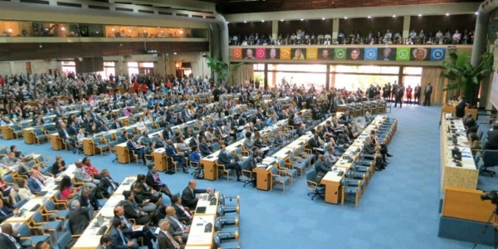

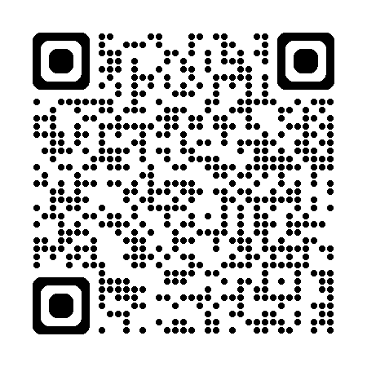

Item 5: Additional information related to synthetic biology
Workshop held before SBSTTA-28
  Noon session on synthetic biology
  25 July 2026
  Nairobi, Kenya
Documents from the meeting of the AHTEG
  Report + considerations
Implementation elements of the thematic action plan will be considered at the seventh meeting of the SBI
Report of the first synthetic biology capacity-building workshop:
  2-6 November 2025, Ilse of Vilm, Germany

Slide 13
28th meeting of the Subsidiary Body on Scientific, Technical and Technological Advice
27 July – 1 August 2026
Nairobi, Kenya

Slide 14
SBSTTA 28
Item 6. Sustainable wildlife management

Slide 15
SBSTTA 28
Background
This mandate comes from previous discussions under the CBD, namely:
Decision 14/7 requested the Executive Secretary to identify areas where complementary guidance may be needed.
Decision 15/23 requested the Executive Secretary to complete the mandate from decision 14/7.
Gap analysis conducted by the CPW and the Secretariat, to identify areas not adequately covered by existing guidance. (INF docs COP 16)
Decision 16/15: Requested the Executive Secretary to prepare draft global guidance on the sustainable management of wildlife applicable to multiple species and multiple practices, with a focus on:
  Inclusive and participatory decision-making;
  The inclusion of multiple systems of knowledge and the recognition of rights;
  The equitable distribution of costs and benefits.

Slide 16
SBSTTA 28
Approach
Submissions of Information
April-May 2025
Expert meeting
February 2026
Peer review
April 2026
SBSTTA
August 2026
Notifications 2025-014 and 2025-015
Submissions provided information on practical experiences, implementation challenges, and proposed priorities for inclusion in the guidance.
Brought together Parties, IPLCs, UN bodies, scientific experts, and other stakeholders. The meeting helped validate findings and refine key elements of the guidance.
The draft guidance was circulated to Parties and organizations for feedback through notification 2026-024. Comments helped improve the draft document.
The guidance was revised based on all inputs. The new draft has now been made available for SBSTTA consideration.
Review of existing materials: relevant CBD decisions, existing guidance, the IPBES assessment on the sustainable use of wild species, the CPW and CBD’s gap analysis
The Secretariat convened an informal technical steering committee composed of CPW, CMS, and CITES. The committee provided support
for the preparation of the draft global guidance

Slide 17
SBSTTA 28
Key findings
Contextual | Technical
Fragmented policies and poor coordination across sectors continue to be a major barrier to the effective implementation of SWM measures. Thus, cross-sectoral policy coherence and coordination are important for facilitating the implementation of the guidance | Recognition of the impact of the drivers of biodiversity loss on the decline of many wildlife populations and species
The need for a management systems that integrates scientific and local systems of knowledge and ensures that wildlife management remains ecologically sustainable and aligned with conservation objectives | The importance of sustainable use was highlighted along with the need for stronger safeguards and precautionary restrictions
Effective SWM depends on structured and meaningful participation of IPLCs, a wide range of stakeholders, and it can be strengthened when it draws on multiple systems of knowledge and is implemented in ways that ensure the recognition of rights, governance systems and responsibilities | Global guidance must remain flexible enough to accommodate different species, ecosystems, and national circumstances, but it can be complemented with more context-specific implementation guidance
The equitable distribution of costs and benefits is important for SWM, as it strengthens fairness, legitimacy and long-term effectiveness | SWM is supported by a broad international normative framework, including the CBD, CMS, CITES, FAO, and IUCN

Slide 18
SBSTTA 28
The draft global guidance in summary
The draft guidance has been structured as follows:
Context
Mandate
Purpose and scope
Principles
Safeguards
Key elements for developing and implementing policies on sustainable wildlife management
Actions for implementation for sustainable wildlife management
A. Cross-cutting Elements: Policy coherence and cross-sectoral integration
B. Inclusive and participatory decision-making
C. Inclusion of multiple systems of knowledge and a human rights-based approach
D. Equitable distribution of costs and benefits

Slide 19
SBSTTA 28
Key conclusions/ what the guidance proposes
The guidance sets out general principles, safeguards and broad areas for action to support Parties in strengthening national approaches to sustainable wildlife management.
Implementation of the present guidance may be adapted to national and local contexts, taking into account ecological conditions, cultural diversity and governance systems.
The guidance propose actions on 4 areas:
  Cross-cutting elements: policy coherence and cross-sectoral integration
  Inclusive and participatory decision-making
  Inclusion of multiple systems of knowledge and recognition of rights
  Equitable distribution of costs and benefits

Slide 20
SBSTTA 28
SBSTTA recommendation
The draft recommendation proposes that COP 17 adopt the global guidance and encourage Parties and relevant stakeholders to integrate it into national biodiversity strategies and action plans, wildlife policies, legal and institutional frameworks, and relevant sectoral and cross-sectoral plans;
It further promotes coherent implementation across sectors involved in wildlife management, implementation of the guidance through capacity-building, technical cooperation and resource mobilization, and encourages the monitoring of implementation, exchange of experiences and lessons learned, and reporting on progress;
Requests the Executive Secretary to, among other things promote awareness and facilitate the use of the guidance, exchange of experiences, and compile information on the use and effectiveness of the guidance and present the information to SBSTTA.

Slide 21
SBSTTA 28
Thank you

Slide 22
28th meeting of the Subsidiary Body on Scientific, Technical and Technological Advice
27 July – 1 August 2026
Nairobi, Kenya

Slide 23
SBSTTA 28
Item 7. Strategic Review of and Update to the Programme of Work on Protected Areas

Slide 24
SBSTTA 28
Background
Review of the Programme of Work on Protected Areas (PoWPA)
Adopted at COP 7 (2004) as the primary global framework for protected areas.
Guided national and international action on protected area systems for over 20 years.
COP 16 requested a strategic review of PoWPA in light of the Kunming-Montreal Global Biodiversity Framework (KMGBF) – decision 16/32.
The review was to assess the continued relevance and identify opportunities to align PoWPA with current biodiversity goals.

Slide 25
SBSTTA 28
Methodology
1. Strategic review and gap analysis
Mapping of PoWPA goals, elements and activities against the KMGBF
Call for views and information (notification 2025-135): 29 submissions received (13 Parties, 16 organizations).
Review of relevant COP decisions and CBD technical and scientific documents
2. Peer review
Draft review circulated through notification 2026-023: 32 submissions received (15 Parties, 17 organizations)
3. Output
Strategic review of and update to the programme of work on protected areas (SBSTTA 28 agenda item 7, CBD/SBSTTA/28/6)

Slide 26
SBSTTA 28
Key findings 1: PoWPA Remains Relevant
Strong support from Parties, indigenous peoples and local communities, and relevant organizations.
PoWPA continues to serve as a reference for national planning and implementation of protected and conserved areas.
Many countries continue to use PoWPA concepts, approaches and tools.
Particular relevance recognized in supporting implementation of Target 3.

Slide 27
SBSTTA 28
Key Finding 2: Strong Alignment with the KMGBF
The PoWPA contributes directly to several KMGBF targets, particularly Target 3.
Strong guidance already exists on:
  Protected area planning
  Management effectiveness including governance, participation and equity
Further alignment could strengthen coherence with evolving policy approaches, scientific knowledge and terminology.
Relevance recognized in supporting implementation of Target 3.
Some targets would benefit from updated and strengthened alignment

Slide 28
SBSTTA 28
Key findings 3: Priority Focus on Target 3
Phased prioritization approach: Most submissions identified Target 3 as the primary focus for updating PoWPA.
Based on submissions and the gap analysis, the Secretariat organized proposed updates into 3 categories, allowing efforts to focus primarily on the areas most relevant to supporting implementation of Target 3.
Priority actions | Areas most directly relevant to supporting Target 3 implementation
Complementary actions | Targets partially addressed by the programme
Areas for further development | Address gaps and emerging issues

Slide 29
SBSTTA 28
Key priorities identified by submitters
  Better integration of other effective area-based conservation measures & indigenous and traditional territories.
  Human rights-based approaches and equitable governance.
  Ecological connectivity.
  Climate change and resilience.
  Sustainable finance
  Monitoring and evaluation systems.
  Facilitate exchange of experiences and good practices.
  Strengthen capacity-building and technical support.
  Alignment with the timeframe of the KMGBF.

Slide 30
SBSTTA 28
SBSTTA recommendation
SBSTTA draft recommendation to the COP:
  Recognize the continued contribution of PoWPA to implementation of the KMGBF, particularly Target 3.
  Update the programme to strengthen alignment with the KMGBF and address identified gaps.
  Rename the programme as the ”Programme of Work on Protected and Conserved Areas" to improve clarity and coherence.
  Promote implementation through human rights-based approaches including equitable governance.
  Request continued support from the Secretariat and partners through capacity-building, knowledge sharing and technical assistance

Slide 31
SBSTTA 28
Thank you

Slide 32
28th meeting of the Subsidiary Body on Scientific, Technical and Technological Advice
27 July – 1 August 2026
Nairobi, Kenya

Slide 33
28th meeting of the Subsidiary Body on Scientific, Technical and Technological Advice
27 July – 1 August 2026
Nairobi, Kenya

Slide 34

SBSTTA 28
Item 8. Marine and Coastal Biodiversity
Joe Appiott, Programme Management Officer, Marine, Coastal and Island Biodiversity

Slide 35
SBSTTA 28
Overview
Submissions of new EBSA descriptions and modifications to existing descriptions
Continuation of EBSA Informal Advisory Group
Voluntary guidelines on peer-review processes for the description of EBSAs and other relevant compatible and complementary scientific criteria
Catalyzing new EBSA submissions in ABNJ (possible global workshop to catalyze submissions)
Ecologically or Biologically Significant Marine Areas (EBSAs)
Conservation and sustainable use of marine and coastal biodiversity
Updating of previous CBD guidance (e.g., MPA networks, cold-water biodiversity, EIAs/SEAs)
Issues related to marine biodiversity beyond national jurisdiction (BBNJ), including possible formation of an Informal Advisory Group on BBNJ

Slide 36
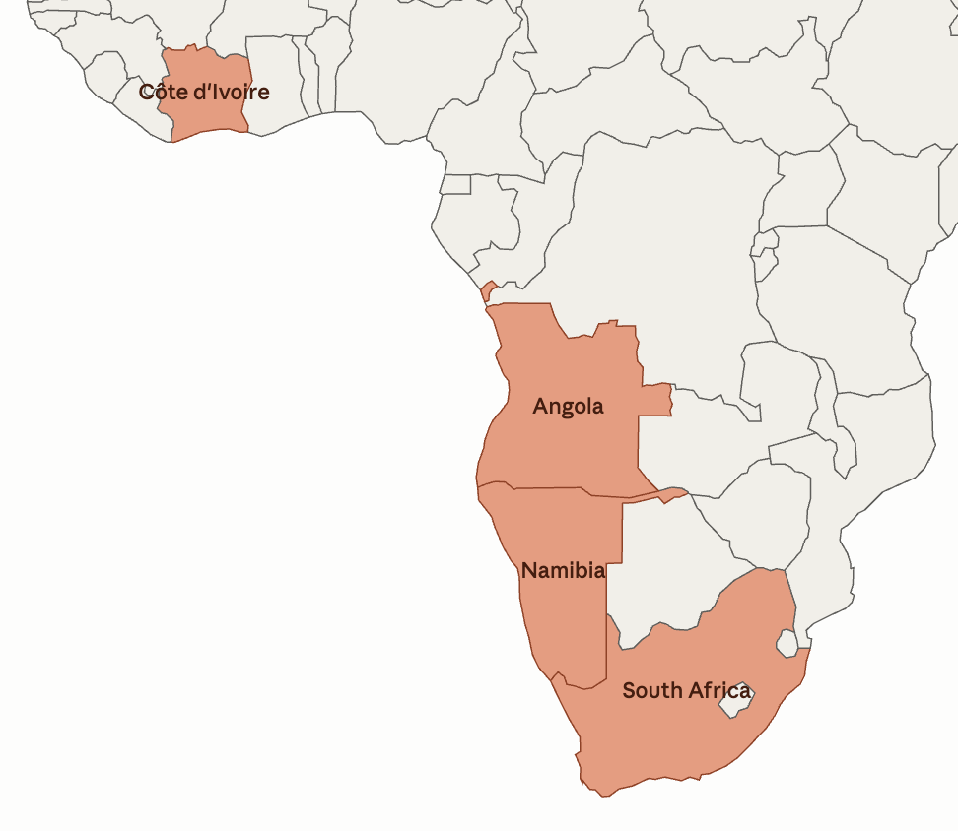
SBSTTA 28
EBSA SUBMISSIONS
New modalities for the EBSA process adopted at CBD COP 16 (decision 16/16)
29 submissions from Angola, Côte d’Ivoire, Namibia and South Africa
  All within national jurisdiction (some straddling multiple jurisdictions)
  11 submissions for new areas; 18 submissions for modifications
In line with the modalities, submissions have been opened for comment for 6 months and comments addressed
Next step is consideration by SBSTTA and COP
  COP to decide whether to include in EBSA repository
No submissions received in marine areas beyond national jurisdiction (ABNJ)

Slide 37
SBSTTA 28
EBSA PEER- REVIEW GUIDELINES; EBSA IAG
Voluntary guidelines on peer-review processes for the description of areas meeting the EBSA criteria and other relevant compatible and complementary scientific criteria
  Requested in decision 16/16
Draft guidelines were…
  Developed by the Secretariat, then
  Reviewed by the EBSA Informal Advisory Group, then
  Opened for comment through notification 2026-011
  Sections of the draft guidelines:
    Information regarding the criteria for which the area is being proposed
    Clear justification of why the area meets the criteria
    Experts engaged in the peer-review process
    Establishing and conducting the peer-review process
EBSA Informal Advisory Group held two meetings as well as a special informal session on issues related to marine biodiversity of areas beyond national jurisdiction

Slide 38

SBSTTA 28
MARINE BIODIVERSITY OF AREAS BEYOND NATIONAL JURISDICTION (ABNJ)
Expert workshop on scientific and technical work conducted under the Convention on Biological Diversity relevant to marine biodiversity in areas beyond national jurisdiction, Bergen, Norway, 2-5 December 2025
Bergen’s ocean of opportunities: Co-Chairs’ summary of opportunities for cooperation and further work under the CBD to contribute to the conservation and sustainable use of biodiversity of ABNJ
  Opportunities to catalyse improved national-level coordination and cooperation
  Opportunities for cooperation across competent organizations on biodiversity-related issues
  Opportunities for further work under the Convention on Biological Diversity

Slide 39
SBSTTA 28
OVERVIEW OF THE DRAFT RECOMMENDATIONS
Ecologically or biologically significant marine areas (EBSAs)
Extend term of the EBSA Informal Advisory Group | Paragraph 1
Consideration of EBSA submissions | Paragraphs 2 and 5
Encourage further engagement in EBSA process | Paragraph 3
Adopt voluntary guidelines | Paragraph 4
Request Secretariat to catalyze further EBSA submissions, including through global EBSA ABNJ catalyzing workshop | Paragraph 6
Conservation and sustainable use
Welcome entry into force of BBNJ Agreement | Paragraph 7
Appreciation for CBD ABNJ expert workshop | Paragraph 8
Encourage strengthened national-level coordination on BBNJ issues | Paragraph 9
Encourage use of CBD guidance in conservation and sustainable use in ABNJ | Paragraph 10
Request Secretariat to work with other competent organizations to share tools and guidance under CBD that are relevant to ABNJ management | Paragraph 11
Request Secretariat to update specific previous guidance | Paragraph 12
Establish Informal Advisory Group for BBNJ issues | Paragraph 13

Slide 40
Q & A

Slide 41
Thank you
https://www.cbd.int/meetings/SBSTTA-28

