Slide 1
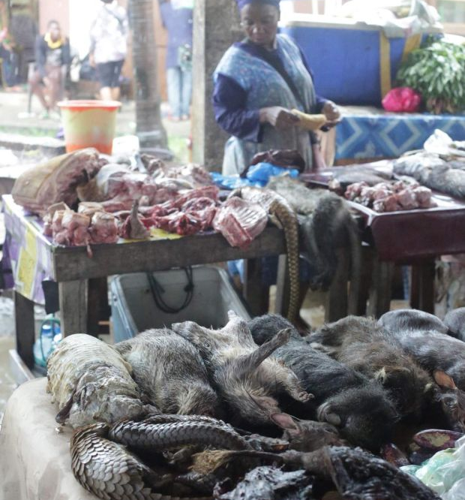

GEF’s COVID-19
Response Task Force
CBD Meeting on Biodiversity, One Health and COVID-19
December 15, 2020
Mark Zimsky
GEF Biodiversity Coordinator
Notes:
My name is Mark Zimsky and I am the head of the biodiversity program at the GEF Secretariat. It is a pleasure to participate in this special CBD meeting on biodiversity, one health, and covid-19.

Slide 2
COVID-19 impact on GEF’s work
Currently impacting GEF’s project design, operations and implementation
In many instances, GEF projects are designed to address the actual drivers and root causes that have led to the current pandemic:
  Collectively, conserving protected areas, mainstreaming biodiversity into production landscapes and seascapes, reducing impact of food systems on natural ecosystems, improving land use planning, all help prevent the emergence of zoonotic diseases
COVID-19 poses both risk and opportunity to the viability of GEF investments now and into the future
GEF formed a COVID-19 task force of technical experts and their respective institutions to help GEF map a way forward to respond to the risk and opportunity that COVID-19 presents in the short, medium and long-term
Notes:
Today, I would like to bring to your attention the work of the GEF COVID-19 task force. The Task Force has been convened to help map a way forward to respond to the risks and opportunities that COVID-19 presents in the short, medium and long-term. For an organization like the GEF, the disruptions caused by COVID-19 have proven to be insidious and widespread. We decided early in the pandemic to start examining what we could do, along with our partner agencies, to ameliorate the impacts of COVID and put in place measures that could mitigate the emergence of new zoonotic diseases. It became obvious that three areas of our work – protected areas and landscape management, food systems and land use, and our work on global wildlife trade– each could play a central role in dealing with COVID-19. I will now briefly describe the progress with the work of the task force.

Slide 3
Objectives of the GEF COVID-19 Task Force
Short-term
Mid-term
Long-term
Greater focus on wildlife trade and consumption challenges
Conduct analysis on the future risks of emerging infectious diseases
Identify risks in GEF projects and programs
Develop an internal blueprint on deploying GEF-7 projects that can help sustainable post-COVID-19 recovery
Provide guidance to the GEF-8 cycle identifying promising action areas within the mandate of the GEF
Notes:
The work of the task force can be divided in short-, medium-, and long-term objectives. In the short-term, we envision greater focus on wildlife trade and consumption challenges through our Global Wildlife Program. One area of focus would be to speed up analyses on the future risks of emerging infectious diseases of zoonotic nature. We have also introduced for all GEF projects a set of guidelines on how to deal with the pandemic in project design and how GEF investments can start contributing to green recovery efforts. Finally, the task force is serving to provide guidance to the GEF-8 cycle which will begin negotiations in early 2021.

Slide 4













Composition of the Task Force
GEF bodies
GEF
Agencies
Conservation Organizations
Health and
Philanthropic
Organizations
Notes:
The task force is composed of like-minded organizations including GEF agencies, conservation NGOs and health and philanthropic foundations, who have generously invested their time and expertise to help us consider how to best tackle the challenges of COVID-19.

Slide 5
Key Topics Covered
Wildlife trade and consumption (link to GEF GWP)
SFM in the Amazon (link to GEF ASL Program)
Food systems & land use (link to GEF FOLUR Program)
Nature-based Tourism
Indigenous peoples
Behavior change and systems change

Slide 6

White Paper
Outline
GEF and a COVID-19 Response Strategy
Background on the Science of SARS-CoV-2 and other Zoonotic Diseases
Opportunities for GEF Investment at a Project/Program Scale
  Biodiversity, Land Use Change/Land Degradation, Infrastructure, Human Health connections, Wildlife Trade, Domestic Animals and Agriculture, Climate Change, Disease management, Chemicals and Waste
Opportunities for GEF Investment and Partnership at a Global scale
  Behavior Change, One Health approaches, Resilience, Innovative Finance and Private Sector Engagement
Green Recovery: Green and blue infrastructure and modernizing global environmental governance; promote greening stimulus packages that include green building renovation, clean public transport, decentralized energy systems and promotion of local food supply chain and urban farming.
Notes:
A major output of the task force is the GEF COVID-19 Response Strategy White Paper. This White Paper was designed to help identify the future risks linked to emerging infectious diseases. The paper was not restricted to topics that are currently within the GEF’s current purview but looked more broadly to include issues that might rise in priority and even be chosen to be included in GEF-8. This paper was jointly produced with input from members of the GEF COVID-19 Response Task Force and is not intended to generate binding directives to the GEF. Rather, this information paper was drafted with the aim of serving as one element among others that can guide GEF directions in the short, medium and long term when dealing with the impact and ramifications of the current pandemic. It contains an in-depth discussion of where the GEF could find opportunities that may help address the current crisis and prevent future ones. Each of the topics concludes with a list of possible investments that the GEF and its partners might choose to consider including in their priorities. Some of these recommendations are within the current GEF mandate while others would represent new avenues of investment if the GEF chooses to pursue them and if they are valuable to further the GEF’s mission. Many of these investment ideas are already being actively pursued by GEF partners and other organizations.

Slide 7


https://www.thegef.org/council-meeting-documents/white-paper-gef-covid-19-response-strategy
Thank you
Notes:
The white paper can be found in GEF’s website under the link provided above. With this, I thank you very much for your attention.

