Slide 1
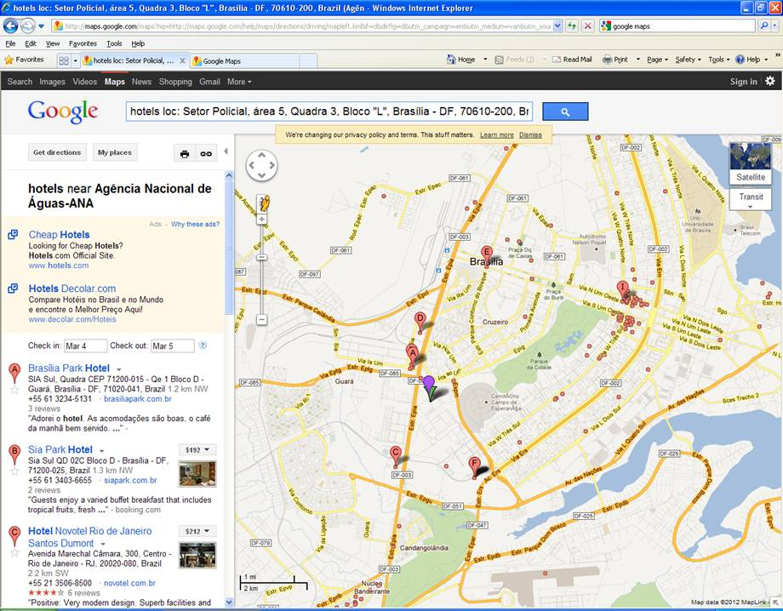
Global Workshop on the Strategic Plan for Biodiversity (Brasilia, 12 to 14 March 2014)
Purple dot = location of new workshop venue - Agência Nacional de Águas (ANA), Setor Policial, Área 5, Quadra 3, Bloco K
Red dot (I) surrounded by red bubbles = main hotel district (Airam, Bristol, Mercure Brasilia Lider, Mercure Brasilia Eixo, etc.)

