Slide 1
Funding Needs Assessment for GEF-8 (2022 – 2026)
GEF-8 Expert Team, OEWG 2, Rome
https://www.cbd.int/financial/gef8needs.shtml

Slide 2
COP Decision 14/23 2018
Adopts ToR for a full assessment of funds needed for the implementation of the Convention and its Protocols during the eighth replenishment period of the GEF
Invites relevant Parties to submit their estimated funding needs under the financial mechanism for the third determination of funding and investment requirements at COP15
Requests Executive Secretary working with the contracted expert team…, to prepare a compilation of ….needs submitted,… for consideration by SBI 3

Slide 3
Objective and Scope
Enable COP to make an assessment of funds necessary to assist developing countries and countries with economies in transition, in accordance with COP guidance over the GEF 8 replenishment cycle
Assessment should be comprehensive and primarily directed towards assessing total funding needs required to meet agreed full incremental costs of measures for the period July 2022 to June 2026

Slide 4
CBD Expert Team Composition
Mr. Ravi Sharma, based largely in New Delhi, will be the assessment focal point for Asia and the Pacific, and can be reached at: ravsharma2002@hotmail.com
Mrs. Stephanie Mansourian, based in Geneva, will be the assessment focal point for Africa and Eastern Europe, and can be reached at: smansourian@infomaniak.ch /stephanie@mansourian.org
Mr. Yasha Feferholtz, based in Santiago, Chile, will be the assessment focal point for Latin America and the Caribbean, and can be reached at: yasha.feferholtz@gmail.com

Slide 5
Methodology – Data assessment
Second report of the High-level Panel on the Global Assessment of Resources
Draft post-2020 global biodiversity framework
National reports and, the financial reporting framework
National biodiversity strategies and action plans
Data requests through the questionnaire

Slide 6
Methodology
Synergies with other GEF-funded Conventions and other biodiversity-related conventions
Strategy for resource mobilization and its targets
Progress made on the implementation of the SDGs in particular Goal 17
Experience to date in the provision of funds by the financial mechanism for each replenishment period
Notes:
GEF-funded convencions: Convention on Biological Diversity (CBD), United Nations Framework Convention on Climate Change (UNFCCC), Stockholm Convention on Persistent Organic Pollutants (POPs), UN Convention to Combat Desertification (UNCCD), and Minamata Convention on Mercury.

Slide 7
Consultation
Consult widely with all relevant persons, institutions and information sources
Design a questionnaire on funding needs for the period July 2022 to June 2026, in consultation with the Secretariat and the GEF
Organize interviews with relevant key stakeholders, major groups of Parties, CBD Secretariat, GEF and its implementing agencies
Endeavour to undertake regional and sub-regional consultations

Slide 8
Questionnaire
Six sections:
Part 0: Background Info
Part A: Project characteristics: Components of biodiversity
Part B: Project characteristics: Strategic objectives
Part C: Financing needs
Part D: Linkages
Part E: Any additional information

Slide 9
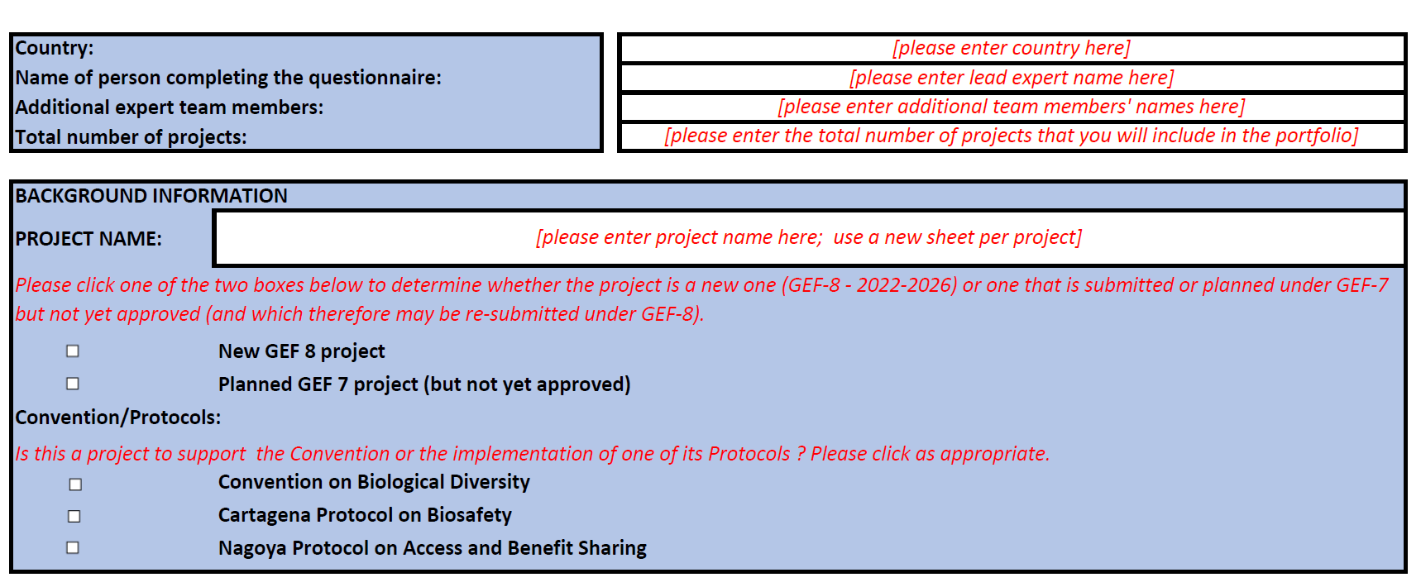
Questionnaire
Part 0: BACKGROUND INFORMATION

Slide 10
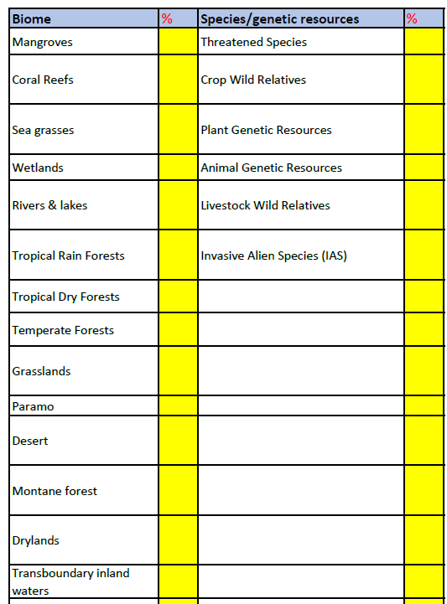
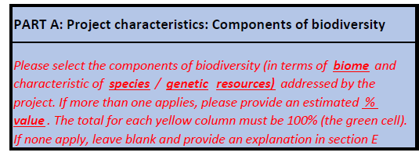
Questionnaire

Slide 11
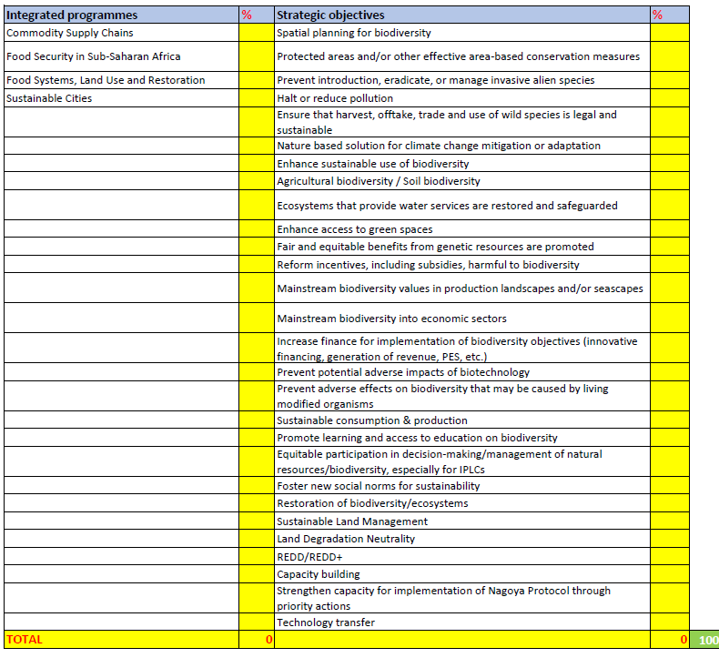

Questionnaire

Slide 12
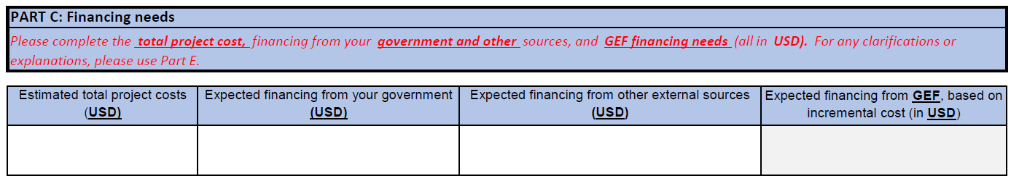
Questionnaire

Slide 13
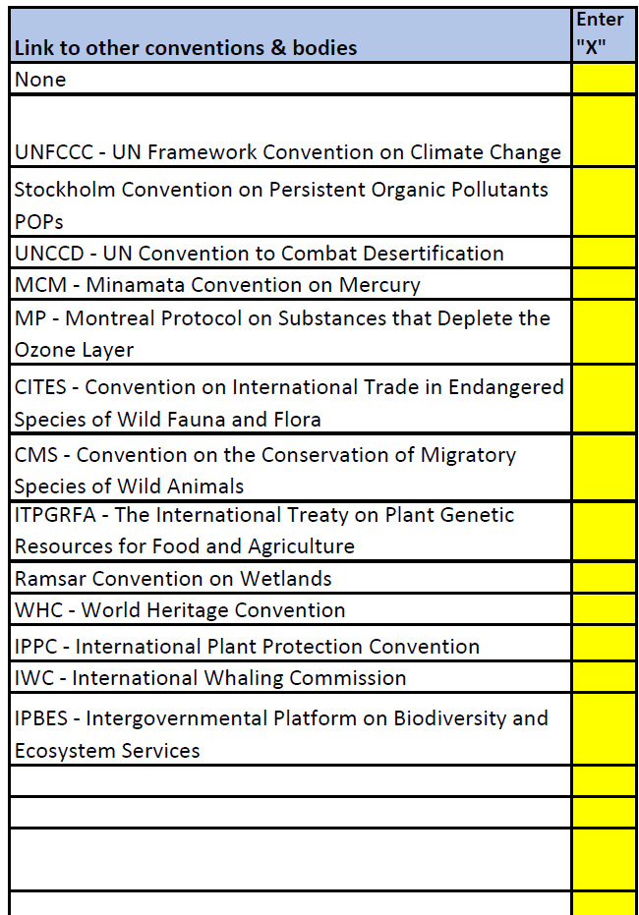
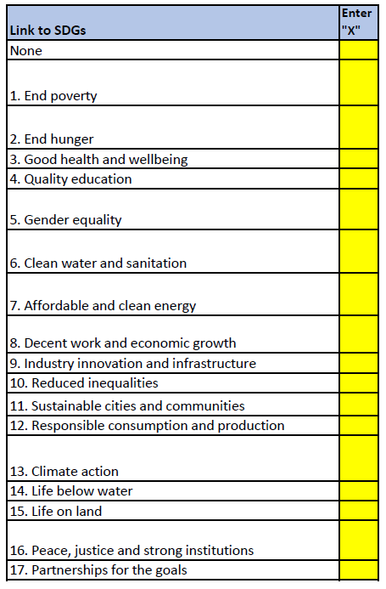
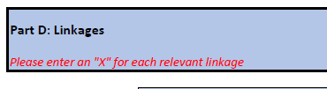
Questionnaire

Slide 14
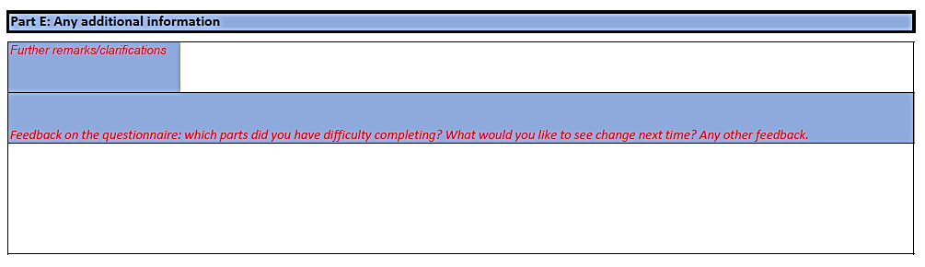
Questionnaire

Slide 15
Schedule 2020
18 Feb.
  Questionnaire circulated to Parties
23 Feb.
  Consultation launched at OEWG 2, Rome
22 Mar.
  Submission deadline for questionnaire
15 Apr.
  Submission to SBI 3
27 July
  OEWG 3
14 Aug.
  Final submission to COP 15

Slide 16


Sources of information
Questionnaire: https://www.cbd.int/financial/gef8needs.shtml
High level panel on global assessment of resources for implementing the strategic plan for biodiversity 2011-2020’: https://www.cbd.int/doc/meetings/cop/cop-12/information/cop-12-inf-04-en.pdf
GEF Operational Guidelines for Incremental Costs: https://www.thegef.org/sites/default/files/documents/OPERATIONAL.GUIDELINES.FOR_.THE_.APPLICATION.OF_.THE_.INCREMENTAL.COST_.PRINCIPLE_0_0_0_0.pdf
Notes:
In Slide Show mode, select the arrows to visit links.

