Slide 1

Transformative Biodiversity Financing in Botswana
Dineo D. Gaborekwe
Ministry of Environment, Wildlife and Tourism
Department of Environmental Affairs
Botswana
Phone: (+267) 3902050/ 3644656
Fax: (+267) 3902051/ 3914687
Email: ddoitsile@gov.bw

Slide 2
Key element of NBSAP
Vision
  By 2025, ecosystem, species and genetic diversity is valued, protected, and used sustainably and equitably, through the involvement of all sectors of society and the provision of sufficient resources for its sound management

Slide 3
Preconditions to achieving the vision
1. Mainstreaming biodiversity
  Simplification of the NBSAP, and coordination
  Focus on awareness
  Establishing cooperation: managing cross-sectoral impacts
2. Valuing biodiversity
  Economic valuation (Dryland ecosystems, Capturing not only direct use values, but also indirect, options and existence values, and improve data collection)
  Incentives and dis-incentives (Assessment of applicability of Payment for Ecosystem Services, Review of CBO incentives)

Slide 4
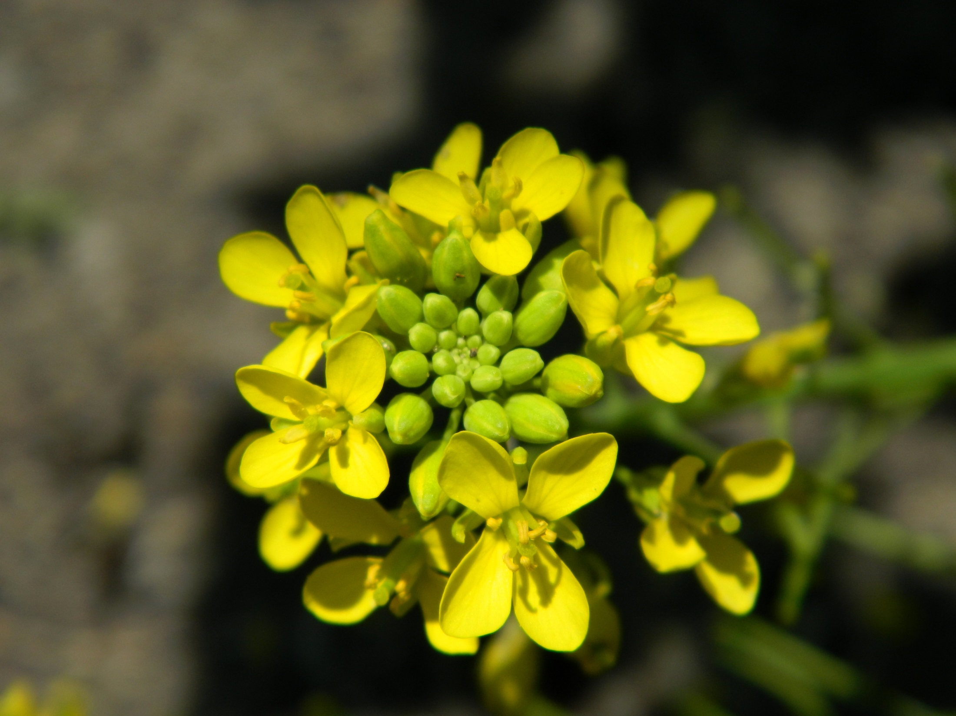

Slide 5
Preconditions…cont’
3. Biodiversity conservation
  Knowledge base
    Inventory, studies, and monitoring of species, habitats and ecological processes and provide feedback into adaptive management of resources
  Management style
    Adaptive management approach
    Effective and open distribution of biodiversity data and information
    Reporting on the basis of ecoregions

Slide 6
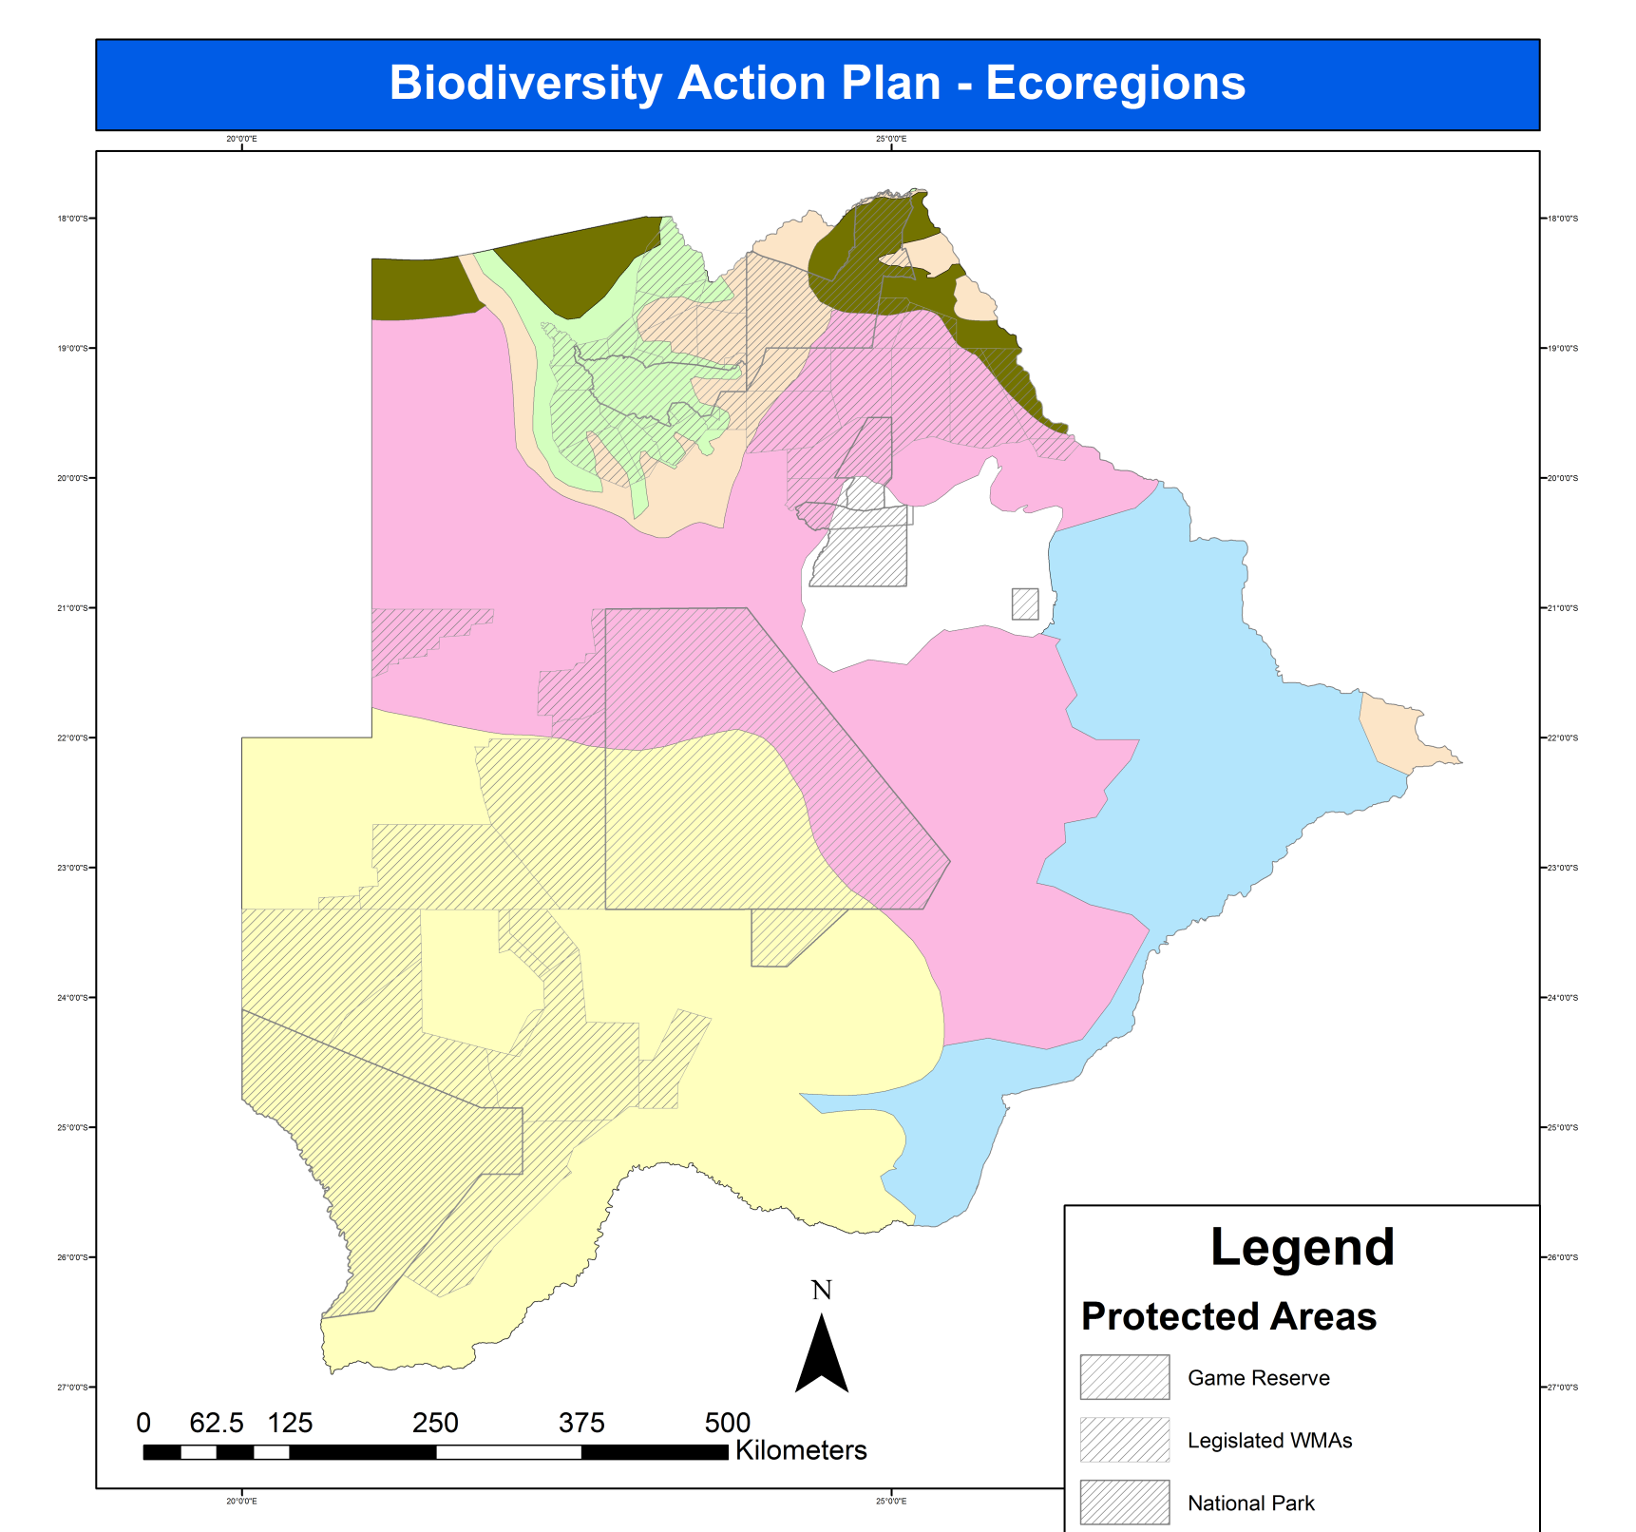
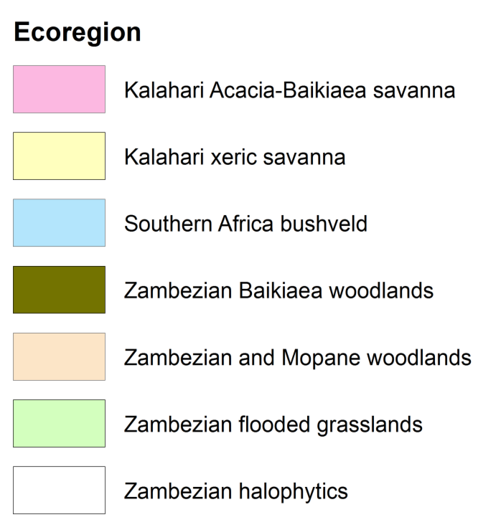

Slide 7
Preconditions…cont’
  4. Natural Resource Accounting to be accounted for in the system of national accounts or GDP to capture:
  Use of natural capital – sector users and benefits…
  Depletion of natural capital – minerals, water, forests…
  Environmental costs – air & water pollution, soil erosion…
  Ecosystem services – carbon storage, water quality …
5. Funding
  Biodiversity Expenditure data is required …….including opportunities for private sector investment
  Deliberate efforts needed to finance biodiversity (NEF) including increasing investments

Slide 8
Ecosystem Accounting
No Ecosystem accounts developed but Botswana aims to prepare Ecosystem accounts that supports policy making by:
Presenting a comprehensive overview of ecosystem capital including the different services provided by different land use and administrative units;
Indicating interdependencies between ecosystems and economic activities;
Enabling measuring changes in ecosystem capital over time;
Providing a number of other potential applications that can support environmental management

Slide 9
Scoping Exercise in Botswana
The main policy issue is how to ensure that natural resources (in particular ecosystem resources such as national parks, rangelands, forests, agricultural soil and water resources) can be used in a more productive and sustainable way in support of inclusive economic development.
This specifically relates to eliciting the relation between
  ecosystems
  economic growth and diversification,
  poverty reduction,
  employment creation,
  transboundary resource management,
  resource degradation,
  climate change adaptation,
  supporting the implementation of the NSSD

Slide 10
Botswana specific needs for the ecosystem accounts
There is a lack of integrated and quantitative data on natural resources in support of policy making and implementation.
There is a need to enhance the information supply to National Development Planning.
Support for the implementation of ecosystem management plans such as the ODMP, the MFMP, the Revised NBSAP, the Forest Inventory Project and the BioChobe project.
Transboundary resource management and water management

Slide 11
Potential scope of Botswana ecosystem accounts
Scoping of the ecosystem account involves:
Delineation of the area to be covered
Ecosystem services to be included
Ecosystem properties to be addressed

Slide 12


Slide 13
Potential scope … delineation of area to be covered
An area covering the Kalahari, Makgadigadi and Okavango areas in the ecosystem accounts, identifying the following policy concerns:
Lack of data in particular in the Kalahari area ( past work on environmental information was focused on the Okavango and Chobe areas, whereas the Kalahari covers a large part of the country and there are significant causes for concern regarding environmental degradation)
The Okavango has received ample attention from past studies and is a RAMSAR and World Heritage site. It is a key area for tourism and wildlife, and at the same time it is vulnerable to climate variability and climate change, development projects in Angola and Namibia that would affect the cross boundary inflow of water into the Okavango, and land degradation.

Slide 14
Potential scope … delineation of area to be covered
The Makgadikgadi wetlands are an additional important area, connected to both the Kalahari and the Okavango systems. Plans exist to nominate the Makgadikgadi for UNESCO Biosphere Reserve certification in 2015. It is subject to fires and has recurrent human-wildlife conflicts. Several studies have been conducted on natural resource management, and there is basic data availability on ecosystem properties and uses.
A potentially interesting area to include is Chobe District. Chobe is a forest area receives more rainfall than the rest of the country. There are human-wildlife conflicts, there is intermediate data availability, and the area is of high importance for biodiversity conservation.

Slide 15
Potential scope … ecosystem services to be included
Livestock grazing: The aim of the ecosystem account is to analyse the contribution of the ecosystem to the livestock sector, in particular the supply of animal feed
  Livestock is a significant part of the Botswana economy,
  At the same time, livestock grazing is making intensive use of the land, and in particular the pasture resources
  carrying capacity of the pastures
  increasing frequency of fires is putting additional pressure on the rangelands (contributing to changes in species composition and rangeland degradation)
Tourism: The purpose of the ecosystem account is to measure the contribution of the ecosystem to tourism.
  this can be measured in terms of days spent on wildlife tourism, either by boat (Okavango) or safari tour on land.
  The various forms and types of wildlife tourism, and the wildlife density maps can serve as ecosystem condition indicator relevant for this service.
  In monetary terms, the contribution of the wildlife to the tourism sector

Slide 16
Potential scope … ecosystem services to be included
Wildlife habitat. Biodiversity is an ecosystem condition indicator. In addition, wildlife habitat is highly relevant for the tourism sector and it is also a final service in itself (since people appreciate and are willing to pay for nature conservation).
Carbon sequestration. Carbon sequestration is the only regulating service for which the capacity equals the flow (since it does not matter where carbon is captured, carbon capture is always a benefit for people given global climate change).
Future potential services for consideration include:
  Wood production
  Crop production
  Air filtration
  Water regulation

Slide 17
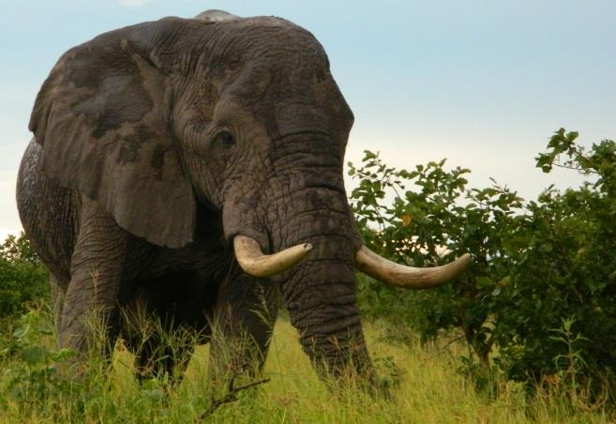
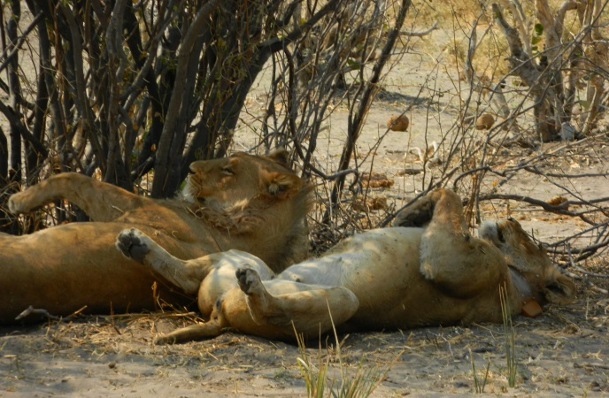

Slide 18
Potential scope …ecosystem properties to be addressed
Tentatively the key variables to be included in the ecosystem account include inter alia:
Rainfall (and its spatial and temporal distribution)
  Since water is a key constraint to ecosystem productivity, rain is a key indicator determining ecosystem services supply
Land cover
  A land cover map has been produced (completed for the country with the exception of Central District)
Soil type
  Soil maps are available for Botswana and are an indicator for ecosystem conditions, affecting soil organic matter contents, infiltration rates, etc
Species composition
  Dominant species, both in the grass layer and in the tree layer

Slide 19
Potential scope …ecosystem properties to be addressed
Rain Use Efficiency
  Rain Use Efficiency - expresses how efficient vegetation uses rainfall for the production of biomass can be used in order to understand the status of rangelands
Carbon stock
  Carbon stock is an indicator for degradation status, and is linked to the services of grass production for livestock, wood production and carbon sequestration
Soil organic Matter
  Soil organic matter is correlated with soil carbon, and is an indicator of soil fertility and it may also be correlated with low infiltration rates and low water holding capacity of the soil
Fire risk
  fire occurrence / risk mapped building upon existing datasets

Slide 20
Institutional setup for Ecosystem Accounts
Need for long-term vision and commitment. The main added value that the accounts provide is providing the possibility to compare ecosystem capital between years, and the quality, resolution, coverage and accuracy of the accounts will increase over time as a function of the experiences to be gained. This long-term commitment should ensure that budget for developing the accounts is made available for a certain time period
Need for capacity building. In the field of ecosystem accounting including the spatial modelling part, the valuation, and the linking of the accounts to the national accounts.
Need for external technical assistance. At the same time there is a need to institutionalise the developments and maintenance of the accounts, independent of temporary project funding.
Need to address high staff turn-over. A need to consider incentives for staff to stay on for a sustained period. It also means that it would be prudent to train a number of staff as back up

Slide 21
Linking up with BIOFIN as an existing initiatives
Point of entry
  The ecosystem accounting component, in the view of the potential of the ecosystem accounts to provide information on the economic benefits generated by ecosystems, and to which sectors they contribute, as well as the analysis of trends in ecosystem condition.
  This could be supportive to the analysis of funding opportunities and needs for biodiversity in Botswana.
  Making additional data available for the ecosystem accounts, in particular on biodiversity.
  Discussion (DEA, UNDP, WAVES Botswana and MFDP) on going for BIOFIN to focus on the same area as the WAVES Botswana ecosystem accounts in view of the synergies between the projects

Slide 22
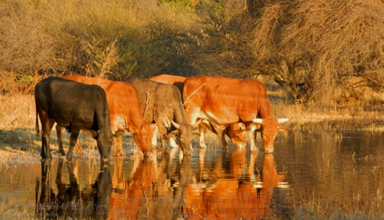
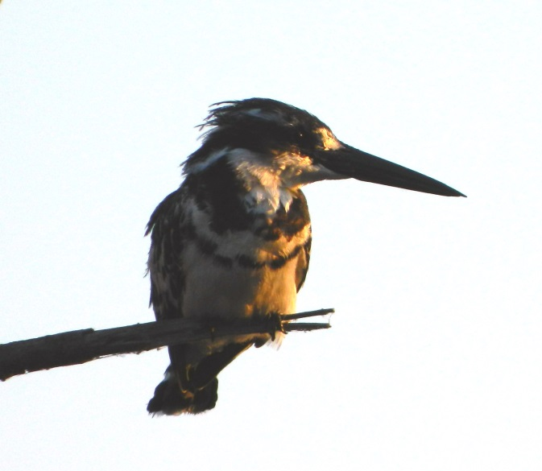
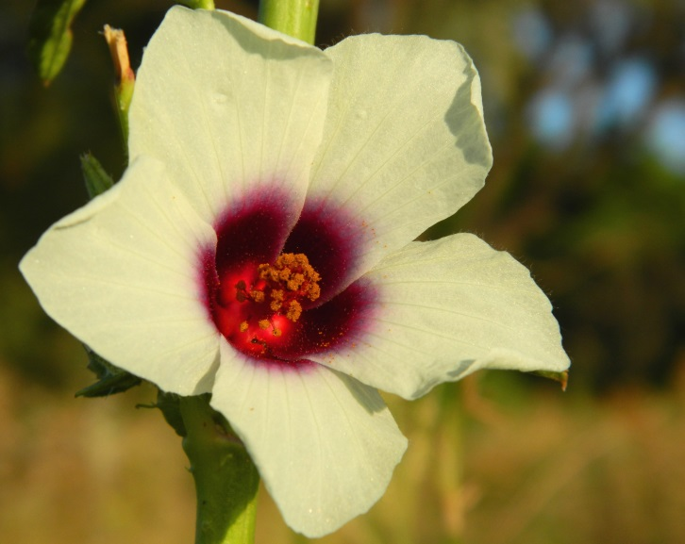
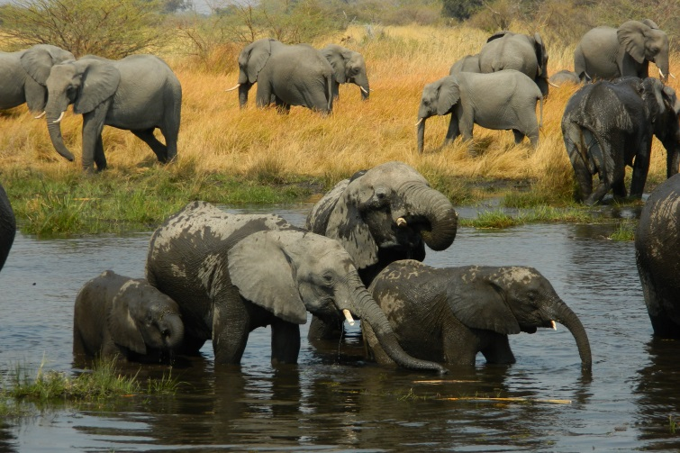
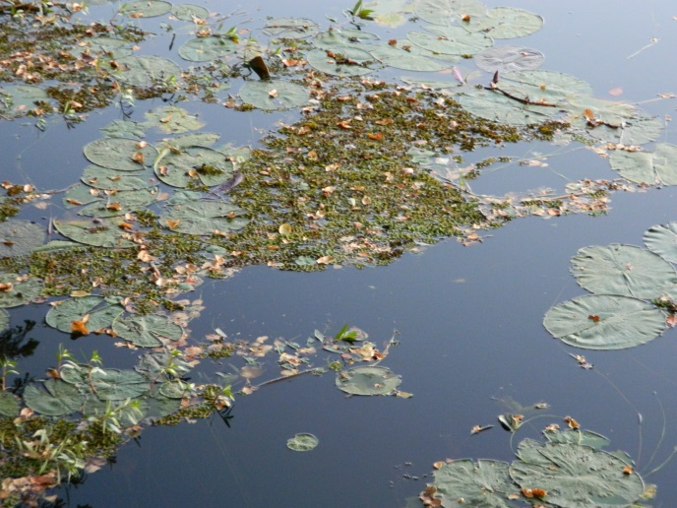
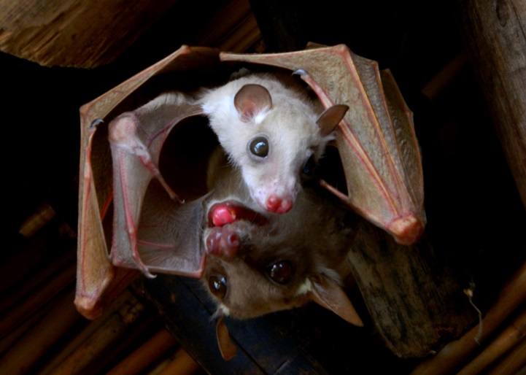
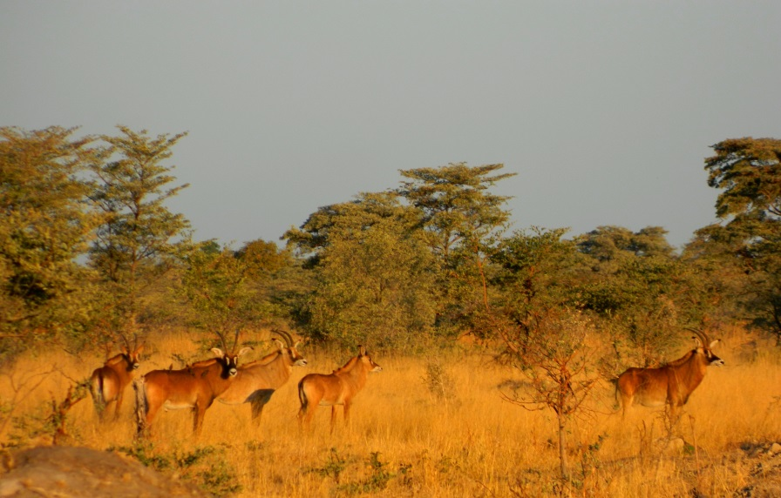
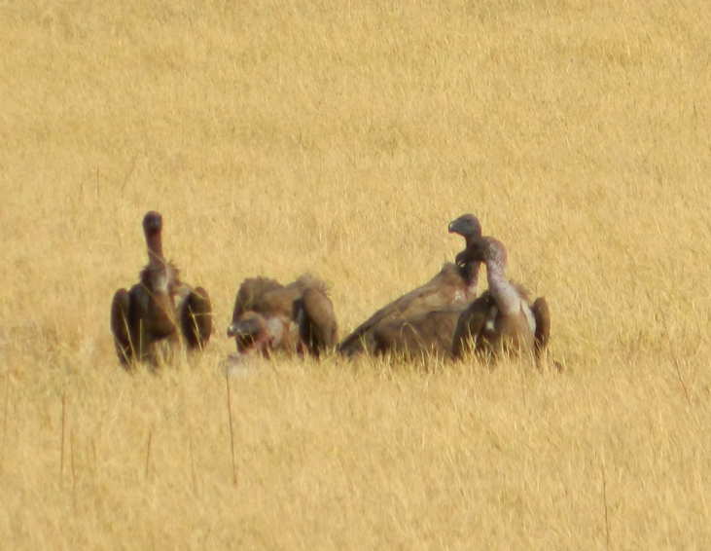


Slide 23
Biodiversity Finance Initiative (BIOFIN),
BIOFIN seeks to address the biodiversity finance challenge by building a sound business case for increased investments in the conservation and sustainable management of ecosystems and biodiversity.
  This entails development and piloting of a methodology for quantifying the biodiversity finance gap at the national level.
  The purpose of the methodology is to improve cost-effectiveness through mainstreaming of biodiversity into national development and sectoral planning, and for development of comprehensive national resource mobilising strategies.

Slide 24
BIOFIN & NBSAP
Effective implementation of the NBSAP as the overarching biodiversity management tool at the national level requires
  Innovative sources of funding for biodiversity management that can be sustained over the long term, in light of competing national development priorities
  Detailed national level biodiversity finance assessments to provide more robust information on the biodiversity finance gap and explore opportunities for resource mobilisation so as to effectively utilize existing sources of finance and identify new innovative financing mechanisms

Slide 25
PROGRESS ON BIOFIN
IMPLEMENTATION
Achievements:
Setting up of the BIOFIN Country Team – Project Lead, Project Management Officer.
Consultations with the Project Steering Committee (NBDA) – formal introduction of the initiative to the committee was done on the 15th July 2013.
Implementation plans and methodologies drafted.
Recruitment of other experts to support the Team ongoing
  Policy and Institutional Expert to start on the 1st October 2014
  Private Expenditure Review Expert to be engaged in November 2014
Communication with MFDP as strategic partners under Public Expenditure Review on-going

Slide 26
Challenges & Opportunities
Existing challenges: Turnaround time for requests for meetings and providing feedback lengthy
Potential challenges: Unavailability of data or failure to disclose information on investments by the private sector for private expenditure review may pose a challenge for fulfilling the objectives of the project.
Opportunities:
  BIOFIN feeds into already existing national planning tools such as NBSAP. This makes it easier to lobby for government support.
  BIOFIN has reached an understanding with WAVES for collaboration and consolidation of efforts on converging issues (e.g. synchronisation of missions where possible, sharing of information, and support on key issues of concern)

Slide 27
BIOFIN - Next Steps
Policy and institutional Analysis from October 2014 - March 2015;
Recruitment of other specialists – Private Finance/ Business Expert, Environmental Economist, Costing Specialist by November 2014;
Private Expenditure Review process: data collection, input and analysis October 2014 - March 2015; with due consideration to the development of Ecosystem Accounts

Slide 28

ACKNOWLEDGEMENTS
Botswana Scoping Mission Report: Lars Hein
Botswana WAVES Coordinator: Portia Segomelo
www.wavespartnership.org
Thank you

