Slide 1
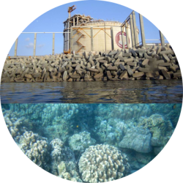
Corporate Biodiversity Finance Financing no net loss & positive impacts Dr Francis Vorhies Earthmind
Panel 1B: Resource Mobilisation
CBD Cop12 Business & Biodiversity Forum
12-14 October 2015 – Pyeongchang, Korea

Slide 2
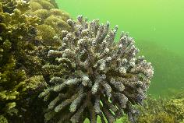
Financing no net loss & positive impacts
Three tools for corporate biodiversity finance
Corporate Biodiversity Mitigation
Verified Conservation Areas
Conservation Capital Funds
Corporate biodiversity finance tools

Slide 3
1st tool: Corporate Biodiversity Mitigation
IFC Performance Standard 6
To protect and conserve biodiversity
To maintain the benefits from ecosystem services
To promote the sustainable management of living natural resources through the adoption of practices that integrate conservation needs and development priorities
ifc.org/sustainability
Corporate biodiversity mitigation

Slide 4
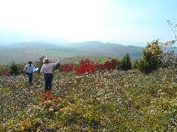
IFC PS6 paragraphs 7 & 10
7. As a matter of priority, the client should seek to avoid impacts on biodiversity and ecosystem services. When avoidance of impacts is not possible, measures to minimize impacts and restore biodiversity and ecosystem services should be implemented. …The client should adopt a practice of adaptive management in which the implementation of mitigation and management measures are responsive to changing conditions and the results of monitoring throughout the project’s lifecycle.
10. For the protection and conservation of biodiversity, the mitigation hierarchy includes biodiversity offsets, which may be considered only after appropriate avoidance, minimization, and restoration measures have been applied.
Corporate biodiversity mitigation

Slide 5
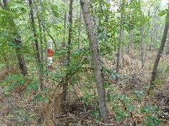
Biodiversity mitigation strategy
Avoid ➔ Minimize ➔ Restore ➔ Offset
Through a process of adaptive management
Over the lifecycle of the project
➔ “No net loss and preferably a net gain of biodiversity”
Corporate biodiversity mitigation

Slide 6
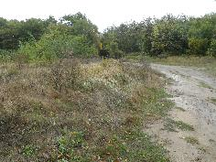
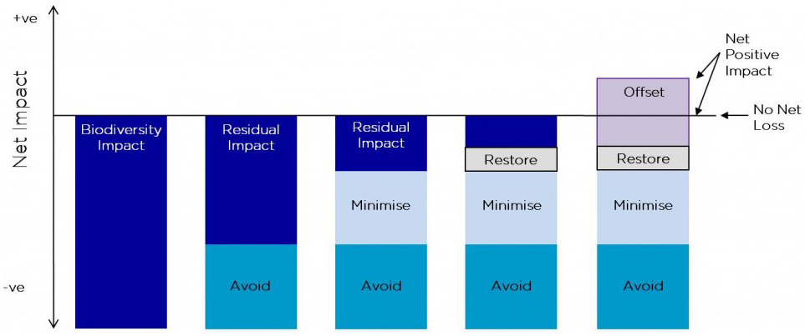
Biodiversity mitigation hierarchy
(The Biodiversity Consultancy)
Corporate biodiversity mitigation

Slide 7
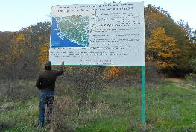
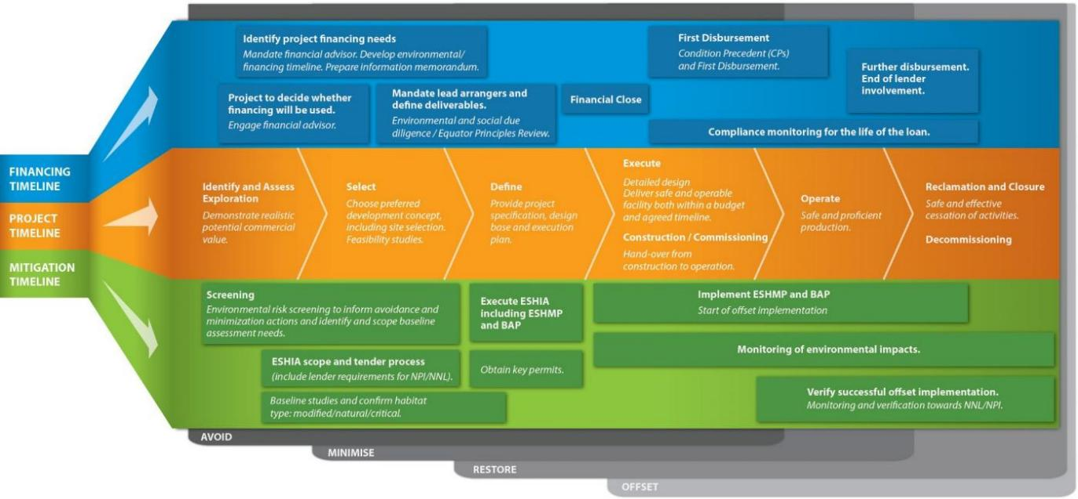
Biodiversity mitigation timeline
Adaptive management over the project lifecycle
Aligning financing, management & mitigation
(Cross-Sector Biodiversity Initiative)
Corporate biodiversity mitigation

Slide 8
The financing case for IFC PS6
Export credit agencies under the OECD Common Approaches
“When undertaking a review, Members should benchmark … all eight IFC Performance Standards, in particular where justified and/or practicable due to the size and/or structure of the transaction…”
Commercial banks under the Equator Principles
For Projects located in Non-Designated Countries, the Assessment process evaluates compliance with the then applicable IFC Performance Standards on Environmental and Social Sustainability and the World Bank Group Environmental, Health and Safety Guidelines.
Corporate biodiversity mitigation

Slide 9
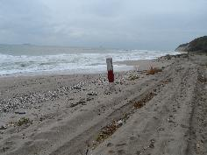
South Stream Offshore Pipeline
ESIAs
for
Russia,
Turkey &
Bulgaria
IFC-compliant
as required by the ECAs & banks
Corporate biodiversity mitigation

Slide 10
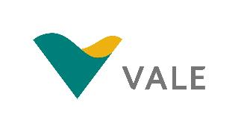
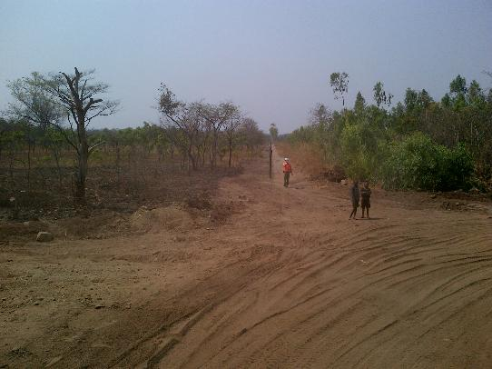
Nacala Corridor, Mozambique
Linking the Moatize coal mine to Nacala, where Vale will build a deep-water sea port
Revamping some 682 kilometres of existing railroads & laying 230 new kilometres
Associated facilities: coal mine, railroad & port
Corporate biodiversity mitigation

Slide 11
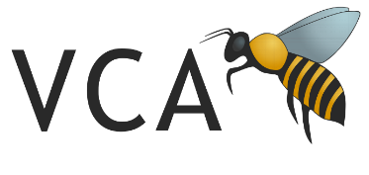
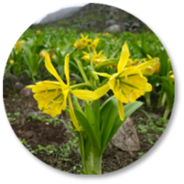
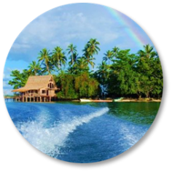
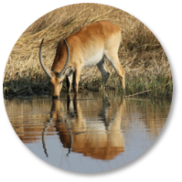
2nd tool: Verified Conservation Areas
The VCA Registry
Making conservation visible, accountable & marketable
To register a VCA, submit an audited Management Plan
To remain registered, submit an audited Performance Report yearly
v-c-a.org
Verified conservation areas

Slide 12
Investing in verified conservation
Opportunities for business
VCAs ‘inside the fence’
– minimisation, avoidance, lifecycle management, decommissioning
VCAs ‘outside the fence’
– avoided areas, offsets, compensation, strategic CSR
VCAs in supply chains
– adds landscape-level conservation to commodity standards:
CCBA, FSC, MSC, RSPO, RTRS, UFZ, etc.
Verified conservation areas

Slide 13
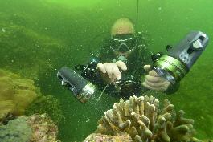
Yemen LNG marine conservation area
Verified conservation areas

Slide 14
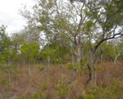
Coutada 5, Mozambique
687,000 hectares hunting concession
Large-scale private wilderness restoration
Large-scale sustainable agriculture & ranching
Community-based conservation farming
Verified conservation areas

Slide 15
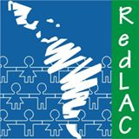
3rd tool: Conservation Capital Funds
Securing long-term capital for biodiversity conservation
Providing independent assurance & accountability
Can finance biodiversity mitigation & verified conservation
CAFÉ - Consortium of African Funds for the Environment
RedLAC - The Latin American and Caribbean Network of Environmental Funds
redlac10.earthmind.net
Conservation capital funds

Slide 16
La Fondation pour l'Environnement et le Développement au Cameroun
Trust fund set up as an environmental compensatory mechanism
under the Chad-Cameroon Pipeline Construction Project
Conservation capital funds

Slide 17
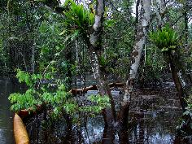
Niger Delta Biodiversity Trust Fund
Under development by a UNDP/GEF Project
Support to long-term biodiversity management as a collaborative engagement mechanism for local communities, oil & gas companies, and Government
Conservation capital funds

Slide 18
Financing no net loss & positive impact
Three tools for corporate biodiversity finance
Corporate Biodiversity Mitigation
Verified Conservation Areas
Conservation Capital Funds
Thank you!

