Slide 1
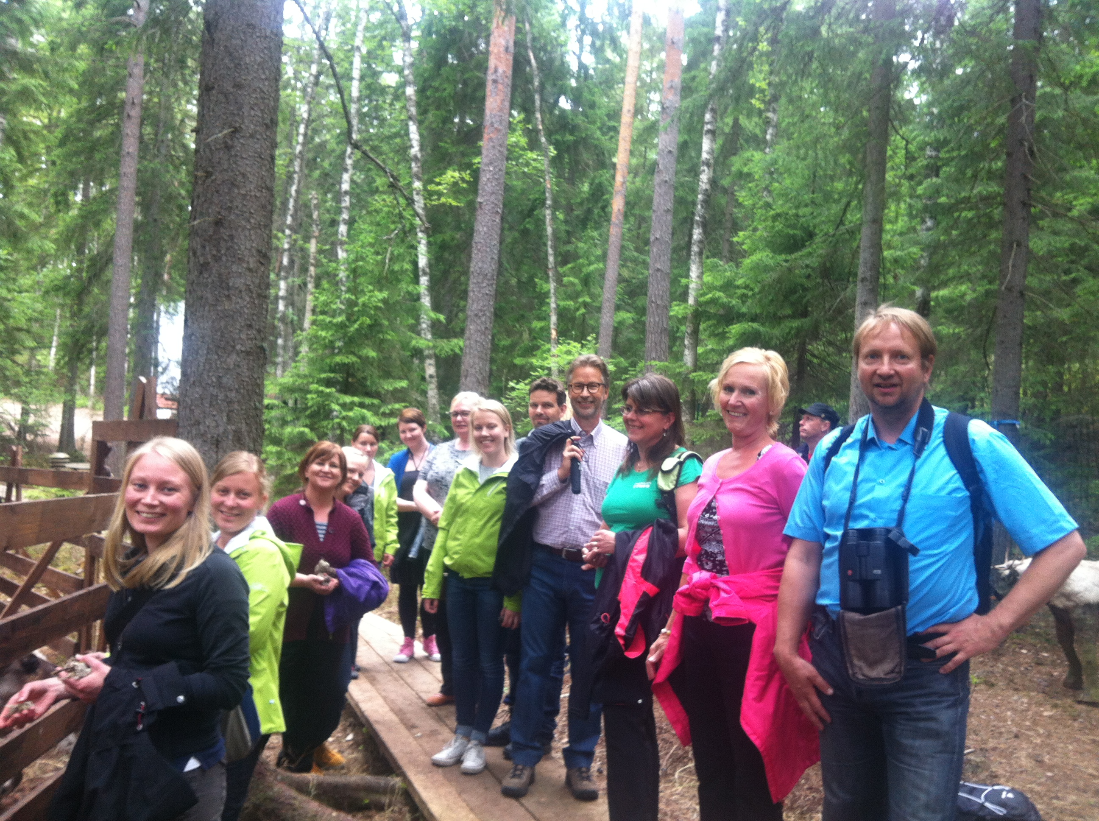

What Are the Opportunities and Challenges for Initiatives and the Global Partnership
-Case Finland
CBD COP 12 business and biodiversity forum 12.10.2014

Slide 2
Finnish B & BD Initiative, 28th of Jan, 2014
The purpose
In line with global CBD Aichi targets -> integrates biodiversity into business practices
Creates the platform for the key stakeholders
Aims at inventing new ways of doing sustainable business
Provides tools for integrating biodiversity and ecosystem services into the environmental CR work
Steering committee of the Initiative
Consists of members from ministries, other public authorities, NGOs, research, business sector representatives
FIBS Corporate Responsibility Network and Finnish Environment Institute
Notes:
Kehittää toiminnan vaikuttavuuden raportointia
Tunnettuvuuden lisääminen
Kannustaa uusia toimijoita mukaan verkostoon
Uudet rahoitusmallit ja rohoituspohjan kehittäminen
Natural Capital Finance (Metso)
Kehittämisehdotukset YM:lle
Mukana NGO, yritykset, hallinto, tutkimus
Toimikausi 2015 loppuun

Slide 3
FIBS – Runs Finnish B & BD Initiative
Is the leading network for responsible business in Finland
Promotes financially, socially and environmentally sustainable business in Finland
Encourages companies to embrace sustainability in the strategic planning and day-to-day management – as a key success factor
Conducts the Corporate Sustainability Survey
Brings together companies, NGOs, decision-makers, public sector and research
Has recently joined CBD Global Partnership, WBCSD & EU Business & Biodiversity Platform
Actively participates international forums e.g. CSR 360 and CSR Europe
Notes:
We do this through seminars, workshops, magazine, newsletters, sustainability tools, networking, competitions etc.

Slide 4
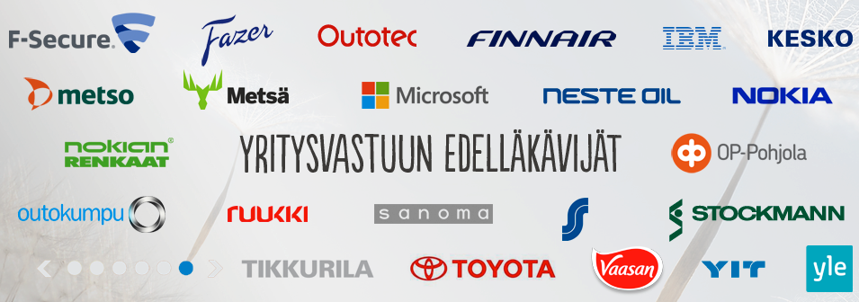
FIBS has over 240 members
Notes:
8/10 suuryrityksestä
Suurin osa yrityksiä, ngo ja yliopistoja yms.

Slide 5



Finnish B & BD Initiative in Practise
Open seminars and workshops
Master Class –training
  Food industry, aggregates, energy, construction
  Based on BET training model (IUCN/WBCSD)
  Has inspired deeper dialogue and collaboration e.g. field excursion, communication workshop, visit to parliament (the environment committee)

Slide 6

Finnish B & BD Initiative- Challenges
  The awareness of biodiversity is poor
    Difficult to attract companies
    The lack of examples
    Terms and concepts of biodiversity and ecosystem services are difficult to understand
  The top priority for CR work is to ensure continuity of the business operations*
  The Finnish companies prioritize environmental as CR-work*
    Most of the development work is targeted to environmental performance
    Companies are involved with energy efficiency, waste and water management
    Biodiversity is hardly recognized, although it should be a key component in ensuring the
  Creating new ways of doing sustainable business
  Financing of the Initiative at the starting phase
  How to keep companies involved after Master Class training?
  What is the effectiveness of B & BD Initiative?
  What is the added value of international networking?
    *Source: FIBS Corporate Responsibility Survey 2014

Slide 7
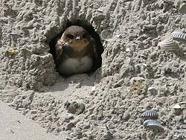
Finnish B & BD Initiative- Opportunities
  Raises the awareness and understanding of BD
  Enables to companies to get involved with Aichi targets
  Leads to multisectoral collaboration and arises interest for studies
    Partnership as a goal, to build win-win cases
  From the perspective of the companies:
  Increases BD knowledge and introduces applicable tools
  Inspires companies to assess the critical ecosystem services, provides a new point of view to environmental CR work
  CR reporting compulsory from 2017 on at EU-level
  Enables the continuity of the business in the long run
  and helps to discover new business opportunities
    Rudus & gravel pits -> compensational ponds for Rana arvalis
    New nests for Riparia riparia from handmade sand cliffs
    http://www.rudus.fi/ymparisto/rudus-lumo-ohjelma

Slide 8
Finnish B & BD Initiative- +2015
  Workbook on B &BD Master Class training to be published 01/2015
    Cases and experiences for others to share
  Master Class 2014 continues the work with round table sessions
  New Master Class 2015 begins
  Participants interested in international seminar on Biodiversity

Slide 9
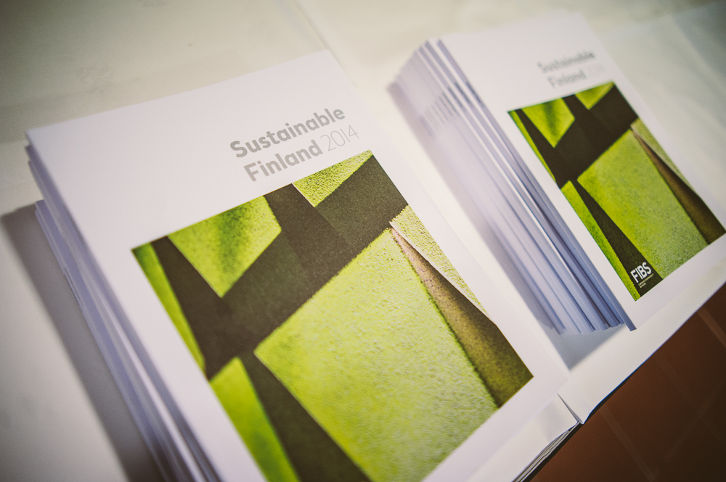
Sustainable Finland 2014 -report
http://www.e-julkaisu.fi/fibs/sustainable_finland_2014

Slide 10

Thank you! kristiina.niikkonen@ymparisto.fi, www.ym.fi leila.rasanen@fibsry.fi, www.fibsry.fi

