Slide 1


12 October 2014

Slide 2




About IBBI
Officially launched on the occasion of International Day for Biological Diversity on 22nd May, 2014 in New Delhi
The Ministry of Environment, Forests & Climate Change (MoEFCC) has endorsed and supported the establishment of India Business & Biodiversity Initiative (IBBI) under Global Partnership for Business and Biodiversity
IBBI is hosted by the CII-ITC Centre of Excellence for Sustainable Development with the initial support of German International Cooperation (GIZ)
It serves as a national platform for businesses and its stakeholders for dialogue, sharing and learning, ultimately leading to mainstreaming sustainable management of biological diversity into businesses

Slide 3
IBBI Declaration
The members of the India Business & Biodiversity Initiative (IBBI) acknowledge the objectives of the Convention on Biological Diversity (CBD).
On behalf of my organisation, we shall endeavour to take action in some of the following areas:
mapping biodiversity interfaces with business operations;
enhancing awareness on biodiversity within the organisation;
considering the impacts of business decisions on biodiversity;
setting objectives and targets for biodiversity management;
designating an individual within the organisation as biodiversity champion;
assessing biodiversity risks and opportunities;
including the applicable biodiversity aspects in the environmental management systems;
encouraging relevant stakeholders to support better biodiversity management;
engaging in policy advocacy and dialogue with Government, NGOs and academia on biodiversity concerns;
Initiating the valuation of relevant biodiversity and eco-system services.
To demonstrate ongoing commitment, my organisation will every two years after becoming the signatory provide the IBBI with a public disclosure report to showcase the progress made on this declaration.

Slide 4



















Signatories

Slide 5
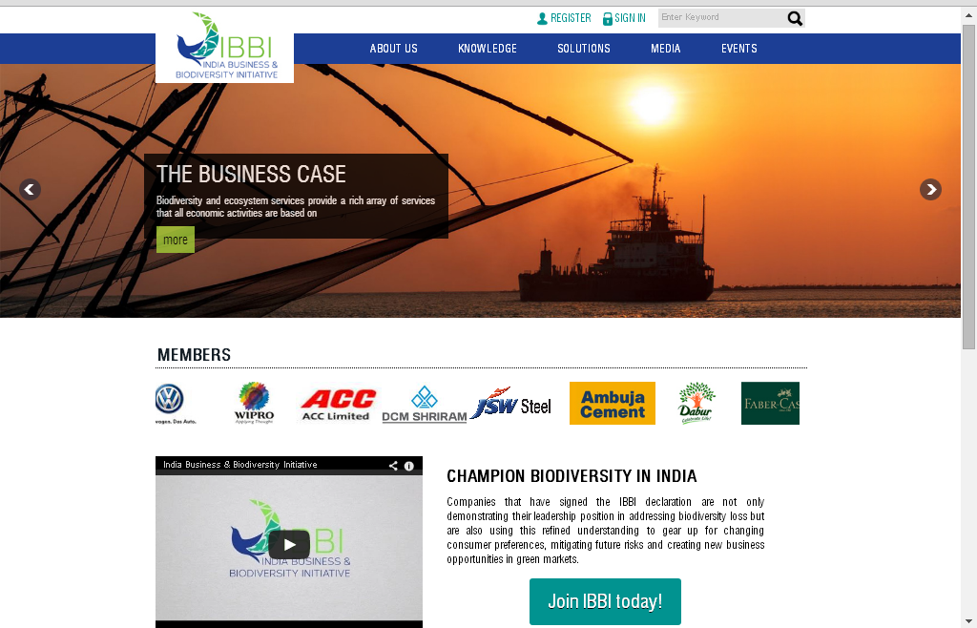
www.BusinessBiodiversity.in

Slide 6
Opportunities & Challenges
Challenges:
Demonstration of business case
Understanding of biodiversity
Valuation of natural capital
Opportunities:
Enabling collective and collaborative action
2% CSR mandate in India
South-South cooperation

Slide 7
Side Event
PROGRAMME
India Business & Biodiversity Initiative: Mainstreaming Sustainable Management of Biodiversity by Indian Businesses
Monday, 13 October 2014 18:15-19:45
Venue: Hall B, Room 2 – side-event room
Release of “Business and Biodiversity in India: 20 Illustrations”
Showcase of good business practices by IBBI member companies
Panel discussion
Reception and networking
18:15 | Welcome & Introduction to IBBI Mr. R Mukundan Chairman, IBBI Managing Director, Tata Chemicals Limited
 | Inaugural Address & Release of “Business and Biodiversity in India: 20 Illustrations” Mr. Hem Pande Additional Secretary, Ministry of Environment, Forests & Climate Change, Government of India
 | Good Business Practice Presentations by IBBI Member Companies Tata Steel Limited ITC Limited Panel Discussion Mr. R Mukundan Chairman, IBBI Managing Director, Tata Chemicals Limited Mr. Hem Pande Additional Secretary, Ministry of Environment, Forests & Climate Change, Government of India Mr. Edgar Endrukaitis Director, Biodiversity Programme, GIZ India Mr. Shubhenjit Chaudhuri Chief Corporate Sustainability, Tata Steel Ltd Mr. Vijay Vardhan Manager – Operations, Social Investments, ITC Ltd
19:45 | Reception & Networking

Slide 8
Thank you!
sustainability@cii.in
+91 11 4150 2301-02
www.BusinessBiodiversity.in

