Slide 1
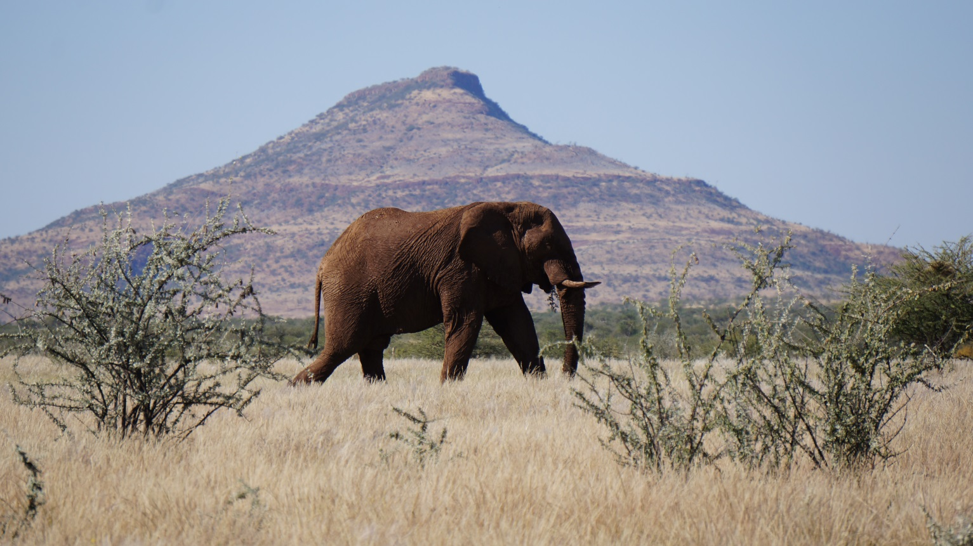
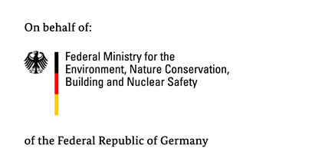
A Biodiversity Expenditure Review using the BIOFIN Assessment Methodology in Namibia
Lawrie Harper-Simmonds
Ministry of Environment and Tourism, Namibia
Supported by:

Slide 2
Objective
Estimate expenditure on biodiversity conservation in Namibia between 2007 and 2012
Project a baseline of ‘business as usual’ biodiversity expenditure from 2013 to 2020
Supported by:

Slide 3
Methodology
BIOFIN
The Biodiversity Finance Initiative
WORKBOOK 1C: Public and Private Biodiversity Expenditures and Effectiveness Status and Trends
Methodology | Govt. Biodiversity Expenditure | Non-Govt. Biodiversity Expenditure | Total Biodiversity Expenditure | Biodiversity Expenditure and National Indicators | Conclusions

Slide 4
Namibian Government Biodiversity Expenditure Review
Disaggregating Budget and Expenditure Data
National
Total Budget / Expenditure
Methodology | Govt. Biodiversity Expenditure | Non-Govt. Biodiversity Expenditure | Total Biodiversity Expenditure | Biodiversity Expenditure and National Indicators | Conclusions

Slide 5
Namibian Government Biodiversity Expenditure Review
Disaggregating Budget and Expenditure Data
National
Total Budget / Expenditure
Ministry
Ministry of Environment and Tourism (MET)
Methodology | Govt. Biodiversity Expenditure | Non-Govt. Biodiversity Expenditure | Total Biodiversity Expenditure | Biodiversity Expenditure and National Indicators | Conclusions

Slide 6
Namibian Government Biodiversity Expenditure Review
Disaggregating Budget and Expenditure Data
National
Total Budget / Expenditure
Ministry
Ministry of Environment and Tourism (MET)
Programme
Wildlife and Protected Area Management
Tourism Development
Methodology | Govt. Biodiversity Expenditure | Non-Govt. Biodiversity Expenditure | Total Biodiversity Expenditure | Biodiversity Expenditure and National Indicators | Conclusions

Slide 7
Namibian Government Biodiversity Expenditure Review
Disaggregating Budget and Expenditure Data
National
Total Budget / Expenditure
Ministry
Ministry of Environment and Tourism (MET)
Programme
Wildlife and Protected Area Management
Tourism Development
Activity
Fencing of conservation areas
Water provision for game / wildlife
Methodology | Govt. Biodiversity Expenditure | Non-Govt. Biodiversity Expenditure | Total Biodiversity Expenditure | Biodiversity Expenditure and National Indicators | Conclusions

Slide 8
Namibian Government Biodiversity Expenditure Review
MET Budget and Expenditure Estimates: 2006/07 – 2012/13
Methodology | Govt. Biodiversity Expenditure | Non-Govt. Biodiversity Expenditure | Total Biodiversity Expenditure | Biodiversity Expenditure and National Indicators | Conclusions

Slide 9
Namibian Government Biodiversity Expenditure Review
MET Budget and Expenditure Estimates: 2006/07 – 2012/13
Methodology | Govt. Biodiversity Expenditure | Non-Govt. Biodiversity Expenditure | Total Biodiversity Expenditure | Biodiversity Expenditure and National Indicators | Conclusions

Slide 10
Namibian Government Biodiversity Expenditure Review
MET Budget and Expenditure Estimates: 2006/07 – 2012/13
Methodology | Govt. Biodiversity Expenditure | Non-Govt. Biodiversity Expenditure | Total Biodiversity Expenditure | Biodiversity Expenditure and National Indicators | Conclusions

Slide 11
Namibian Government Biodiversity Expenditure Review
MET Budget and Expenditure Estimates: 2006/07 – 2012/13
Methodology | Govt. Biodiversity Expenditure | Non-Govt. Biodiversity Expenditure | Total Biodiversity Expenditure | Biodiversity Expenditure and National Indicators | Conclusions

Slide 12
Namibian Government Biodiversity Expenditure Review
MET Biodiversity Expenditure Projections: 2006/07 – 2012/13
Methodology | Govt. Biodiversity Expenditure | Non-Govt. Biodiversity Expenditure | Total Biodiversity Expenditure | Biodiversity Expenditure and National Indicators | Conclusions

Slide 13
Namibian Government Biodiversity Expenditure Review
MET Biodiversity Expenditure Projections: 2006/07 – 2012/13
Methodology | Govt. Biodiversity Expenditure | Non-Govt. Biodiversity Expenditure | Total Biodiversity Expenditure | Biodiversity Expenditure and National Indicators | Conclusions

Slide 14
Namibian Government Biodiversity Expenditure Review
MET Biodiversity Expenditure Projections: 2006/07 – 2012/13
Methodology | Govt. Biodiversity Expenditure | Non-Govt. Biodiversity Expenditure | Total Biodiversity Expenditure | Biodiversity Expenditure and National Indicators | Conclusions

Slide 15
Namibian Government Biodiversity Expenditure Review
MET Biodiversity Expenditure Projections: 2006/07 – 2012/13
Methodology | Govt. Biodiversity Expenditure | Non-Govt. Biodiversity Expenditure | Total Biodiversity Expenditure | Biodiversity Expenditure and National Indicators | Conclusions

Slide 16
Namibian Government Biodiversity Expenditure Review
Govt. Biodiversity Expenditure & Projections: 2006/07 – 2020/21
Methodology | Govt. Biodiversity Expenditure | Non-Govt. Biodiversity Expenditure | Total Biodiversity Expenditure | Biodiversity Expenditure and National Indicators | Conclusions

Slide 17
Namibian Government Biodiversity Expenditure Review
Govt. Biodiversity Expenditure & Projections: 2006/07 – 2020/21
Methodology | Govt. Biodiversity Expenditure | Non-Govt. Biodiversity Expenditure | Total Biodiversity Expenditure | Biodiversity Expenditure and National Indicators | Conclusions

Slide 18
Namibian Government Biodiversity Expenditure Review
Govt. Biodiversity Expenditure & Projections: 2006/07 – 2020/21
Methodology | Govt. Biodiversity Expenditure | Non-Govt. Biodiversity Expenditure | Total Biodiversity Expenditure | Biodiversity Expenditure and National Indicators | Conclusions

Slide 19
Namibian Government Biodiversity Expenditure Review
Govt. Biodiversity Expenditure & Projections: 2006/07 – 2020/21
Methodology | Govt. Biodiversity Expenditure | Non-Govt. Biodiversity Expenditure | Total Biodiversity Expenditure | Biodiversity Expenditure and National Indicators | Conclusions

Slide 20
Namibian Government Biodiversity Expenditure Review
Govt. Biodiversity Expenditure & Projections: 2006/07 – 2020/21
Methodology | Govt. Biodiversity Expenditure | Non-Govt. Biodiversity Expenditure | Total Biodiversity Expenditure | Biodiversity Expenditure and National Indicators | Conclusions

Slide 21
Namibian Government Biodiversity Expenditure Review
Govt. Biodiversity Expenditure & Projections: 2006/07 – 2020/21
Methodology | Govt. Biodiversity Expenditure | Non-Govt. Biodiversity Expenditure | Total Biodiversity Expenditure | Biodiversity Expenditure and National Indicators | Conclusions

Slide 22
Namibian Government Biodiversity Expenditure Review
Govt. Biodiversity Expenditure & Projections: 2006/07 – 2020/21
Methodology | Govt. Biodiversity Expenditure | Non-Govt. Biodiversity Expenditure | Total Biodiversity Expenditure | Biodiversity Expenditure and National Indicators | Conclusions

Slide 23
Namibian Government Biodiversity Expenditure Review
Real Govt. Biodiversity Expenditure & Projections: 2006/07–2020/21
Methodology | Govt. Biodiversity Expenditure | Non-Govt. Biodiversity Expenditure | Total Biodiversity Expenditure | Biodiversity Expenditure and National Indicators | Conclusions

Slide 24
Namibian Government Biodiversity Expenditure Review
Real Govt. Biodiversity Expenditure & Projections: 2006/07–2020/21
Methodology | Govt. Biodiversity Expenditure | Non-Govt. Biodiversity Expenditure | Total Biodiversity Expenditure | Biodiversity Expenditure and National Indicators | Conclusions

Slide 25
Namibian Government Biodiversity Expenditure Review
Real Govt. Biodiversity Expenditure & Projections: 2006/07–2020/21
Methodology | Govt. Biodiversity Expenditure | Non-Govt. Biodiversity Expenditure | Total Biodiversity Expenditure | Biodiversity Expenditure and National Indicators | Conclusions

Slide 26
Non-Government Biodiversity Expenditure Review
Real Non-Govt. Biodiversity Expenditure: 2007/08 – 2020/21
Methodology | Govt. Biodiversity Expenditure | Non-Govt. Biodiversity Expenditure | Total Biodiversity Expenditure | Biodiversity Expenditure and National Indicators | Conclusions

Slide 27
Non-Government Biodiversity Expenditure Review
Real Non-Govt. Biodiversity Expenditure: 2007/08 – 2020/21
Methodology | Govt. Biodiversity Expenditure | Non-Govt. Biodiversity Expenditure | Total Biodiversity Expenditure | Biodiversity Expenditure and National Indicators | Conclusions

Slide 28
Non-Government Biodiversity Expenditure Review
Real Non-Govt. Biodiversity Expenditure: 2007/08 – 2020/21
Methodology | Govt. Biodiversity Expenditure | Non-Govt. Biodiversity Expenditure | Total Biodiversity Expenditure | Biodiversity Expenditure and National Indicators | Conclusions

Slide 29
Non-Government Biodiversity Expenditure Review
Real Non-Govt. Biodiversity Expenditure: 2007/08 – 2020/21
Methodology | Govt. Biodiversity Expenditure | Non-Govt. Biodiversity Expenditure | Total Biodiversity Expenditure | Biodiversity Expenditure and National Indicators | Conclusions

Slide 30
Non-Government Biodiversity Expenditure Review
Real Non-Govt. Biodiversity Expenditure: 2007/08 – 2020/21
Methodology | Govt. Biodiversity Expenditure | Non-Govt. Biodiversity Expenditure | Total Biodiversity Expenditure | Biodiversity Expenditure and National Indicators | Conclusions

Slide 31
Non-Government Biodiversity Expenditure Review
Real Non-Govt. Biodiversity Expenditure: 2007/08 – 2020/21
Methodology | Govt. Biodiversity Expenditure | Non-Govt. Biodiversity Expenditure | Total Biodiversity Expenditure | Biodiversity Expenditure and National Indicators | Conclusions

Slide 32
Total Biodiversity Expenditure Review
Real Total Biodiversity Expenditure: 2007/08 – 2020/21
Methodology | Govt. Biodiversity Expenditure | Non-Govt. Biodiversity Expenditure | Total Biodiversity Expenditure | Biodiversity Expenditure and National Indicators | Conclusions

Slide 33
Biodiversity Expenditure and National Indicators
Biodiversity Expenditure as a Percentage of Total Govt. Expenditure
Methodology | Govt. Biodiversity Expenditure | Non-Govt. Biodiversity Expenditure | Total Biodiversity Expenditure | Biodiversity Expenditure and National Indicators | Conclusions

Slide 34
Biodiversity Expenditure and National Indicators
Biodiversity Expenditure as a Percentage of Total Govt. Expenditure
Methodology | Govt. Biodiversity Expenditure | Non-Govt. Biodiversity Expenditure | Total Biodiversity Expenditure | Biodiversity Expenditure and National Indicators | Conclusions

Slide 35
Biodiversity Expenditure and National Indicators
Biodiversity Expenditure as a Percentage of GDP
Methodology | Govt. Biodiversity Expenditure | Non-Govt. Biodiversity Expenditure | Total Biodiversity Expenditure | Biodiversity Expenditure and National Indicators | Conclusions

Slide 36
Conclusions
Annual real biodiversity expenditure > N$1bn
Projected decline in real biodiversity expenditure
Context of increasing total real biodiversity expenditure and growing economy
Need for mainstreaming of biodiversity
Methodology | Govt. Biodiversity Expenditure | Non-Govt. Biodiversity Expenditure | Total Biodiversity Expenditure | Biodiversity Expenditure and National Indicators | Conclusions

Slide 37
A Biodiversity Expenditure Review using the BIOFIN Assessment Methodology in Namibia
Lawrie Harper-Simmonds
Ministry of Environment and Tourism, Namibia
Supported by:

