Slide 1
Insights from the Fourth Global Biodiversity Outlook for monitoring, accounting and valuing biodiversity and ecosystem services and link to Dutch examples
Marcel Kok
PBL Netherlands Environmental Assessment Agency

Slide 2
Outline
Insights from GBO-4
Dutch experience:
  map: digital atlas natural capital
  value: ecosystem valuation in Limburg province
  use: including natural capital in decision-making

Slide 3
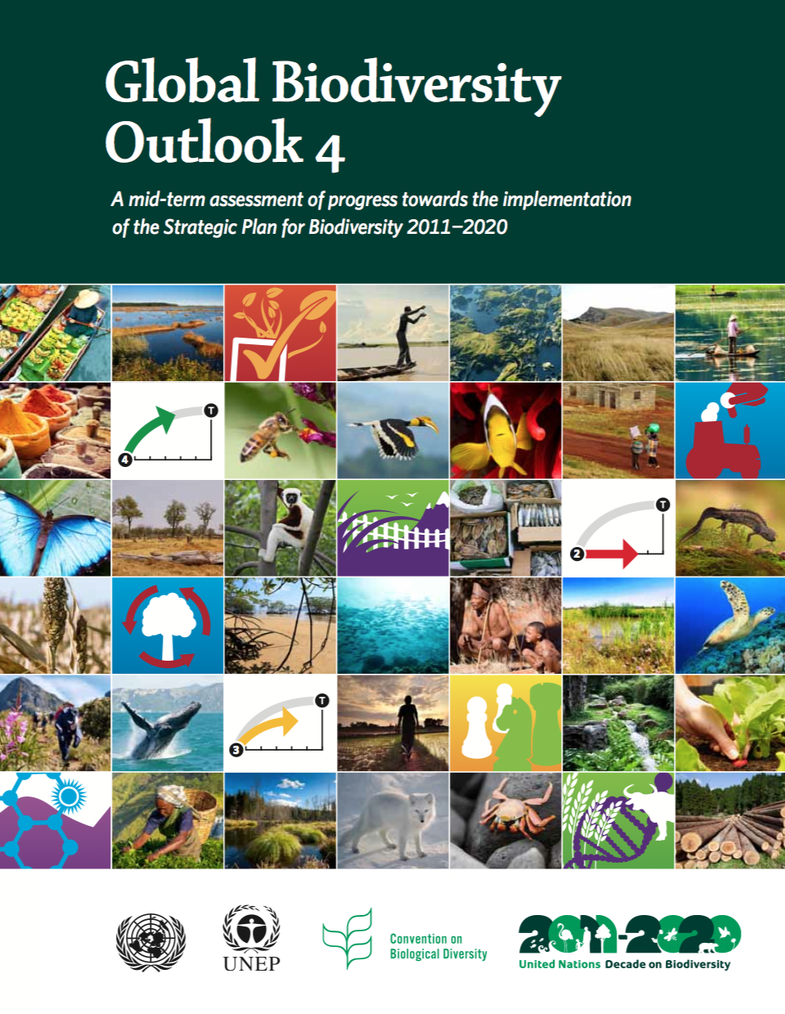

GBO-4: A mid-term assessment of progress towards the implementation of the Strategic Plan for Biodiversity 2011-2020

Slide 4
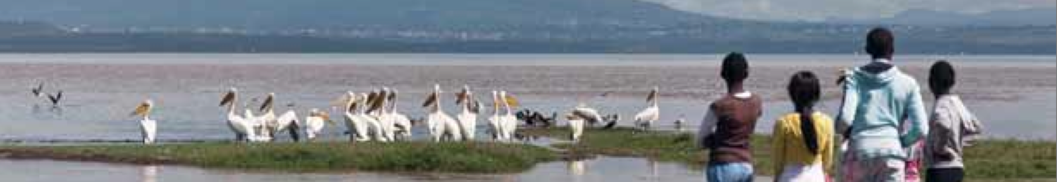
Conclusions GBO-4
• Progress is being made towards reaching the majority of the Aichi Targets.
• However, this progress is insufficient to attain most of the Aichi Targets by 2020, meaning that a redoubling of efforts is needed.
• Despite considerable progress in a wide range of actions to improve the status of biodiversity and ecosystems, most indicators of the status of biodiversity continue to decline, in part due to persistent increases in pressures.

Slide 5
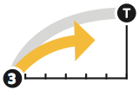
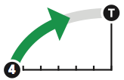
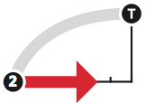
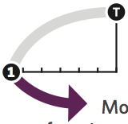
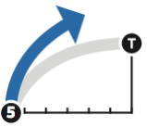
Overview of the “Dashboard” for the Aichi Targets
Target elements
Target elements
1
2
3
4
5
6
7
8
9
10
11
12
13
14
15
16
17
18
19
20
C
Status of biodiversity
A
Underlying Causes
No clear evaluation
D
Enhance benefits
B
Direct pressures
No clear evaluation
E
Enhance Implementation
No clear evaluation

Slide 6
Overview of the “Dashboard” for the Aichi Targets
Target elements
Target elements
1
2
3
4
5
6
7
8
9
10
11
12
13
14
15
16
17
18
19
20
C
Status of biodiversity
A
Underlying Causes
No clear evaluation
D
Enhance benefits
B
Direct pressures
No clear evaluation
E
Enhance Implementation
No clear evaluation

Slide 7
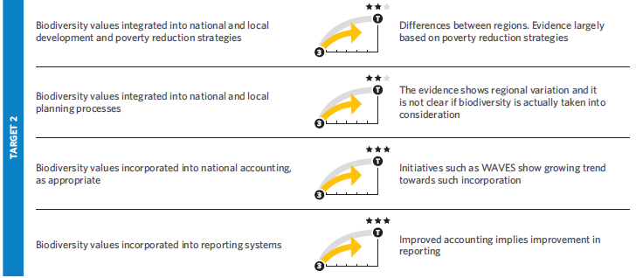
Dashboard for Target 2: Integration of biodiversity values
Assessment has been done by key elements of Targets
Stars indicate level of confidence

Slide 8
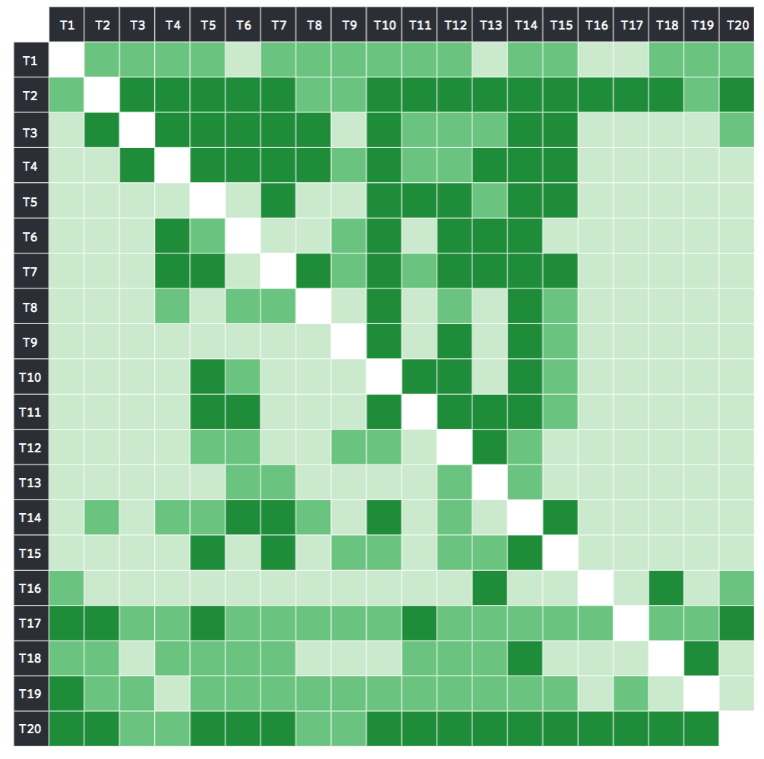
The importance of integration of biodiversity values for other targets is highlighted
Marques et al., 2014

Slide 9
The importance of integration biodiversity values for other targets (T2)
Marques et al., 2014

Slide 10
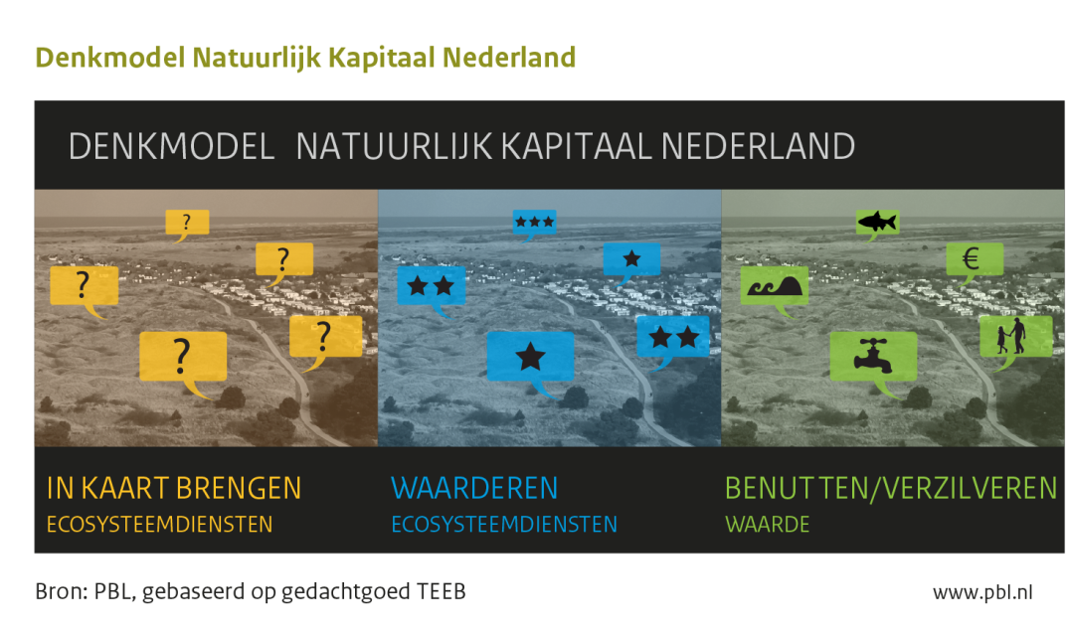
The Netherlands: map, value, use

Slide 11
Three ongoing activities
Map: Digital Atlas Natural Capital
(Ministry of Infrastructure and Environment and Ministry of Economic Affairs)
Value: Ecosystem accounting – Limburg province
(Statistical Office and Wageningen University)
Use: natural capital in decision-making
  (PBL, Netherlands Environmental Assessment Agency)

Slide 12
Map: Digital Atlas Natural Capital NL
“EU biodiversity strategy:
Member States, with the assistance of the Commission, will map and assess the state of ecosystems and their services in their national territory by 2014,
assess the economic value of such services, and promote the integration of these values into accounting and reporting systems at EU and national level by 2020”.
Atlas will be published by end of the year

Slide 13
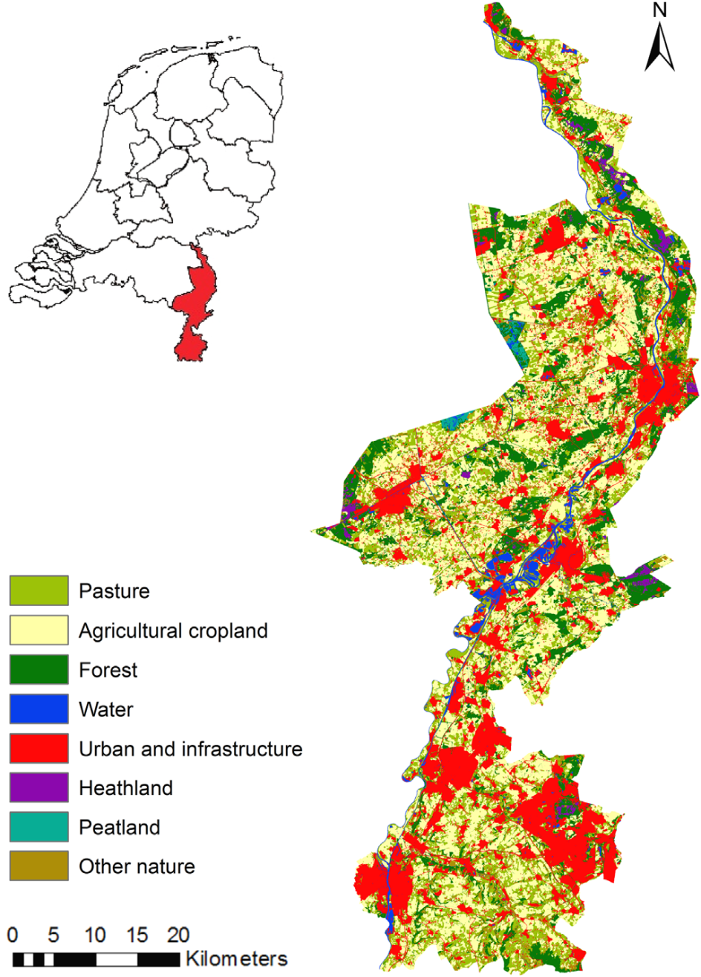
Value: Ecosystem accounting – Limburg province

Slide 14
Spatial biophysical accounting for multiple ecosystem services (Remme et al., 2014)
Seven ecosystem services in a cultural landscape consistent with ecosystem accounting.
Hunting, drinking water extraction, crop production, fodder production, air quality regulation, carbon sequestration and recreational cycling.
Model outcomes were used to develop an ecosystem accounting table in line with SEEA-EEA guidelines.
For the data-rich case of Limburg spatial modelling for ecosystem accounting in line with SEEA-EEA is feasible.
With the Statistical Office this now developed in a well functioning ecosystem valuation tool

Slide 15
Sectors struggle to include biodiversity concerns in their daily operations

Slide 16
Use: natural capital in decision-making
To be effective as policy concept natural capital needs further operationalisation…
Project to identify concrete options for business and policy makers to arrive at nature-inclusive investment- and policy-decisions

Slide 17
Studying how the economic value of nature can be included in decisions of business, societal organisations and governments
By interfering in four existing policy domains:
Water and nature in the Deltaprogramme
Ecosysteemservices EU Common Agricultural Policies
Water quality with a Water utility and agriculture
Natural capital in international suppy chains

Slide 18
Developing directions for action, with focus on…
Enabling conditions and policy frameworks
Organisational structures
Finance models
Knowledge requirements

Slide 19
Thank you for your attention!
Contact: marcel.kok@pbl.nl

