Slide 1



Measuring and Monitoring External Development Finance for Biodiversity
The OECD Development Assistance Committee Statistics & Rio Markers
Anna Drutschinin, OECD DAC Secretariat
“Transformative Initiatives” side event, CBD COP 12
16 October 2014, Pyeongchang, Korea
Notes:
Directly relevant to the CBD financial reporting framework as the Rio markers are used by many countries to report on “international financial resource flows” to biodiversity

Slide 2
Outline
OECD DAC Statistical System & Rio markers
Use of Rio marker data for reporting to the CBD
Future Improvements: ENVIRONET-WP-STAT Task Team

Slide 3
OECD DAC Statistical System
Development finance statistics are:
reported by members, international organisations & some non-DAC and charities
collected within the Creditor Reporting System (CRS),
monitored by Secretariat & WP-STAT (quality controls & reviews)
transparent - activity-level aid data publically available online
Reporting guided by standardised definitions and classifications, e.g.
commitments, disbursements
sector classifications
Bilateral / multilateral (avoids double counting)
exchange rates
ODA definition
Part of the modernisation and post-2015 reforms of development finance
Notes:
In particular highlight standardisation and transparency

Slide 4
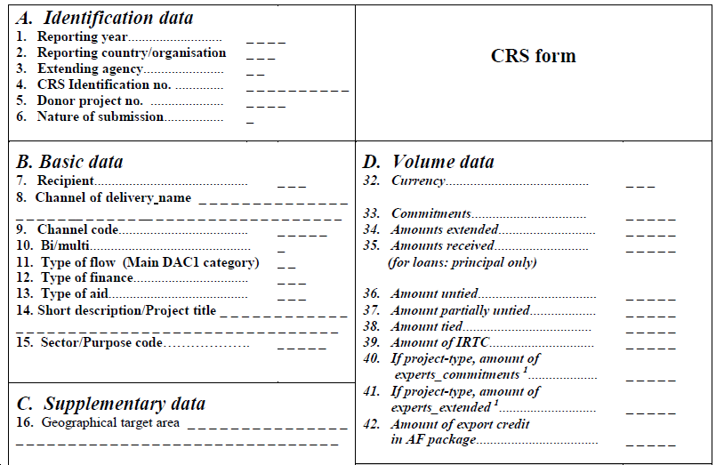
The Creditor Reporting System (CRS)
Reporting on Official Development Assistance (ODA) flows and Other Official Flows (OOF) at the at the activity level filling in the CRS Reporting Form.
Over 50 fields of descriptive information – including donors, recipients, regions, income groups, sectors, aid instruments, individual activity descriptions
CRS Reporting Form
Notes:
Will not go into this slide in detail.
Note that each individual aid activity is reported into the CRS, at a high level of detail (over 50 fields of descriptive information)

Slide 5
Measuring biodiversity-related finance within the CRS
Biodiversity-related aid is tracked within the CRS using the biodiversity “Rio marker” (since 1998, mandatory from 2006)
Rio markers track policy objectives
i.e. aid activities targeting biodiversity as a principal objective, a significant objective, or not at all
Marking guided by: Definition, eligibility criteria, typical examples and guidance
Data allow for an approximate quantification of finance flows to biodiversity & track mainstreaming

Slide 6
Outline
OECD DAC Statistical System & Rio markers
Use of Rio marker data for reporting to the CBD
Future Improvements: ENVIRONET-WP-STAT Task Team

Slide 7
Using Rio markers for reporting quantitatively to Rio Conventions
Large number of members draw on Rio markers to provide the basis for their reporting to the UNFCCC, CBD and UNCCD on bilateral ODA.
With awareness and recognition for the limitations of the Rio marker methodology - which allows for an approximate quantification of financial flows
Many members adopting “innovations” for reporting, in particular applying coefficients to adjust the share of finance
Rio marker data (as reported to CRS)
Select Coefficient
Estimate Finance Flow for International Reporting
Notes:
With relation to the CBD in particular, OECD DAC members are using the Rio markers to report on international finance flows to biodiversity, to track progress towards the target on resource mobilisation. However, the Rio markers were not initially establish to track progress on quantitative finance goals – rather, they were established in order to track the degree to which members are integrating and mainstreaming environmental (e.g. biodiversity) considerations into their development co-operation activities, and to support members in preparing their National Communications or their National Reports to the Conventions.
Therefore, OECD members are drawing on the Rio markers but applying a wide range of coefficients to the Rio markers to adjust the level of finance reported to the CBD. This is particularly the case for the use of data marked as targeting biodiversity as a significant objective. One of the areas of work of the task team has been to do a stocktake of how different members are using the Rio markers to report to the CBD, and to be a forum for members to share their methodologies and experiences in this area.

Slide 8
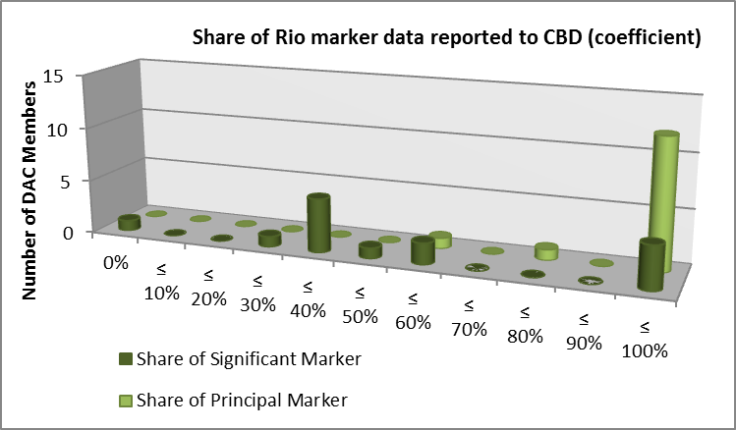
Use of Rio marker data for Reporting to the CBD:
Most report 100% principal
Varied treatment of significant
Different approaches and coefficients may relate to the nature of different member portfolios, and how the marker is applied.
Comparability and the need for harmonisation are pressing concerns
Source: OECD DAC Stocktake, summary of members survey responses
Notes:
Note that this comes from a stocktake survey the OECD DAC secretariat did at the end of last year on members’ reporting practices
A wide range of different approaches being taken. There is very little evidence to date to inform the use of coefficients. Different approaches by members may relate to the nature of different member portfolios, and how the marker is applied. This is an area where the TT is working to lead technical support in exploring the evidence base to support more quantified reporting. In considering areas to develop the evidence base, it was identified that activity size, sector and types of activities may be important factors.
Note that the revised CBD financial reporting framework asks members, in the “methodological information” section, to report what coefficient they apply to flows marked with the “significant” biodiversity Rio marker.

Slide 9
Outline
OECD DAC Statistical System & Rio markers
Use of Rio marker data for reporting to the CBD
Future Improvements: ENVIRONET-WP-STAT Task Team

Slide 10
The Joint ENVIRONET-WP-STAT Task Team on the Improvement of Rio markers, environment and development finance statistics
Goal:
DAC methodologies and data remain a point of reference on Official Development Assistance & Other Official Flows* targeting environmental objectives
Areas for improvement :
Quality - the application of Rio markers and data
Coverage - reconciliation of “green ” multilateral finance flows
Communication - including user access and training workshops
Use - supporting transparency and harmonisation in reporting
*non-export credit
Ref: Terms of reference and scope of work for a Joint ENVIRONET and WP-STAT Task Team on Improvement of Rio markers, environment and development finance statistics.
Notes:
However, there remains room for improvement with the data related to its quality, coverage, communication and use - especially as the way that the Rio marker data is being drawn upon is evolving. To this effect, the Joint Task Team was revived in November 2013. It has the goal of ensuring that (read goal).
This task team is open to participants beyond OECD DAC members. At past task team meetings, have welcomed participants from a range of developing countries and CSOs. (Indonesia, Philippines, Ethiopia, Zambia, research institutes in Bangladesh and Jamaica…)
Quality: Members’ improving reporting to DAC, e.g. timeliness and reporting on disbursements and Other Official Flows, and options to improve the Rio marker definitions - but no fundamental change in methodology;
Coverage: improving the reconciliation of “green” multilateral finance flows within DAC statistics, through collaboration with MDBs, and to potentially develop a system for attributing multilateral biodiversity finance;
Communication: Improving the communication, user access and online profile of the OECD DAC environmental data. Have produced a number of statistical flyers, and now have data visualisation portal for biodiversity-related aid. Also introducing training on how to access, draw on and interpret the data – user guide, short video, and September workshop.
Use: Exploring analytical basis for how to use Rio marker data for reporting to the Conventions, and for continued co-operation – but note that the OECD plays a supporting role, is not to determine how the Rio markers are used in reporting to the Conventions. TT is working to lead technical support in exploring the evidence base to support more quantified reporting. In considering areas to develop the evidence base, it was identified that activity size, sector and types of activities may be important factors.

Slide 11
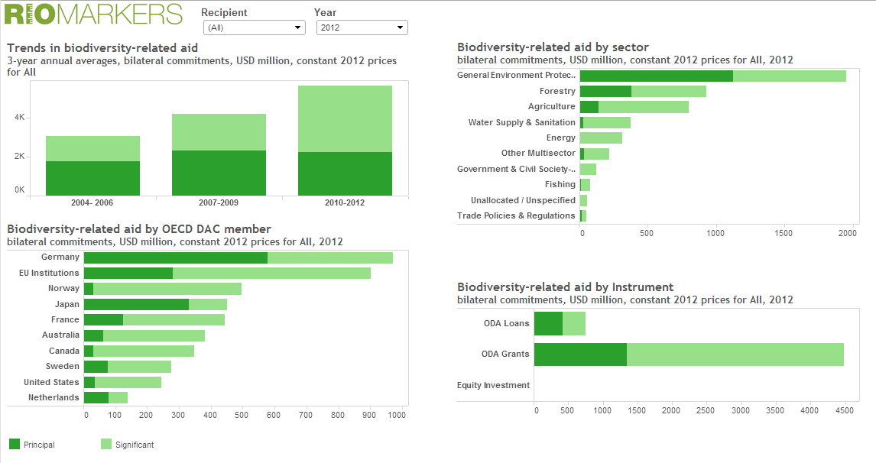
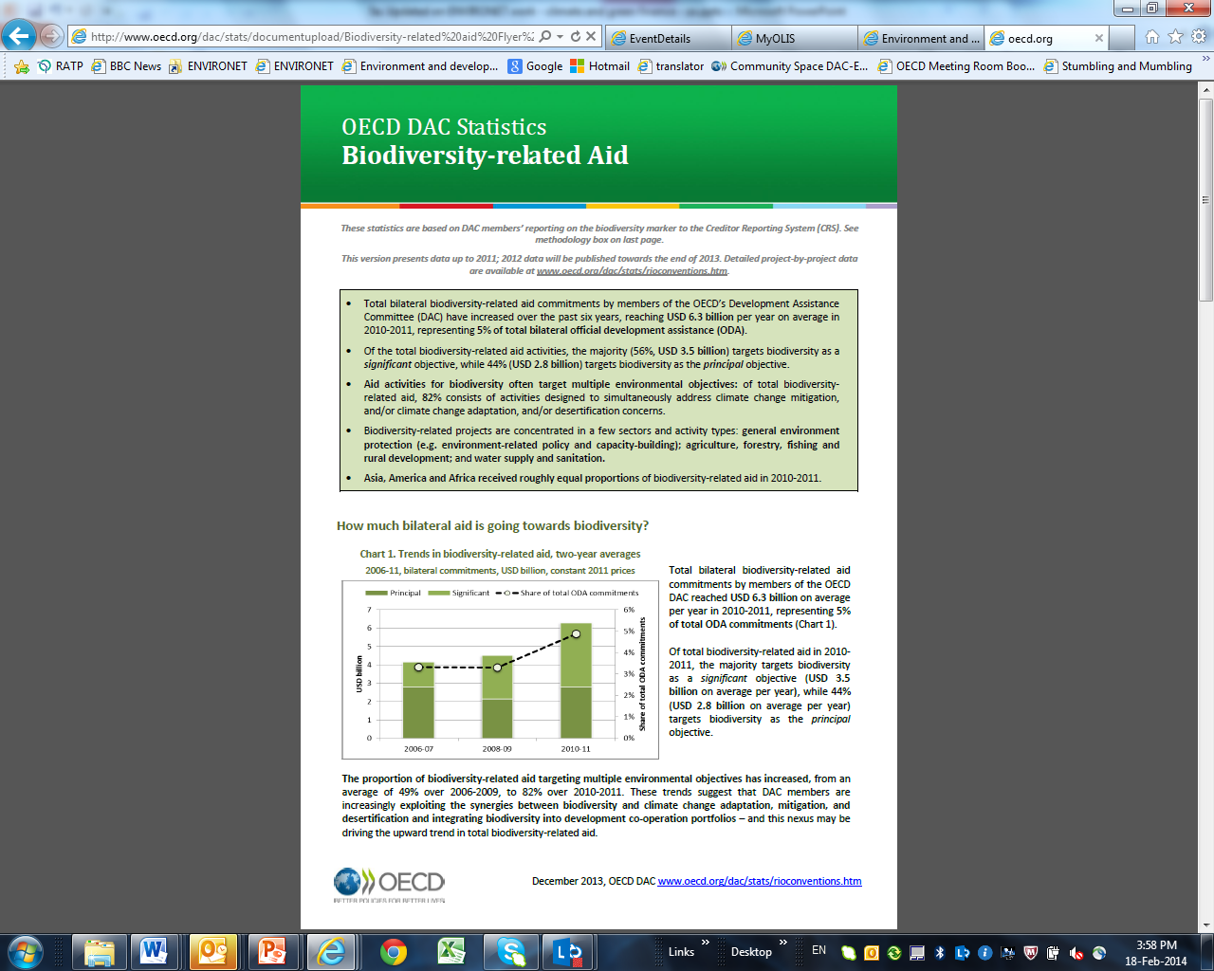
OECD DAC CRS Rio marker statistics, analysis & access to data http://oe.cd/RM Biodiversity-related statistics and analysis http://www.oecd.org/dac/stats/biodiversity.htm Rio markers training workshop: www.oecd.org/dac/environment-development/training-workshop.htm OECD Environment and Development Homepage www.oecd.org/dac/environment-development
Joint ENVIRONET-WP-STAT Task Team: Stephanie.Ockenden@OECD.org and Valerie.Gaveau@OECD.org
Biodiversity and Development: Anna.Drutschinin@oecd.org and Juan.CasadoAsensio@oecd.org

