Slide 1

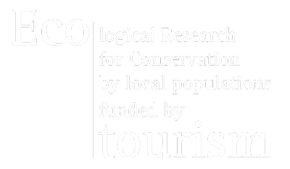
PANEL SESSION # 3
CAPACITY BUILDING AND COOPERATION
Oct. 13th 2014, Korea

Slide 2
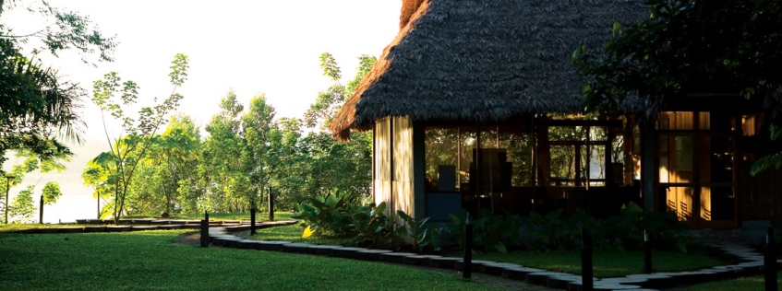
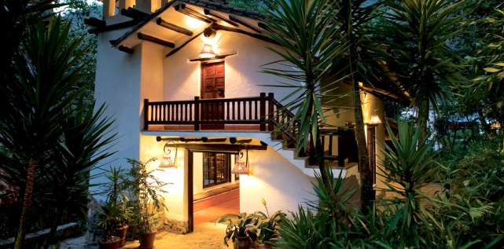
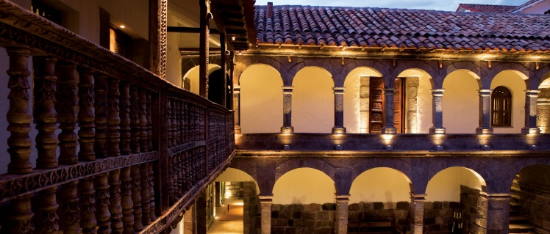
INKATERRA - PERU
Pioneered Ecotourism since 1975
A world leader in Sustainable Development
Holistic approach:
Research → Conservation + Education = Economic Growth
Added value in rural areas
Better quality of life for every living being
Luxury standards:
Native materials + Sense of place
Authenticity and Uniqueness
Inkaterra Reserva Amazónica (Amazon Rainforest)
World’s 25 Best Ecologdes by National Geographic Traveler (2013)
Best lodge in the Amazon Basin, Latin American Travel Association (UK)
Inkaterra Hacienda Concepción (Amazon Rainforest)
The Best New Hotels in the World, Condé Nast Traveler’s Hot List 2012
Inkaterra Machu Picchu Pueblo Hotel (Andean Amazon Cloud Forest)
Travel+Leisure World Best Hotels (2014)
Inkaterra La Casona (Cusco City High Andes)
First Relais & Châteaux property in Peru
ONGOING PROJECTS
Inkaterra Hacienda Urubamba (Midway from Cusco to Machu Picchu)
Overlooking the Sacred Valley of the Incas
Casa Hacienda and 24 Casitas
Cabo Blanco (Pacific Ocean and Desert)
Inkaterra Cabo Blanco – opening 2016
World records: Marlin (1,560 pounds) and Big Eye Tuna (434 pounds)
Proposed first marine reserve area in Peru
Inkaterra Reserva Amazónica
Inkaterra Machu Picchu Pueblo Hotel
Inkaterra La Casona

Slide 3
INKATERRA’S RESPONSIBLE TRAVEL APPROACH SINCE 1975
RESEARCH
ONSERVATION
EDUCATION
POSITIVE MEASURABLE FOOTPRINT
(World Records)
LOCAL IMPACT
(4000 + local people trained since 1975)
SENSE OF PLACE + FACTUAL INFORMATION
(World Awards)
ENGAGING EXPERIENCE FOR VISITORS + ACADEMICS
(200,000 pax. 2014)
Sustainability

Slide 4
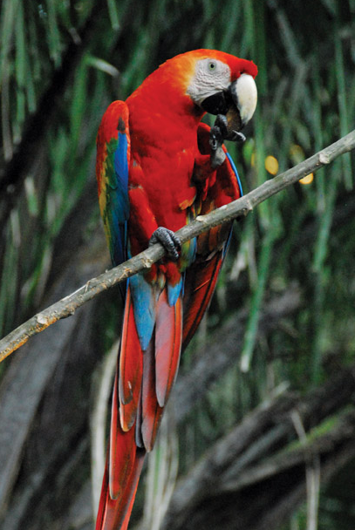
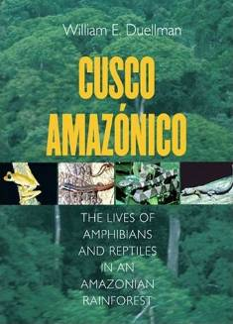
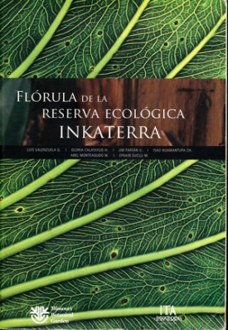
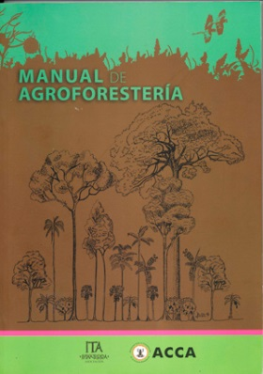
GEF – IFC OUTCOMES
INKATERRA ASOCIACIÓN (ITA)
NGO working on research for conservation and sustainability
Scientific research since 1978.
Sustainable development via ecotourism.
Benchmark to compare Inkaterra’s future impact in areas of influence.
200 + researchers sponsored by Inkaterra.
  Global Environment Facility (GEF)
  first loan to the private sector, via World Bank Group (IFC).
Cusco Amazónico: The Lives of Amphibians and Reptiles in an Amazonian Rainforest
(Cornell University Press, 2005)
Flórula de la
Reserva Ecológica Inkaterra
(Missouri Botanical Garden and Inkaterra Asociación, 2007)
Manual de Agroforestería
(Inkaterra Asociación) and ACCA 2014)

Slide 5
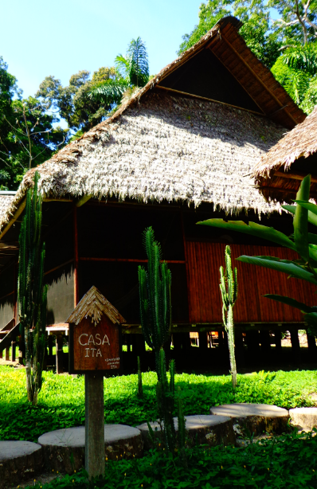
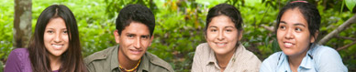
ENGAGING CIVIL SOCIETY AND ACADEMIA IN PARTNERSHIP BUSINESS
Contribution to the creation of laws to preserve ecological reserves
First Private Ecological Reserve (1979).
Alliance with local and international universities and institutions.
200 + researchers sponsored by Inkaterra Since 1978.
Volunteer programs for research, conservation and
community development in Madre de Dios - Tambopata.
ITA Field Stations:
Rainforest / Cloudforest / High Andes / Coastal Desert.
Lodging for researchers
Students + Volunteers.
ITA scholarship: Ants / Fungus.
ITA Field Station

Slide 6
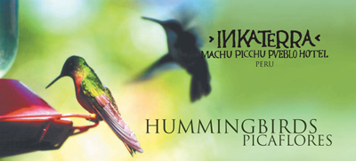
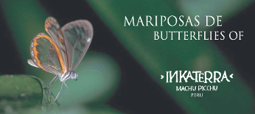
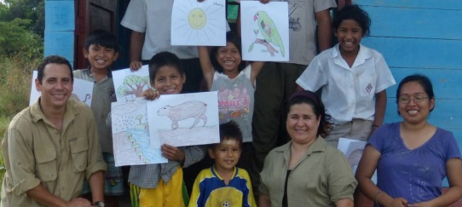
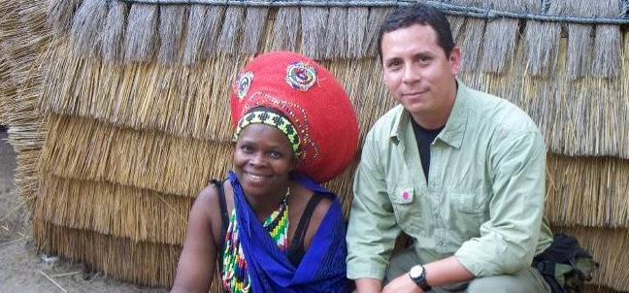
ENGAGING LOCAL COMMUNITIES
JOB CREATION FOR LOCAL EMPLOYEES
ENVIRONMENTAL WORKSHOPS & CONFERENCES
SUPPORT OF LOCAL INSTITUTIONS
LOCAL SUPPLIERS
EXPLORER GUIDES TRAINING SCHOOL
INKATERRA
Educational Tools: Field Guides
Environmental Conservation workshops
International Training Programs

Slide 7
ENGAGING LOCAL COMMUNITIES
4,000 + local people trained since 1975
Improvement of local resource management skills
Increase in communities’ agriculture and handcraft productivity
Career opportunities to achieve management or administration positions
Pleasant work environment and appropriate conditions according to law
 | Local employees | External employees | Total employees
Inkaterra Reserva Amazonica | 58% | 42% | 100
Inkaterra Machu Picchu Pueblo Hotel | 79% | 21% | 161
Inkaterra La Casona | 94% | 6% | 47
Inkaterra Hacienda Concepcion | 77% | 23% | 29
El MaPi byInkaterra | 77% | 23% | 100

Slide 8
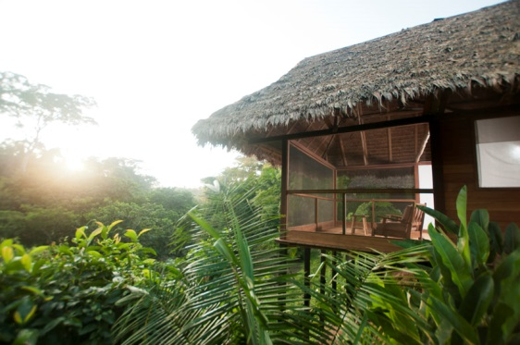
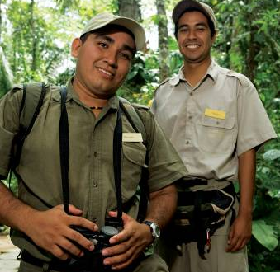
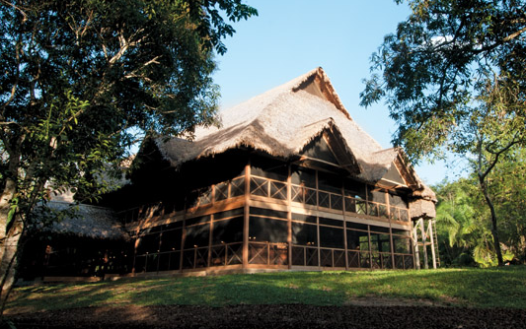
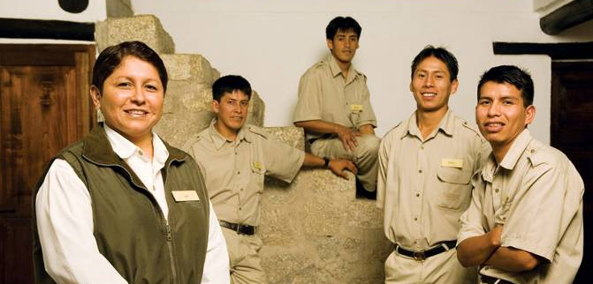
ENGAGING LOCAL COMMUNITIES
  3 Generations
  of local families are part of Inkaterra
  Vargas Family
    1st generation – Juan Vargas (1975)
    2nd generation - Samuel, Hugo and Juan Vargas (1985)
    3rd generation - Ever Vargas (2009)
    Percy Ccopa
    Explorer Guide, 2006 - 2011
    Leader Explorer Guide, 2011 - 2012
    Chief Explorer Guide, 2012
    Resident Manager, 2013 – up to date
    Gloria Neyra
    Senior receptionist, 2007
    Chief receptionist, 2007 – 2008
    Deputy Resident Manager, 2008
    Office Administrator, 2011
    Resident Manager, 2012 – up to date
4 Generations of Herpetologists
(Kansas University and Colorado Boulder)
William Duellman & Linda Trueb – 80s
Eric Wild – 90s
Sara Orlofske – 2000
Robert Jadin – 2011
4 Generations of Botanicals
(Missouri Botanical Garden/ UNSAAC)
Alwyn Gentry – 80s
Percy Nuñez – 90s
Luis Valenzuela – 2000
Gloria Calatayud – 2011

Slide 9
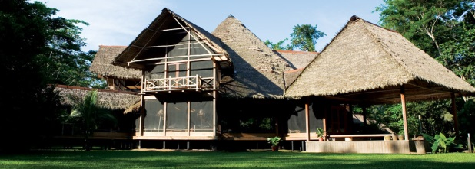
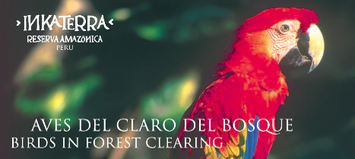
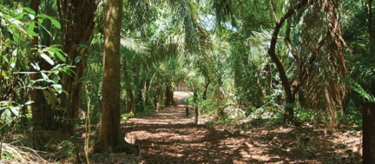
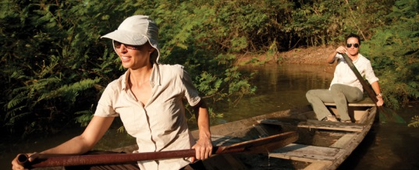
BENEFITS AND MEANS OF ENGAGING WITH LOCAL COMMUNITIES
ENVIRONMENTAL AWARENESS & CONSERVATION
Traditional knowledge transfer
Native architecture + materials = Sense of original place
POSITIVE FOOTPRINT
Primary Forest Carbon Monitoring since 1989
Inventories and sustainable use of gene bank
GOOD PRACTICES IN CONSERVATION & TOURISM
ECONOMIC SUSTAINABILITY
EXPERIENTIAL TRAVEL
Authenticity & Uniqueness
Ecotourism improves quality of life
Forest research + restoration
Local jobs
New sustainable tourism destination
Profits = long term replicability
Environmental Awareness
Educational plates
Forest Restoration
Low Impact excursions

Slide 10
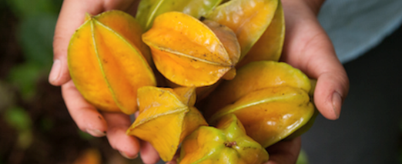
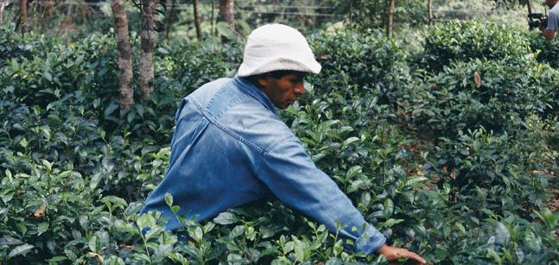
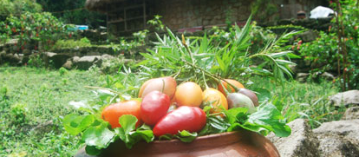
SUSTAINABLE PROCUREMENT AND SUPPLY CHAIN MANAGEMENT
AGROFORESTRY DESIGN
Determines location of forestal, nutritional species for organic production
PLOTTING WORKSHOP
Adequate land use by local communities
NATIVE
FARM
HARVEST & PROCESSING
FINAL PRODUCT
Cacao
Brazilian Nut
Organic Tea
Honey
Quinoa
Chia
Potatos
Corn
Organic Production – Carbon Free
Supply to Inkaterra hotel restaurants for visitors consumption
Traditional Farming tools

Slide 11
SUSTAINABLE PROCUREMENT AND SUPPLY CHAIN MANAGEMENT
    Inkaterra’s Responsible Tourism approach leads the basis for a tourism replicable model
    at national level based on the following conditions:
Inkaterra´s Replicable Model
Low initial investment
Education & knowledge transfer
Local involvement
Authentic Experience (Excursions, lodging)
Research & Conservation
Sustainable initiatives and good practices

