Slide 1
Mainstreaming biodiversity in the production sectors
Jeffrey Milder, Rainforest Alliance
CBD Business & Biodiversity Forum
October 13, 2014

Slide 2
What is mainstreaming, anyway?
Biodiversity mainstreaming:
“the process of embedding biodiversity considerations into policies, strategies and practices of key public and private actors to promote conservation and sustainable use of natural resources”
GEF has supported 327 mainstreaming investments totaling US $1.6B since 2003
Mainstreaming “is not yet routinely embedded into the work of conservation practitioners nor into key sectors relevant to biodiversity preservation”
Source: Huntley, B.J. and Redford, K.H. (2014). Mainstreaming biodiversity in practice: a STAP advisory document. Global Environment Facility, Washington, DC.

Slide 3
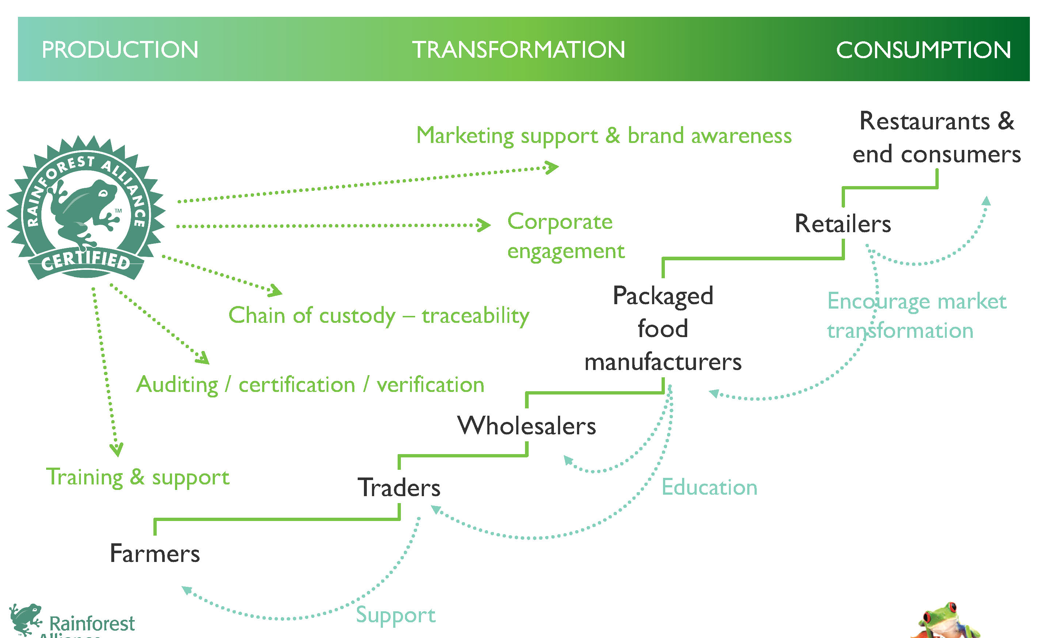
RAINFOREST ALLIANCE’S MAINSTREAMING WORK
Mission: The Rainforest Alliance works to conserve biodiversity and ensure sustainable livelihoods by transforming land-use practices, business practices and consumer behavior.

Slide 4
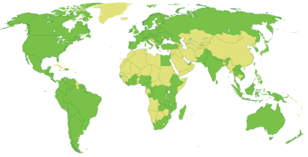
RESULTS AT GLOBAL SCALE
>1.1 million farms certified
75 million hectares under sustainable management
>11 million farmers, workers, and family members benefit
4.7% of global coffee market is Rainforest Alliance Certified
10% of global cocoa market is Rainforest Alliance Certified
11.5% of global tea market is Rainforest Alliance Certified
3.4% of global banana market
(21% of total exports)

Slide 5
BIODIVERSITY-friendly PRODUCTION LANDSCAPES
>11.4M ha set-aside in natural ecosystem reserves in production landscapes – connected by corridors and protected against major harmful impacts
Ecosystems restored in areas critical for biodiversity and ecosystem services
Farms managed in wildlife-friendly ways

Slide 6
Structured approaches to sustainable consumption & production (SCP)
3RD PARTY
STANDARD-SETTING (e.g., principles, criteria, and indicators)
ROUNDTABLES / MSIs
TRAINING (e.g., producer & enterprise training and support)
ASSURANCE (e.g., verification / certification, traceability)
1st PARTY (company)
CLAIMS (e.g., eco-labels, B2B designations or differentiation)
SECTOR INITIATIVES

Slide 7
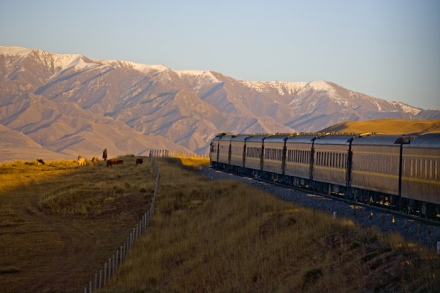
The train to shangri-la
Shangri-La

Slide 8
The train to shangri-la
Drivers – risk management, NGO campaigns, sustainable procurement policies, sustainable lending guidelines, gov’t regulations, etc.
Private good – value to the firm
Public good – including biodiversity protection
Mechanisms & tools – company sustainable sourcing policies, standards & certification, environmental management systems, ecosystem valuation, jurisdictional approaches, monitoring & performance assessment, etc.

