Slide 1
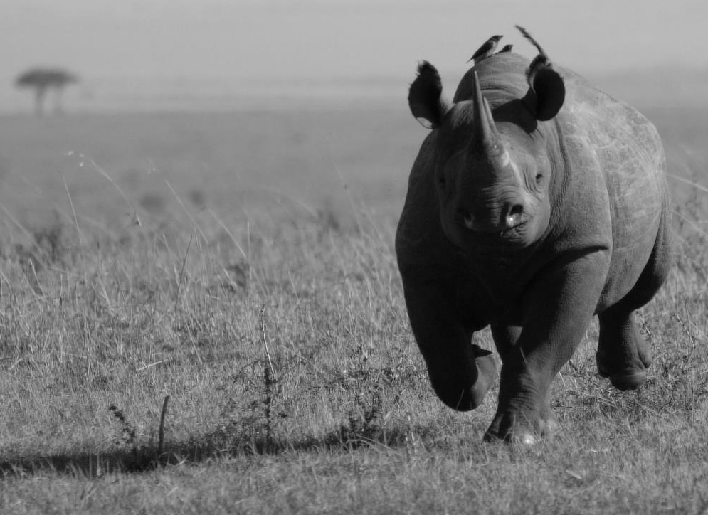
rhino impact Bond changing the conservation landscape
With thanks to:
Social Finance is authorized and regulated by the Financial Conduct Authority FCA No: 497568
Notes:
My presentation is going to take you through an project that aims to demonstrate that by tapping into investment funds, rather than relying on traditional grants, bonds could potentially leverage new sources of conservation finance and provide value for money for government investments by using taxpayer funds efficiently and only paying once outcomes are achieved.
ZSL and Social Finance are leading on this project as part of the United for Wildlife partnership, and this project is currently being supported by UNDP / GEF and the Royal Foundation.
This project will harness the power of private finance to drive a fundamental change in how we approach conservation by focussing on measuring impact. Rhino protected areas need to be rapidly strengthened, requiring both upfront and sustained funding, as well as the flexibility to change activities as the poaching threat changes.
The idea behind a SIB/DIB is that long-term donor funding commitments (by governments or intergovernmental agencies) are used to leverage private investment, on the basis that if outcomes are verifiably achieved, then investors will be paid back (potentially with interest) by the donor.

Slide 2
the CONSERVATION movement needs to change
Realistic global funding levels needed for protected areas are only 2-4% of global military spending, but many governments is disinvesting in protected areas
Scaling up conservation funding therefore requires
New sources of finance, including harnessing the power of private finance to drive change in approach to conservation.
Implying greater focus on measuring impact.
Notes:
Despite decades of effort and billions of dollars spent, the conservation movement has been unable to stem the loss of biodiversity. A new approach is urgently needed.
As we have seen governments and philanthropic foundations are ready to scale-up funding but require a greater focus on measuring impact – a challenge that conservation has been slow to embrace to date.
This project will harness the power of private finance to drive a fundamental change in how we approach conservation.

Slide 3
escalating poaching is leading to a tipping point
Escalating poaching threatens to push rhino populations over a tipping point.
The Javan rhino recently went extinct in mainland SE Asia, the last individual was poached
Rapid, global response urgently needed.
The growing impact investing market could be a large source of upfront capital to boost site-based rhino conservation.
The project will create a roadmap to reduce poaching, applied first to rhinos, then all high value species.
Number of rhinos poached in Africa
Source: Emslie, R. & Knight, M. 2014. Update on African Rhino Status and Poaching Trends from IUCN SSC African Rhino Specialist Group (AfRSG). Data from IUCN SSC AfRSG, TRAFFIC and CITES Rhino Working Group.
Notes:
The escalating poaching in Africa and Asia is threatening to push rhino populations over a tipping point. The illegal wildlife trade – the fourth most lucrative global illicit activity – undermines national security and rural development.
Well-funded armed poaching gangs are highly mobile, making poaching a ubiquitous threat. A rapid and global response is urgently needed across all rhino conservation sites.
The growing impact investing market could be a large source of upfront capital to boost site-based rhino conservation, but accessing this risk capital depends on conservationists having a clear pathway to achieving measurable impacts.
This project will create a roadmap to reducing poaching. We will apply it to rhinos first, but the aim is to benefit all high value species threatened by poaching.

Slide 4
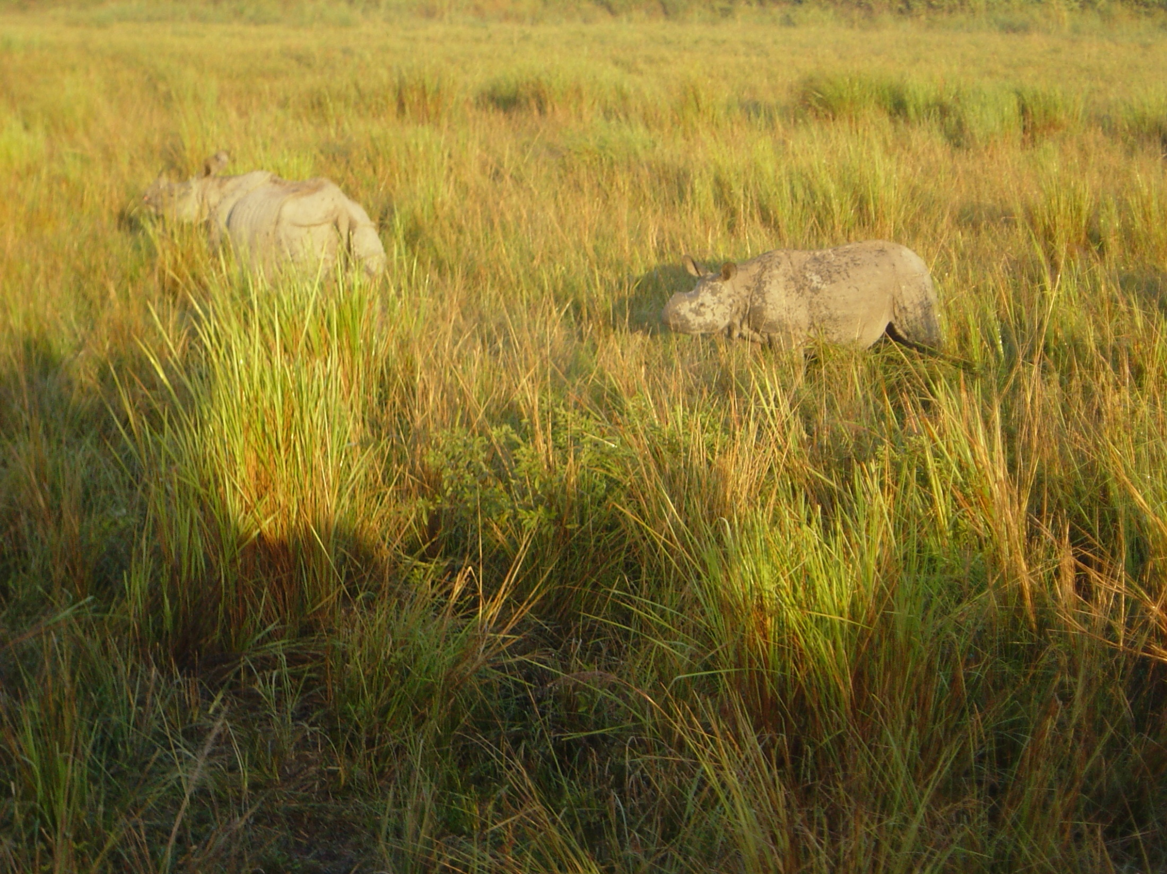

Slide 5
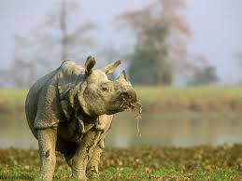
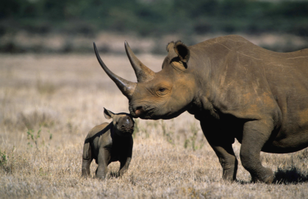
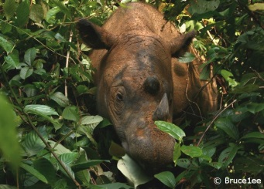
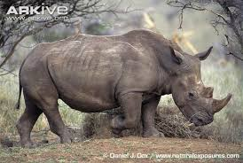
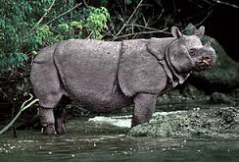
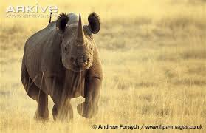
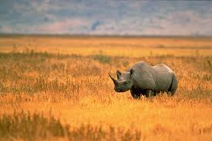
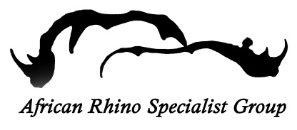
Our Aim is to launch a $40-50m impact bond to conserve rhinos globally
Site data provided by IUCN SSC Rhino Specialist Groups
Notes:
This project is a global project and is focussing on priority rhino sites as defined by the IUCN Rhino Specialist Groups. These will be Key 1-rated populations which have at least 100 rhino individuals and are the key to success for the species.

Slide 6
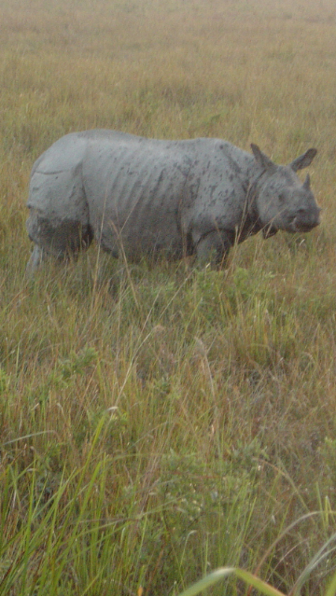
The rhino impact bond in a nutshell
Impact bonds are not traditional bonds or trust funds
They are equity investments where return is pegged more to social returns than maximum profits
The rhino impact bond represents a collaboration between investors and donors, such that investors risk their profits and some of their capital to ensure that donor contributions are only used for successful projects

Slide 7
unique structure of IMPACT bonds lends itself to tackling the poaching problem
Rhino protected areas need:
upfront and sustained funding;
flexibility to change activities as poaching threat changes.
Impact bonds provide:
long-term (c. 10 year) funds;
incentives to achieve impact through linking funding to results;
‘service providers’ (e.g. PA managers) with flexibility in implementation.
Donor pays for impact
achieved, rather than
controlling inputs and
processes
Impact achieved
improves as programme
is adaptive, client-centred
and evidence-based
Investors provide
up-front capital to, and
portfolio manage,
service providers in
real-time
The generic structure of an impact bond
Notes:
Rhino protected areas need to be rapidly strengthened, requiring both upfront and sustained funding, as well as the flexibility to change activities as the poaching threat changes.
Impact bonds incentivise the achievement of impact by linking funding to results and allowing ‘service providers’ (e.g. rhino site managers) flexibility in implementing interventions to achieve the necessary impact.
The long-term finance offered by an impact bond is ideal for slow breeding animals such as rhinos with the impacts of reducing poaching on population growth will be manifested over 5 to10 years.

Slide 8
Return on investment will depend on verified success of the portfolio of rhino sites
NO IMPACT
X
INVESTORS
Capital is returned
+
5-10% IRR
ONLY
if impact is achieved
Upfront capital
Return on investment depends on success
RHINO IMPACT PARTNERSHIP
OUTCOMES FUNDERS
Capital is spent on site based actions
Portfolio management
SITE MANAGERS
Site-based actions over 8-10 years
DESIRED OUTCOME
RHINO POPULATION

Slide 9
Pros and cons
For investors
Pros
Supporting conservation
With strong measures attached to help make investment decisions as the project progresses
If successful, capital back along with some modest profits
Cons
Can lose profits, some of capital or at worst all capital
Lower profits than traditional investment
For donors
Pros
Money not wasted on failed projects
Someone else providing oversight
Cons
In the case of a successful project the donor has to pay 5-10% more to provide return on investment

Slide 10
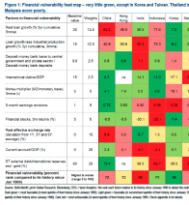
project will assess the gaps across rhino sites to provide investors with a clear ‘theory of change’
Theory of change based on holistic PA management framework …
… for gap analysis by PA managers…
… to produce intervention model, indicators and budget
Pillar | Element assessed
Generic
A: IMPORTANCE AND STATUS | 1. Social, cultural and biological significance 2. Protected area design 3. Legal status, regulation and compliance
B: MANAGEMENT | 4. Management planning 5. Management plan/system implementation 6. Management processes 7. Staffing (full time and part time) 8. Infrastructure, equipment and facilities 9. Sustainability of financial resources 10. Adaptive management
C: COMMUNITY | 11. Human-wildlife conflict 12. Community relations 13. Stakeholder relationships
D: TOURISM (optional) | 14. Tourism and interpretation
E: PROTECTION | 15. Protection
Rhino specific
F: HABITAT MANAGEMENT | 16. Habitat management
G: RHINO POPULATIONS | 17. Rhino population monitoring & management
Developing outcomes indicators is a methodological challenge
Notes:
Investors want a clear theory of change – answering how the investment will lead to impact within the target population.
Therefore need a thorough and holistic gap analysis, based on a checklist filled in by the PA managers themselves. Checklist is not prescriptive, rather asks PA managers what they need to do their job effectively and meet the performance targets they’ve set.
Lessons can be learned from the CA|TS process and links built with the IUCN’s Green List of Well-Managed PAs

Slide 11
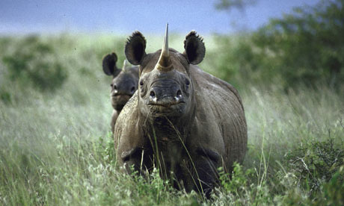
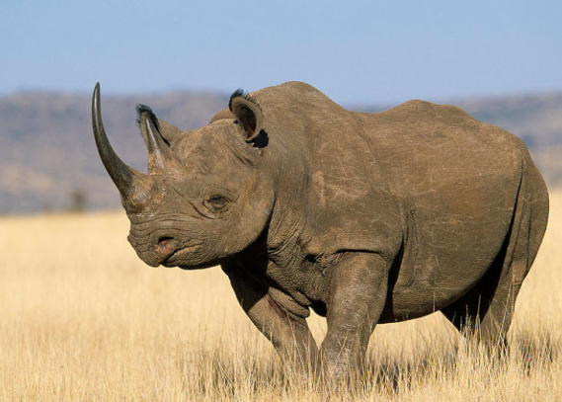
GEF Project will Prove the concept and build investor confidence over 2 years, to launch bond in 2017
Activities to design the bond and build investor confidence:
Gap analyses in several priority rhino sites
Test interventions and performance metrics
Aiming to work in:
Asia and Africa (East and Southern)
Focus on Key1-rated rhino populations
Learn lessons for investors
Notes:
The GEF Project will Prove the concept and build investor confidence over the next 2 years, with a view to launching the bond in 2017
Conducting a Pilot Impact bond will be conducted (with up to $5.1m) in 3 proposed sites:
Hluhluwe-iMfolozi Park, South Africa to respond to high poaching levels in a flagship South African site
Tsavo West National Park, Kenya to secure a government-run park against poaching to enable translocation of rhinos and enable rapid population growth
Chitwan National Park, Nepal to maintain low poaching levels in Nepal’s top rhino site
The aim being to choose a range of sites with different management issues and varying poaching threats.
Then we will get a further 7 sites, ‘investor ready’ for the full bond. This will include conducting gap analysis, defining performance metrics and setting-up data systems (with $1.5m) including:
Kaziranga National Park, India to respond to growing poaching threats in the global stronghold of the Greater One-Horned rhino in Assam

Slide 12
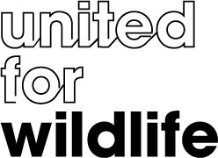
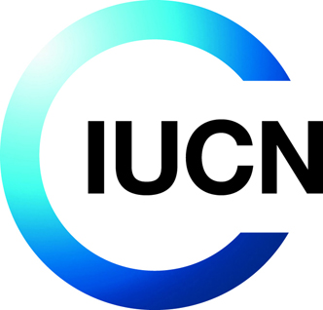
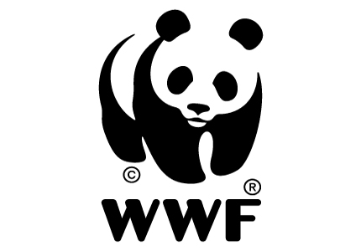
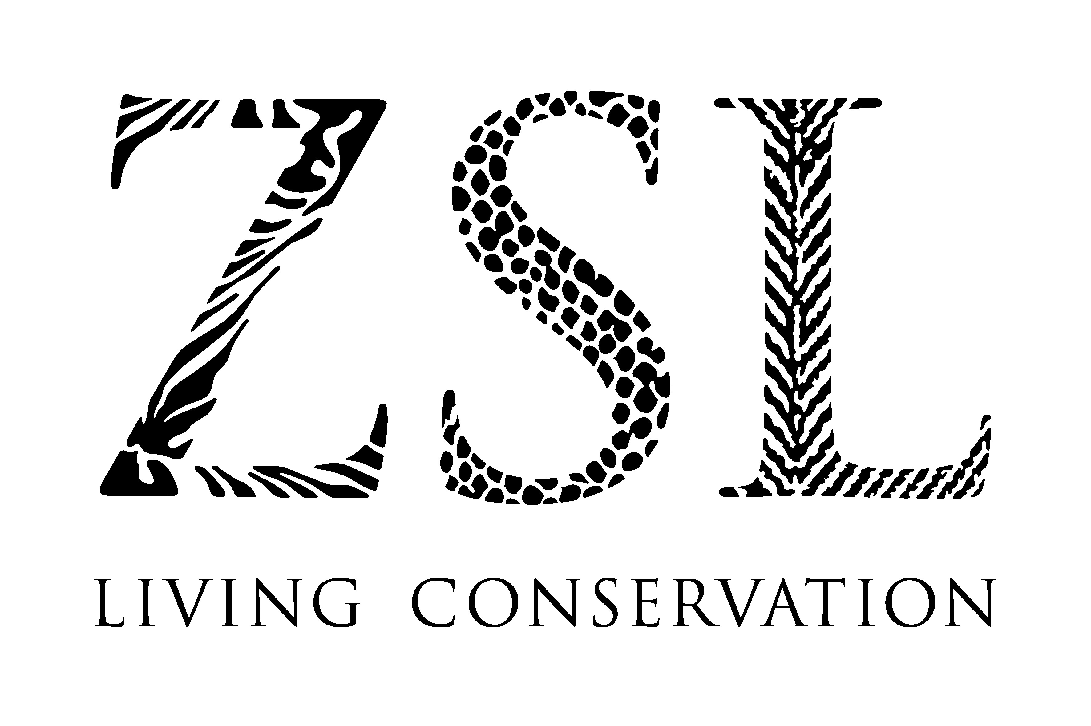
Notes:
Just a bit of background on the United for Wildlife Partnership
United for Wildlife has been convened by the Duke of Cambridge, with the support of The Royal Foundation of The Duke and Duchess of Cambridge and Prince Harry
United for Wildlife comprises seven international field based conservation organisations and is committed to focusing increased attention on the most pressing conservation issues of our time. The initial focus is on the escalation of the illegal wildlife trade.

Slide 13
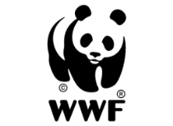
Thank you
"Impact Bonds stand to improve the efficiency of development assistance in the coming years“
Elizabeth Littlefield, president of overseas private investment corporation
For more information: Katherine Secoy,
Zoological Society of London
Katherine.Secoy@zsl.org

Slide 14
