Slide 1
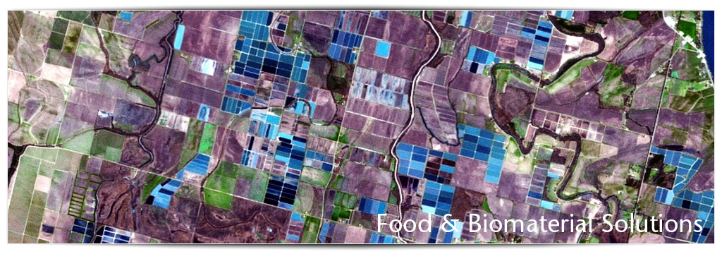
Mainstreaming and Assessment
A WBCSD perspective
CBD COP12, 13 October 2014
Violaine Berger, WBCSD

Slide 2




























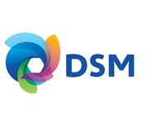





















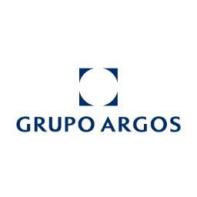








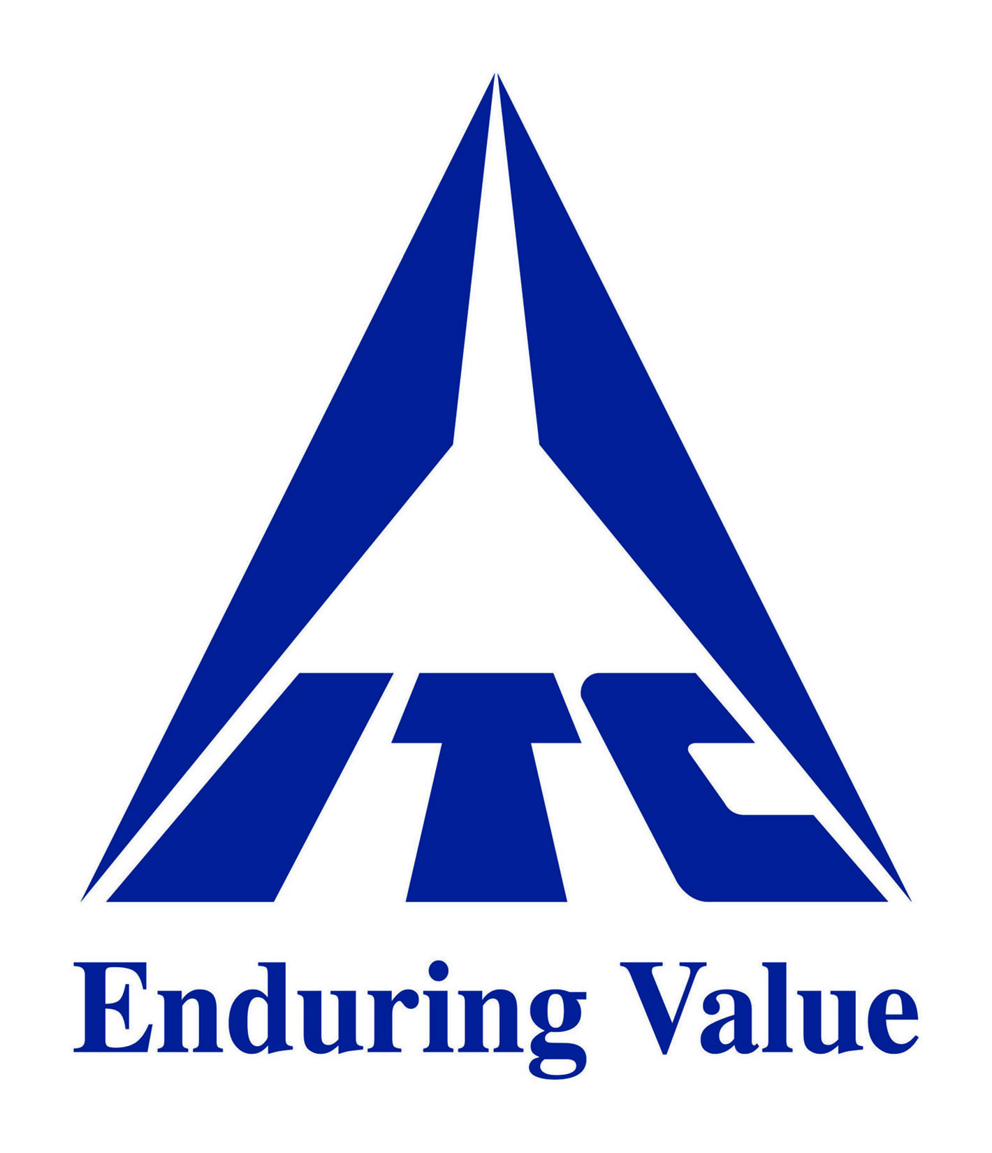

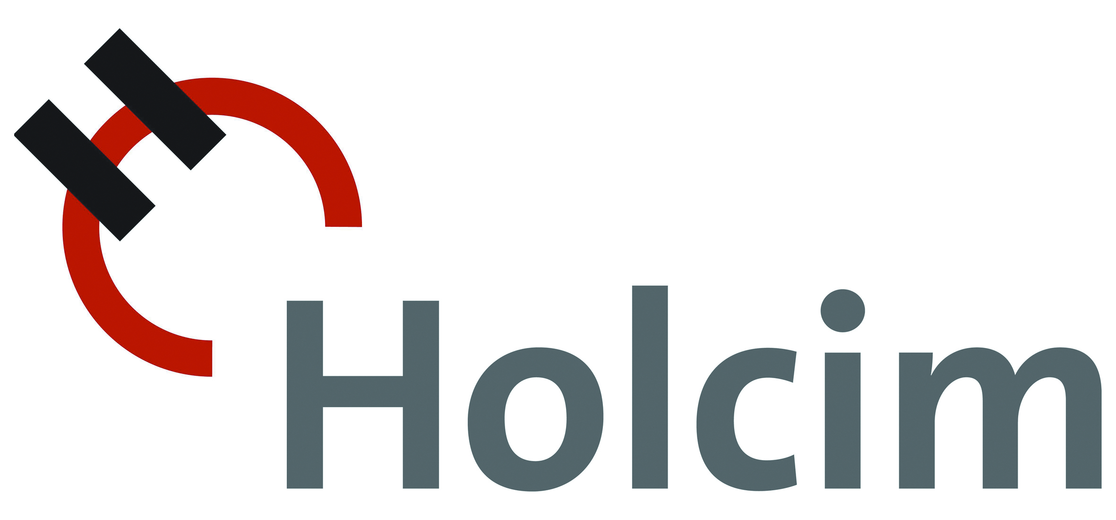





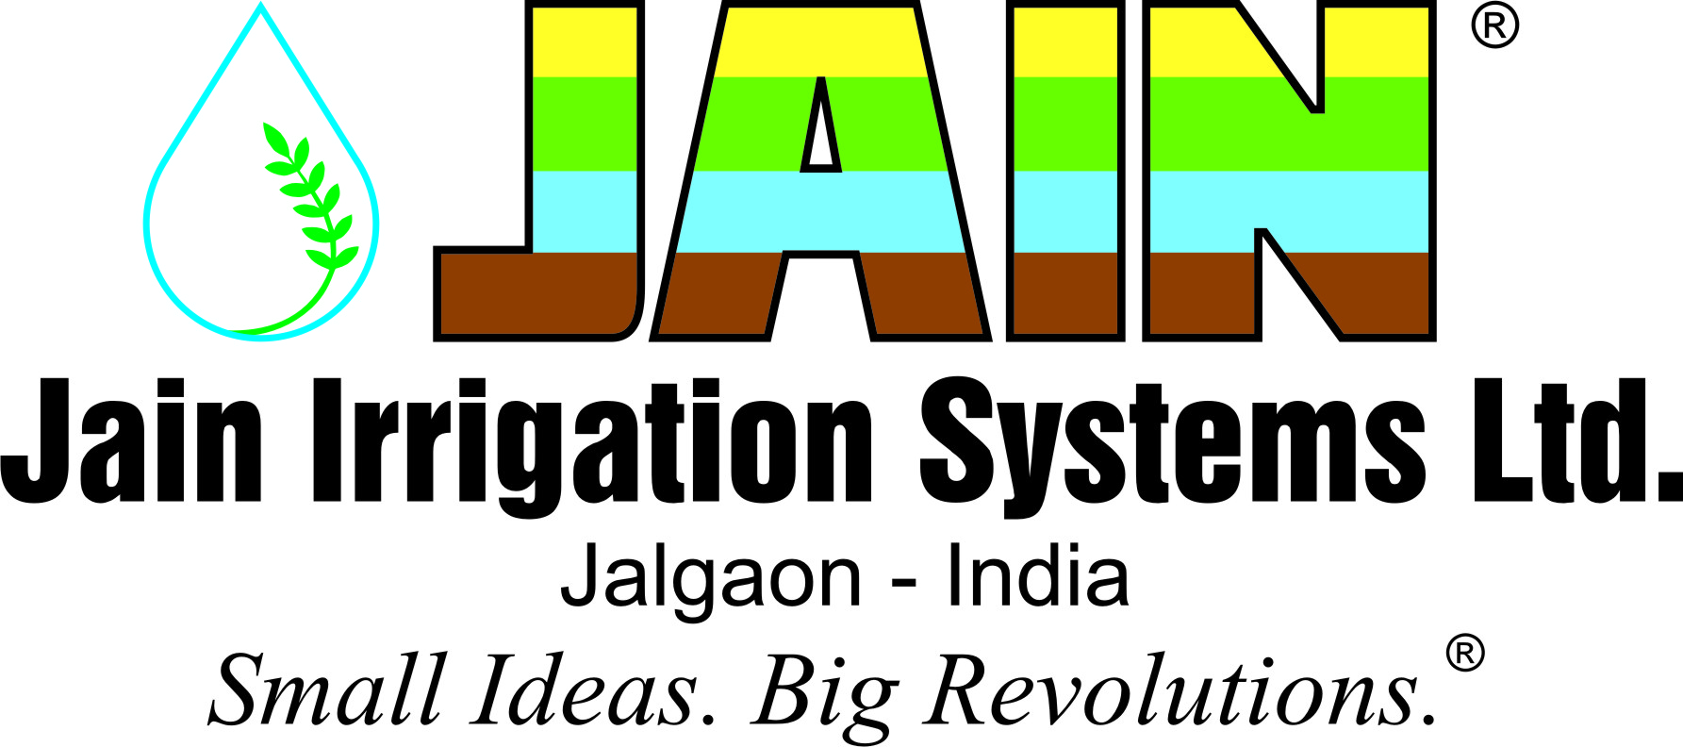







































































Slide 3
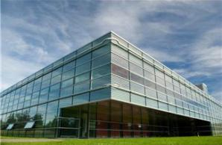
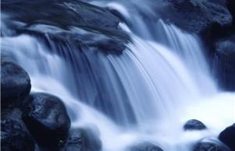
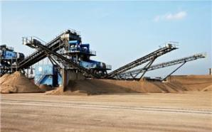
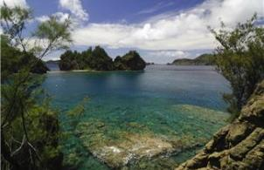
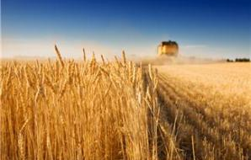
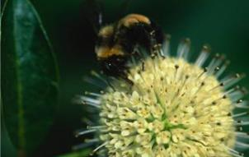
The business case for action
Businesses directly and indirectly IMPACT
on nature
RISKS and OPPORTUNITIES
Businesses directly and indirectly RELY and DEPEND on nature
Notes:
So there is a relationship between business and nature. All businesses depend upon, and in some way impact, the ecosystem services that are provided by the natural ecosystems and biodiversity that make up planet Earth. And these impacts and dependencies can be direct as well as indirect (i.e. in your supply chain).
However, very little is known about the actual value of these services for business, or the specific opportunities that they present in business terms. Such values have not, conventionally, formed a part of business planning and financial analysis.
Background information:
Water, for instance, is a critical input for most, if not all, major industrial processes. The pharmaceutical industry benefits from nature’s genetic resources. Agribusiness and the food sector depend on nature’s pollination, pest control, water, and erosion regulation services. Forest industries – and downstream construction, communications and packaging sectors – rely on continued supplies of timber and wood fiber. All extractive industries inevitably cause some level of ecosystem disturbance, while tourism increasingly builds on nature’s cultural services and aesthetic values. All building owners and plant operators benefit from the natural hazard protections that some ecosystems provide. In fact, it is hard to think of any economic activity that does not benefit from ecosystem services, or in some way impact the natural ecosystems around it.

Slide 4
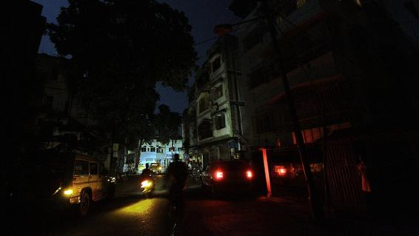
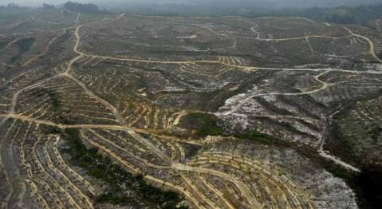
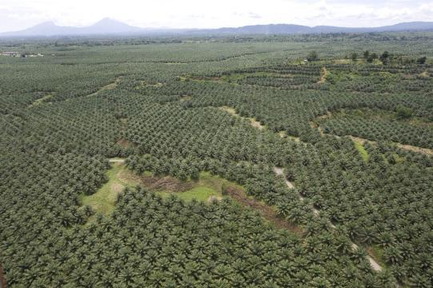
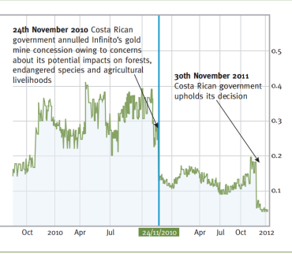

Risks & Opportunities
OPERATIONAL
E.g. black out in India (July 2012) affected > 620 million people
LEGAL
E.g. Concord Pacific fined $97 million after being found guilty of illegal logging in Papua New Guinea
Photo Credit: The Economist
REPUTATIONAL/ MARKETS
E.g. palm oil
FINANCIAL
E.g. Infinito Gold lost more than half of its value when the Costa Rican court annulled a gold mine concession
Notes:
In a world that is increasingly carbon and natural resource-constrained, global companies with strong brand positions face material risk as a direct result of biodiversity loss and ecosystem degradation. By the same token, these risks provide many new business opportunities.
Operational risks
Energy black out in India (July 2012). Did you know that it was due to extreme heat and water scarcity?
In the summer of 2012, leading up to the failure, extreme heat had caused power use to reach record levels in New Delhi. Due to the late arrival of monsoons, agricultural areas in Punjab and Haryana drew increased power from the grid for running irrigation pumps to paddy fields. The late monsoon also meant that hydropower plants were generating less than their usual production.
- Largest power outage in history, occurring as two separate events on 30 and 31 July 2012.
- Affected over 620 million people (9% of the world population or 50% of India's population) spread across 22 states in Northern, Eastern, and Northeast India.
Source: Wikipedia, http://en.wikipedia.org/wiki/2012_India_blackouts#Investigation
Legal risks
Malaysian logging company Concord Pacific has been fined $97 million after being found guilty of illegal logging and causing environmental damage in Papua New Guinea.
Source: Radio Australia, 24 June 2011 and 27 June 2011
Financial risks
Canadian gold mining company, Infinito Gold, lost over 50% of its share value as a result of the withdrawal of a mining concession in Costa Rica due to concerns about the potential impacts on agriculture, endangered species and forests. This led to a reference in the audit accounts to material uncertainties regarding the company’s ability to continue as a going concern
Source: KPMG, Flora and Fauna International, Acca, Is natural capital a material issue? (2012)
Reputational / Market risks
Increasing number of manufacturers that work with the Roundtable on Sustainable Palm Oil, following NGO and consumer pressure

Slide 5
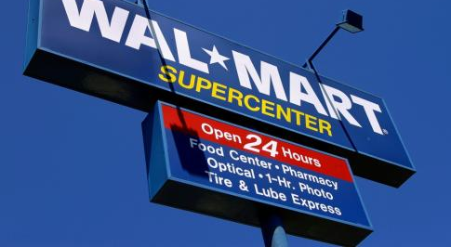
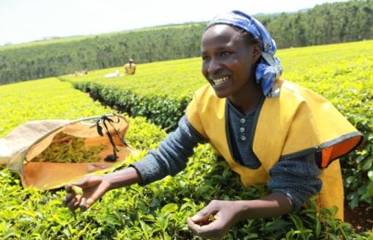
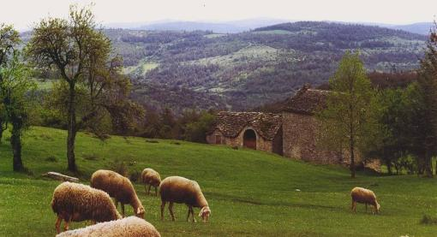
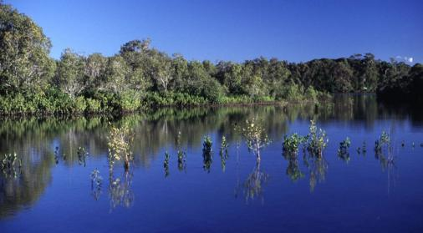
Risks & Opportunities
Walmart to save $150 Million in 2013 thanks to sustainability programs
Unilever’s Rainforest Alliance Certified tea: +12% sales in Australia
Photo Credit: Unilever
Vittel secured license to operate by rewarding farmers for better mgt
Chevron could earn US$ 150m income from selling wetland credits
World Resources Institute
World Resources Institute
Notes:
Risks also provide many new business opportunities.
Walmart
Walmart announced in Oct 2012 the company could save as much as $150 million during the company’s 2013 fiscal year due to several of its sustainability programs.
The announcement builds on Walmart’s recent achievements on reducing costs throughout its supply chain and operations. For example, by expanding waste diversion and recycling programs, Walmart reported it saved $231 million alone last year. Meanwhile the retailer has expanded solar and wind power generation at various sites across the United States.
Source: http://www.triplepundit.com/2012/10/walmart-save-150-million-sustainability-programs
Unilever
The launch of Unilever’s Rainforest Alliance Certified tea in Australia saw 12% growth in sales
Source: KPMG, Flora and Fauna International, Acca, Is natural capital a material issue? (2012)
Vittel
In the 1980s, mineral water company Vittel (now a brand of Nestlé Waters) faced a critical problem. Nitrates and pesticides were entering the company’s springs in northeastern France. Local farmers had intensified agricultural practices and cleared native vegetation that previously had filtered water before it seeped into the aquifer used by Vittel. This contamination threatened the company’s right to use the “natural mineral water” label under French law. The Vittel brand and business were at stake. Vittel decided to work with farmers to change their agricultural practices and a package of incentives was developed in collaboration with them (e.g. 200 Euros/ha/year over 5 years guaranteed income during the transition period; free technical assistance etc). The programme was ultimately successful. By 2004, all 26 farms in the area had adopted the new farming system and 92% of the sub-basin was protected.
Source: Perrot-Maître, D. 2006. The Vittel Payments for Ecosystem Services: A “Perfect” PES Case? London: International Institute for Environment and Development.
Chevron
US federal law mandates that developers who destroy wetlands must replace them by purchasing credits or shares in wetland mitigation banks—typically located in the same watershed—to offset ecological damage. Recognizing an opportunity, ChevronTexaco received approval in 2005 to convert a tapped-out drilling site in Louisiana into a 2,800-hectare wetland to generate credits for the US wetland mitigation banking market. At an expected market price of US$ 50,000 to US$ 62,000 per hectare, the company could earn more than US$ 150 million selling the credits to developers.
Source: Kenny, A. “Chevron Opens Mitigation Bank in Paradis(e).” Katoomba Group. Available at: http://ecosystemmarketplace.com/pages/article.news.php?component_id=4255&component_version_id=6132&language_id=12

Slide 6

What can business do…right now?
Beyond companies’ fence line
Value chain (e.g. Suppliers, Clients, Consumers) | Landscape level | Public Policy
Direct operations
Measure, value, report
Manage & mitigate direct impacts & dependencies
Invest in ecosystems and the services they provide
Measure, value, report beyond their fenceline
Manage & mitigate indirect impacts & dependencies
Invest in ecosystems and the services they provide, adopting a landscape level approach
Promote partnerships & “smart” regulation

Slide 7
Value chain footprints – Puma
Going beyond company’s direct operations
2010 GHG emissions by value chain source
2010 Water use by Value Chain Source
Tier 2 supplier
Tier 1 supplier
Company activities
Downstream value chain
…
Notes:
Land Use
Negative impacts on biodiversity and ecosystem services as a result of land-use for agriculture and buildings in PUMA’s supply chain are valued at € 37 million or 26% of the total E P&L. More than any other impact these costs are concentrated in Tier 4 with just 1% arising in PUMA’s operations and Tiers 1-3. Because leather is used extensively in footwear – PUMA’s dominant business line – and it is the most land extensive raw material that PUMA sources, the use of leather is the greatest single factor contributing to impacts on land-use. As a result, footwear accounts for € 34 million or 91% of the overall land-use impact.

Slide 8
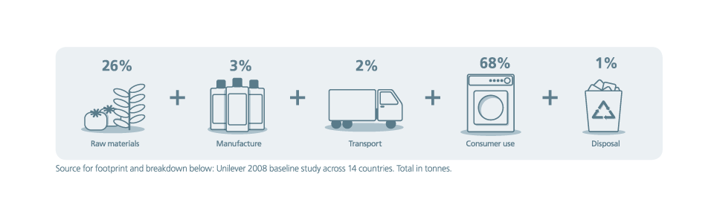
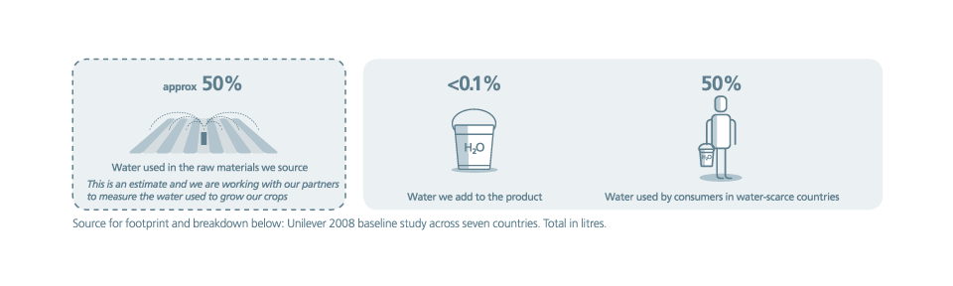
Value chain footprints – Unilever
Going beyond company’s direct operations
GHG emissions
26%
3%
2%
68%
1%
+
+
+
+
Raw materials
Manufacture
Transport
Consumer use
Disposal
Water footprint
approx 50%
<0.1%
50%
Water used in the raw material we source
Water we add to the product
Water used by consumers in water-scarce countries
Tier 2 supplier
Tier 1 supplier
Company activities
Downstream value chain

Slide 9

1. Measuring, Valuing, Reporting – a business toolkit

Slide 10
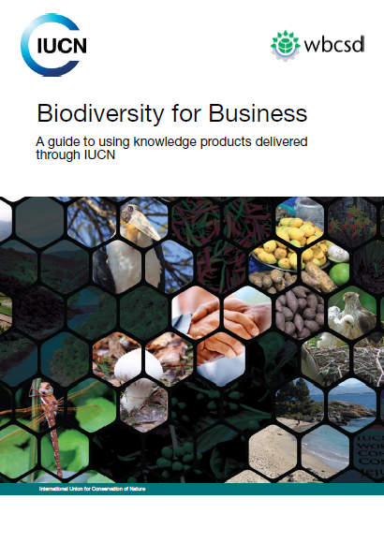
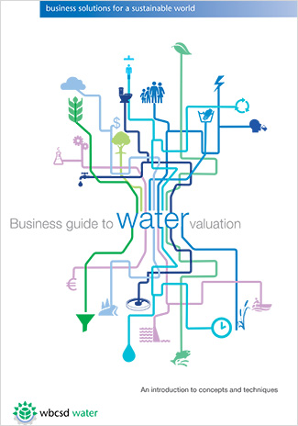
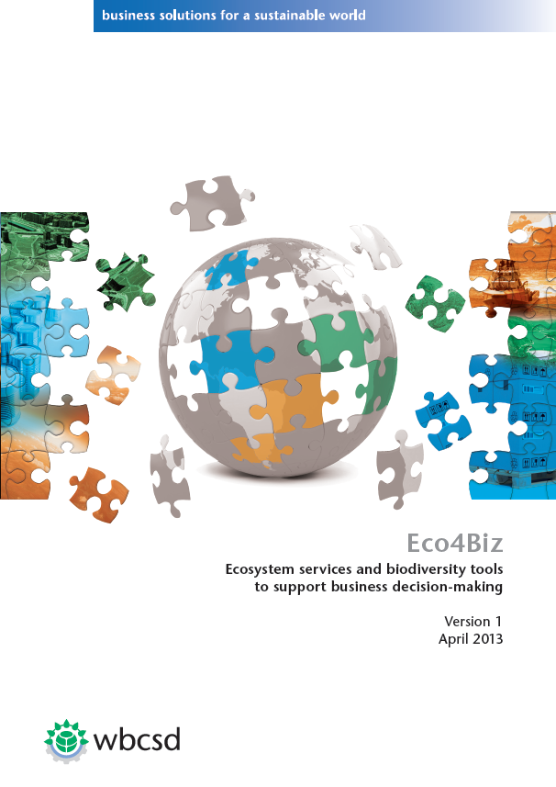
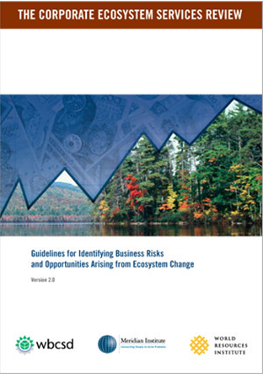
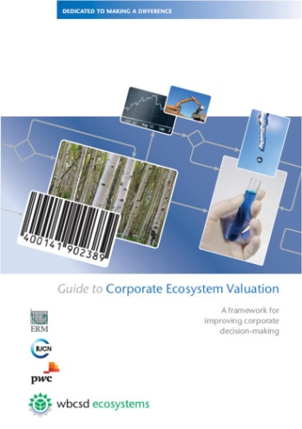
Ecosystems Toolkit
Corporate Ecosystem Services Review (ESR)
Guide to Corporate Ecosystem Valuation (CEV)
Business Guide to Water Valuation
Eco4Biz
IUCN Knowledge Product Guide
2014
2013
2013
2011
2008 & 2012
Notes:
The India Water Tool (IWT) is a country customization of the Global Water Tool, and has been developed by a working group of 14 companies based in India (co-chairs ACC and PwC, technology partner Infosys, and working group members Ambuja, BASF, Bayer, BP, DSM, HCC, Jain Irrigation, ITC, PepsiCo, Siemens and Vedanta). The companies pooled their expertise to obtain the best available data on ground water availability and quality in India and customize the tool to their country context. The tool will help companies respond to the growing challenges of managing water effectively in this large, water scarce country.

Slide 11


Natural Capital Protocol
Enable business to assess and better manage their (direct & indirect) interactions with natural capital
Increase knowledge and awareness to generate & deliver greater consistency
Equip project managers to effectively link and embed the outputs directly into business (operations, accounting, etc.), and get value from it.
Stimulate action

Slide 12


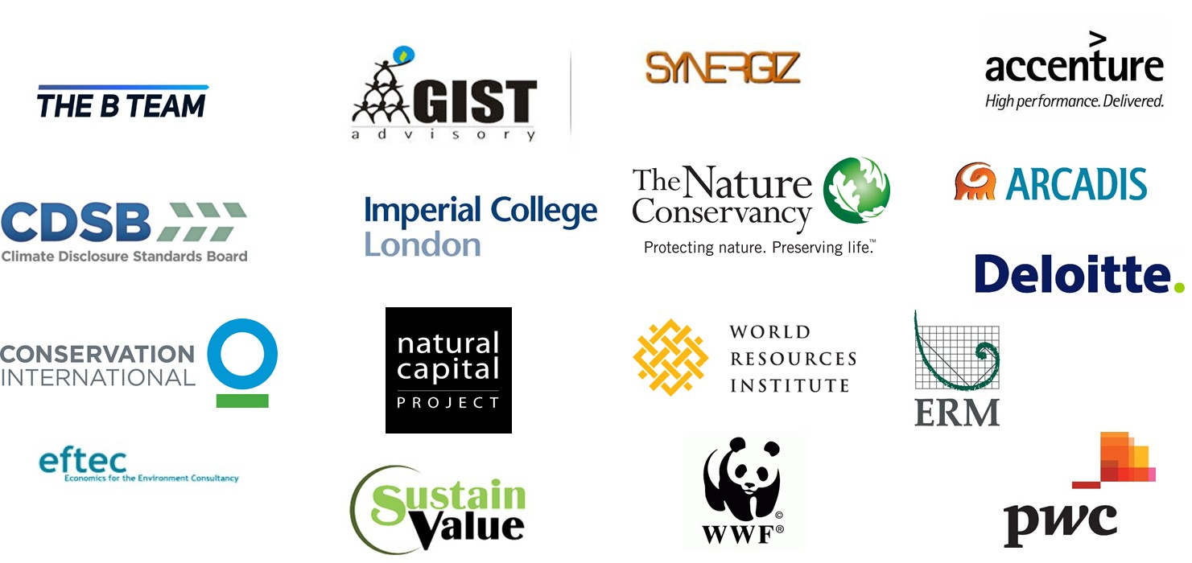






Overall coordination
Multi-stakeholder consultation process
Generic Natural Capital Protocol
Sector guides for Food & Beverage + Apparel
Pilot testing

Slide 13
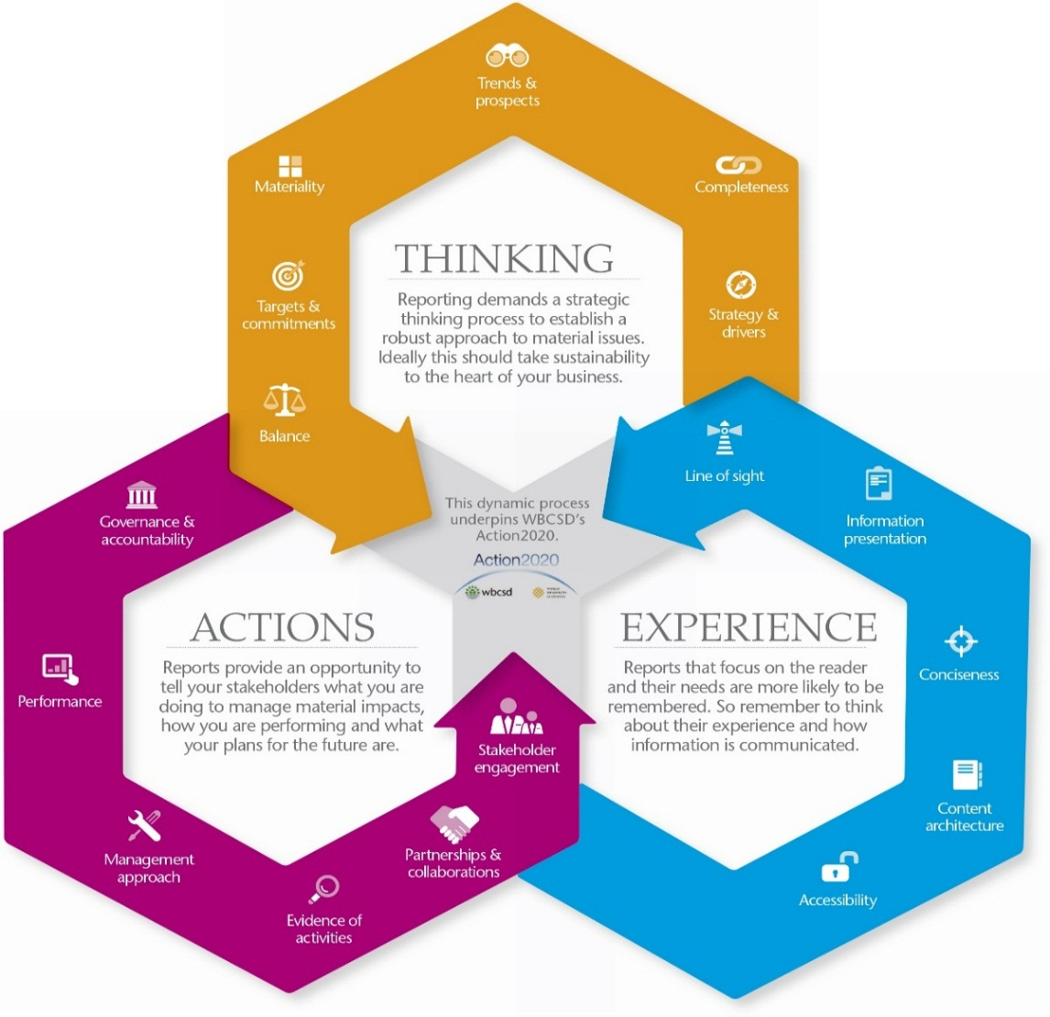
Reporting is a dynamic process
Company Reporting
        And not a goal in itself, but an instrument to:
        improve the effectiveness of corporate investments in sustainability
        trigger internal changes towards integrated decision-making
Key role to play in accelerating transition towards integration of values of impact & dependencies in decision making

Slide 14

What about corporate practice?
Less than 12% of reports reviewed reflect those sustainability issues considered to be material to the business.
80% of WBCSD members produce a stand-alone sustainability report with the rest developing self-declared integrated reports
75% use the GRI Guidelines with an upward trend to combine the use of several frameworks
60% of total reports reviewed have some form of assurance on their sustainability disclosures with limited level as the dominant form
When known, the average time period between year-end and the publication date is approximately six months reflecting a disconnect between sustainability and financial reporting cycles
Notes:
WBCSD reviews all member sustainability reports to shed light on effective non-financial reporting practices and offers a pool of inspirational examples to stimulate the sharing of best practices.
The review provides recommendations so that corporate reports can help companies create value for all stakeholders in the short, medium and long-term.

Slide 15
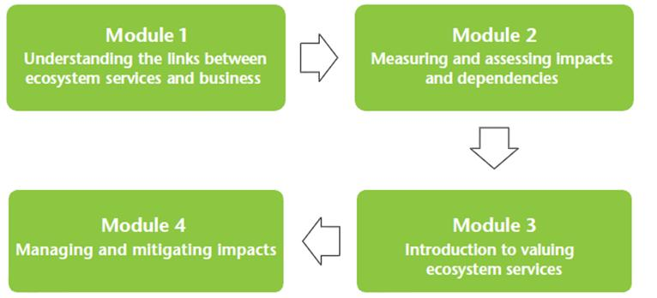

Ecosystems Capacity Building
Business Ecosystems Training
Objectives: equip companies with the skills they need to better measure, manage and mitigate their ecosystem impacts and dependencies
Material:
4 modules, with presentation slides, facilitator notes, facilitation tips
Open source on WBCSD’s website
Content:
Definitions
Case studies / best practices
Introduction of ESR & CEV methodologies
Notes:
Click on icon to watch 3 minute video

Slide 16

2. Managing & Mitigating

Slide 17
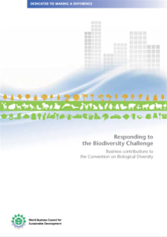
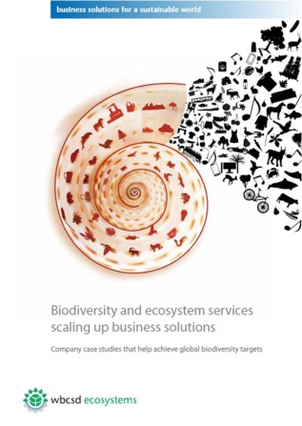
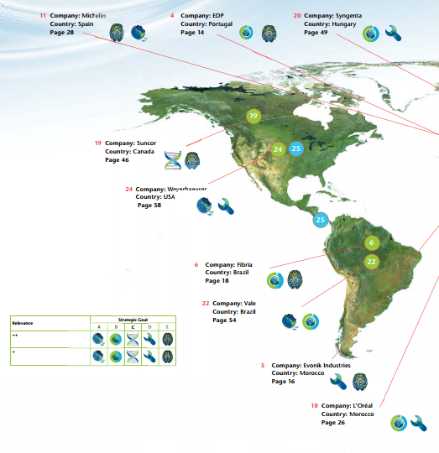
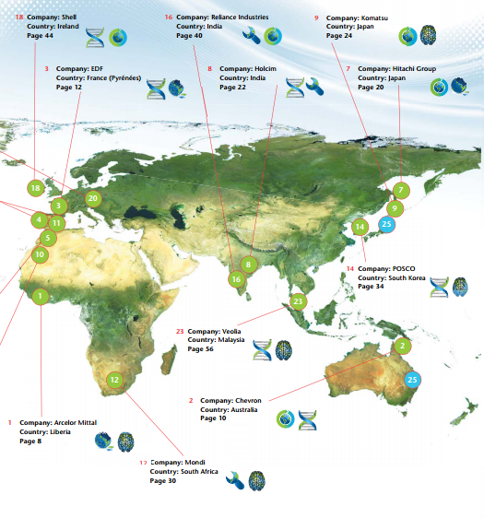
Sharing best practices
  Case studies on effective company actions to reduce the pace of biodiversity loss and ecosystem degradation
2010
2012
  Over 10 sectors of activities
  Global to national scope

Slide 18
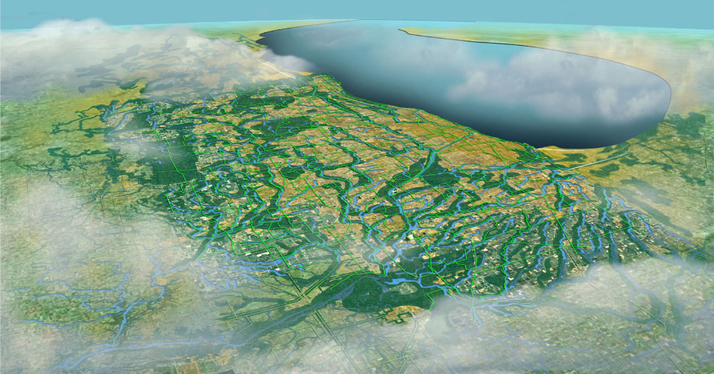
3. Invest in ecosystems, adopting a landscape level approach

Slide 19
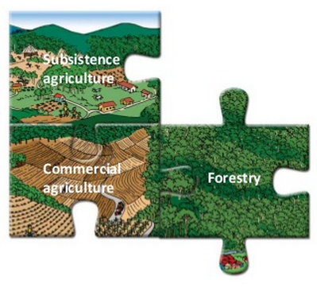
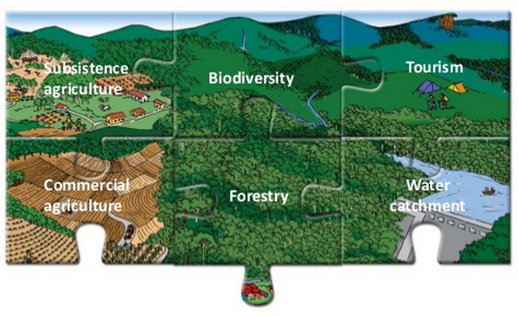
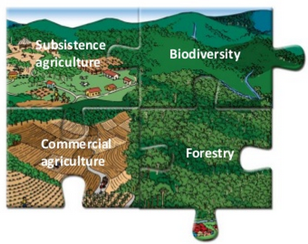
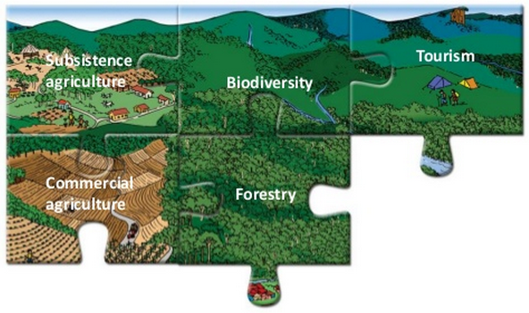
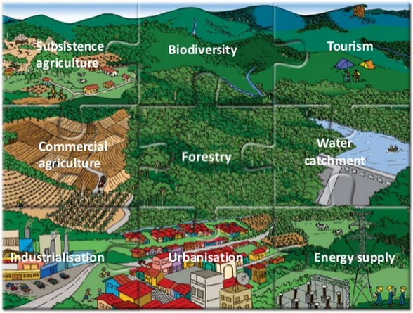
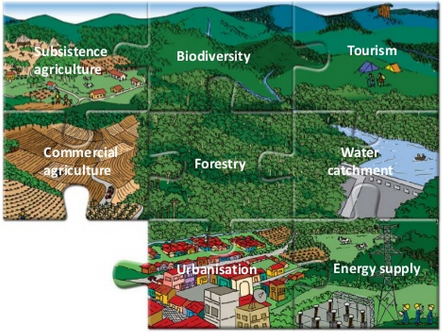
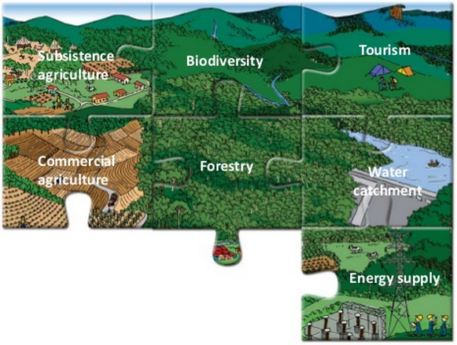
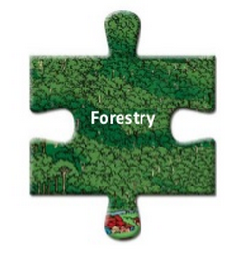
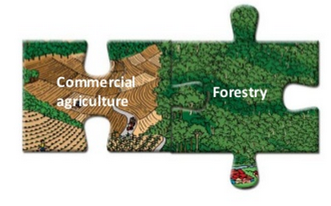
Adopting a landscape-level approach
Source: GPFLR
Notes:
Landscapes can have multiple functions, as they provide a variety of services to society, such as biodiversity, food, water, shelter, livelihood, economic growth, and human well-being. All these services are interlinked; so if the agricultural area in a landscape expands, it will have repercussions for the area covered by forests.
By adopting a landscape approach, we learn how to look at landscapes from a multifunctional perspective, combining natural resources management with environmental and livelihood considera­tions. People and their institutions are therefore perceived as an integral part of the system rather than as external agents operating within a landscape.

Slide 20
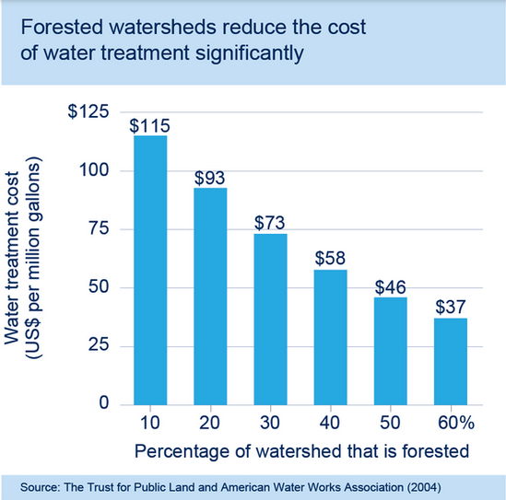
Healthy ecosystems can provide the same services and benefits as man-made infrastructure at lower cost.
Infrastructure spending amounts to roughly 3.8% of global GDP, equivalent to US$2.6 trillion in 2013, and needs will grow to US$3.4 trillion per year through 2030.
Natural infrastructure, in many cases, can provide the same services and benefits as man-made infrastructure and at a lower cost.
A well-functioning ecosystem can deliver the equivalent water availability and filtration, flood control and shoreline protection as a major physical infrastructure project. I
Investing in ecosystems is often cost-competitive with man-made infrastructure investments for equivalent services.

Slide 21
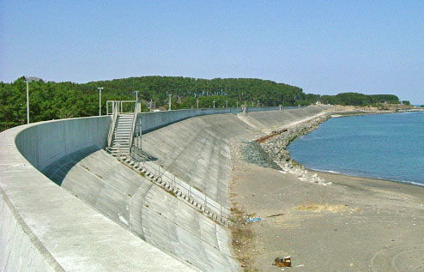
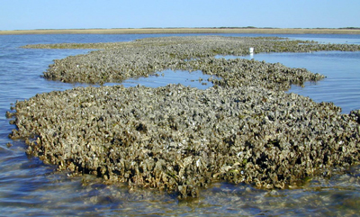
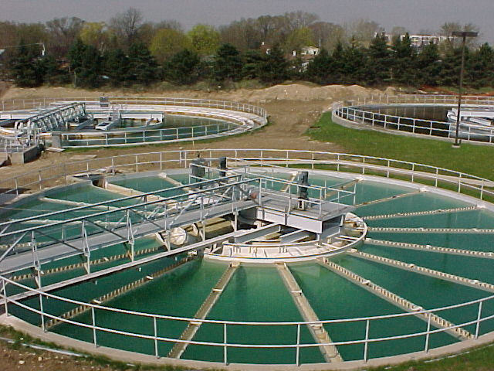
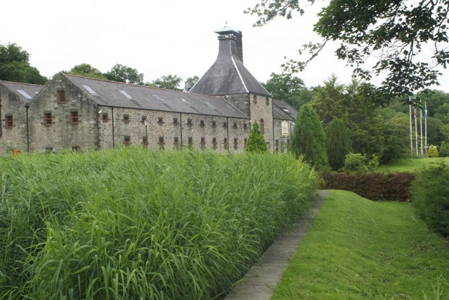
Examples of investments in natural infrastructure (1/2)
Grey Infrastructure
Natural Infrastructure
Shoreline protection and flood control
Levees / sea walls
Mangroves / coral reefs/ floodplains, etc.
Wastewater treatment
Water treatment facility
Wetlands / Reedbeds, etc
Notes:
Mangroves and coral reefs can protect the shoreline from waves, storm surge, and erosion by reducing wave energy (like sea walls or levees) to protect towns and corporate sites located on the coast. This service is worth billions of dollars annually ($230 million in Belize alone).
Dow example: 110-acre engineered wetland ($1.4 Million) in lieu of an industrial wastewater treatment plant ($40 Million)
Reservoir siltation cost Indian power company Satluj Jal Vidyut Nigam Ltd. approximately US$42 million and 22 days of hydropower facility closure in 2010.
^{[1]} Marine Ecosystem Services Partnership (http://marineecosystemservices.org/explore)
^{[2]} WRI, WWF (2008). Coastal Capital: Belize. The Economic Contribution of Belize’s Coral Reefs and Mangroves.
^{[3]} WRI (2011). In India, Enhancing Ecosystems is Not Only Good for Nature—It’s Good for Business.

Slide 22
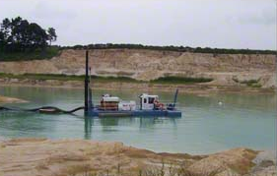

Examples of investments in natural infrastructure (2/2)
Grey Infrastructure
Natural Infrastructure
Erosion control
Dredging operations
Forests/ soil management
Notes:
Mangroves and coral reefs can protect the shoreline from waves, storm surge, and erosion by reducing wave energy (like sea walls or levees) to protect towns and corporate sites located on the coast. This service is worth billions of dollars annually ($230 million in Belize alone).
Dow example: 110-acre engineered wetland ($1.4 Million) in lieu of an industrial wastewater treatment plant ($40 Million)
Reservoir siltation cost Indian power company Satluj Jal Vidyut Nigam Ltd. approximately US$42 million and 22 days of hydropower facility closure in 2010.
^{[1]} Marine Ecosystem Services Partnership (http://marineecosystemservices.org/explore)
^{[2]} WRI, WWF (2008). Coastal Capital: Belize. The Economic Contribution of Belize’s Coral Reefs and Mangroves.
^{[3]} WRI (2011). In India, Enhancing Ecosystems is Not Only Good for Nature—It’s Good for Business.

Slide 23

Healthy ecosystems can provide the same services and benefits as man-made infrastructure at lower cost.
Case Comparative cost
Water filtration
New York City
$8 billion
$1.5 billion
Water treatment
Maine USA
$155 million
$44 million
Air purification
Dow Chemical
$2,5000-5,000/ ton NOx
$2,400-4,000/ ton of Nox**
$3.53 / 1000 gallons
Conventional infrastructure
Aquifer protection
Idaho, USA
Natural infrastructure
$1.38 / 1000 gallons
Storm-water control
North Carolina, USA
$3.24 / 1000 gallons
$0.47 / 1000 gallons
Shoreline protection
Shell
$1.5-3 million
$1 million
* If reforestation occurs on land owned by Dow
Notes:
Seven U.S. cities have saved between $500,000 to $6 billion in avoided water treatment costs.

Slide 24



Investing in ecosystems and the services that they provide
3. Large-scale ecosystem restoration to secure a wide range of ecosystem services in the long term
Natural+Hybrid Infrastructures
2. Natural Infrastructure that delivers several ecosystem services (e.g. filtration, provisioning, habitat)
Natural+Hybrid Infrastructures
1. Natural Infrastructure that delivers one specific ecosystem service (e.g. filtration)
Natural+Hybrid Infrastructures

Slide 25




What is needed to bring existing initiatives at scale?
Business case
Broader business engagement
Company
Pilot projects
Identification of internal/external enablers of scale
Alliance of companies and NGOs
Company – NI investment integrated in internal processes
Projects - Internal
Projects - Multi-stakeholder partnerships
Assessing and investing in Natural Infrastructure will be common practice by 2020

Slide 26

Land, an undervalued asset
Land degradation in Europe, considering biomass, soil, water and biodiversity
¼ of usable global land mass is degraded
Loss of grain worth $1.2 billion/year
To feed future human population in 2050, we will need 6 million hectares of new land (size of Norway) to be brought into production every year
➔ The adoption of sustainable land management could deliver up to USD 1.4 trillion in increased production
Source: Pöyry, based on information provided in LADA Technical report n.17: Global Land Degradation Information System

Slide 27

4. Promoting partnerships & “smart” regulation

Slide 28

Ecosystems Partners
IUCN (In Dec 2013, WBCSD became a member of IUCN)
WRI (Action2020 partner)
TEEB for Business Coalition / Natural Capital Coalition
2 min “Pitch for Nature” video

Slide 29

Business and the value of nature
“Pitch for Nature” video

Slide 30




Ecosystem-related Events
IUCN’s World Conservation Congress (2012)
CBD COP (2006, 2008, 2010, 2012, 2014)
World Forum on Natural Capital (2013)

Slide 31


Ecosystems Public policy
Recommendations from business (CBD COP10)
Picking up the Pace (CBD COP11)
OECD roundtable on effective public policy (Oct 2012)

