Slide 1
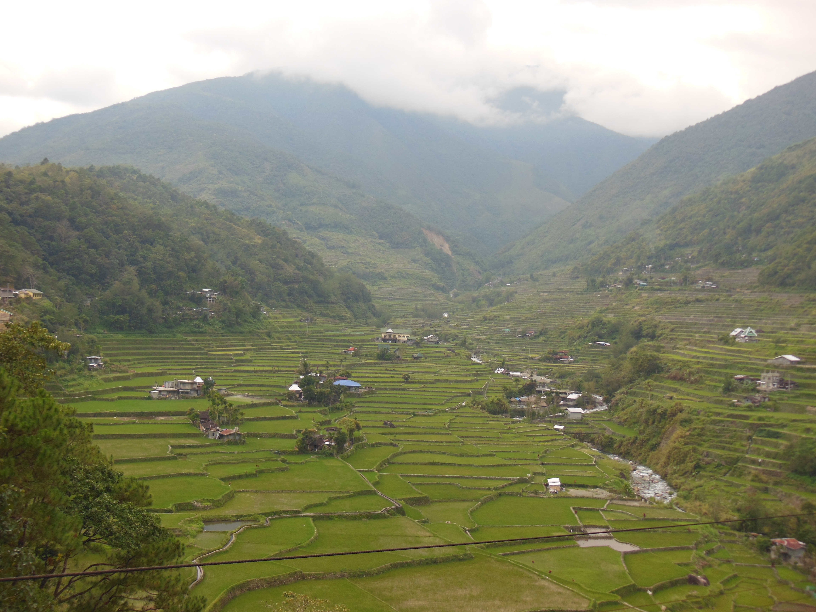
SESSION IV: Panel dialogue:
Dialogue Workshop on Assessment of Collective Action by Indigenous Peoples and Local Communities in Biodiversity Conservation and Resource Mobilization
11-13 June 2015, Panajachel, Guatemala
Methods for measuring and aggregating data related to collective action
Notes:
SESSION IV: Panel dialogue: Methods for measuring and aggregating data related to collective action
Facilitators: Pernilla Malmer and Joji Cariño
Expected outcome: Achieving a common understanding of diverse bottom up and top down methods and processes and linked ethics (for whom by whom) for measuring contribution of collective action and existing practices to biodiversity conservation, as well as exploring how aggregation of data can be done. We will look into how methods links to policy frameworks, legitimacy, credibility and usefulness, perspectives on top down and bottom up approaches, such as GIS mapping and Community Based Monitoring, and combinations thereof. The session will also contribute to a common understanding of terminology and practices related to customary sustainable use and community based monitoring. The session would strive to identify critical knowledge gaps to enhance the applications.
Bottom up panel (25 min presentation and 20 min discussion):
Introduction of the session, and presentation of the Multiple Evidence Base Approach to ensure legitimacy, credibility and usefulness while scaling up outcomes by collective action (6 min)
Pernilla Malmer, SwedBio at SRC, Sweden
Eco-cultural mapping for mobilization of knowledge in a collective action for recovering Kathita river including its natural sacred sites, and its further recognition in local planning and national biodiversity conservation. (7 min)
Gathuru Mburu, ICE, Kenya
Bottom up tools, methods and communication used by ICCA Consortium for documenting and visualizing indigenous peoples and local communities contribution to biodiversity conservation by their collective action in Indigenous Community Conserved Areas (ICCAs). (7 min)
Carmen Miranda, ICCA Consortium and SAVIA, Bolivia
Collective action in local biodiversity governance, Representative from Equator Initiative, UNDP, (5 min)
Plenary discussion Q & A (20 min)
Scaling up and aggregating panel 25 min presentation and 20 min discussion:
Comparative experiences on customary sustainable use and data aggregation. (7 min)
Maurizio Ferrari, FPP and IIFB Working Group on Indicators
GIS mapping and modelling as a top down method for aggregation of data related to collective action in biodiversity conservation. (4 min)
Sarah Cornell, Stockholm Resilience Centre, Sweden
Contributions of Indigenous peoples to biodiversity conservation and global biodiversity targets. A pilot process of aggregation, including ethic considerations. (7 min)
Beau Austin, Charles Darwin University, Australia
Scaling up local community-based monitoring and incorporating it in national management programs on biodiversity (7 min)
Pedro Constantino, Participatory Monitoring and Management Partnership. Brazil
Plenary discussion Q & A (20 min)

Slide 2
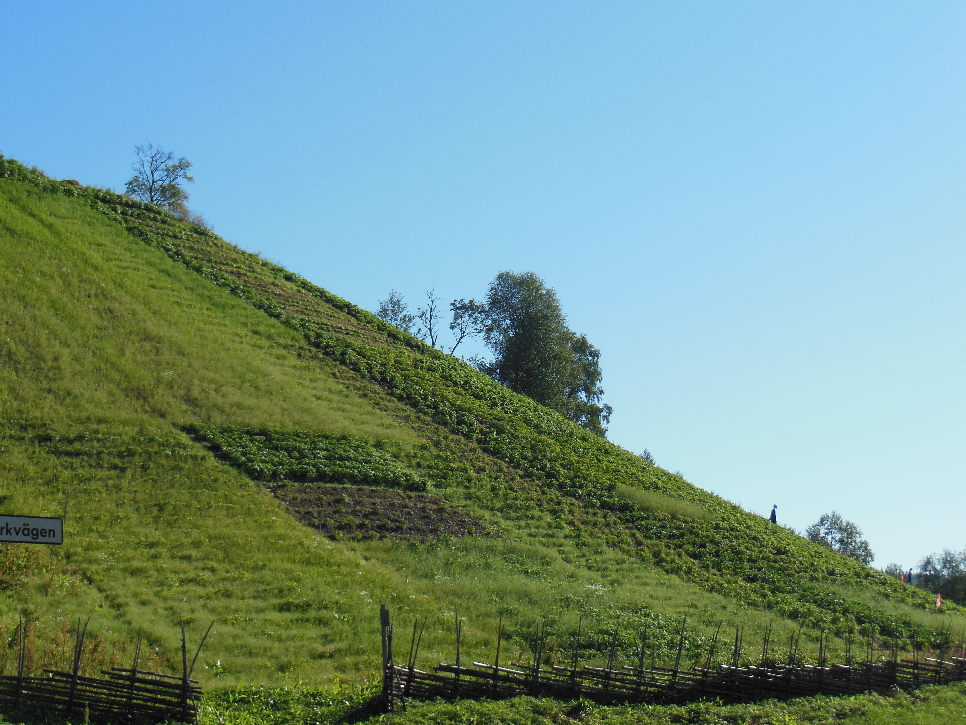
Aggregation of data about collective action across scales
Why ?
Who?
What methods?
Risks and opportunities?
How can positive impact from
Customary sustainable use be
Aggregated across scales in ways that are
legitimate credible and useful
for IPLCs and policy alike?

Slide 3
Top down and bottom up approaches
CBD UNESCO
Aichi targets IPBES ILO FAO
Linguistic diversity
Land use change
Traditional occupations
Top down
Statistical indicator
INTERNATIONAL
CREDIBLE
Intercultural dialogue
Parallel validation
NATIONAL
LEGITIMATE
CBMIS
Bottom-up
- Diversity of CBMIS
Cultural/holistic indicators
LOCAL
CBMIS
CBMIS
USEFUL

Slide 4
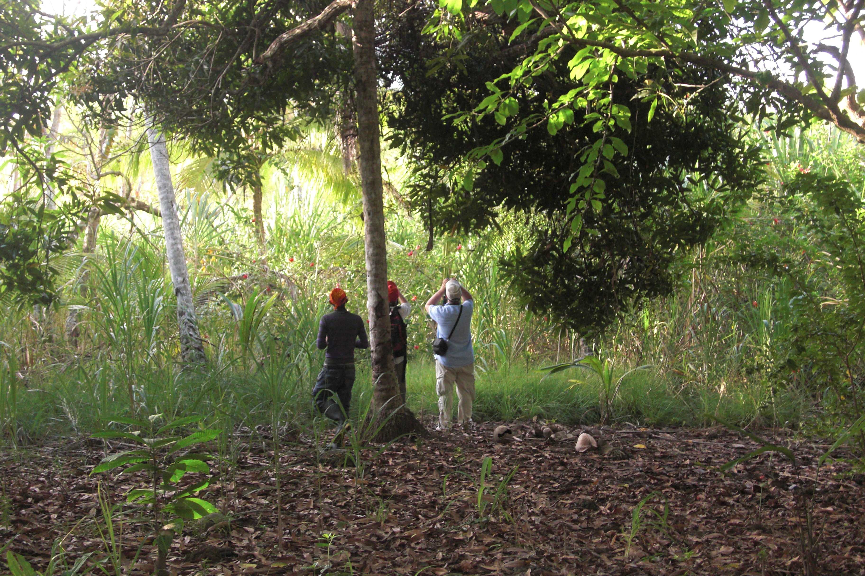
Multiple Evidence Base (MEB) approach – a point of departure
Indigenous, local and scientific knowledge systems are different manifestations of valid and useful knowledge systems…
…which generate complementary evidence for interpreting conditions, change and causal relationships
Notes:
There is a demand for modalities for developing synergies between knowledge systems- for example within IPBES, CBD, and probably by the Arctic Council (?? Carolina would you agree?)
The MEB approach
Multiple Evidence Base emphasizes the value of letting each knowledge system speak for itself, within its own context, in a parallel approach,
Complementary insights will create an enriched picture of the issue of investigation
It is not a new method, it is rather a way of describing how connecting knowledges has always been going on, but providing a more structured understanding and approach of this process.

Slide 5
Knowledge for the 21st Century Indigenous knowledge, traditional knowledge, science and connecting diverse knowledge systems Usdub, Guna Yala, Panama 10 – 13 April 2012
”The Guna Yala dialogue”
Topics:
Validation
Documentation
Sharing of knowledge
Co-production of knowledge
Notes:
A few words need to go to the Guna Yala Dialogue as
Guna Yala wasa key event for building a network and establishing trust to move forward to develop MEB.
It was a unique experience, in the Indigenous territory of Guna Yala.
Essential actitudes:
Trust
Respect
Resiprocity
Equity
Transparency

Slide 6
Three general approaches to exchange between knowledge systems
“Integration”:
Components of one knowledge system is incorporated into another through a validation process
Parallel approaches:
Placing knowledge systems next to each other, using separate validation mechanisms and assessing insights
Co-production of knowledge:
Engaging in mutual processes of knowledge generation
Notes:
How is MEB different from other approaches to exchange between knowledge systems?
This slide is useful to help people differentiate between different approaches – and acknowledge their own approaches.
Not to say any approach is more appropriate than the other but important to reflect upon which one you are engaging in.

Slide 7
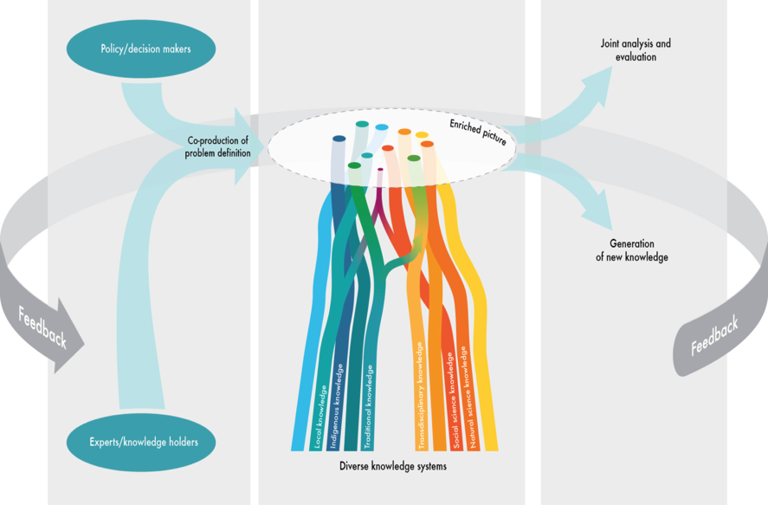
The Multiple Evidence Base in an assessment process connecting indigenous, local and scientific knowledge systems Phase 1 Phase 2 Phase 3
Notes:
As the reindeer case illustrates, it is critical how you design a process before and after the enriched picture is created in a Multiple evidence based process.
This can be easily applicable in an assessment
Phase 1 is where we are now regarding the scoping of the first generation of assessemnts. As this is to be happening very fast now, its good to recall the earlier mentioned fundamental principles brought forward in the Guna Yala dialogue,
Respect, trust, reciprocity equal sharing,transparency – for this TIME will be needed (this is a challenge for many projects!!)
Phase 2 brings together knowledge on an equal platform, in parallel systems where each knowledge system brings up its own evidence and conclusions, based on internal validation mechanisms
Phase 3 is the joint analysis and evaluation of knowledge and insights to generate multi-level synthesis and identify and catalyze processes for generating new knowledge.

Slide 8
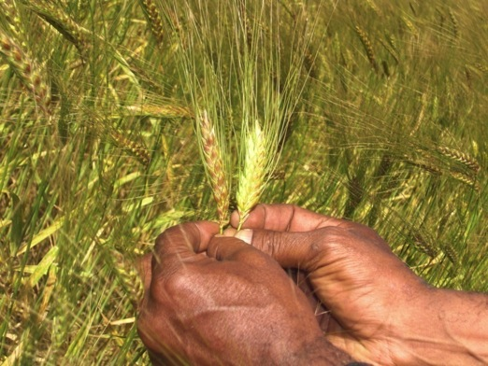
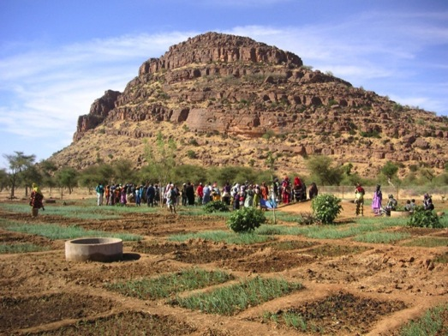
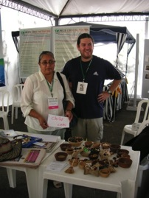
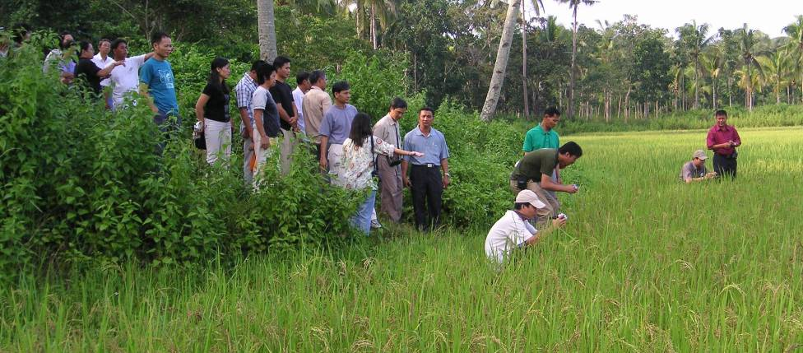
Participatory plantbreeding
Notes:
An easy and classical example of a parallel approach in line with a Multiple Evidence base is Participatory plant breeding.

Slide 9
Spheres of knowledge about agricultural biodiversity and food security
Farming communities and knowledge holders
Academics and Universities
Plantbreeding
Companies
Institutes
Gene banks
Notes:
Thorugh the enriched picture of the spheres of knowledge about reindeer and landscape,we got a new and more nuanced picture, thorugh information that did exist, but was not brought together before.

Slide 10
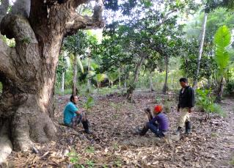
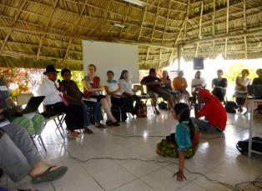
For more information on:
The Guna Yala Dialogue please visit:
http://www.stockholmresilience.org/21/policy--practice/swedbio/dialogues/guna-yala-dialogue/multiple-evidence-base.html
For a fact sheet on the MEB please visit:
http://www.stockholmresilience.org/download/18.3110ee8c1495db744321641/1415346253123/meb+fact+sheet+140916.pdf

