Slide 1


Collective Action
Fisheries Management
BELIZE, Mesoamerica Region
Presenter: Celia Mahung
Toledo Institute for Development and Environment
http://www.tidebelize.org
http://www.facebook.com
Equator Initiative award winner!

Slide 2
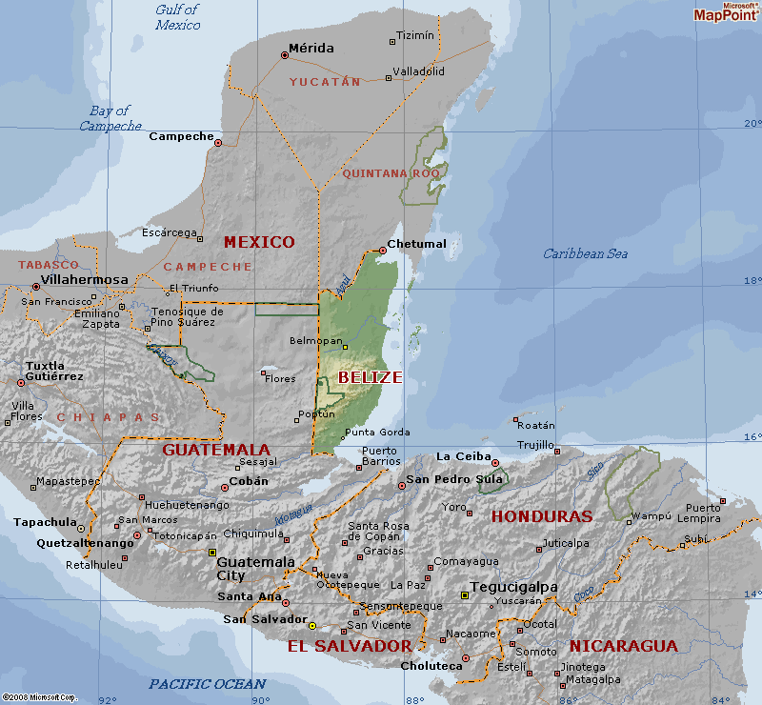
Where is Belize?

Slide 3
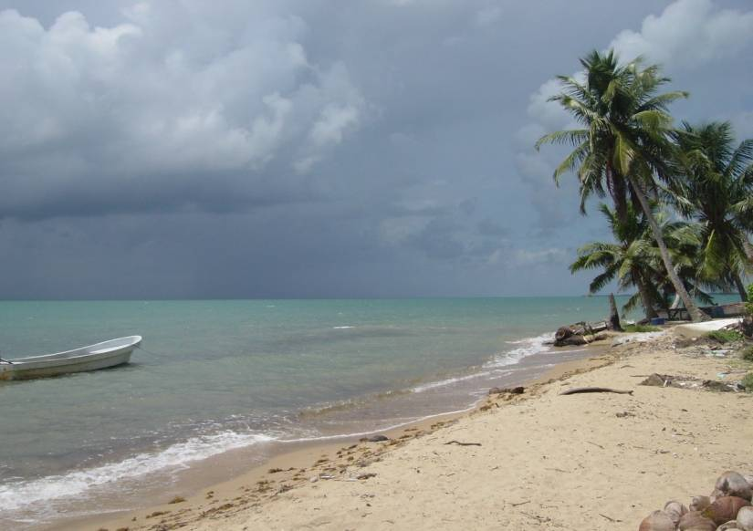
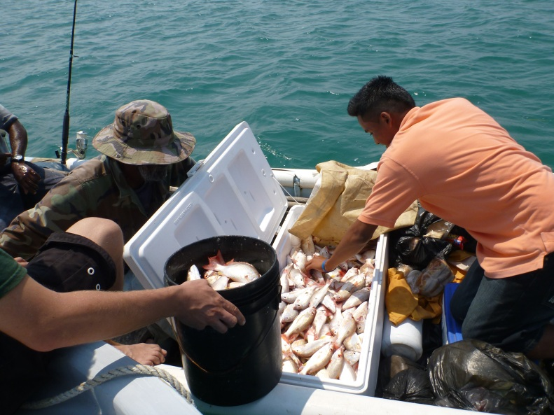
The Port Honduras Marine Reserve co-mgt. by TIDE and Fisheries Dept.

Slide 4
Why there was need for collective action?
In 2009, local fishers observed increased fishing pressure – nationally and regionally
increase demand (markets + protein source)
status of marine reserve report – prepared by TIDE and community researchers showed no significant increase in commercial species
all partners saw the urgent need to put an end to ‘open access’ to commercial fishing!

Slide 5
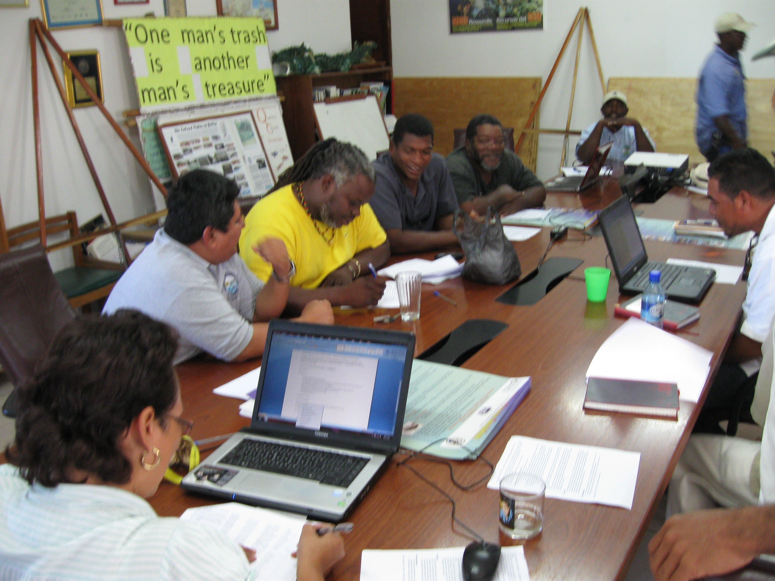
Managed Access Committee

Slide 6
Role of the committee
planned community meetings
developed framework/design – criteria for licenses (historical use, catch data, live and sell products in Belize etc.)
liaised with relevant partners
communication campaigns
vetted license applications

Slide 7
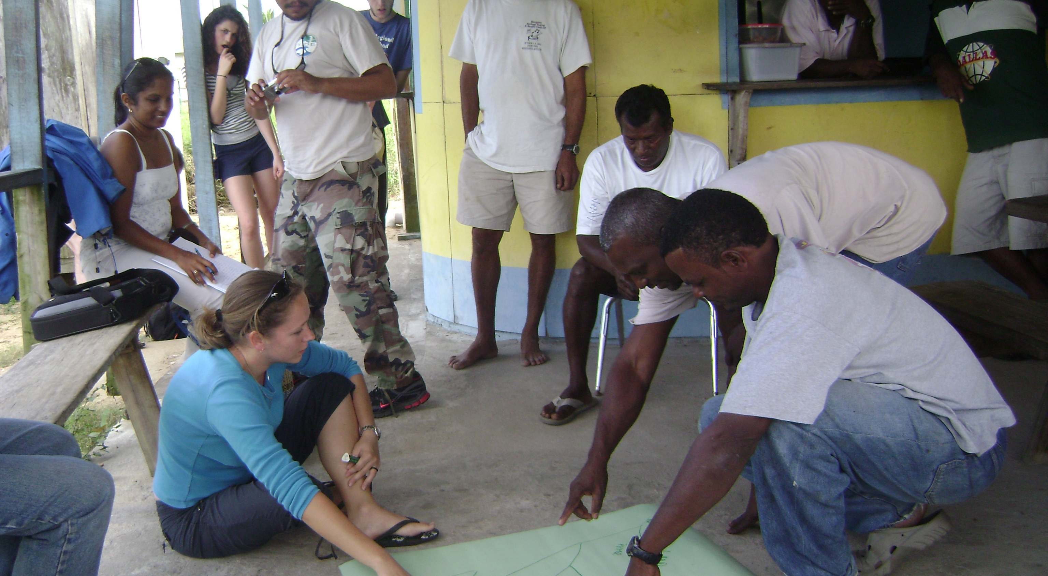
Village Meetings

Slide 8
after 2 years, framework for MA developed, cabinet paper for implementation in 2 marine reserves approved - criteria
Managed Access versus ‘Open Access’
annual assessment of new concept –licenses, enforcement, catch data, perceptions of fishers, results from benthic surveys and catch data submitted by fishers

Slide 9
Partnerships achieved common goal
use of fishers local knowledge, scientific results to demonstrate that there was need for action!
participation from fishers and partners in the development of framework
technical and financial support for planning, advocacy and assessment of design and framework of concept
government ‘buy in’

Slide 10
Results of collective action
legislation for implementation of Managed Access nationwide in 2016.
to right of customary use of marine resources while achieving biodiversity conservation in Belize!
example of community engagement in resource management as per mission of TIDE!

Slide 11
For more information please contact:
Toledo Institute for Development and Environment
cmahung@tidebelize.orghttp://www.tidebelize.org
http://www.facebook.com
ridgetoreef.org/tidetours.org

