Slide 1
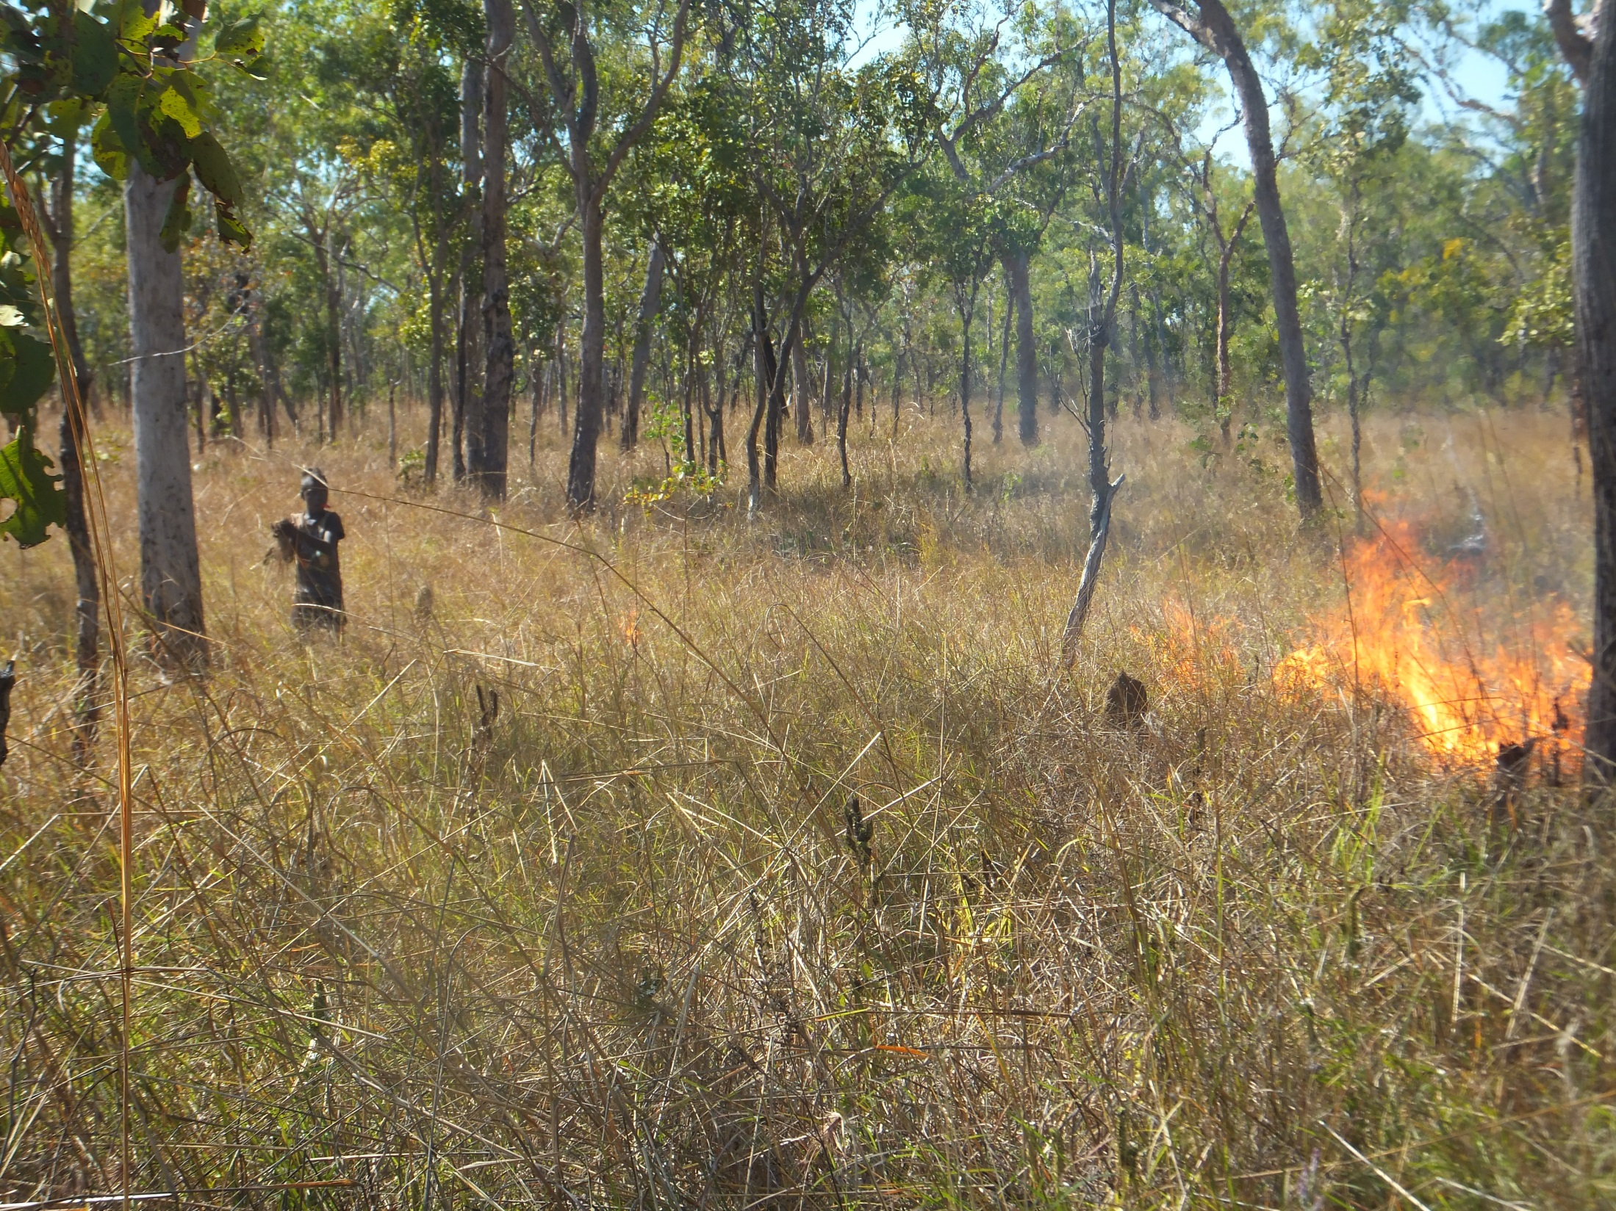
Contributions of Indigenous peoples and local communities to global biodiversity targets

Slide 2
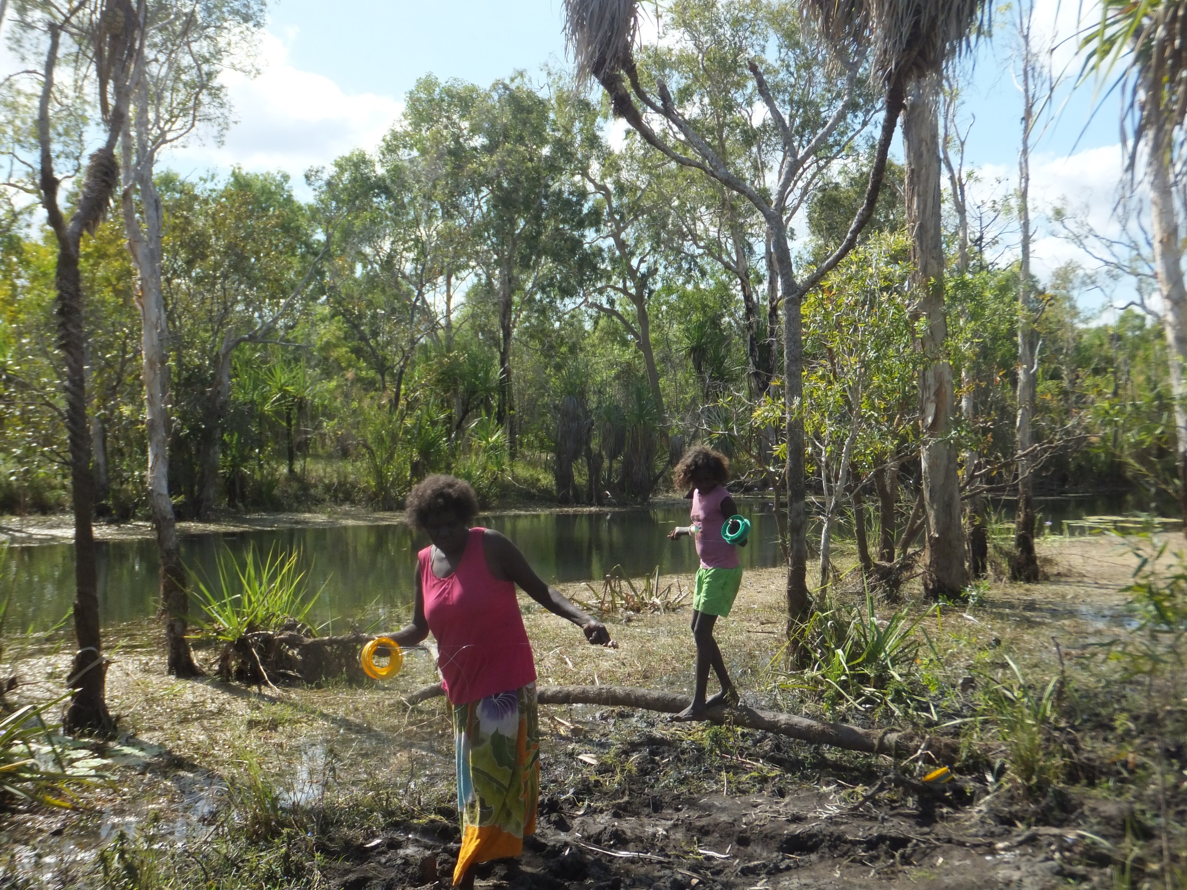

Slide 3
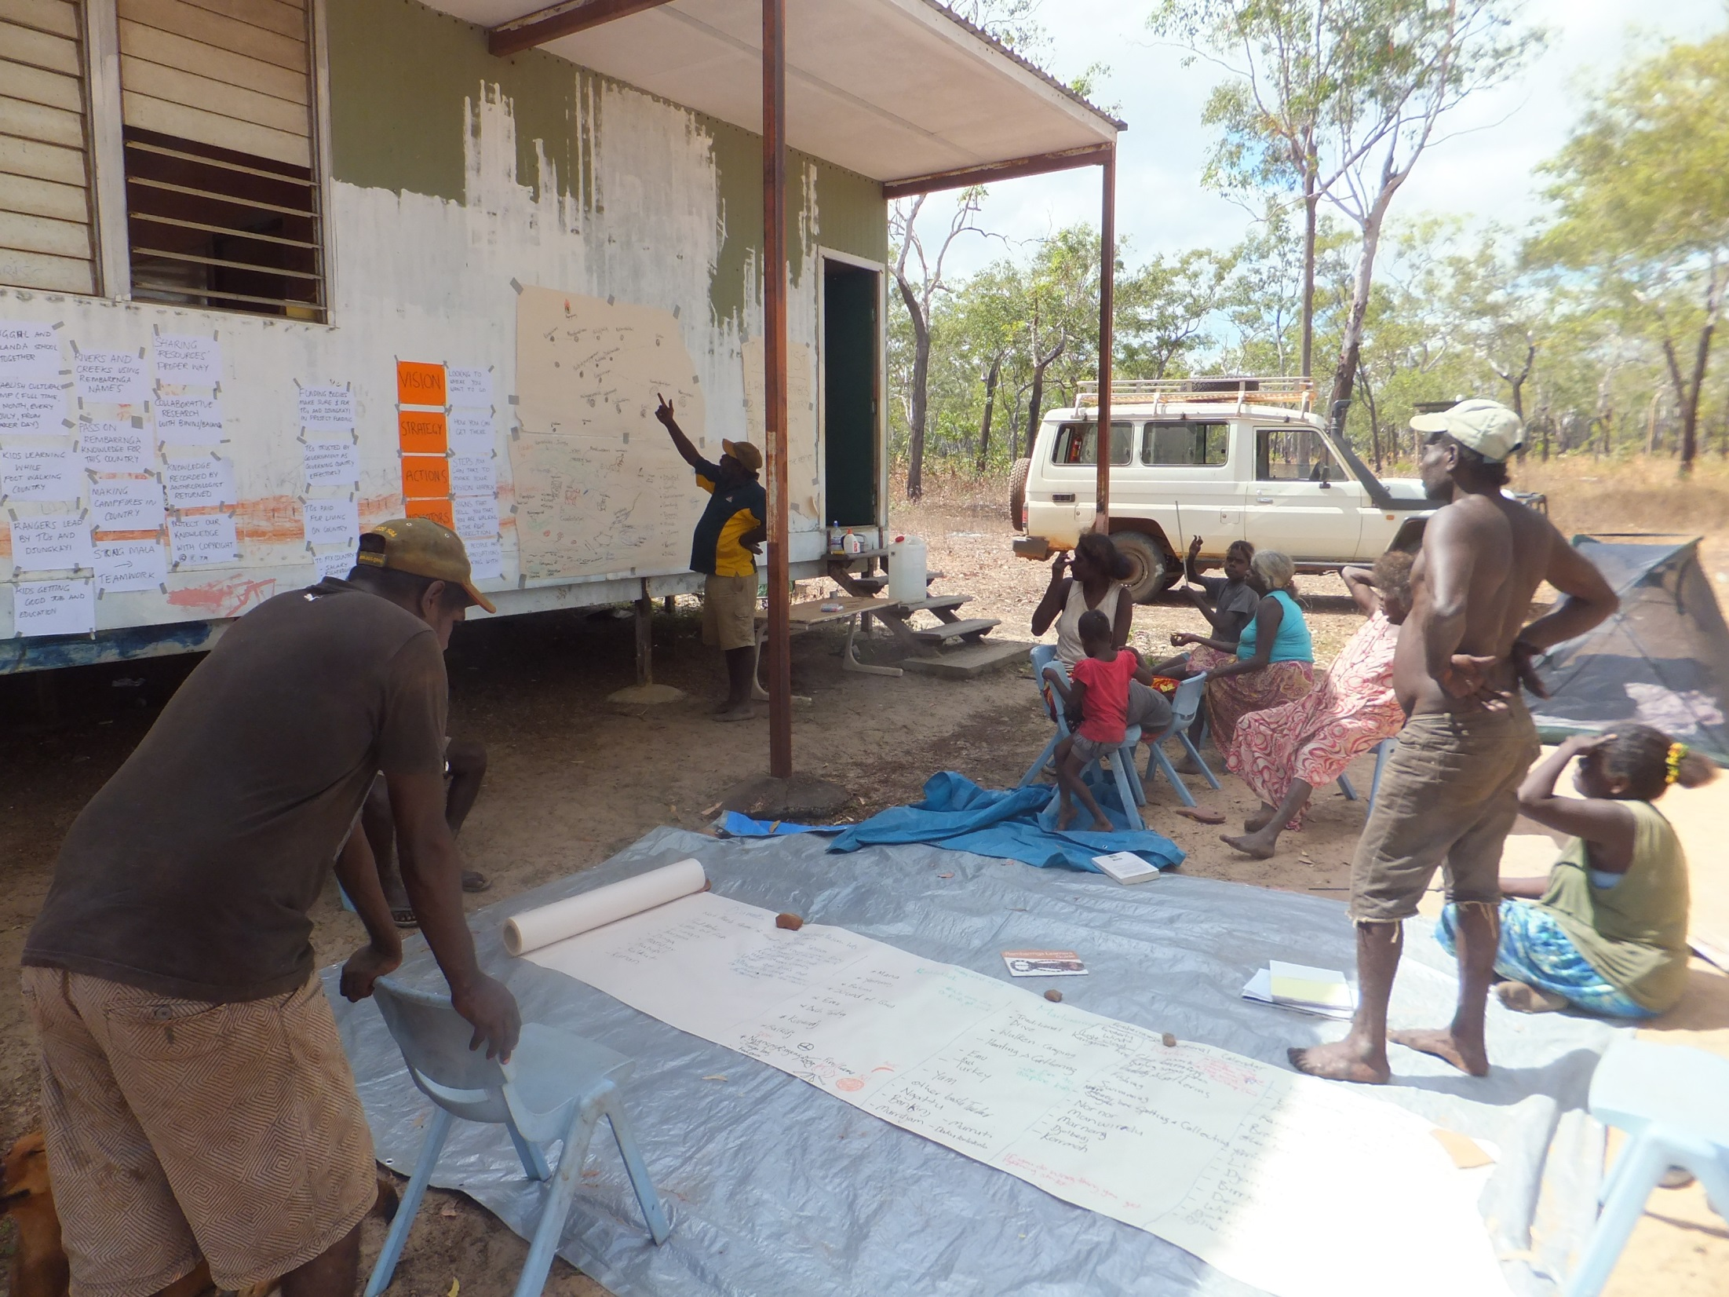

Slide 4
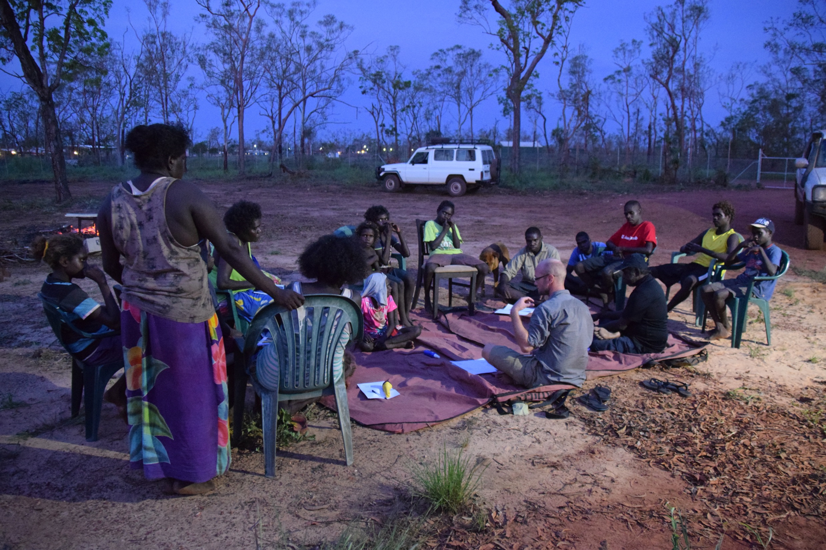

Slide 5
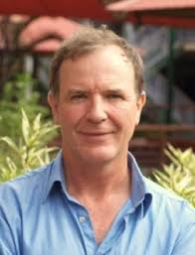
Contributions of Indigenous peoples and local communities to biodiversity targets
Stephen Garnett, Ian Leiper, Neil Collier, Ben McGowan, Amphone Sivongxay, Neil Burgess and Beau Austin
Charles Darwin University, Darwin, Northern Territory, Australia

Slide 6
Objectives
Improve the global evidence base for contributions of Indigenous people and local communities to biodiversity conservation.
Use area of land and sea as a proxy for IPs/LC contributions to/effective control of biodiversity conservation
Obtain estimates for each nation in the world
Obtain estimates for the uncertainty about each country in the world, and cause of uncertainty.

Slide 7
Context
Conceived in 2013 as contribution to World Parks Congress, 2014
First six months spent discussing ethical issues (see below)
Coordinated by Stephen Garnett (Charles Darwin University, Australia). WPC session had contributions from all continents: Ashish Kothari (Asia), Bev Sithole (Africa), Gonzalo Oviedo (Latin America), Val Courtois (North America), Alifereti Tawake (Oceania), Joe Morrison (Australia), Pernilla Malmer (Europe).
Major contributors to database: Ian Leiper, Ben McGowan and Amphone Sivongxay (CDU), Neil Collier (University of Leuphana, Germany), Neil Burgess and students (WCMC)
Many other groups have offered advice on drafts.

Slide 8
Methods (for each country)
overview of tenure, particularly communal title.
presence/absence of self-identifying IPs/LCs and estimate of tenure blind areas they own/occupy/control (including lowest, highest and best guess estimate using publically available data).
the location and area of each tenure type over land and sea – State, Indigenous, local community, private.
assessment of the extent to which protected areas are State owned and controlled or Indigenous owned/controlled and whether the involvement is ‘official’ or ‘unofficial’.
also overlaying on WDPA park layer an assessment of anthromes to assess the extent to which parks in different IUCN categories are occupied by different land uses, with approximate extent of IPs/LC involvement.

Slide 9
Progress
Initially thought area of each country under each type of tenure could readily be identified by experts. Not the case, so have gone in search of source data for each country. A big job!
Already have overlays of IPs/LC occupancy of 234 out of 254 countries with analyses of WPDA and anthromes for 176 countries totalling 62 million km²
Initial full drafts for 104 countries.
Started sending draft country accounts for peer review.
We are happily inviting participation from any interested people.
Next slide shows the categories of land and sea tenure for which we are trying to get estimates of area in each country

Slide 10
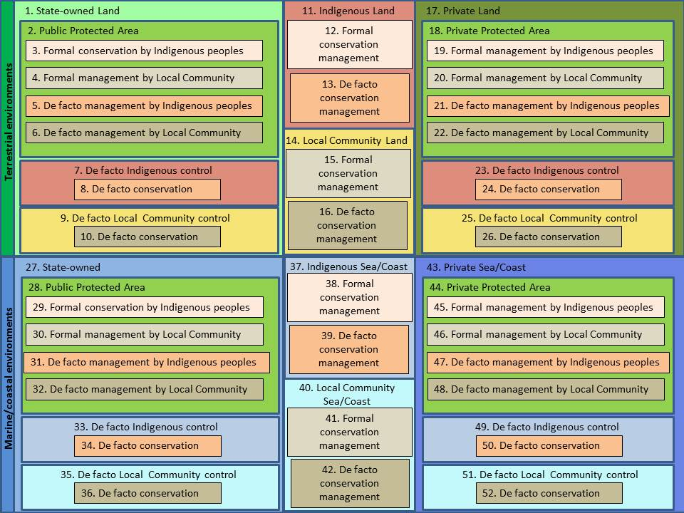

Slide 11
Example of results – anthromes and WPDA
Sweden | Human use | Indigenous/Local community | State
Park categories I-IV | Intensive | 0.0 | 0.3
 | Extensive | 1.7 | 0.5
 | Very little | 7.0 | 0.1
Park categories V + VI | Intensive | 0.0 | 0.5
 | Extensive | 1.0 | 0.3
 | Very little | 1.8 | 0.3
Outside protected areas | Intensive | 1.0 | 15.5
 | Extensive | 20.1 | 26.6
 | Very little | 17.3 | 0.2
Unknown |  | 0.2 | 1.4
Park categories I-IV | % I-IV PA area
 | Intensive | 0.1 | 3.1
 | Extensive | 17.3 | 5.3

Slide 12
Anthromes and WPDA
Sweden | Human use | Indigenous/Local community | State
Park categories I-IV | Intensive | 0.0 | 0.3
 | Extensive | 1.7 | 0.5
 | Very little | 7.0 | 0.1
Park categories V + VI | Intensive | 0.0 | 0.5
 | Extensive | 1.0 | 0.3
 | Very little | 1.8 | 0.3
Outside protected areas | Intensive | 1.0 | 15.5
 | Extensive | 20.1 | 26.6
 | Very little | 17.3 | 0.2
Unknown |  | 0.2 | 1.4
Park categories I-IV | % I-IV PA area
 | Intensive | 0.1 | 3.1
 | Extensive | 17.3 | 5.3
Large proportion of country outside parks with Indigenous/community connection and little or no intensive use – i.e. likely to retain biodiversity values

Slide 13
Anthromes and WPDA
Sweden | Human use | Indigenous/Local community | State
Park categories I-IV | Intensive | 0.0 | 0.3
 | Extensive | 1.7 | 0.5
 | Very little | 7.0 | 0.1
Park categories V + VI | Intensive | 0.0 | 0.5
 | Extensive | 1.0 | 0.3
 | Very little | 1.8 | 0.3
Outside protected areas | Intensive | 1.0 | 15.5
 | Extensive | 20.1 | 26.6
 | Very little | 17.3 | 0.2
Unknown |  | 0.2 | 1.4
Park categories I-IV | % I-IV PA area
 | Intensive | 0.1 | 3.1
 | Extensive | 17.3 | 5.3
A fifth of high protection parks have extensive Indigenous/local community use – i.e. management must be collaborative

Slide 14
% for 104 countries/62 million km² land
Area class | Lowest | Highest | Best guess
State protected lands without people | 4.1 | 7.6 | 5.7
All protected State lands | 8.5 | 16.9 | 12.9
Other areas where Indigenous or Local Community occupancy is likely to be consistent with conservation | 7.2 | 19.8 | 15.5
All areas where Indigenous or Local Community occupancy is likely to be consistent with conservation | 11.6 | 29.1 | 22.7
Private protected areas | 1.5 | 3.4 | 2.3

Slide 15
% for 104 countries/13 million km² coast/sea
Area class | Lowest | Highest | Best guess
Protected State marine and coastal areas without people | 10.1 | 11.0 | 10.6
All protected State marine and coastal areas | 10.7 | 11.9 | 11.4
Other areas where Indigenous or Local Community occupancy is likely to be consistent with conservation | 0.5 | 4.3 | 1.0
All areas where Indigenous or Local Community occupancy is likely to be consistent with conservation | 3.7 | 10.4 | 5.7
Please note – very much draft figures without intended local review

Slide 16
Ethical issues
Is mapping of Indigenous and community conservation ethical without full prior and informed consent of those concerned?
Response:
estimates have, wherever possible, an upper and lower estimate to incorporate uncertainty about e.g. Indigenous ownership of territory
all information to be reported at country level so that internal boundary uncertainty does not cloud broader message
information used is published in the public domain or after peer review with appropriate caveats
benefits from recognition of Indigenous/local community contributions to biodiversity conservation deemed greater than potential impact of lack of ownership of generalised data
FPIC impossible to obtain from all groups, especially if elite capture of agenda to be avoided: even when consent agreed and identification of contribution derived locally, legitimacy of estimate often contestable/contested. This uncertainty absorbed using (i)

Slide 17
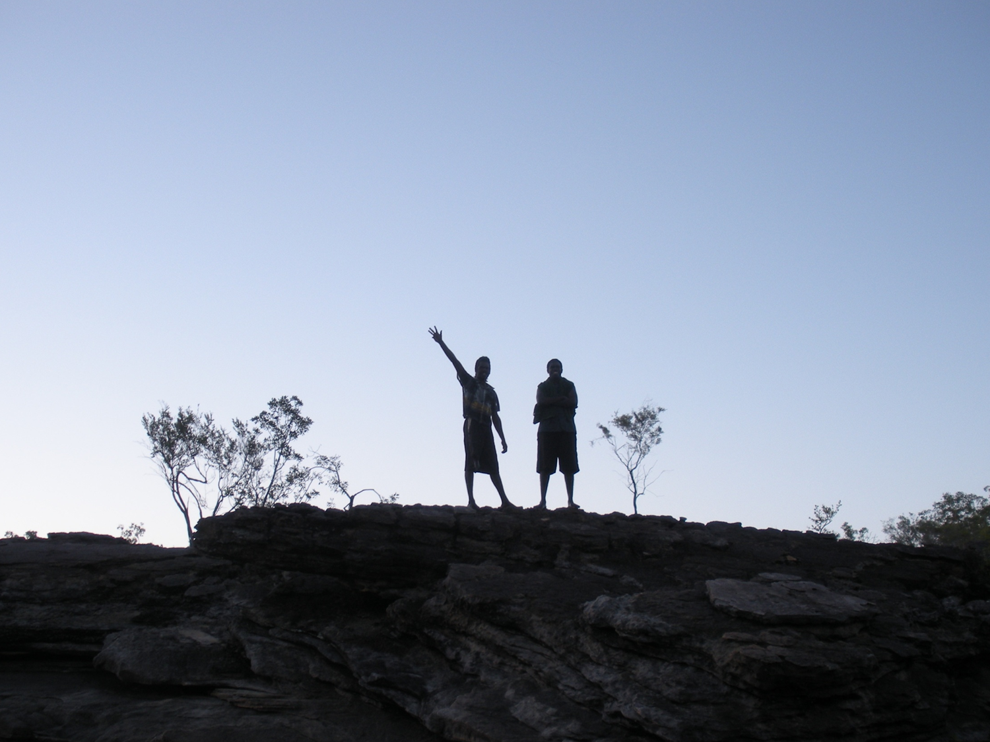
GRACIAS!
Dr. Beau Austin
Postdoctoral Research Fellow
Research Institute for the Environment and Livelihoods
Charles Darwin University
e: beau.austin@cdu.edu.au
p: +61 421777531

