Slide 1



Slide 2

COP decisions 13/29 and 14/35 – GBO-5 should provide:
A report on progress to Aichi Biodiversity Targets, and contributions to the SDGs;
A basis for post-2020 global biodiversity framework
GBO-5 should draw upon, 6th National Reports, IPBES GA etc.

Slide 3

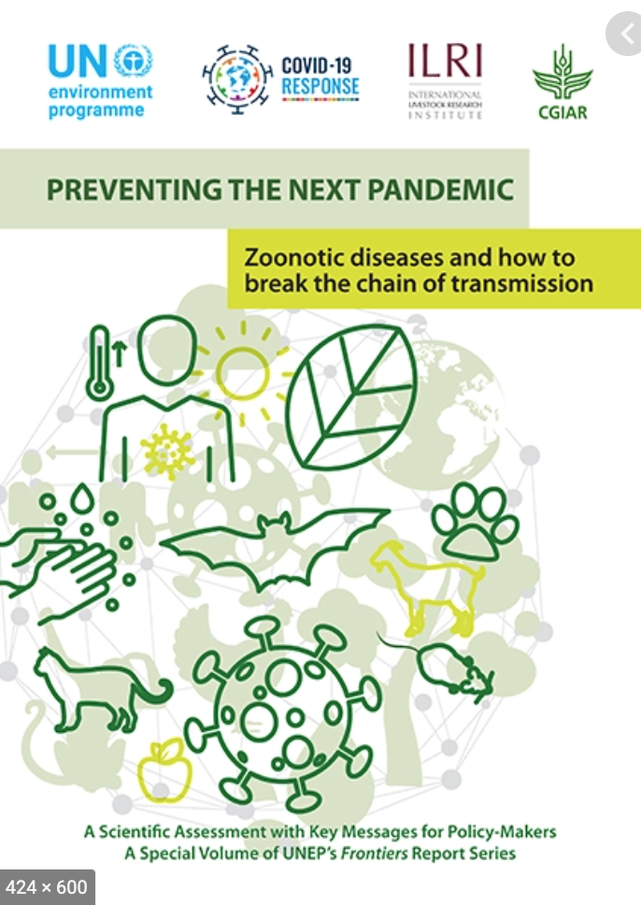





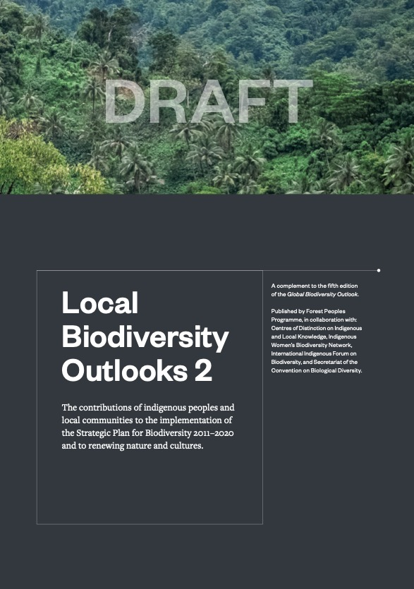
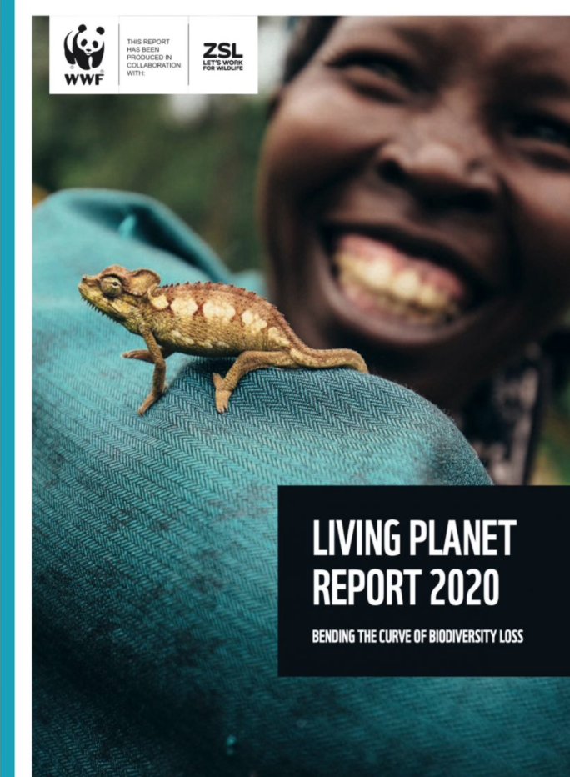


167
170
National Reports and
NBSAPs analysed
93
59
References to national reports from
Parties
675
Citations to academic literature and technical reports
50
Indicators; Focus on trends 2000-2020
926
Comments on the first draft

Slide 4
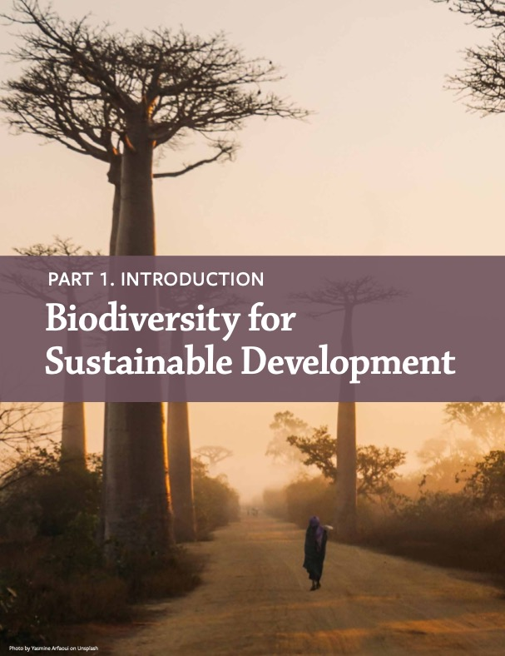

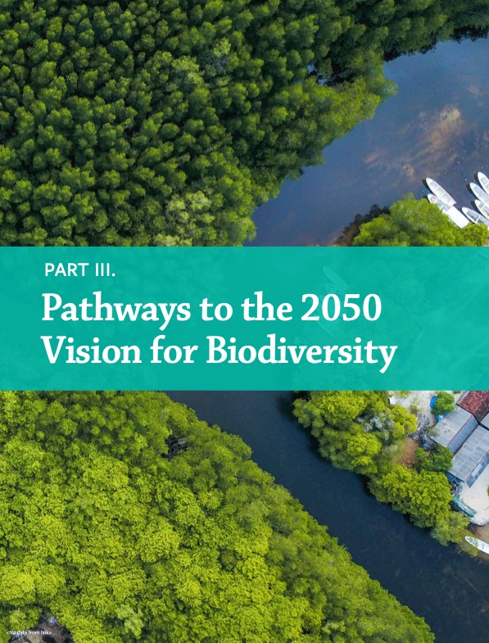

Slide 6
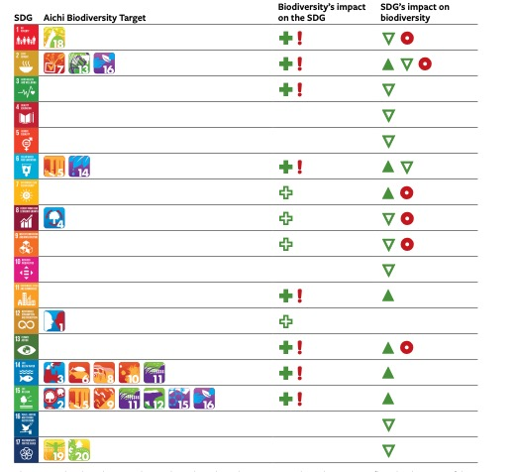
Biodiversity → SDG
Contributes
Supports
Loss Jeopardizes
SDG → Biodiversity
Contributing
Enabling
Constraining

Slide 8
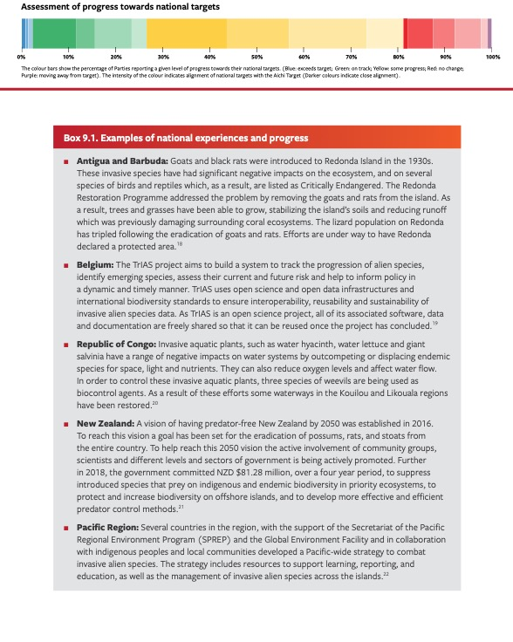




For each Aichi Biodiversity Target:
Summary of progress towards target and each element
Most relevant SDG target(s)
Analysis and examples from national report
Narrative based on national reports and scientific literature
Indicator based charts with data since 2000 and focusing on changes since 2010

Slide 9

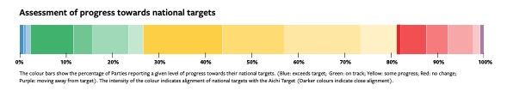
2% Parties report that they will exceed national targets
24% Parties report that they are on track to reach national targets
55% report progress but not at a rate that will allow the target to be
18% report that they are making no progress towards their targets
1% report they are moving away from the target
About a quarter of national targets are similar to (26%) or exceed (1%) the level of ambition and scope set out in the Aichi Target.
Only 10% of reporting parties have national targets of similar scope and ambition to Aichi Biodiversity Target 9 and are on track to meet them

Slide 10
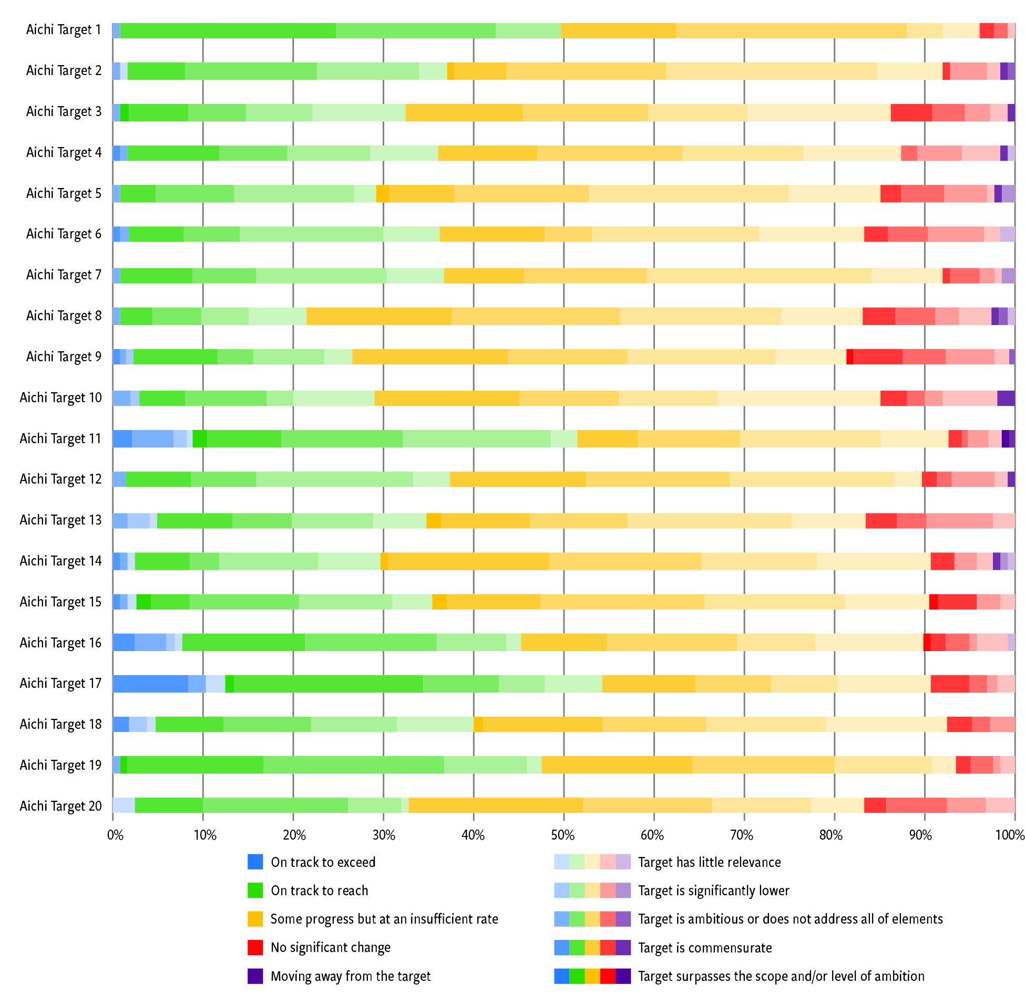

Slide 11




















Slide 12
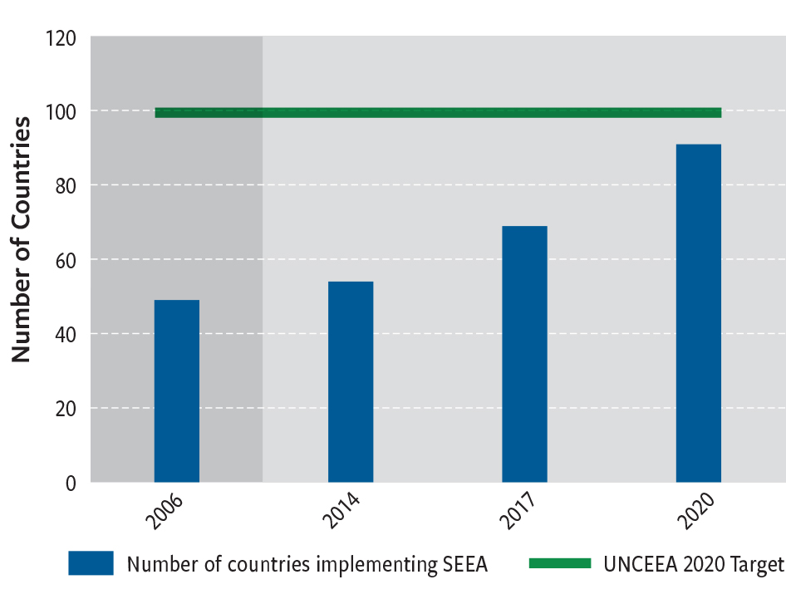
Success Stories relating to the underlying causes of biodiversity loss (Goal A):
Almost 100 countries have incorporated biodiversity values into national accounting systems

Slide 13
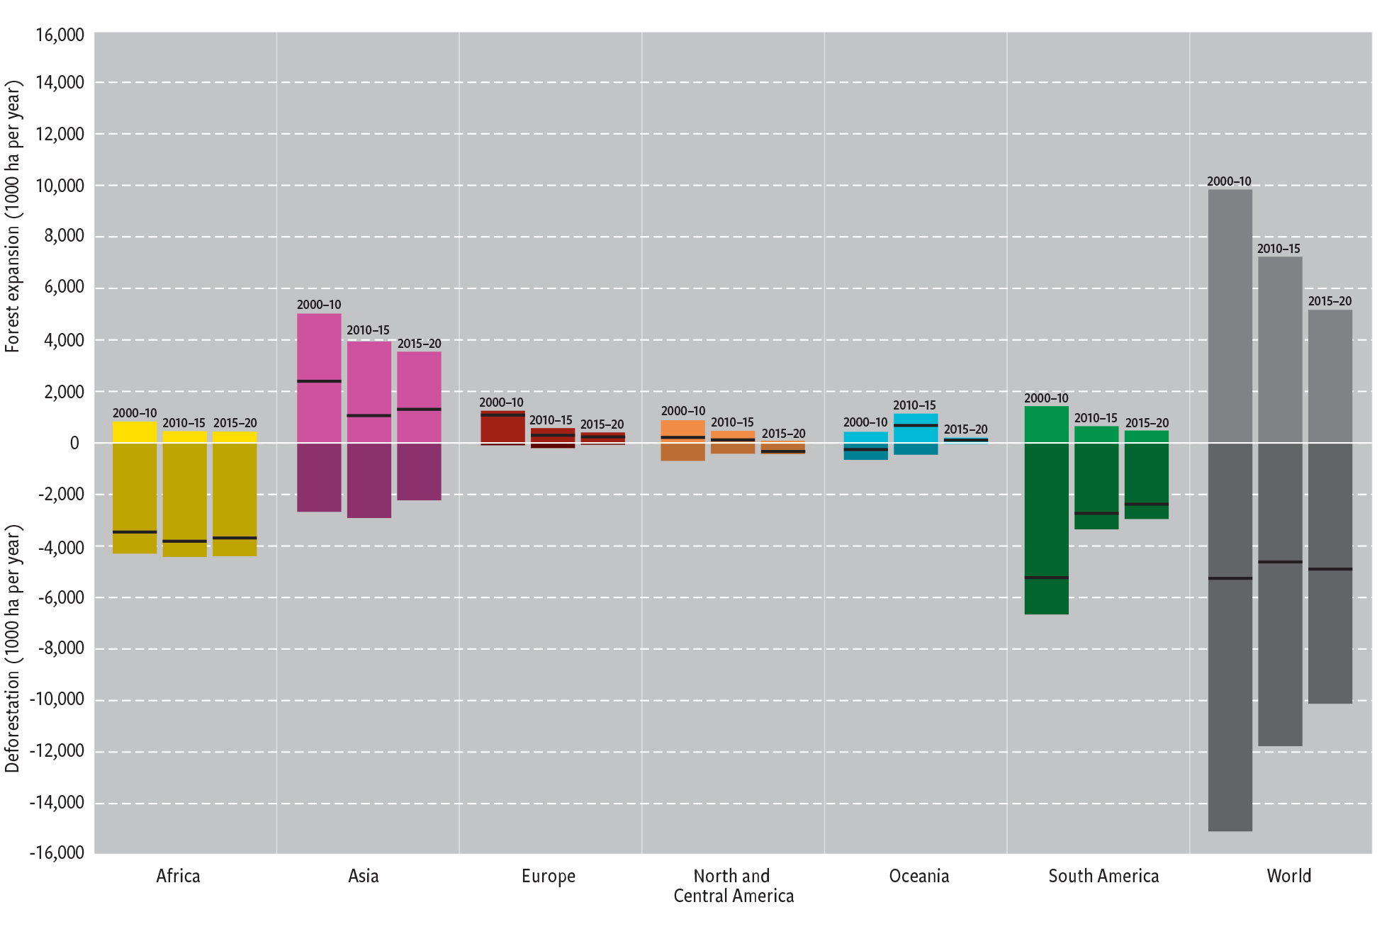
Success Stories Relating to the direct pressures on biodiversity (Goal B):
• The rate of deforestation has fallen globally by about a third compared to the previous decade

Slide 14
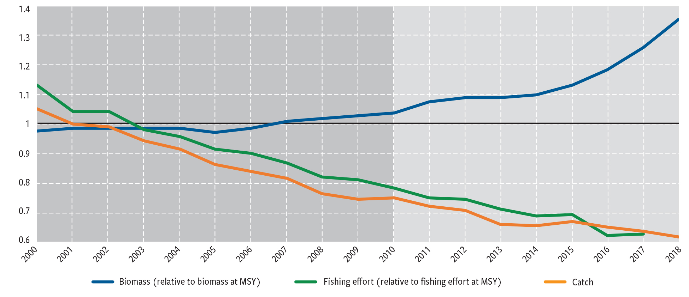
Success Stories Relating to the direct pressures on biodiversity (Goal B): • In about half of fisheries, where good management policies have been introduced, involving stock assessments, catch limits, and enforcement, the abundance of marine fish stocks has been maintained or rebuilt

Slide 15
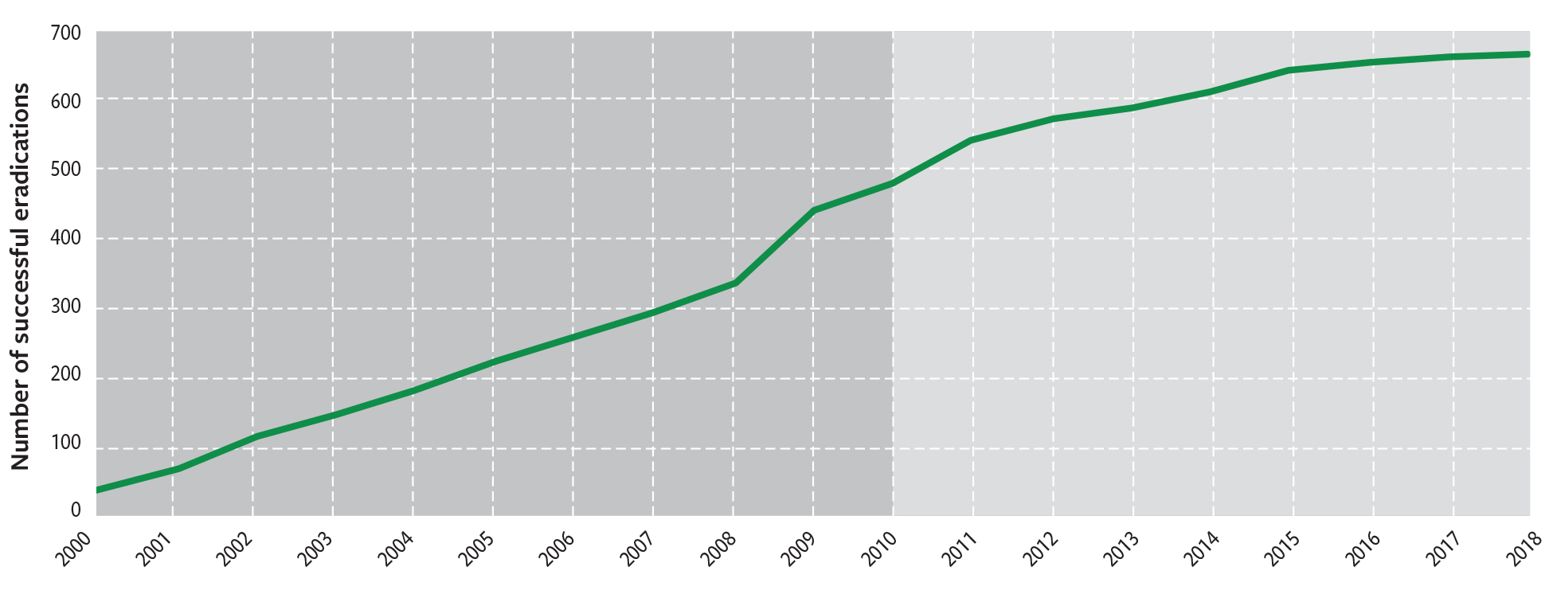
Success Stories Relating to the direct pressures on biodiversity (Goal B):
• There have been an increasing number of successful cases of eradication of invasive alien species from islands, and of the targeting of priority species and pathways to avoid future invasive species introductions

Slide 16
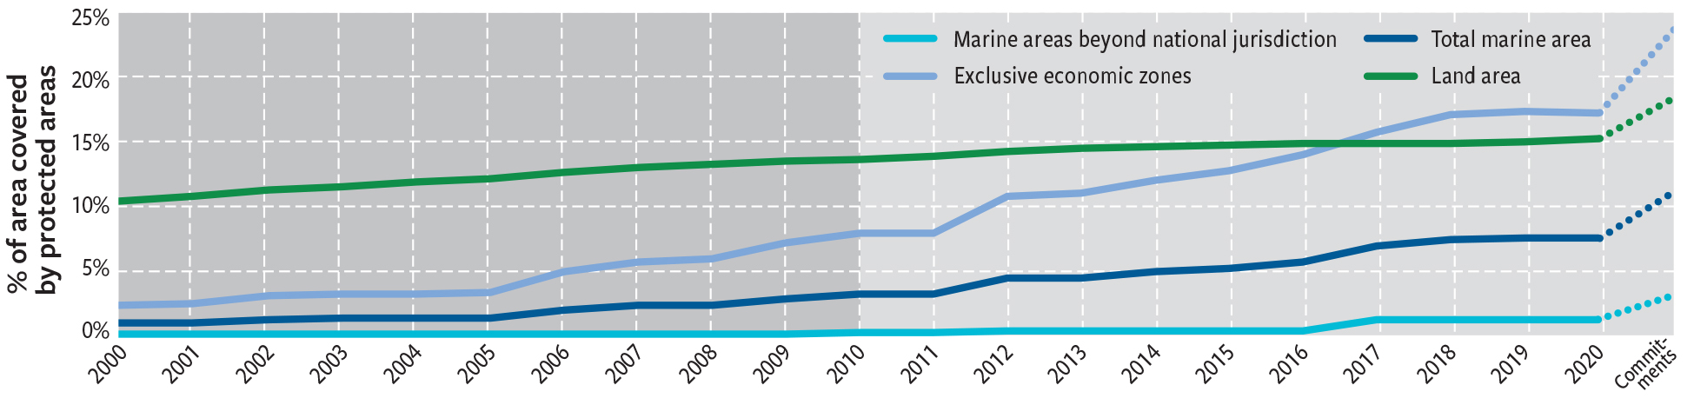
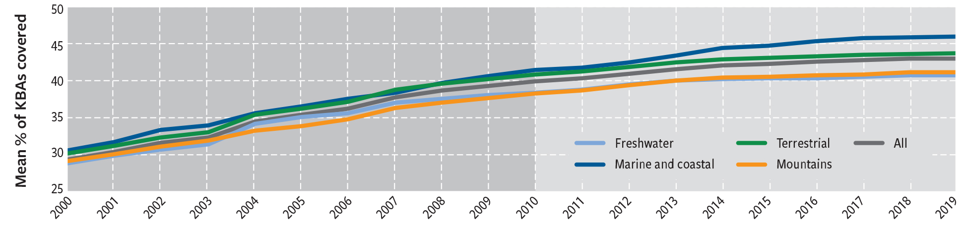
Relating to the status of biodiversity (Goal C):
Protected area, increasing from about 10% to at least 15% terrestrially, and from about 3% to at least 7% in marine areas.
The protection of areas of particular importance for biodiversity (KBAs) has increased from 29% to 44%

Slide 17
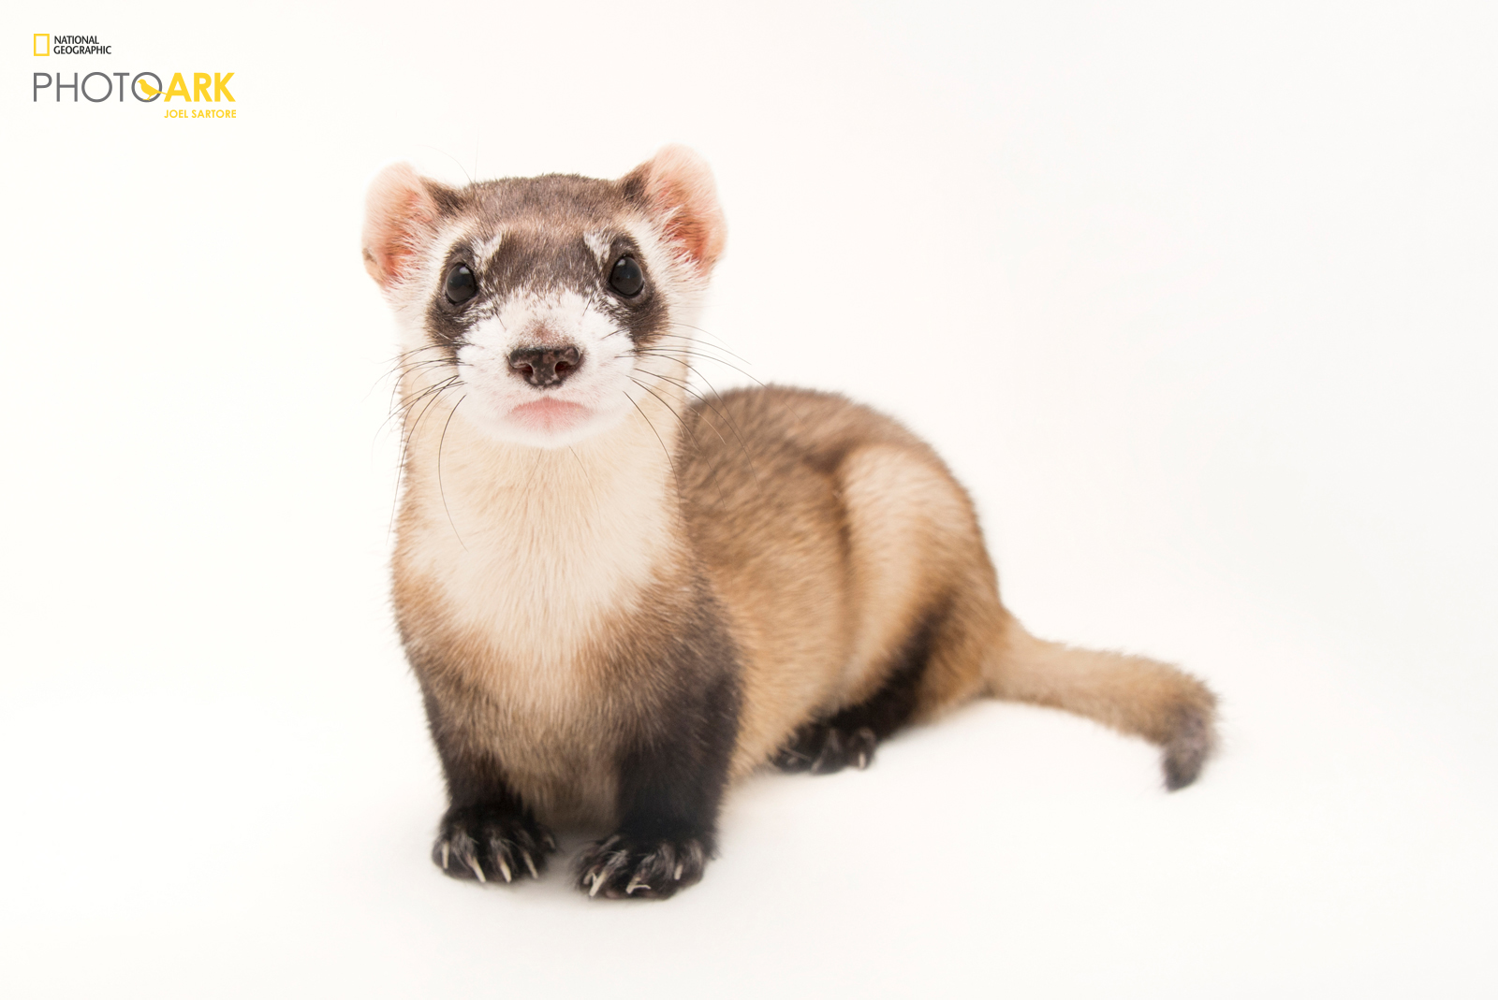
Relating to the status of biodiversity (Goal C):
Conservation actions are estimated to have prevented between 28 and 48 bird and mammal species from going extinct since 1993 (when the CBD came into force), including between 11 and 25 since 2010.
Conservation actions include:
protected areas,
hunting restrictions,
control of invasive alien species,
ex situ conservation &
re-introduction.
Without such actions, extinctions of birds and mammals in the past decade would likely have been two to four times higher.
Black footed ferret
© Joel Sartore/National Geographic
natgeophotoark.org.

Slide 18
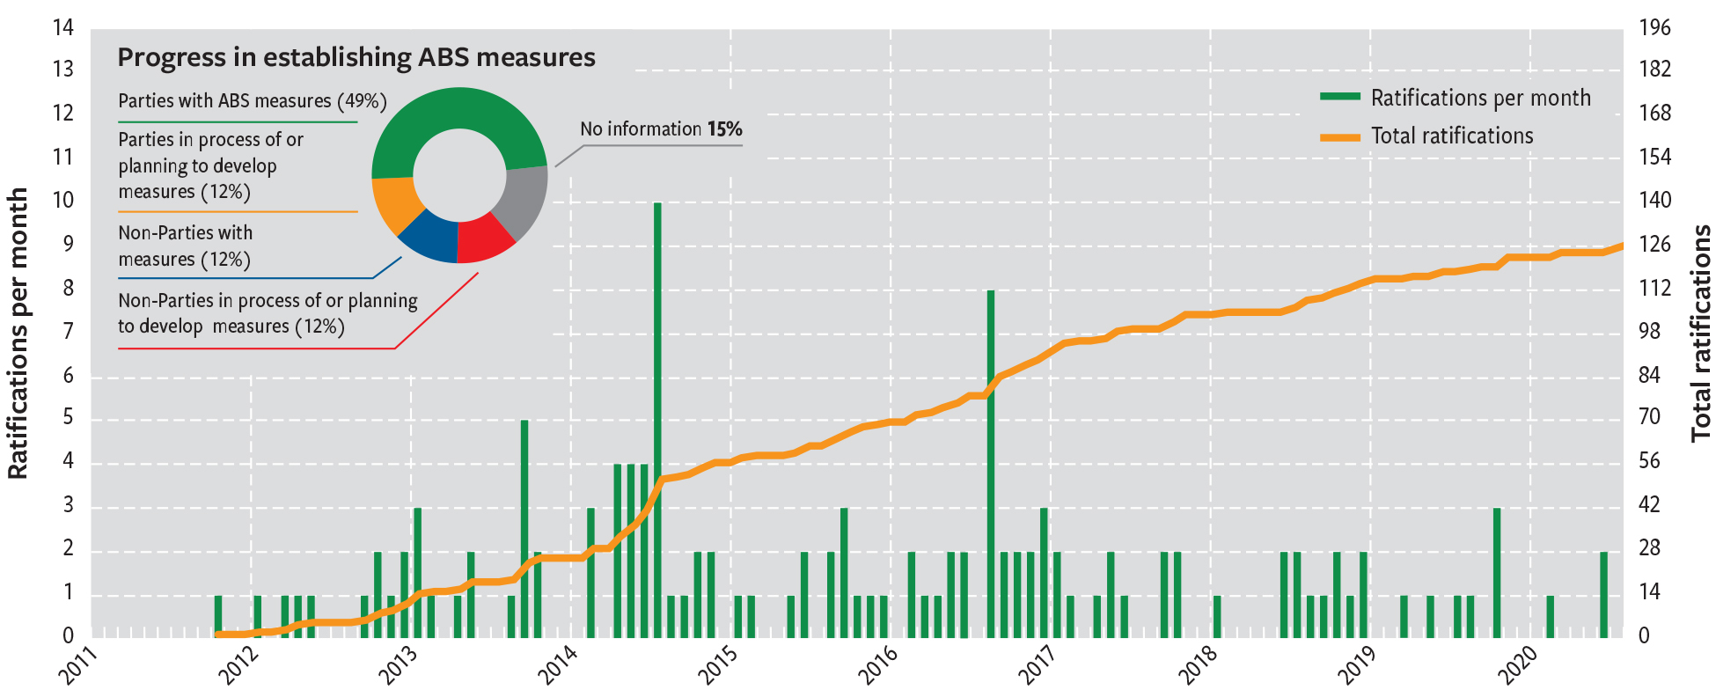
Success stories relating to measures enabling implementation (Goal E):
• The Nagoya Protocol on Access to Genetic Resources and the Fair and Equitable Sharing of Benefits Arising from their Utilization has come into force and is now fully operational in at least 87 countries and internationally

Slide 19
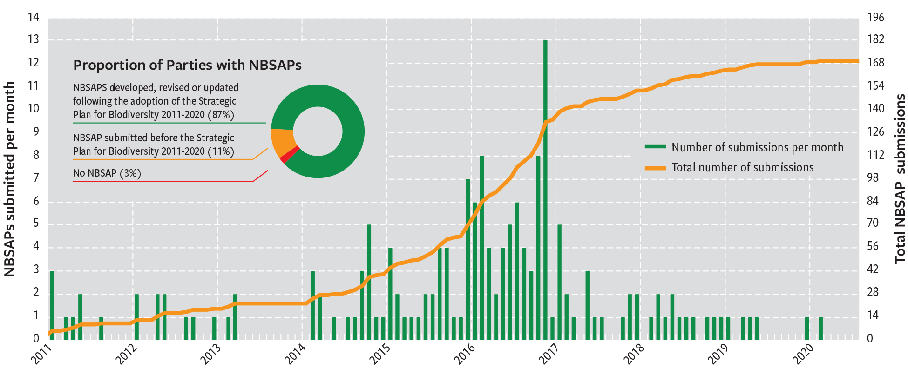
Success stories relating to measures enabling implementation (Goal E):
• National biodiversity strategies and action plans (NBSAPs) have been updated in line with the Strategic Plan for Biodiversity 2011-2020 by 170 countries, 85% of CBD Parties

Slide 20
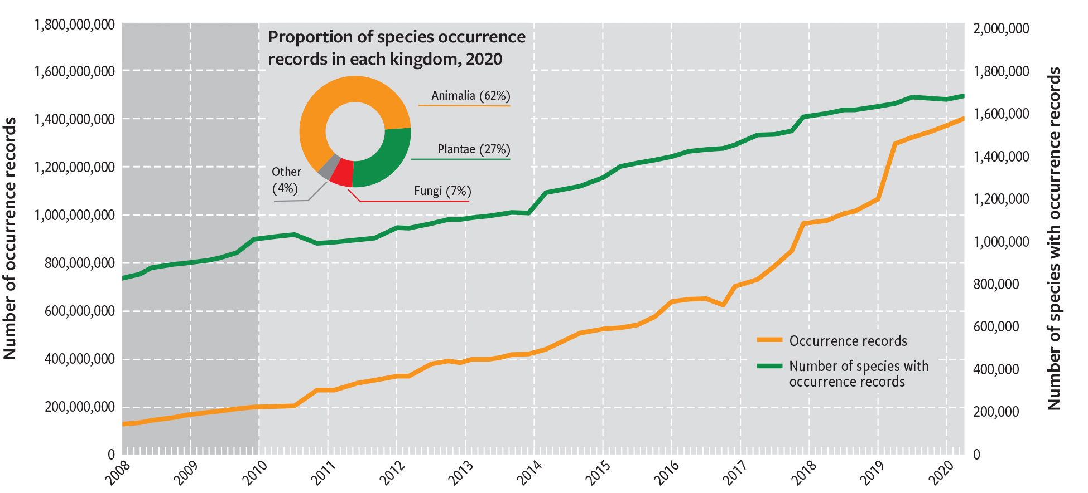
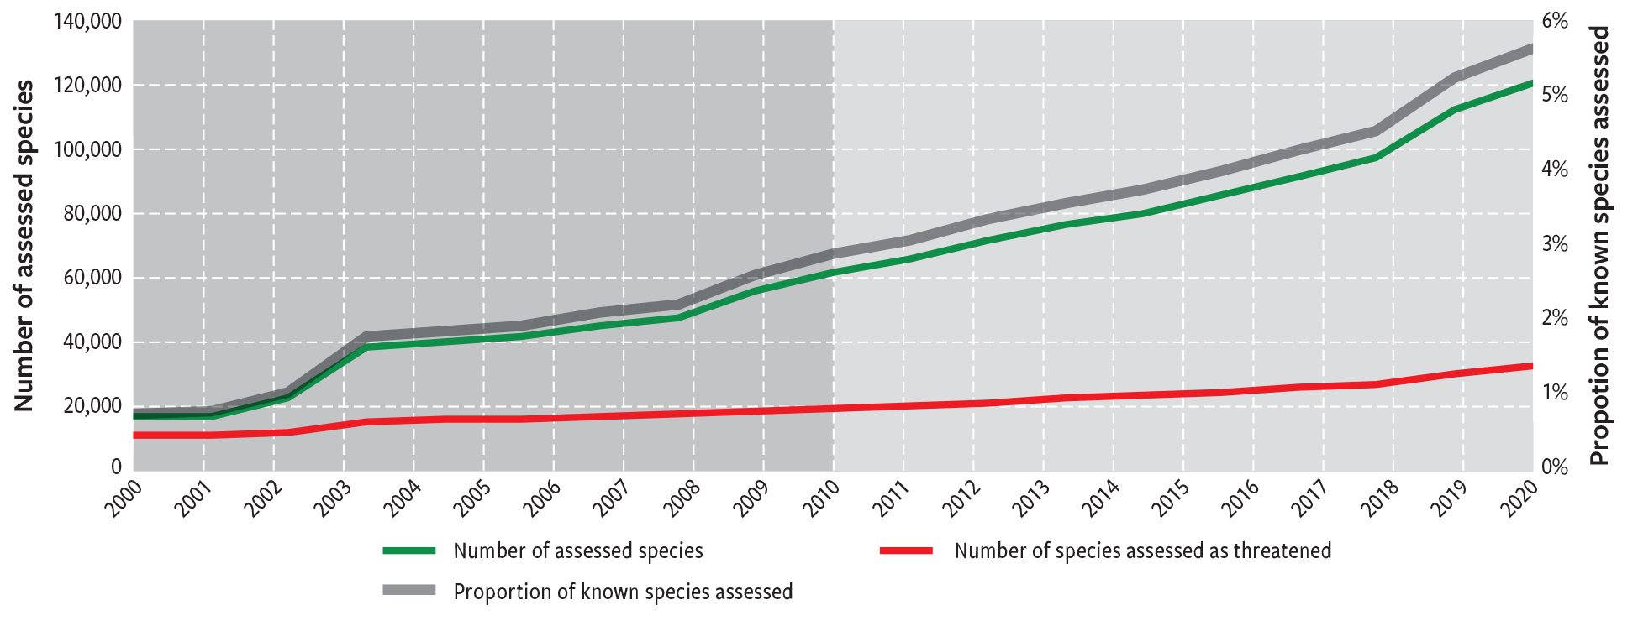
Success stories relating to measures enabling implementation (Goal E):
• There has been a substantial increase in the data and information on biodiversity available to citizens, researchers and policy makers, including through the efforts of citizen science

Slide 21
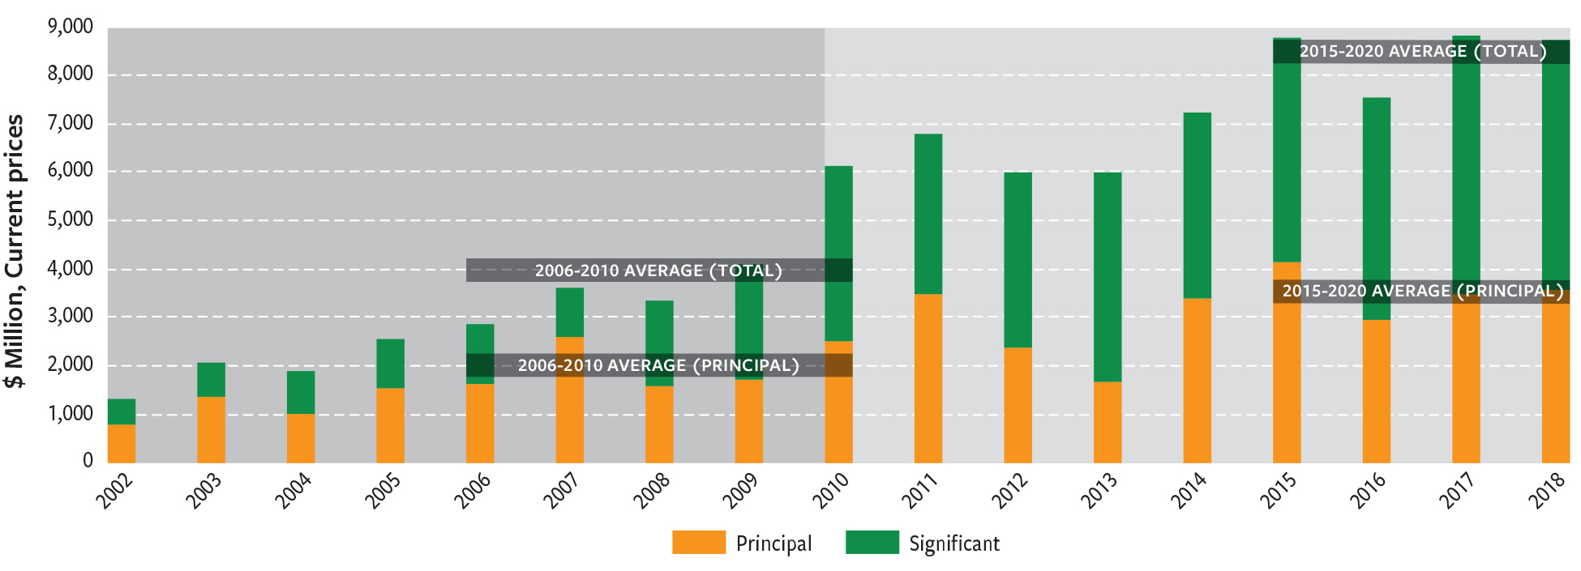
Success stories relating to measures enabling implementation (Goal E): • Financial resources available for biodiversity through international flows have doubled

Slide 22
Lessons from the Strategic Plan for Biodiversity 2011-2020. Need for:
Still greater efforts to address the direct and indirect drivers of biodiversity loss, including through greater interaction among government ministries, economic sectors and society generally.
Strengthen further the integration of gender, the role of IPLCs & stakeholder engagement.
Well-designed goals and targets formulated with clear, and, simple language, and with quantitative elements (i.e. ‘SMART’).
Strengthen NBSAPs, including their adoption as whole-of-government policy instruments.
Reduce time lags in planning and implementation of NBSAPs, and to account for unavoidable time lags in implementation.
Increased ambition of national commitments, and regular and effective review, learning and adaptive management.
Greater attention to implementation; sustained and targeted support to countries.

Slide 24
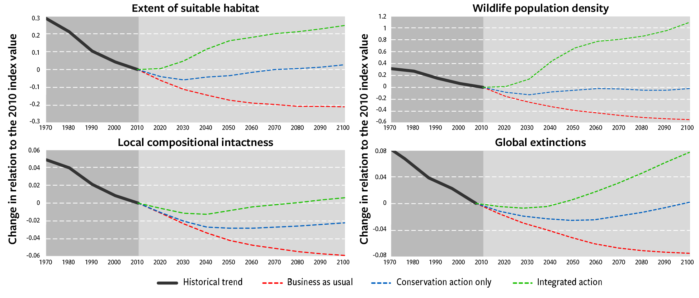
Bending the curve of biodiversity loss requires:
Bold conservation and restoration action; and
Change in agricultural production and trade, and consumption patterns.
→ (Integrated Action Portfolio)

Slide 25
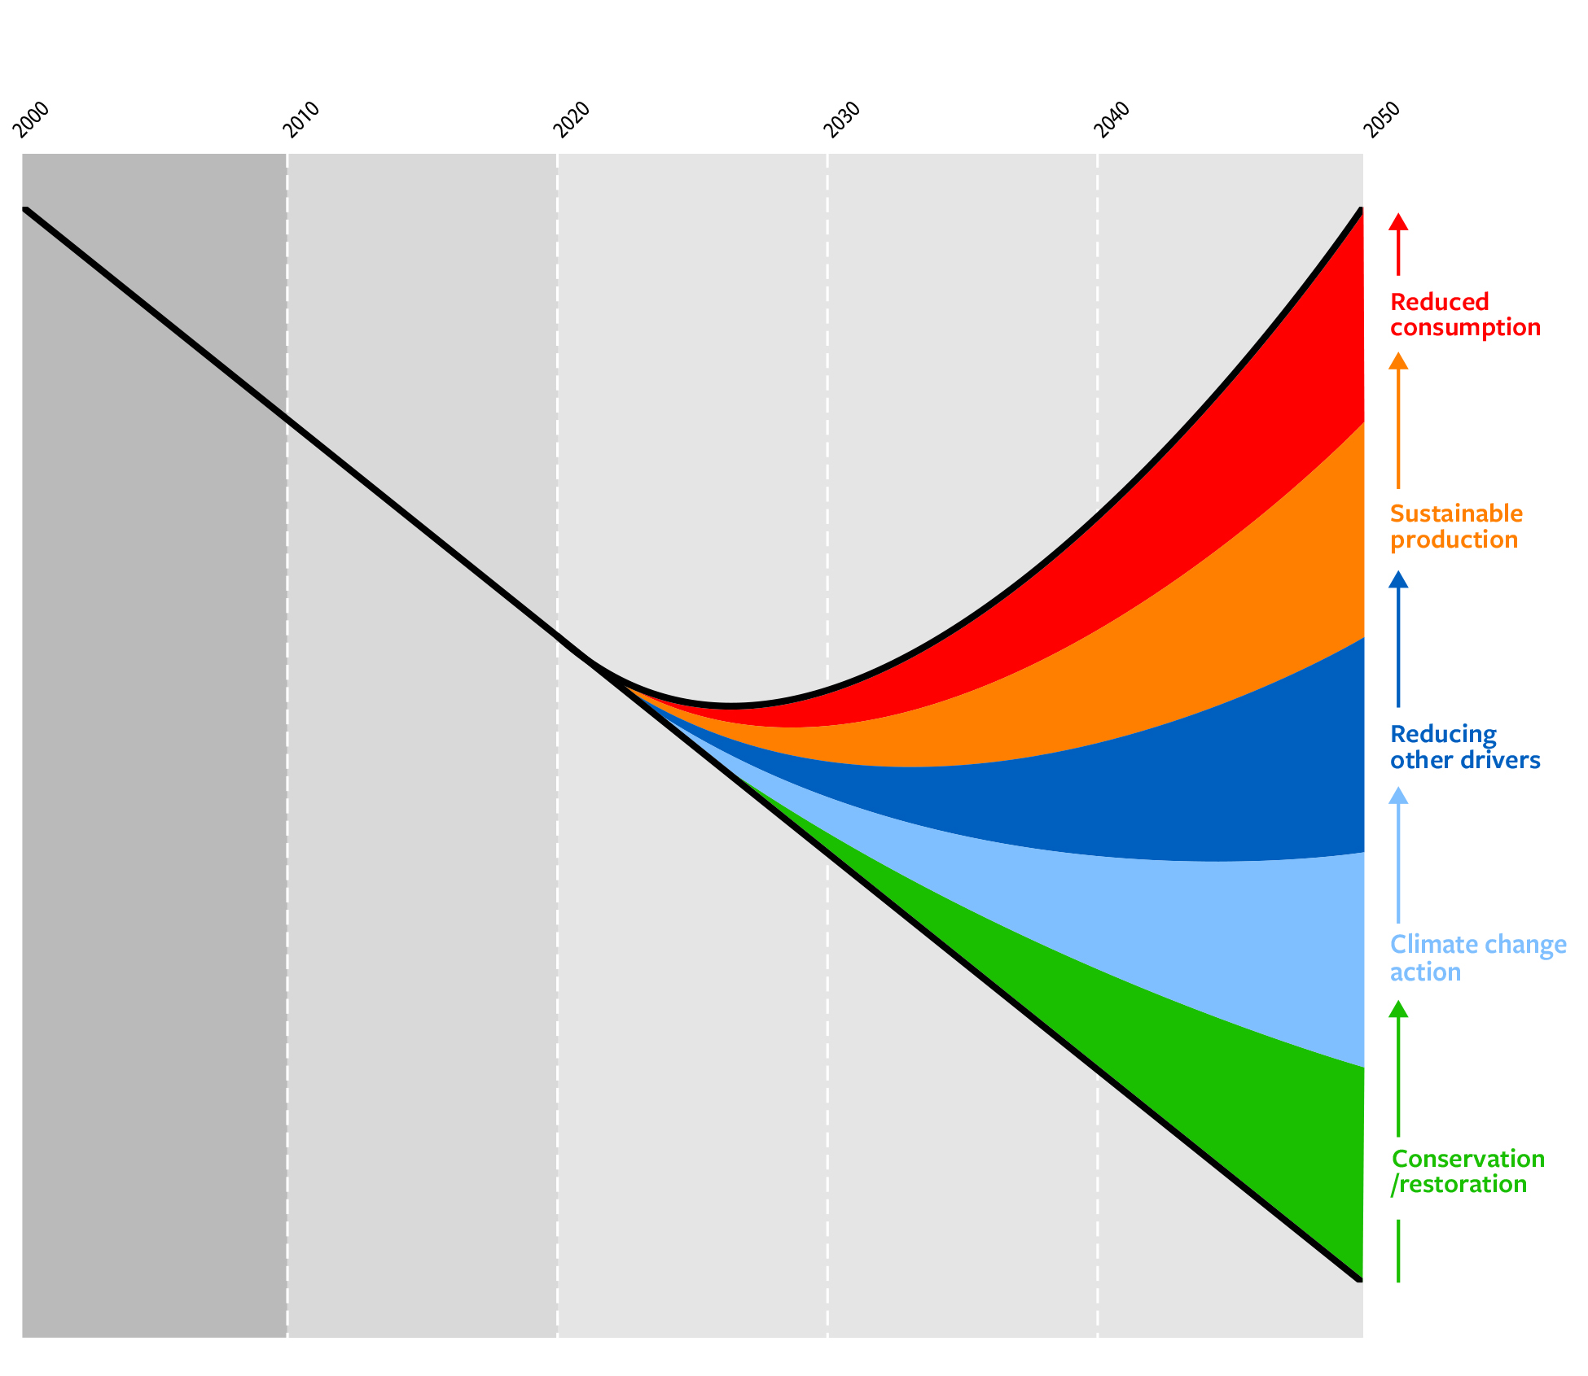
Putting nature on a path to recovery, towards the 2050 Vision requires transformative change through a portfolio of actions

Slide 26








Eight Transitions to Living in Harmony with Nature
The Land and Forests Transition
The Food Systems Transition
The Sustainable Freshwater Transition
The Cities and Infrastructure Transition
The Fisheries and Oceans Transition
The Climate Action Transition
The Sustainable Agriculture Transition
The Biodiversity-Inclusive One Health Transition

Slide 27
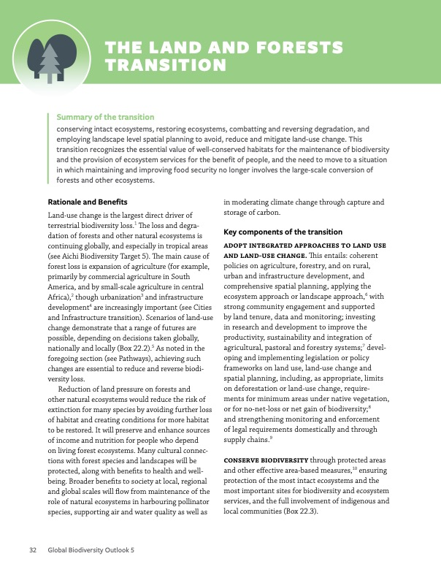
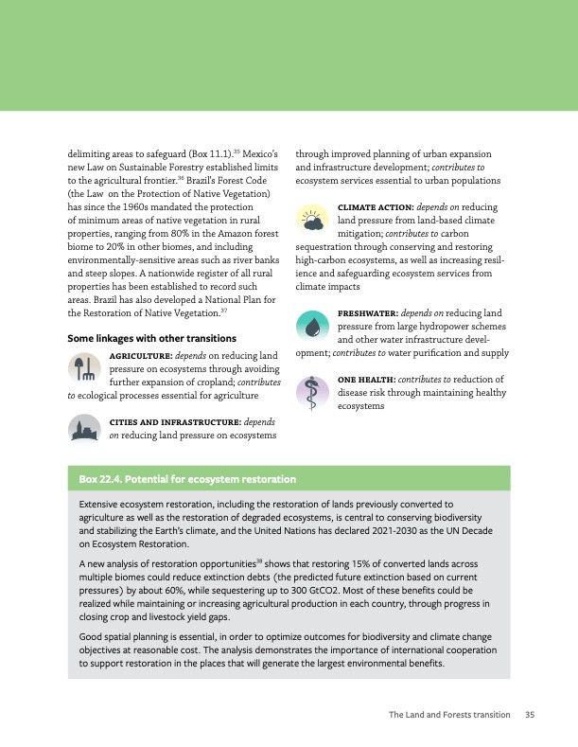




For each Transition:
Progress towards transition (examples)
Linkages with other transitions
Summary description
Rationale & Benefits
Key components

Slide 28

Rebalance agricultural policies and incentives
Promote the availability of healthy and sustainable diets.
Promote access to healthy and sustainable diets
Promote the consumption of healthy and sustainable diets,
Promote measures to reduce food waste,
Encourage businesses to promote sustainability through supply chains and to redesign product portfolios
Enabling sustainable and healthy diets with a greater emphasis on a diversity of foods, mostly plant-based, and more moderate consumption of meat and fish, as well as dramatic cuts in the waste involved in food supply and consumption. This transition recognizes the potential nutritional benefits from diverse foods and food systems, and the need to reduce demand-driven pressures globally while ensuring food security in all its dimensions.

Slide 29

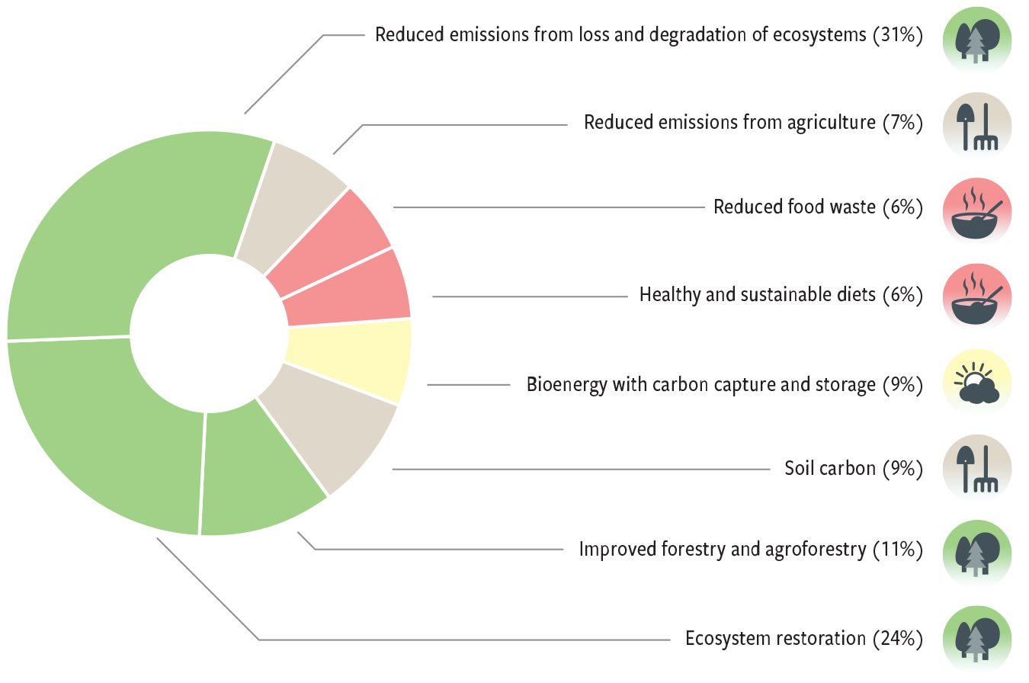
Employing nature-based solutions, alongside a rapid phase-out of fossil fuel use, to reduce the scale and impacts of climate change, while providing positive benefits for biodiversity and other sustainable development goals. This transition recognizes the role of biodiversity in sustaining the capacity of the biosphere to mitigate climate change through carbon storage and sequestration and in enabling adaptation through resilient ecosystems, as well as the need to promote renewable energy while avoiding negative impacts on biodiversity

Slide 30

Managing ecosystems, including agricultural and urban ecosystems, as well as the use of wildlife and trade, through an integrated approach, to promote healthy ecosystems and healthy people.
recognizes the full range of linkages between biodiversity and all aspects of human health, and
addresses the common drivers of biodiversity loss, disease risk and ill-health.
Reduce disease risk by conserving and restoring ecosystems.
Promote sustainable, legal and safe use of wildlife.
Promote sustainable and safe agriculture, including crop and livestock production and aquaculture.
Create healthy cities and landscapes.
Promote healthy diets as a component of sustainable consumption

Slide 31
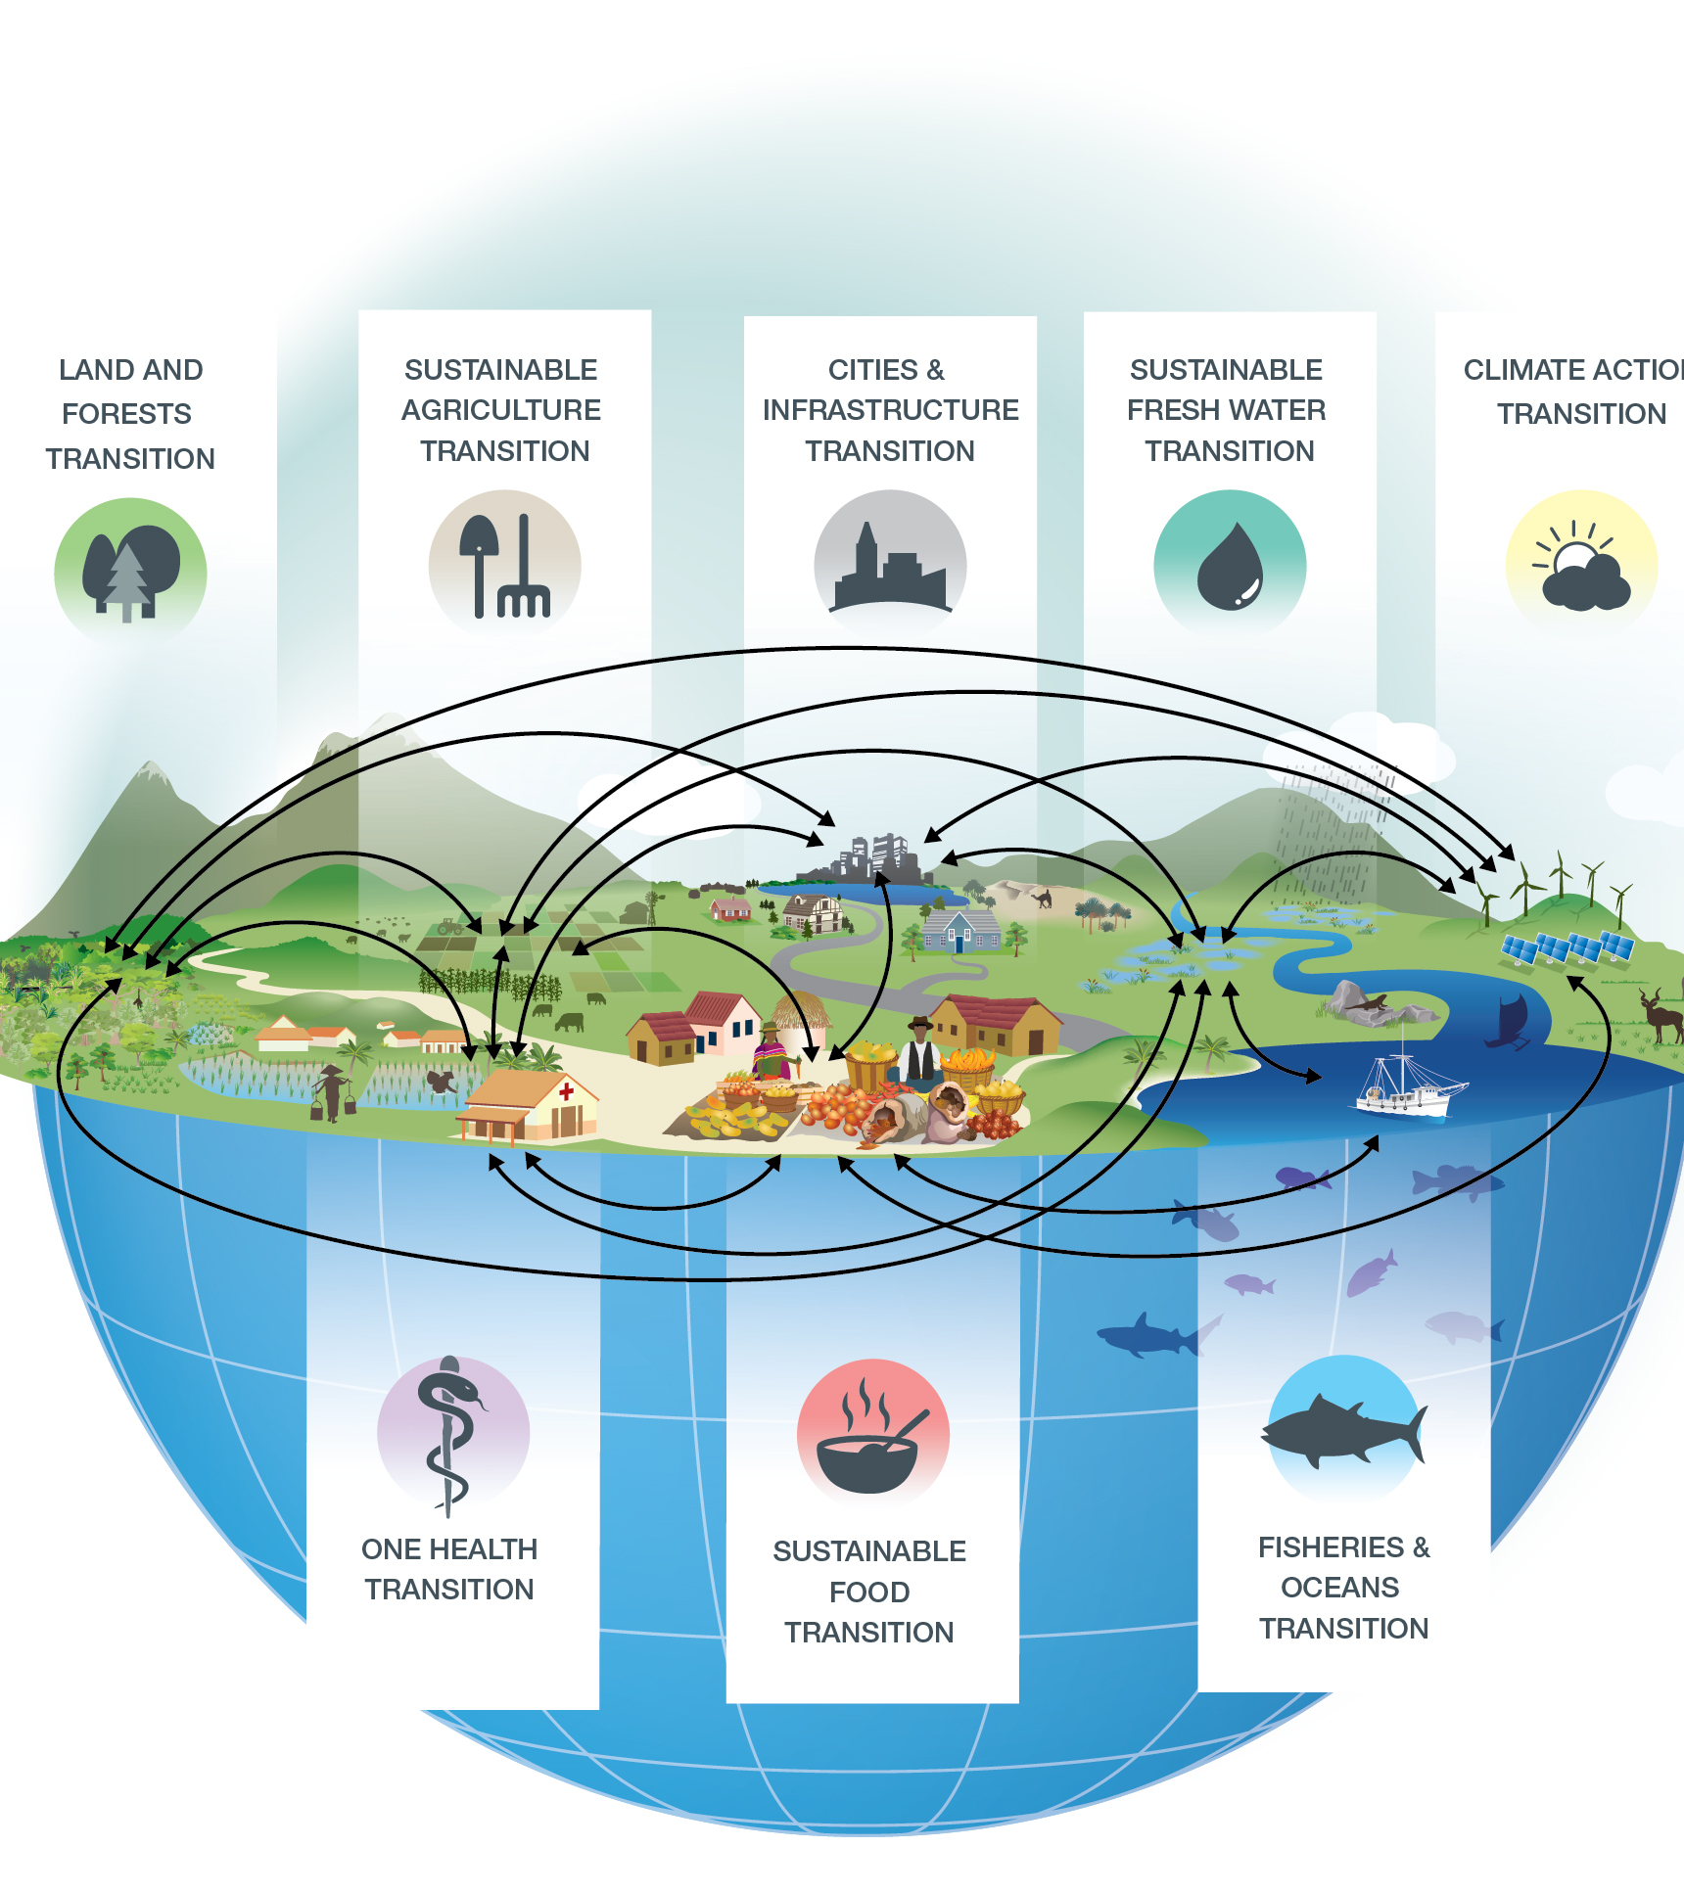

Slide 32
LEVERAGE POINTS
Total consumption & waste
Values & social norms
Tele-coupling
Visions of GQL
Justice & inclusion
Inequality
Innovation
Knowledge
Incentives
& Capacity
Integrated
Decision making
Precautionary & Adaptive management
Managing for resilience
Laws &
enforcement
LEVERS for transformative change

Slide 33

Status:
None of the Aichi targets fully met.
Many examples of success – policy measures work!
Outlook:
Possible to reduce and reverse biodiversity loss, path of recovery towards the 2050 Vision.
Requires strong conservation and restoration action, addressing all drivers, sustainable consumption.
Time for action is now.
Lessons for post 2020 global biodiversity framework.

Slide 34
https://www.cbd.int/gbo5

