Slide 1
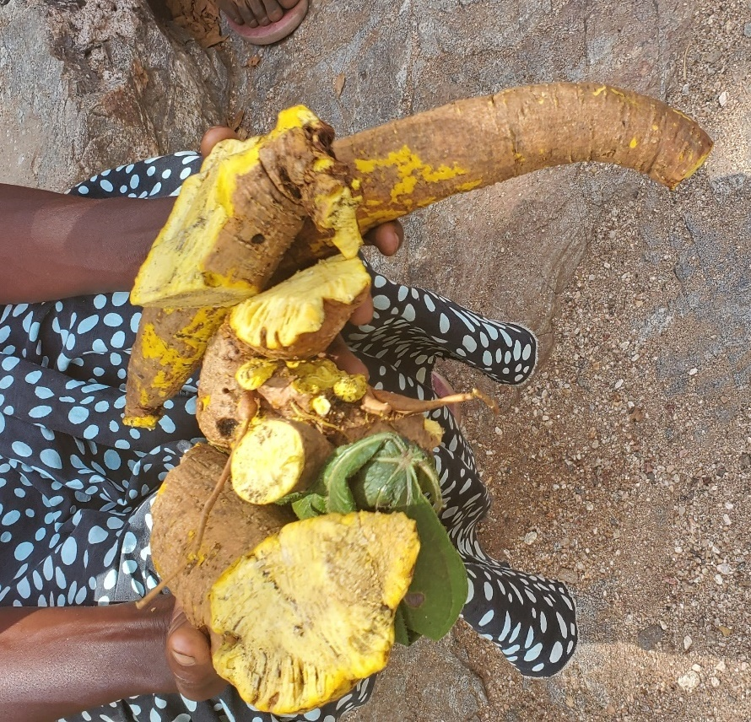
GENDER AND BIODIVERSITY
IN MALAWI
Stella Gama
Mphatso Kalemba
12th August 2020

Slide 2
Status of Gender and Biodiversity in Malawi
Natural resource-based livelihoods predominate in Malawi, yet women have insecure access to land (despite the matrilineal pattern of inheritance) and poor financial capital, which means that they cannot afford the inputs necessary to translate natural capital such as land into an economic or subsistence livelihood (e.g. produce optimal amounts of food).
Their access to other sources of natural capital, such as forests and fisheries, is limited to subsistence purposes (for example collecting firewood for fuel, and fishing for family consumption); whilst men have the capacity to convert such natural capital into financial capital (e.g. charcoal production to sell from forests, and fish to sell from fishing).
These factors all affect their capacity to sustainably utilize biodiversity and adapt to climate change.

Slide 3
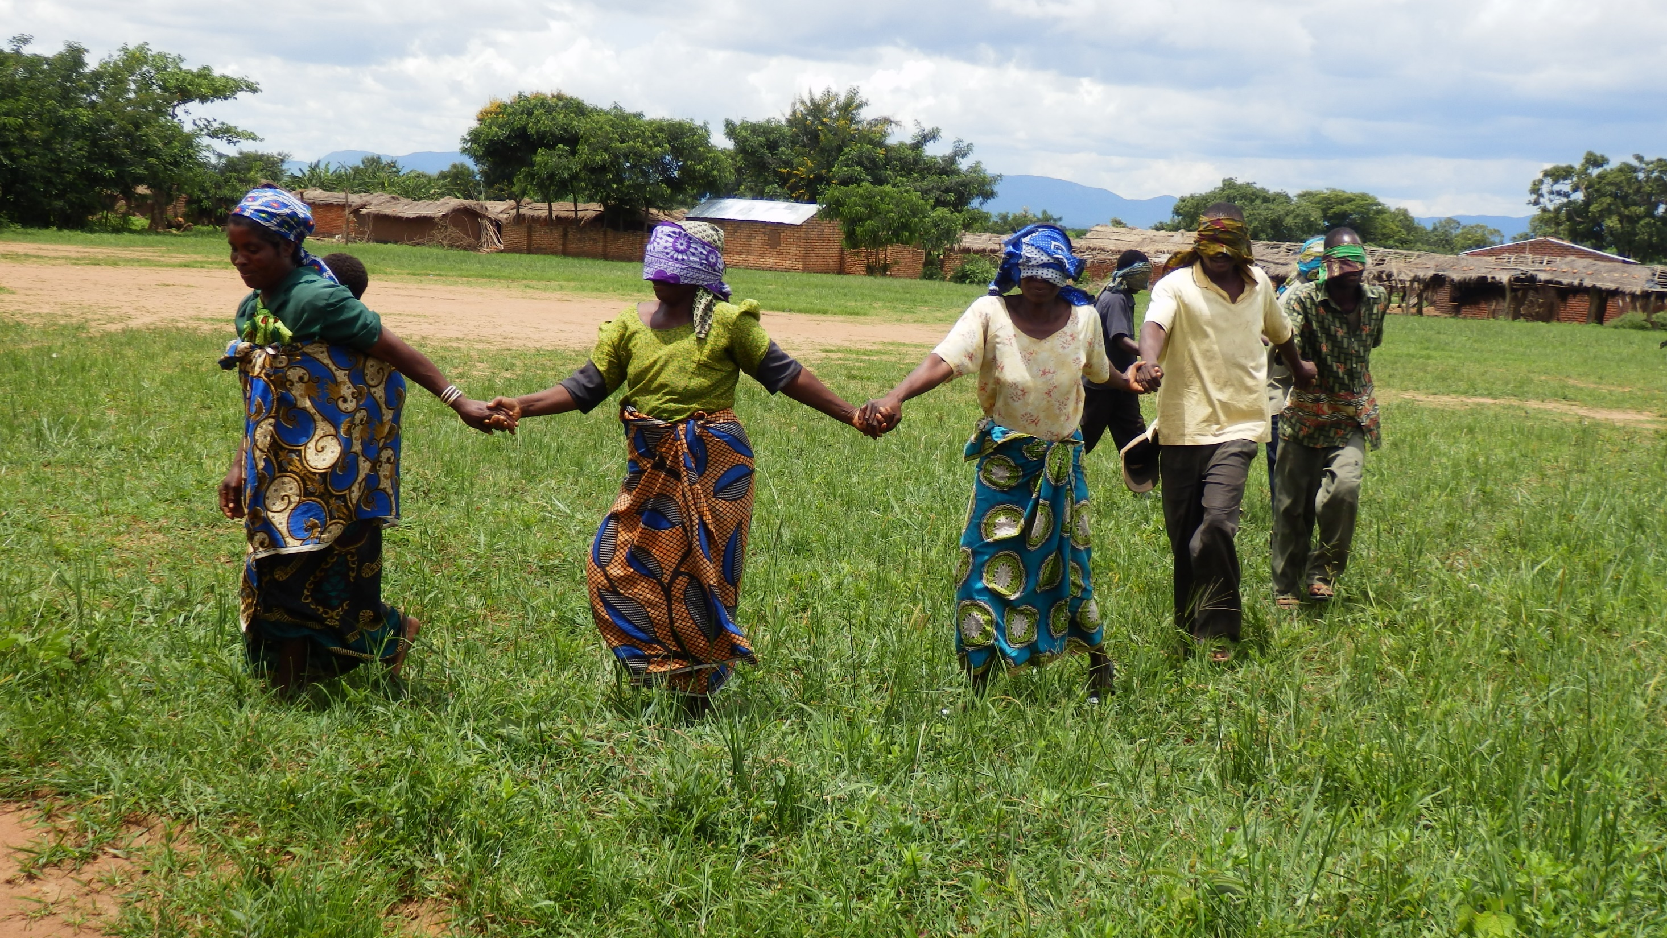
Mainstreaming gender into national biodiversity strategies and action plans
Malawi developed a gender-specific target to address biodiversity and gender considerations. Target 15: By 2025, the supply of important ecosystem services is safeguarded and restored, taking into account gender roles and responsibilities of the youth, the poor and the vulnerable.
As a government Policy, Gender focal points were assigned to relevant line-ministries, Local government and committees, including the National Biodiversity Steering Committee to ensure that a gender-perspective is taken into account in all decision making processes, relevant work and programmes.
Environmental Impact Assessment Guidelines of Malawi were recently revised to include gender issues.

Slide 4
Ensuring equitable participation in decision making related to biodiversity for women and girls
The Malawi Government also collaborated with the Millennium Challenge Corporation to implement an Environment and Natural Resource Management Project in the Shire River.
As part of this project, a Social and Gender Enhancement Activity was carried out. This was conducted by local NGOs, in collaboration with gender focal points, and assessed how women contributed towards decision-making processes in natural resources management.
The findings from the study suggested that women were mostly involved in the implementation of activities but, were not involved in decision-making processes – even if they were landowners.
In order to address this issue, a Social and Gender Enhancement Fund was established, and some of the activities conducted included awareness raising campaigns and capacity-building targeted at women groups, to empower women to participate effectively in local decision-making processes related to biodiversity and resource management.

Slide 5
Ensuring rights over relevant resources for women and girls
Gendered access to and control over agricultural assets vary substantially between men and women.
Access and control are lowest for female-headed households and due to the matrilineal property rights system in many parts of rural Malawi, women generally own the land and have better access to loans and extension information, but men remain the main decision makers in agriculture
The Millennium Challenge Corporation in collaboration with Malawi government created a grant facility to address environmental and natural resource management challenges as well as social and gender disparities in the Shire River Basin. The implementation of activities led to the following:
  Promoted greater awareness of environmental issues;
  Village Savings and Loans (VSL) have enabled women to borrow sizeable amounts of money which is used to buy assets or as business capital;
  Contributed to women empowerment in terms of the women contributing meaningful financial resources to the family; more women having influential positions in the community; women contributing meaningfully to developmental decisions in the community;
  Improved literacy levels of both men and women;
  Led to decrease in the rates of domestic violence;

Slide 6
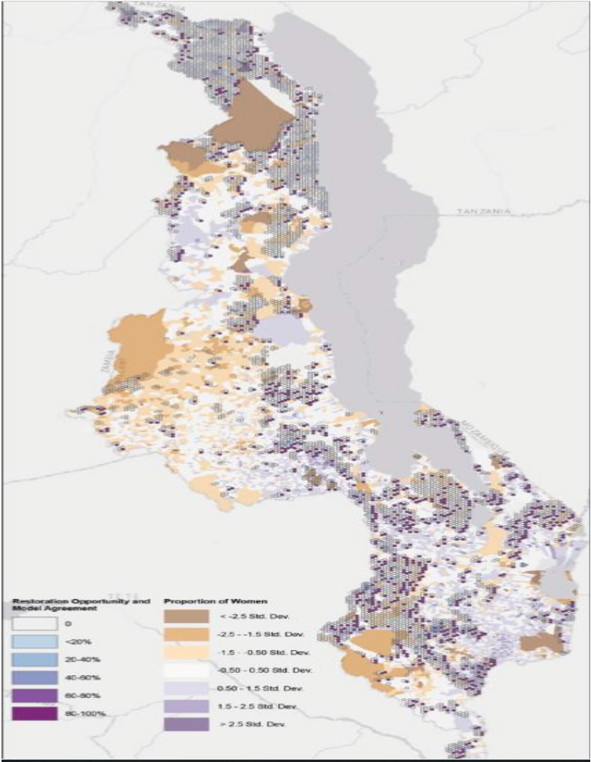
Ensuring collection of Sex Disaggregated data
During the development of Malawi’s Forest Landscape Restoration Strategy Sex disaggregated data was collected.
Map of areas where restoration would optimally benefit ecosystem services, weighed towards areas where there are proportionally more women

Slide 7

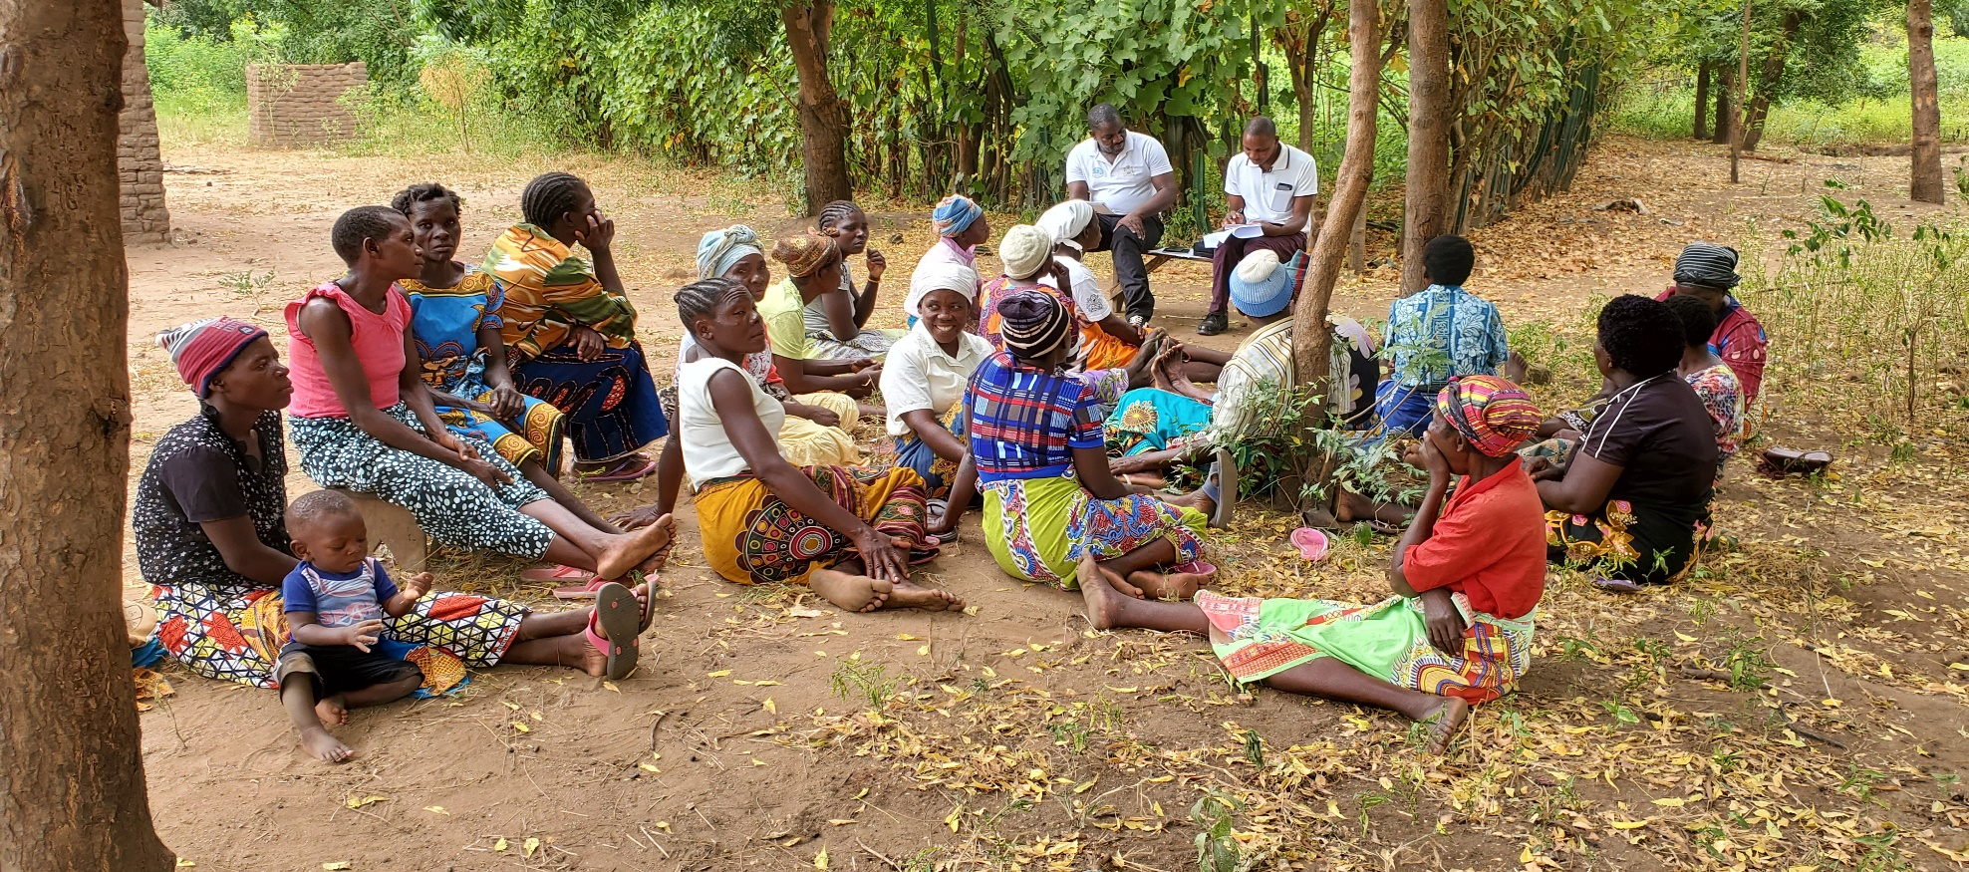
Ensure equitable benefits for women and girls
Based on the Social and Gender Enhancement assessment, it was established that deforestation and soil erosion for charcoal production, was one of the main drivers of biodiversity loss.
Therefore, new alternatives to support livelihoods, and income generation were sought. With the help of the project, loans were granted that allowed women to seek alternatives, such as beekeeping and sustainable fishing.
Around 75% of the women under the projects are participating in bee farming, fish farming and other diversification activities.

Slide 8
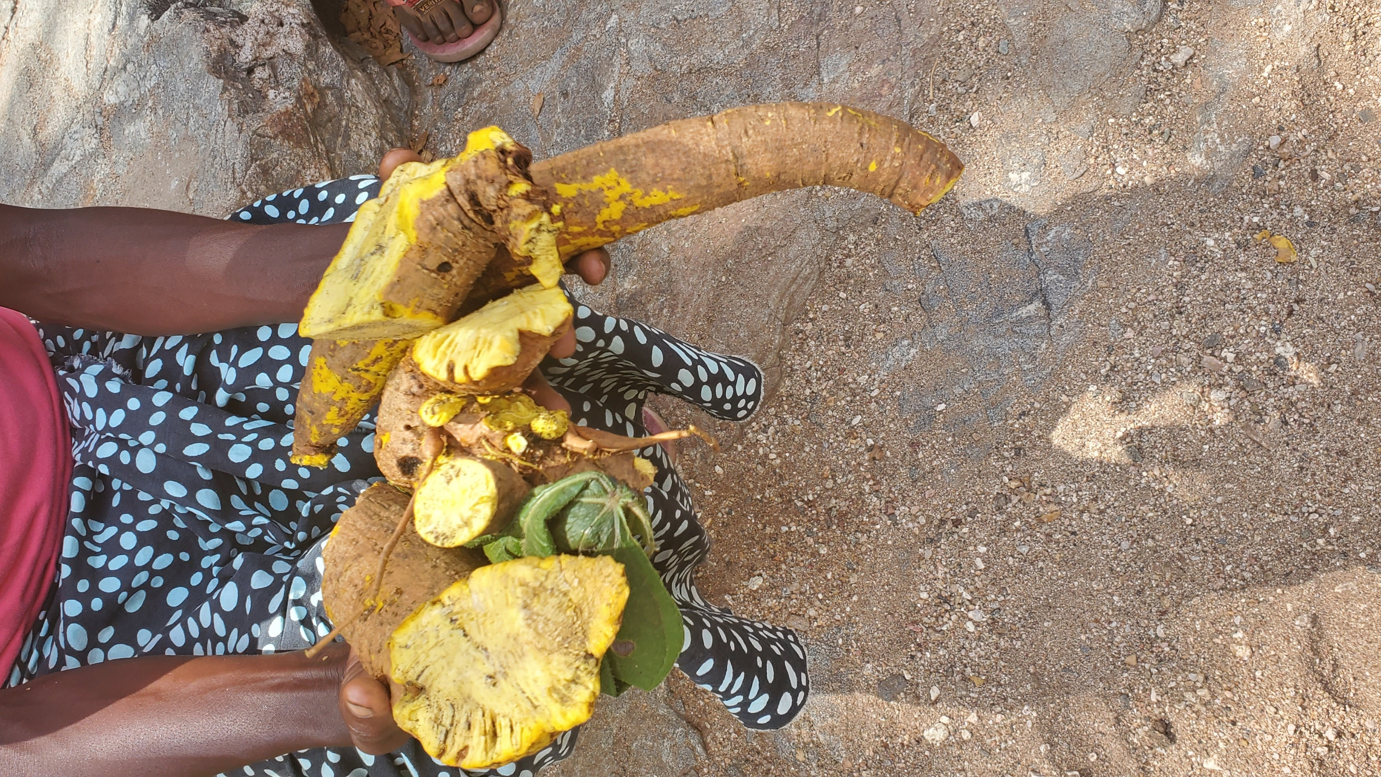
Gender and Post 2020 Framework
Target 20: By 2030, ensure equitable participation in decision-making related to biodiversity and ensure rights over relevant resources of indigenous peoples and local communities, women and girls as well as youth, in accordance with national circumstances
Gender focal persons and champions to enhance Gender beyond global level (Use the process to identify champions)
Indicators for monitoring in the other targets that gender desegregated data would be required. (Entry points)
How to mainstream gender into the implementation mechanisms of the whole framework and enabling mechanisms.

Slide 9
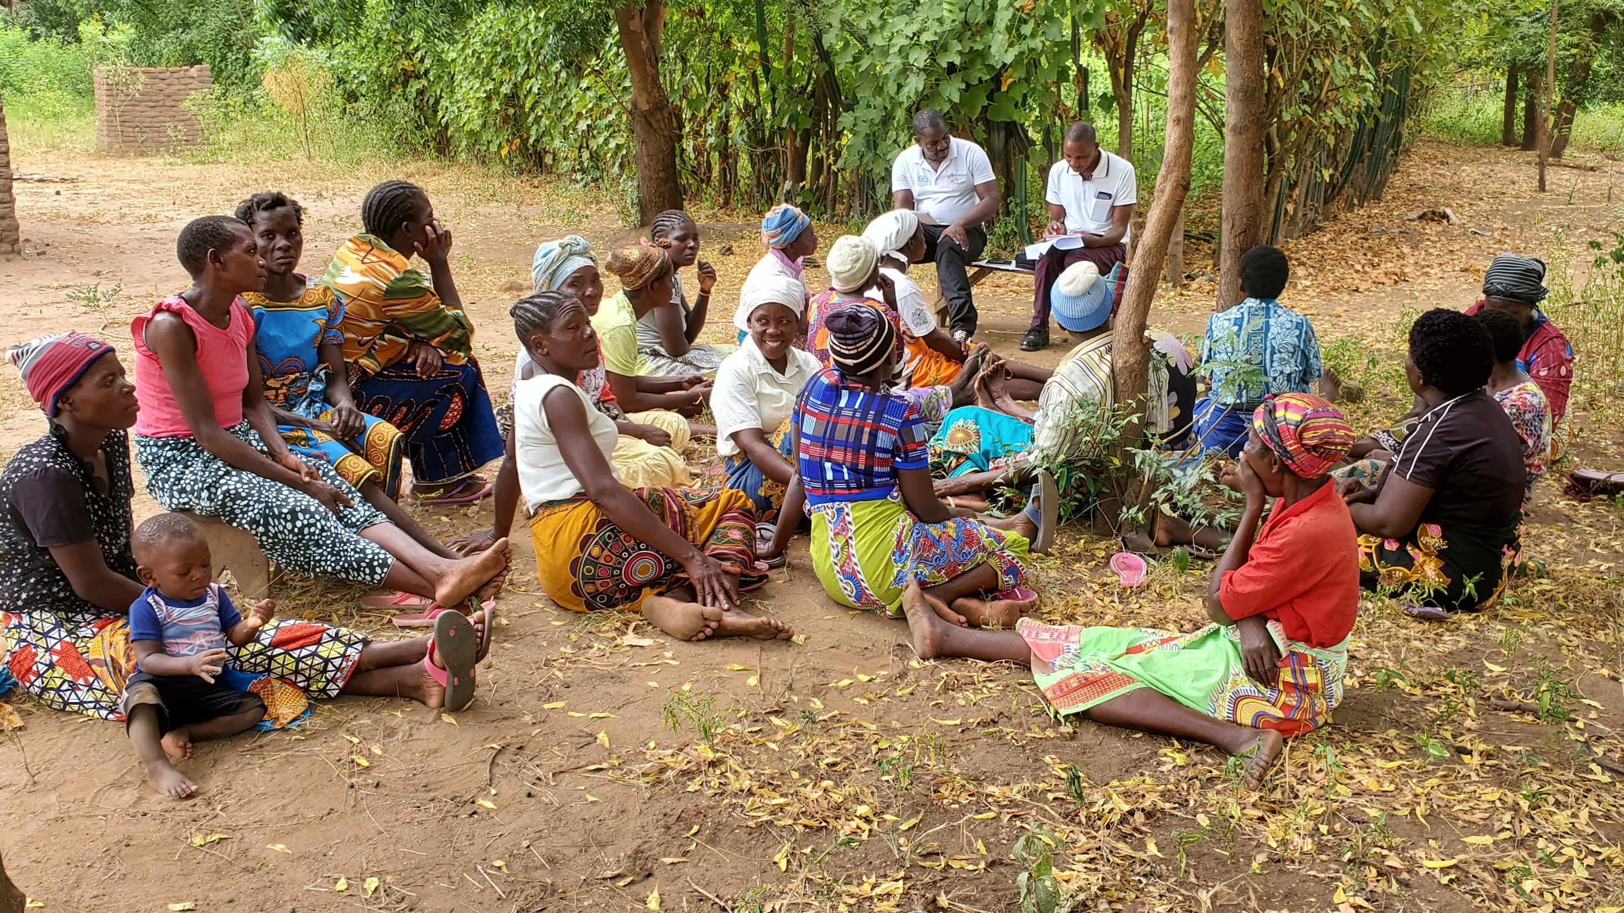
Entry points for gender in biodiversity at National and Local Level
Assessment of Gender Mainstreaming
Sex-disaggregated statistics
Special interventions (Stand alone projects or project components at project design stage)
Capacity Building on gender related activities
Information dissemination approaches that allow women to have adequate preparedness and knowledge on how to cope in the face of ecosystem degradation.
Creation of institutional structures that allow women to come together and make decisions and get empowered.

Slide 10
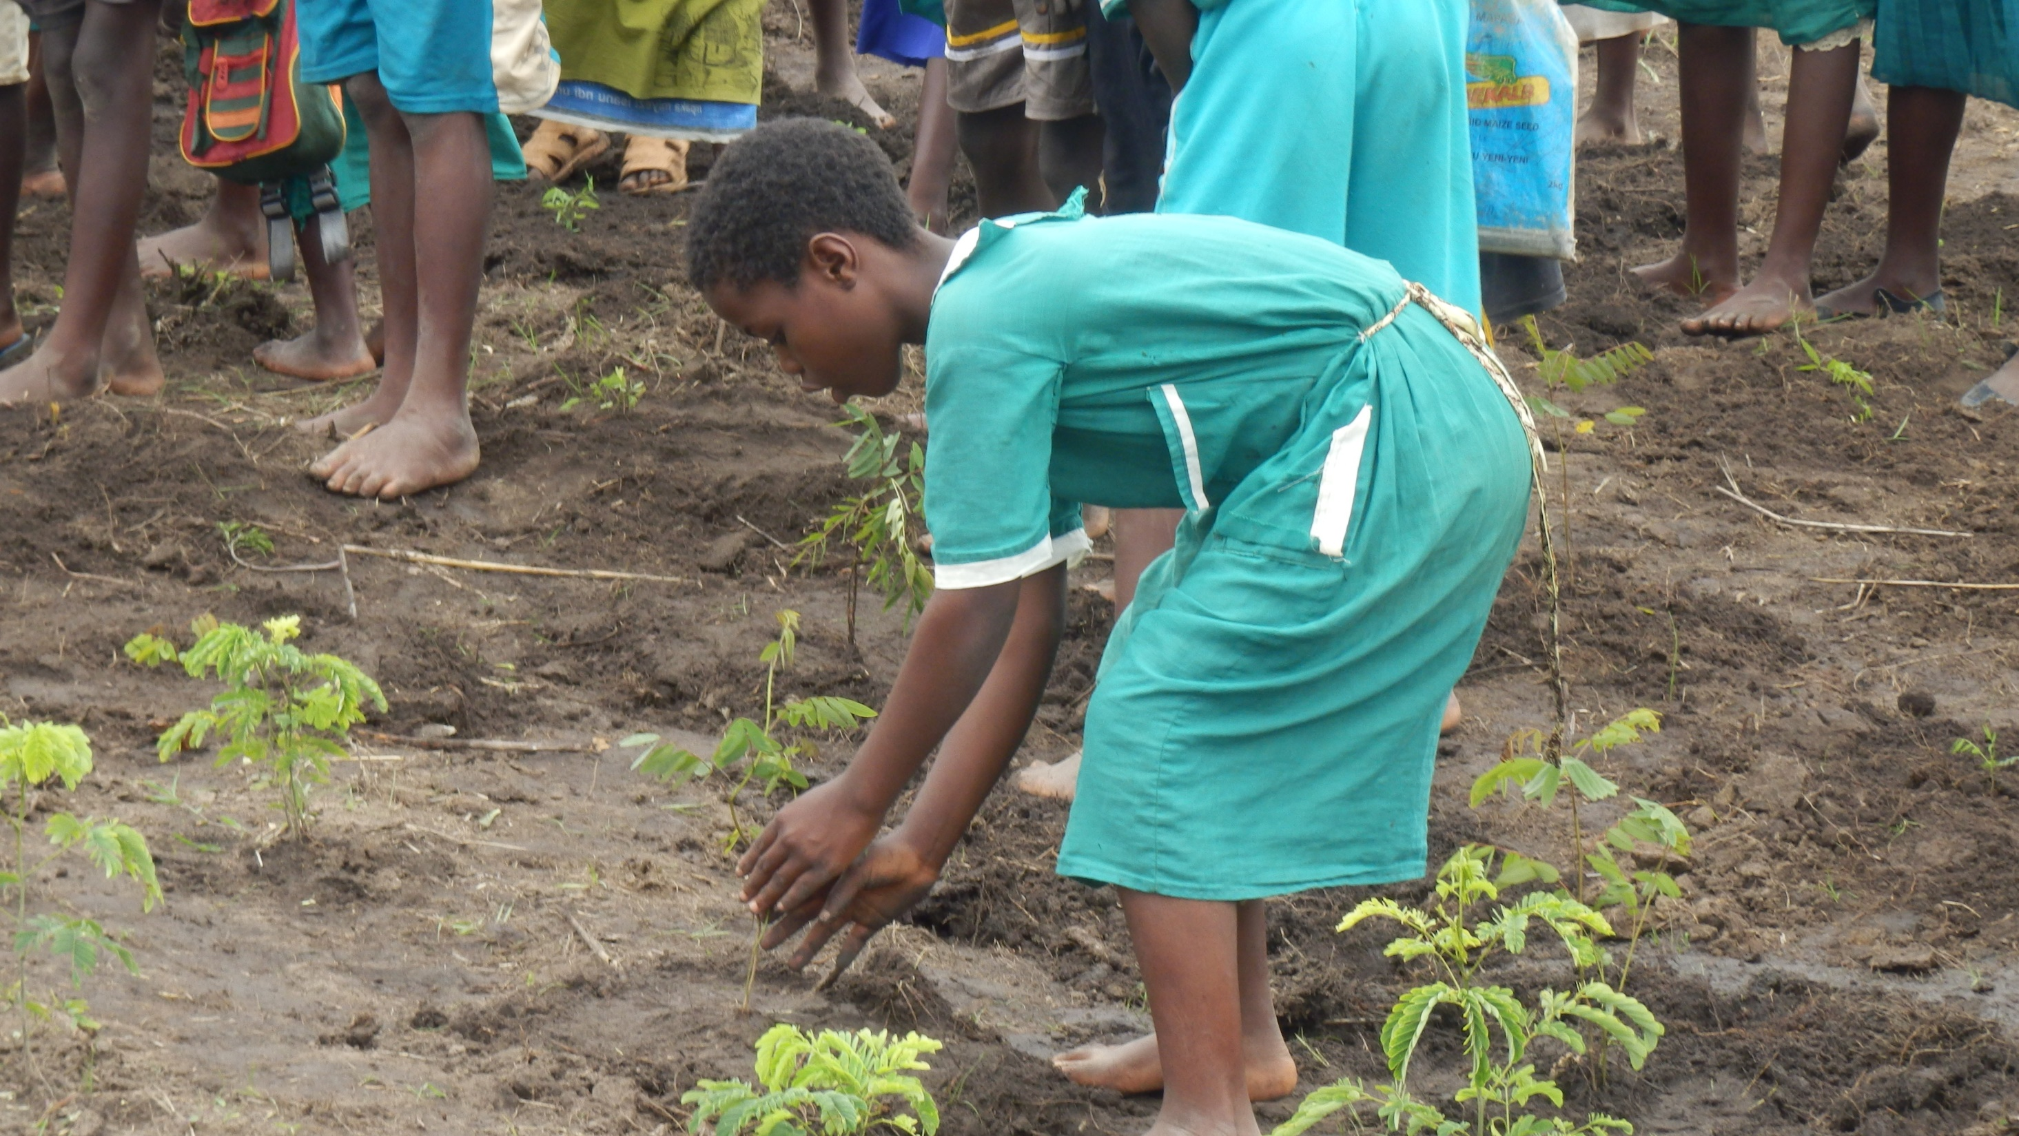
THANK YOU
ZIKOMO
For more information visit: www.ead.gov.mw

