Slide 1
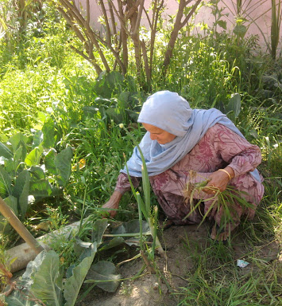
Webinar
Information briefing on a draft outline of a new CBD gender plan of action for the post-2020 period
Organized by the CBD Secretariat, 12 August 2020
Initial Views on the Draft Outline
Verona Collantes-Lebale
Intergovernmental Specialist
UN Women

Slide 2
OUTLINE
General observations on the draft Gender Plan of Action
Initial views on the elements and structure of the GPA

Slide 3
KEY MESSAGES
CBD GPA is a tool for a gender-responsive implementation of the post-2020 global biodiversity framework
Ensure that the structure of the GPA is simple, with specific activities, deliverables and timelines
Build into the GPA a monitoring and reporting mechanism (including through the activities)
Review GAPs of UNFCCC and UNCCD; consult key stakeholders from these sister Conventions and adopt best practice
  Coherence/synergies

Slide 4
General observations
  Structure:
    One, instead of three sections
    Description of objectives – could be presented in the introduction to the GPA
    Identify specific activities
      Actionable/concrete
    Add columns for:
      responsible actors
      timeline for implementation
      specific deliverable per activity

Slide 5
Draft CBD Gender Plan of Action
  CBD Action Area:
  Ensure equitable participation in decision-making related to biodiversity for women and girls
  Proposed phrasing:
  Ensure women’s full, equal and effective participation and leadership at all levels of decision-making…
  CSW in recent years used “full, equal and meaningful”
  CBD Action Area:
  Ensure rights over relevant resources for women and girls
  Proposed phrasing:
  Ensure that women and girls have equal rights to resources, including access to, ownership of, and control over natural resources

Slide 6
Examples of activities
UNFCCC Gender Action Plan (2020-2025):
https://unfccc.int/sites/default/files/resource/cp2019_L03E.pdf
  Action area: Ensure equitable participation in decision-making related to biodiversity for women and girls
UNFCCC GAP B.1 Promote initiatives for capacity-building in leadership, negotiation and facilitation of negotiation for women delegates, including through webinars and in-session training to enhance women’s participation in the UNFCCC process
UNCCD Gender Action Plan: “Parties will seek to increase and strengthen the participation and leadership of women at all levels in decision-making and local implementation of the [UNCCD], including in [drought management and sand and dust storms and LDN interventions,] and aim to reach gender parity by 2030”
UNFCCC GAP D.5 Engage women’s groups and national women and gender institutions in the process of developing, implementing and updating climate policies, plans, strategies and action, as appropriate, at all levels
The above activities could be adapted to CBD-related actions

Slide 7
Examples of activities
  Action area: Ensure equitable participation in decision-making related to biodiversity for women and girls
UNFCCC GAP D.1 Share experience and support capacity-building on gender budgeting, including on the integration of gender-responsive budgeting into national budgets to advance gender-responsive climate policies, plans, strategies and action, as appropriate
Adopt to CBD:
Share experience and support capacity-building on gender-responsive development, revision, implementation and monitoring of national biodiversity strategies and action plans (NBSAPs), including gender-responsive project planning and reporting

Slide 8

Contact: verona.collantes@unwomen.org

