Slide 1
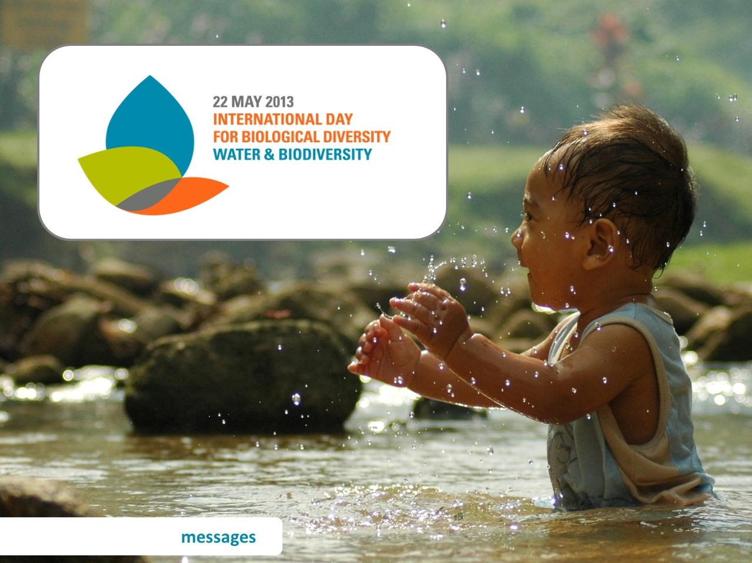
Notes:
Messages for the International Day for Biological Diversity 2013

Slide 2
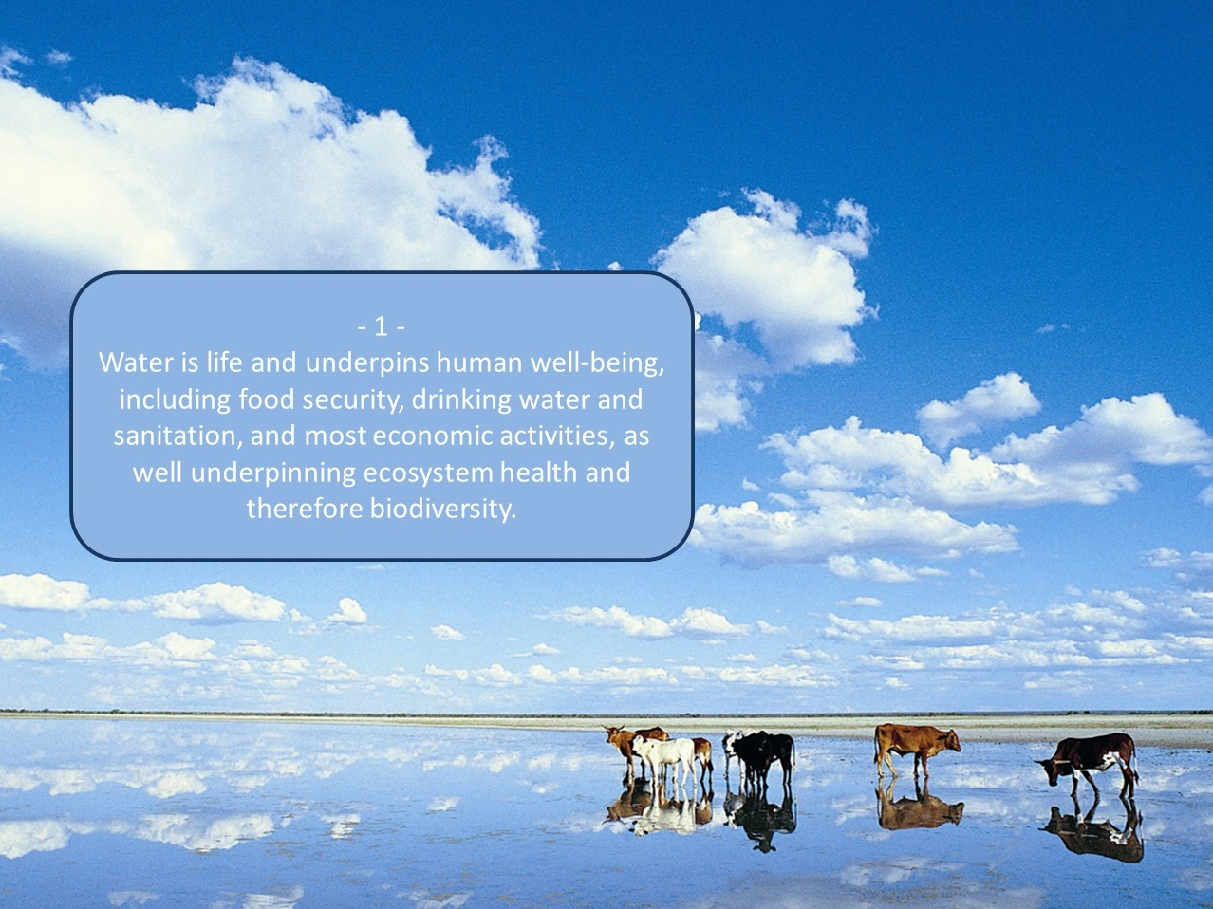
Notes:
Messages for the International Day for Biological Diversity 2013

Slide 3

Notes:
Messages for the International Day for Biological Diversity 2013

Slide 4
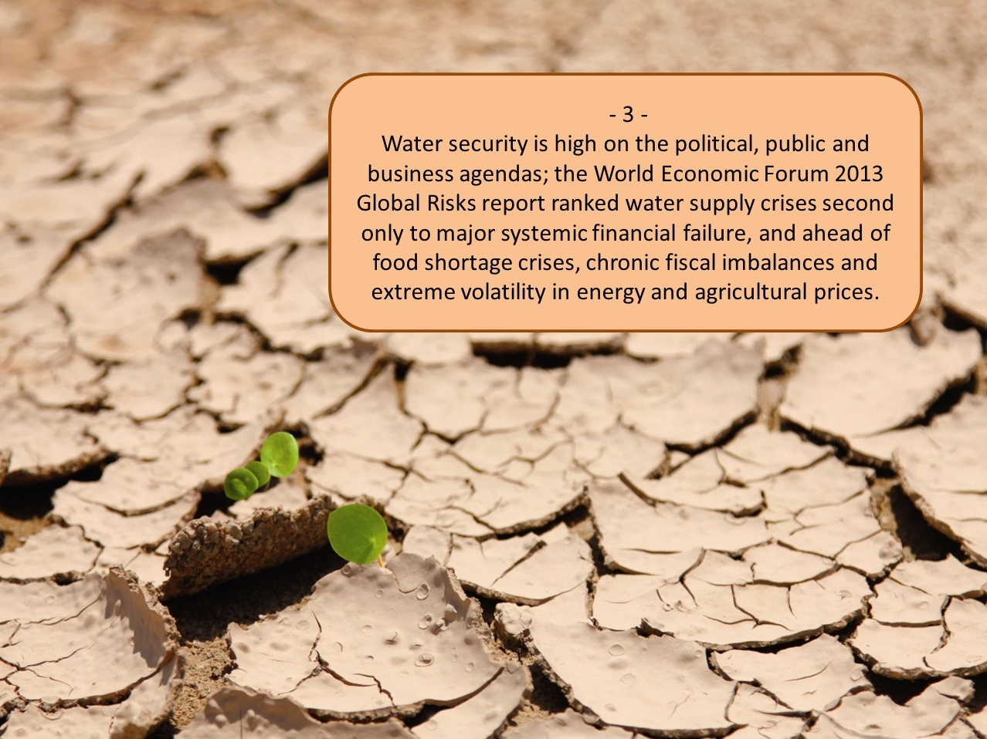
Notes:
Messages for the International Day for Biological Diversity 2013

Slide 5
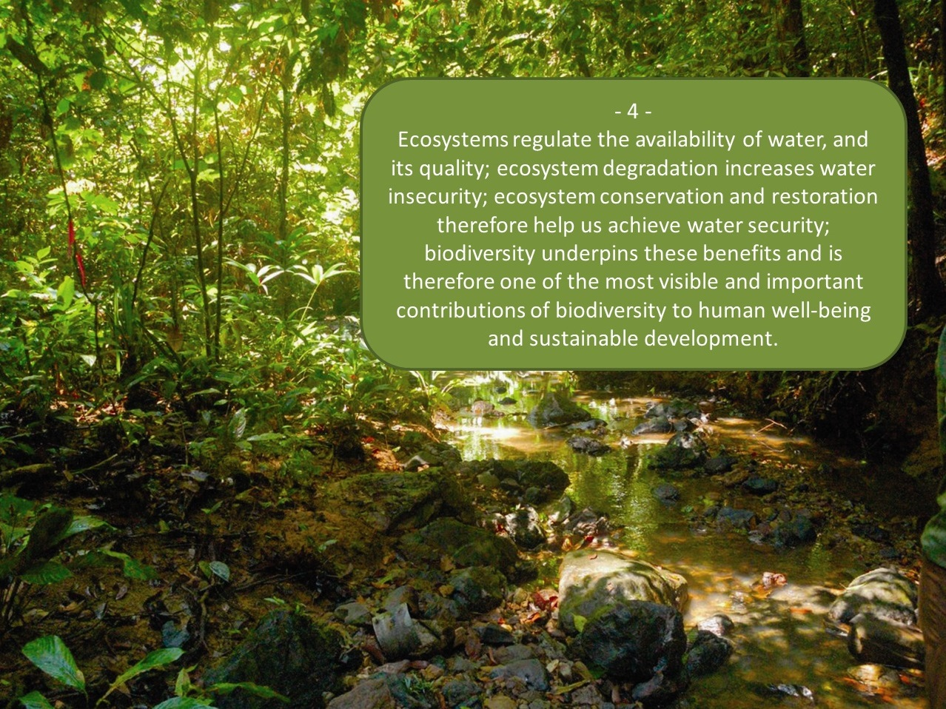
Notes:
Messages for the International Day for Biological Diversity 2013

Slide 6
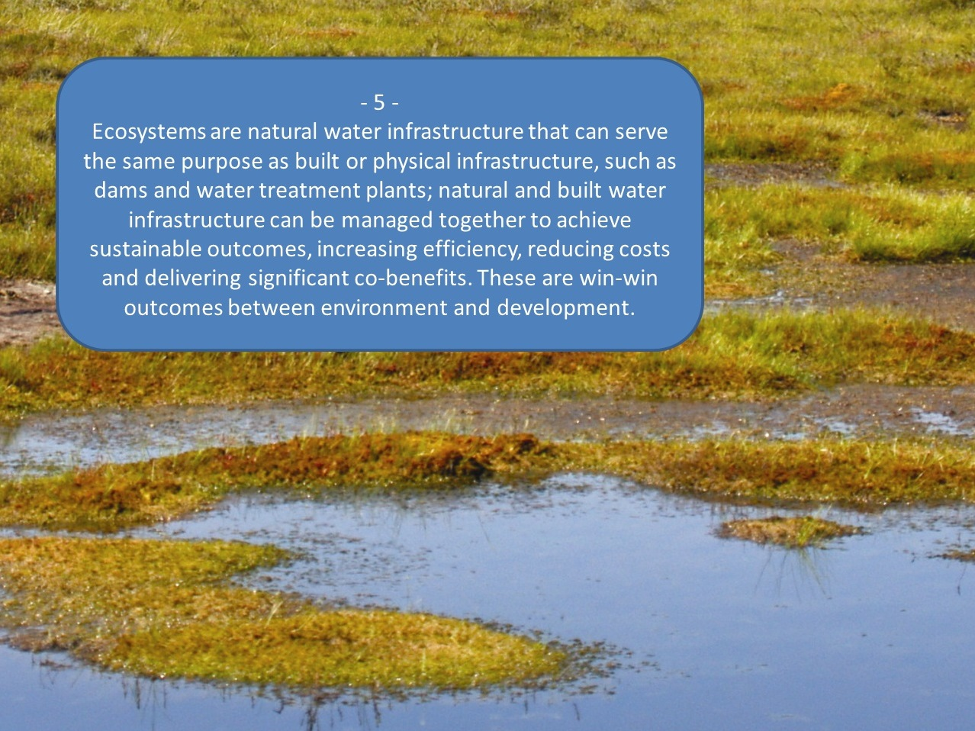
Notes:
Messages for the International Day for Biological Diversity 2013

Slide 7
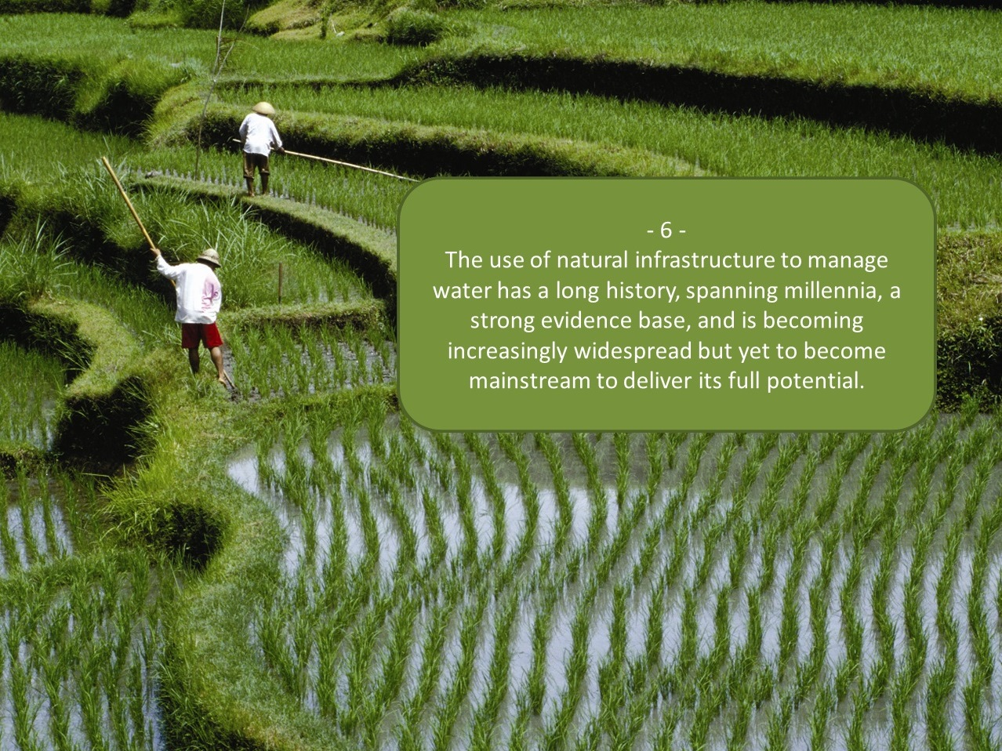
Notes:
Messages for the International Day for Biological Diversity 2013

Slide 8
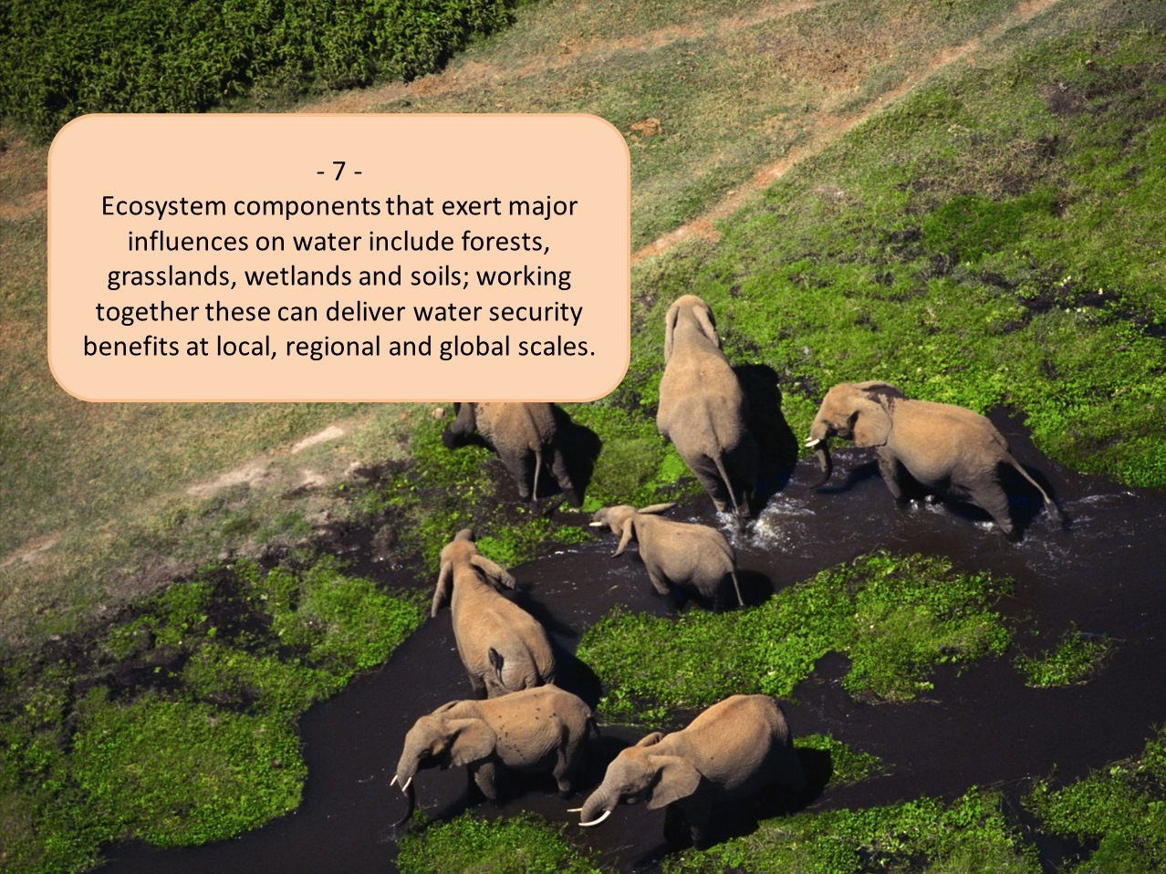
Notes:
Messages for the International Day for Biological Diversity 2013

Slide 9
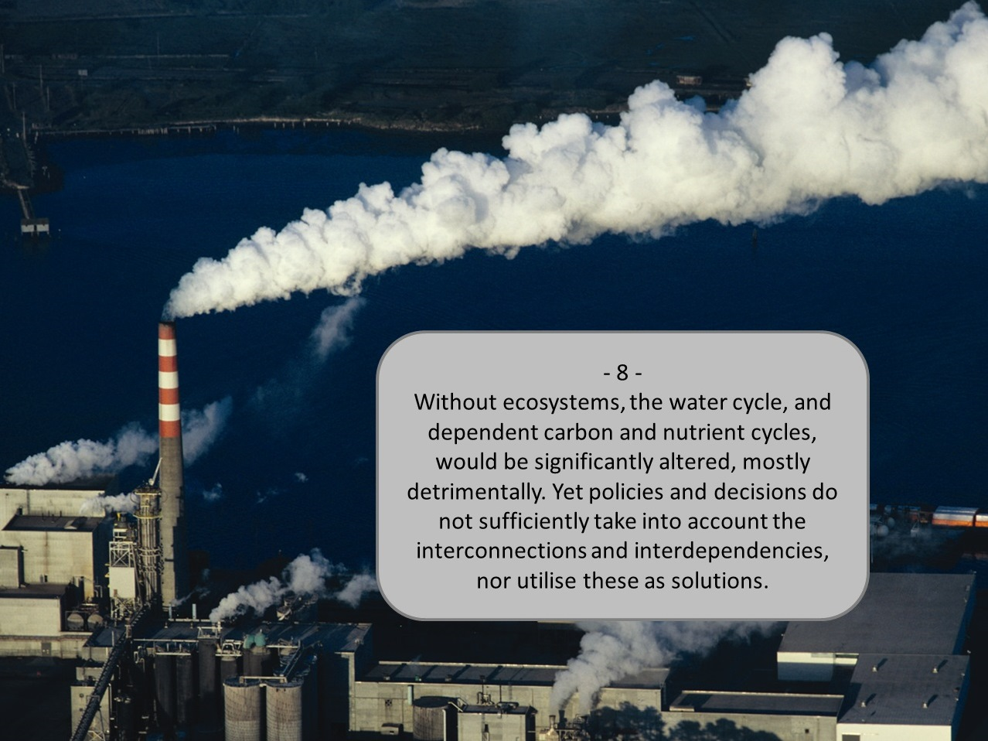
Notes:
Messages for the International Day for Biological Diversity 2013

Slide 10
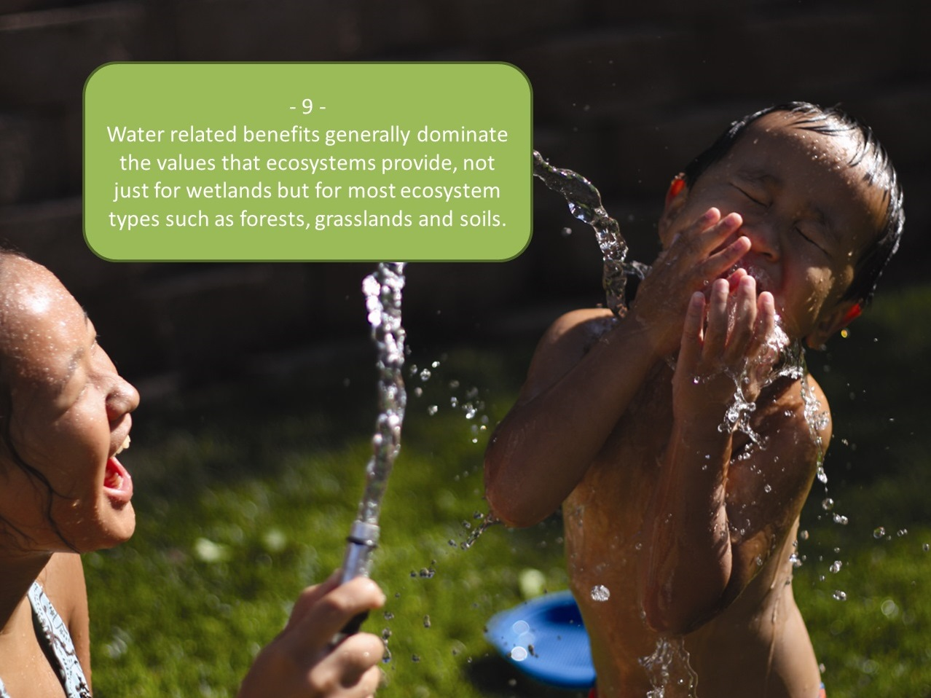
Notes:
Messages for the International Day for Biological Diversity 2013

Slide 11
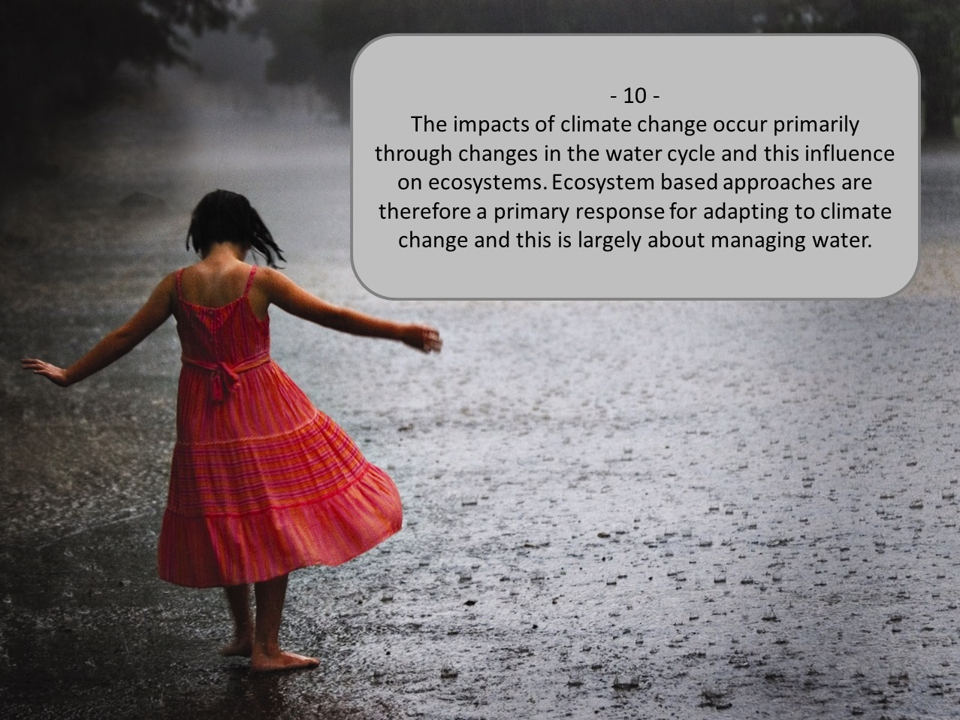
Notes:
Messages for the International Day for Biological Diversity 2013

Slide 12
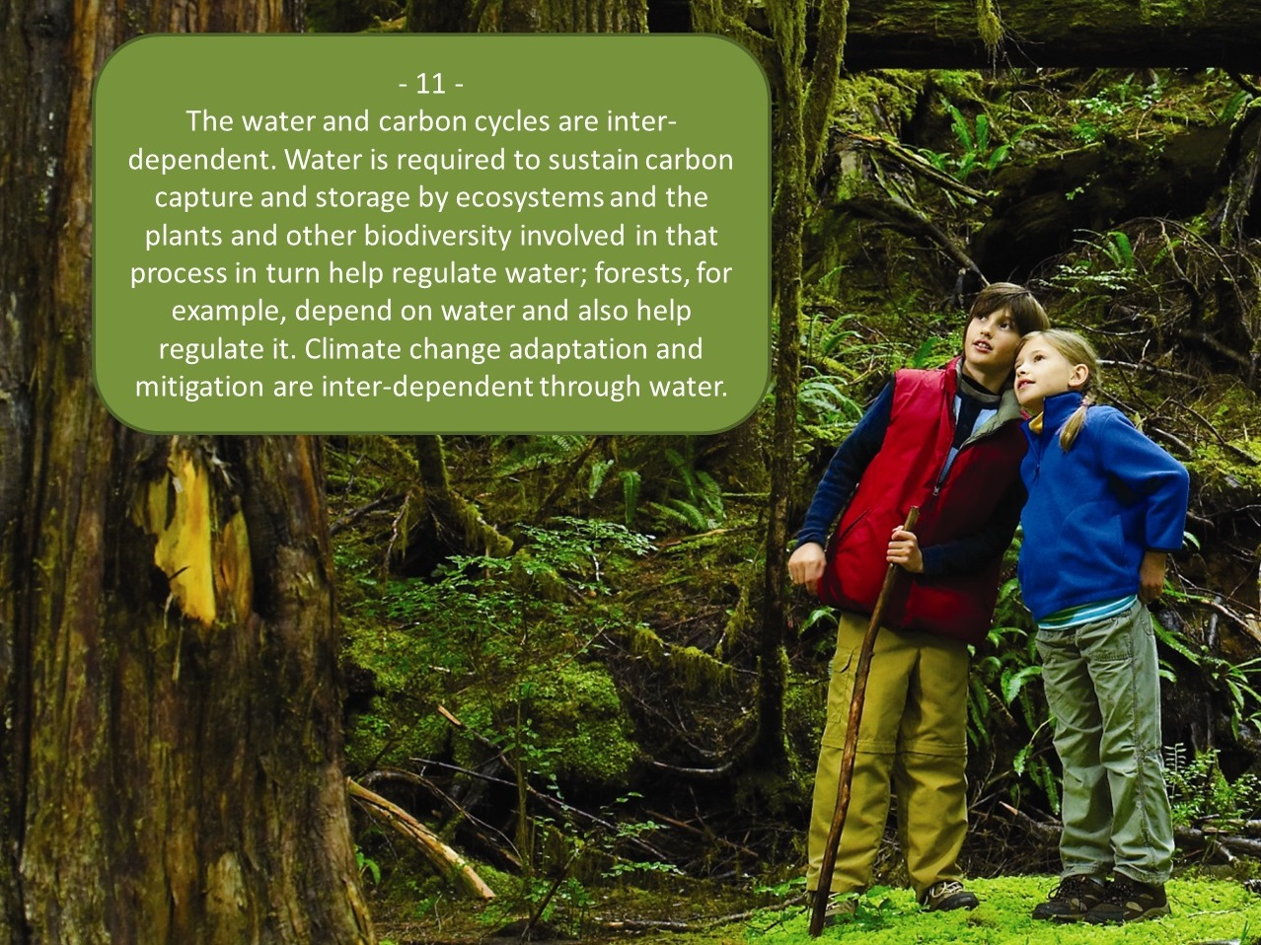
Notes:
Messages for the International Day for Biological Diversity 2013

Slide 13
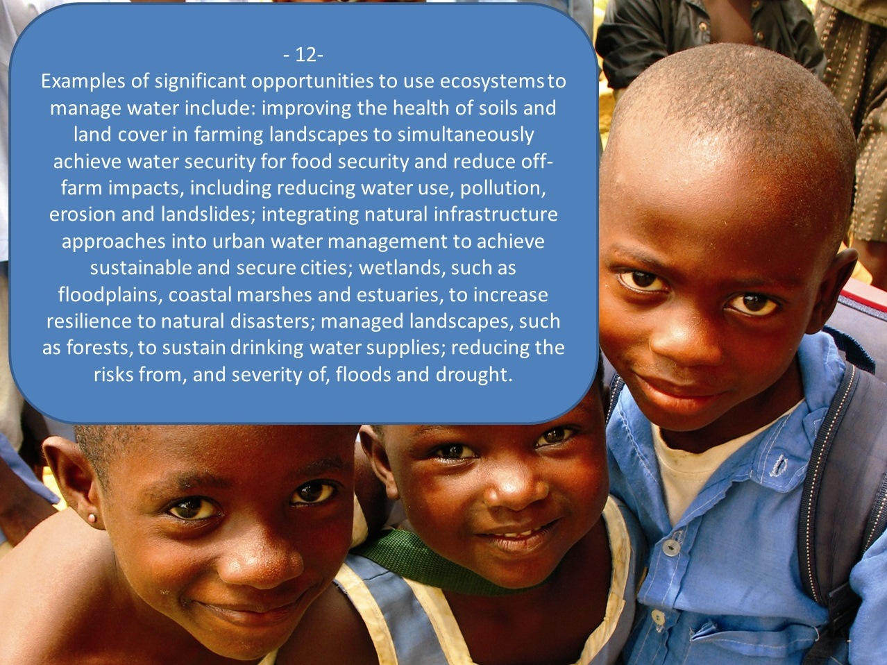
Notes:
Messages for the International Day for Biological Diversity 2013

Slide 14
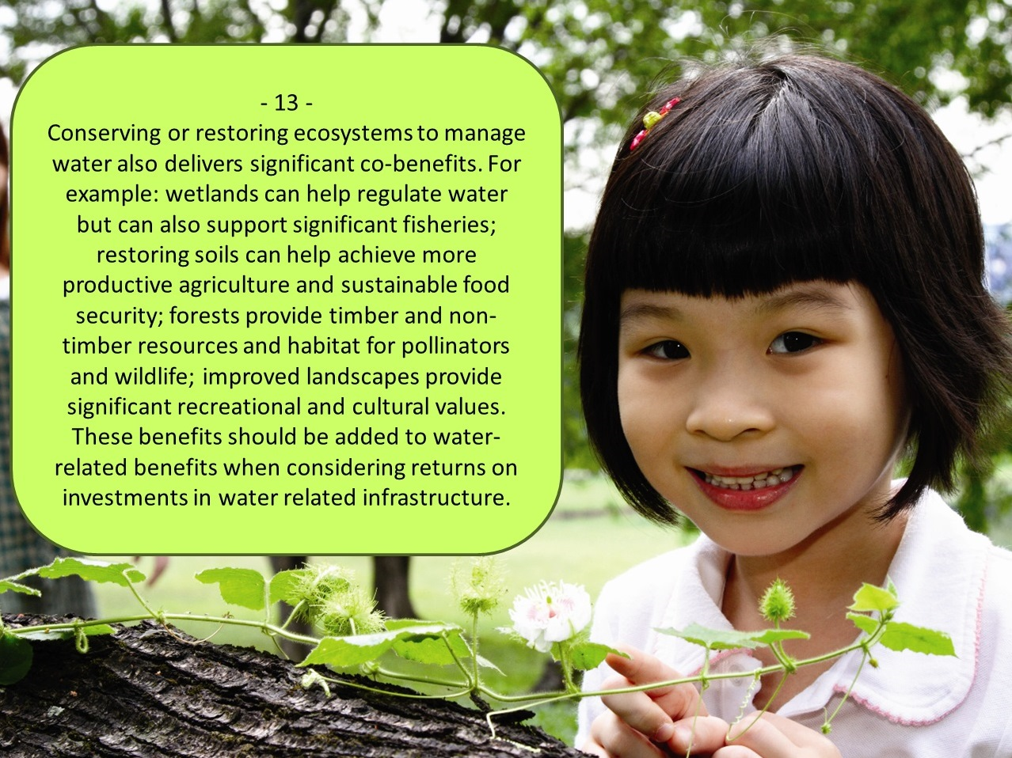
Notes:
Messages for the International Day for Biological Diversity 2013

Slide 15

Notes:
Messages for the International Day for Biological Diversity 2013

