Slide 1

By: Iraj Momenizad, the school teacher
Dayyer Port, Iran

Slide 2
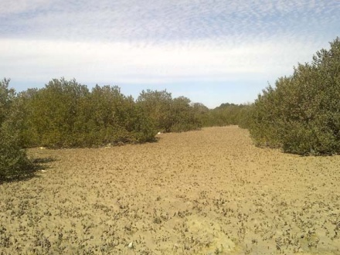
Dayyer, south of Iran
They are a species of Mangroves. We called them Harra

Slide 3
They are getting yellow.
I was worried about this problem.

Slide 4
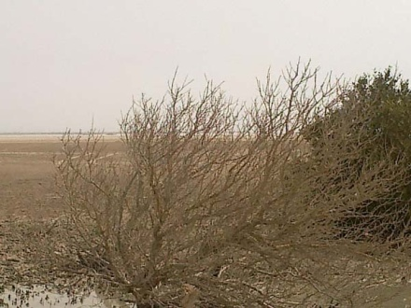
Look at this Mangrove. It is going to die. I found this big problem in some of the Mongroves.

Slide 5
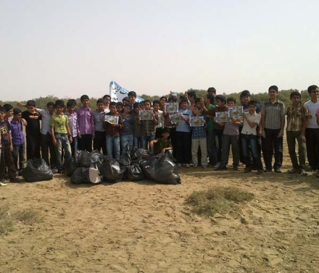
I talked with my students about this problem. They agreed to help the Mangroves.

Slide 6
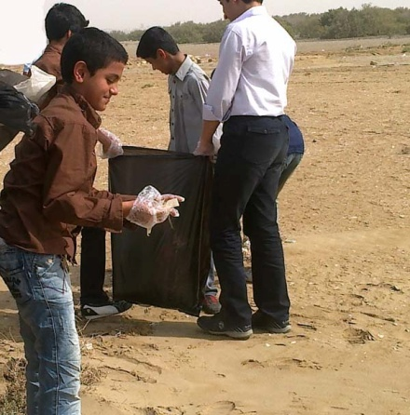
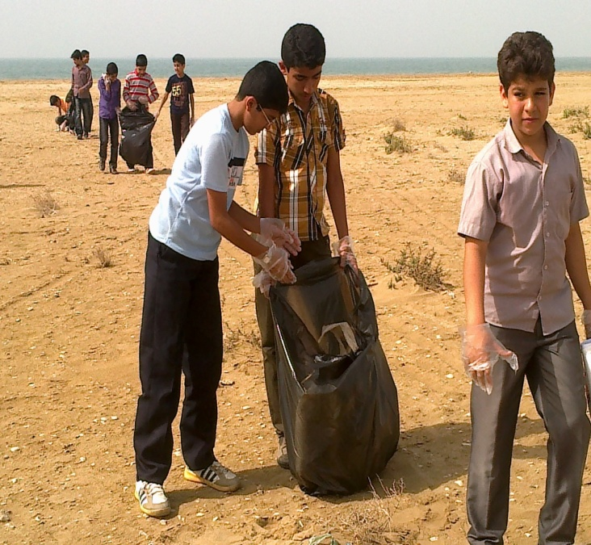
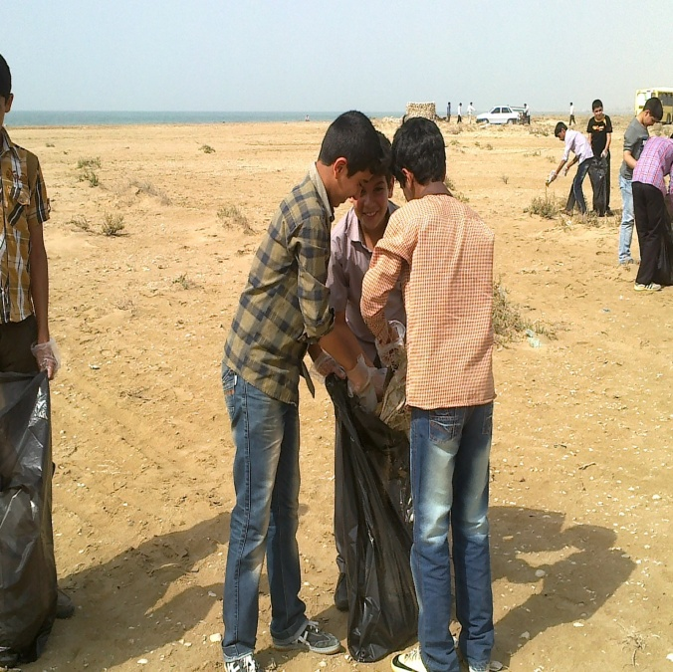
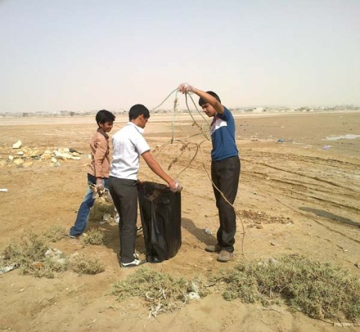
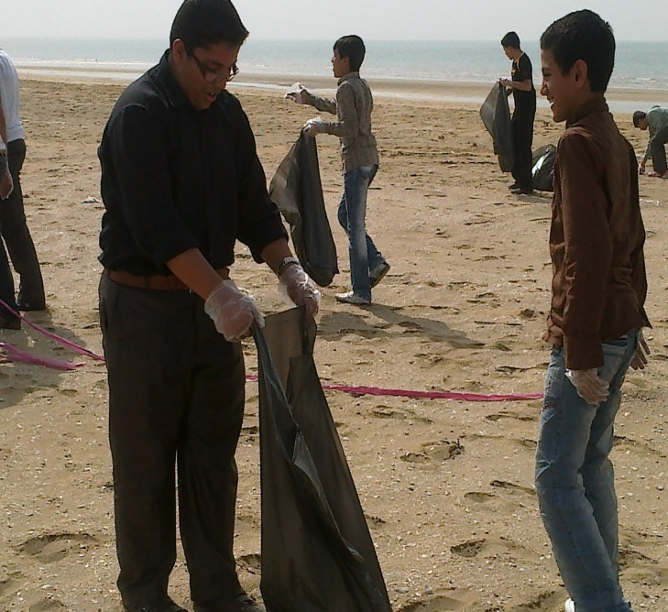
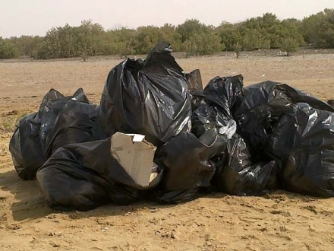
So we organized a community to clean the Mangroves.

Slide 7
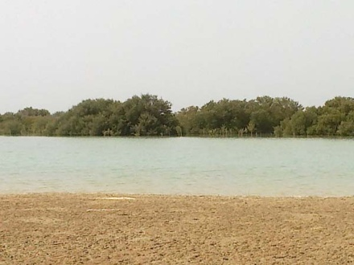
Now they are clean and beautiful.

