Slide 1
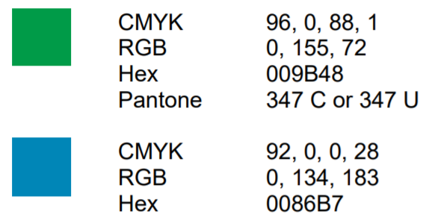
Instructions for customizing logos
The customizable logos are on the next slides.
Do not alter the colours.
If your language is not available in “Impact” font, you may use a different font
If your name is very long, be creative, there is some degree of flexibility
If your name is very short, it will be even more prominent (large font)
Individual logos are on slide 2
Collective logos are on slide 3
Slide 4 explains how to save your image
visual references for
different name lengths
average
short
long
Full guidelines available at:
www.cbd.int/biodiversity-day/logo

Slide 2
Instructions for customizing individual logos
Replace “YOUR-NAME” with your own name. It may be in capital letters (optional)
Adjust the width of the text (font size) to match the other lines
Adjust spacing between lines to make it as even as possible
Maintain the white space between the logo and the text
Your text block should not be higher than the image height (must fit inside the rectangle)
The line at the right of the text may be moved (it serves as a guide to help align your text)
After all adjustments have been made, save your PPT for future use
Steps for saving your logo as an image are explained on the next page
visual reference
22 MAY 2021
BIODIVERSITY DAY
I'm part of the solution
YOUR-NAME #ForNature

Slide 3
Instructions for customizing collective logos
Replace “Organization” with your own. It may be an acronym and/or include a handle (@)
Adjust the width of the text (font size) to match the other lines
Adjust spacing between lines to make it as even as possible
Maintain the white space between the logo and the text
Your text block should not be higher than the image height (must fit inside the rectangle)
The line at the right of the text may be moved (it serves as a guide to help align your text)
After all adjustments have been made, save your PPT for future use
Steps for saving your logo as an image are explained on the next page
visual reference
22 MAY 2021
BIODIVERSITY DAY
We’re part of the solution
Organization #ForNature

Slide 4
Instructions for saving and sharing customized logos
Delete the rectangle and the 2 guidelines
Take a screenshot of your custom logo or save as image (png, jpg)
To save as image go to: File > Save As > dropdown list > select *.png or *.jpg
Crop your final image as needed
Share on social media with the hashtag #ForNature and tag us @UNBiodiversity
For your reference
editable text final logo
22 MAY 2021
BIODIVERSITY DAY
I'm part of the solution
Patricia #ForNature

